Slide 1
Essentials Of Fire Fighting
Seventh Edition
Chapter 1
Introduction to the Fire Service and Firefighter Safety

Slide 2
Learning Objective 1
Explain the mission of the fire service.

Slide 3
Fire Service Mission
AHJ determines services needed to protect citizens and establishes fire service to meet the needs
Different communities require different services
Vary among cities, states/provinces, regions
(Cont.)

Slide 4
Fire Service Mission
Save lives
Protect property and the environment

Slide 5
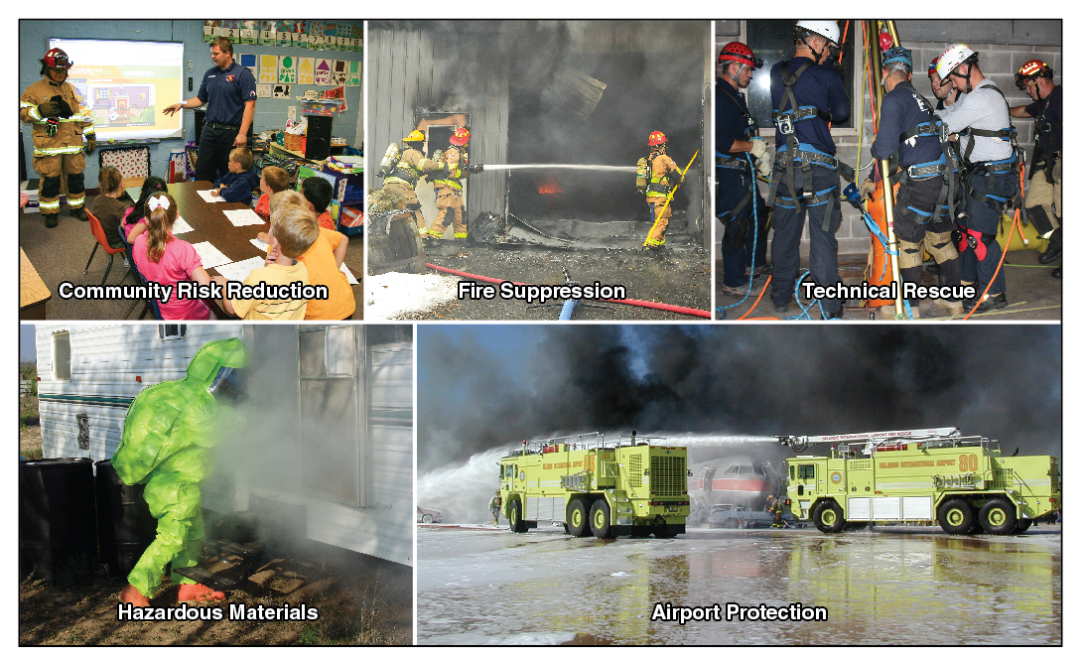
All-Hazard Concept Approach To Fire Protection
Structural fire suppression courtesy of Bob Esposito

Slide 6
Fire Department Mission Statement
Part of department’s rules and regulations
Should be posted in every facility and made available to personnel and the community

Slide 7
REVIEW QUESTION
What is the overall mission of the fire service?

Slide 8
DISCUSSION QUESTION
What are some community needs
in your jurisdiction that may affect
the fire service mission?

Slide 9
Learning Objective 2
Describe how fire departments are organized.

Slide 10
AHJ Establishes Organization Of The Fire Department
Type of department
Number and location of facilities
Types and number of apparatus
Number of personnel
Organizational hierarchy
Functions and responsibilities
Minimum training and certification levels

Slide 11
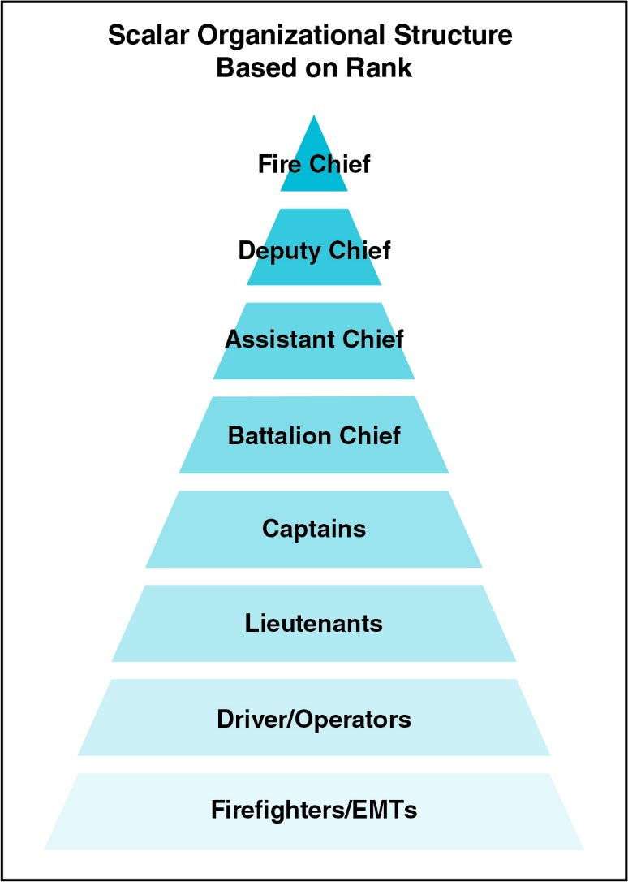
Scalar Organizational Structure
Feedback and information
Decisions and information

Slide 12
Organizational Principles
Chain of command
Unity of command
Span of control
Discipline
Division of labor

Slide 13
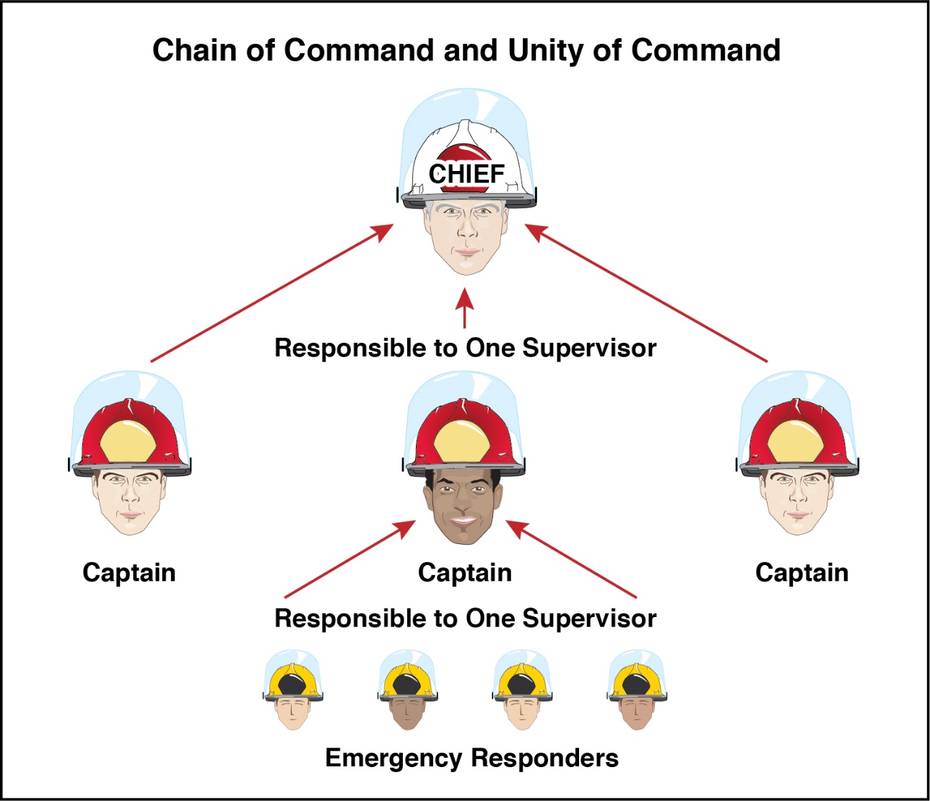
Chain of Command and Unity of Command

Slide 14
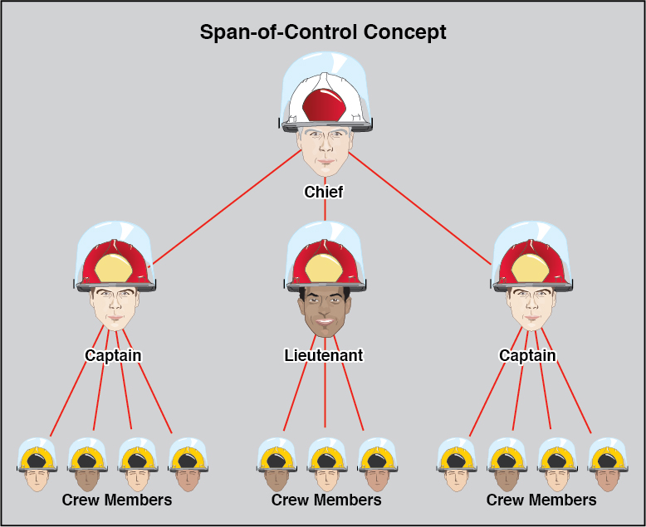
Span Of Control

Slide 15
Discipline and Division Of Labor
Discipline
Organization provides leadership
Individual follows orders
Rules, regulations, and policies define acceptable performance and expected outcomes
Division of labor
Dividing large jobs into smaller jobs
Necessary to assign responsibility and prevent duplication of effort

Slide 16
Types Of Fire Departments
Public departments
Private departments
(Cont.)

Slide 17
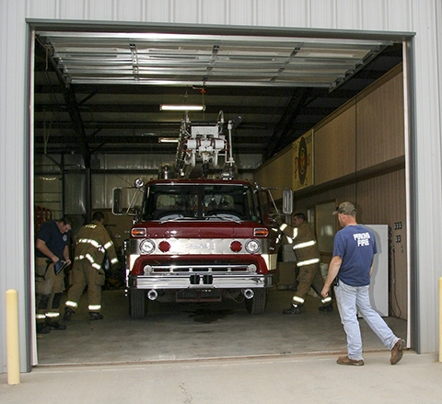
Types Of Fire Departments
Combination
Career
Volunteer

Slide 18
Fire Companies
Battalion or response district
Multiple companies
Operations division
Organized based on local needs (specialized or performs multiple functions)
Apparatus and firefighters
(Cont.)

Slide 19
Fire Companies
Engine company
Truck (Ladder) company
Rescue company
Brush company
Hazardous materials company
Emergency medical/ambulance company
Aircraft rescue and fire fighting (ARFF) company

Slide 20
Classifications Of Fire Department Personnel
Career
Volunteer
Line personnel
Staff personnel

Slide 21
REVIEW QUESTION
How are fire departments organized?

Slide 22
DISCUSSION QUESTION
How are fire departments
organized in your jurisdiction?

Slide 23
Learning Objective 3
Describe the various specializations within the fire service.

Slide 24
Criteria For Fire Fighter I And Fire Fighter II
NFPA 1001
AHJ
Professional qualifications
Educational requirements
Age requirement
Physical fitness requirements
NFPA 1582
Medical requirements

Slide 25
Basic Necessary Medical Care Skills
Cardiopulmonary resuscitation (CPR)
Bleeding control
Infection control
Shock management
Departments may require certification for EMS First Responders, EMT, or paramedic candidates

Slide 26
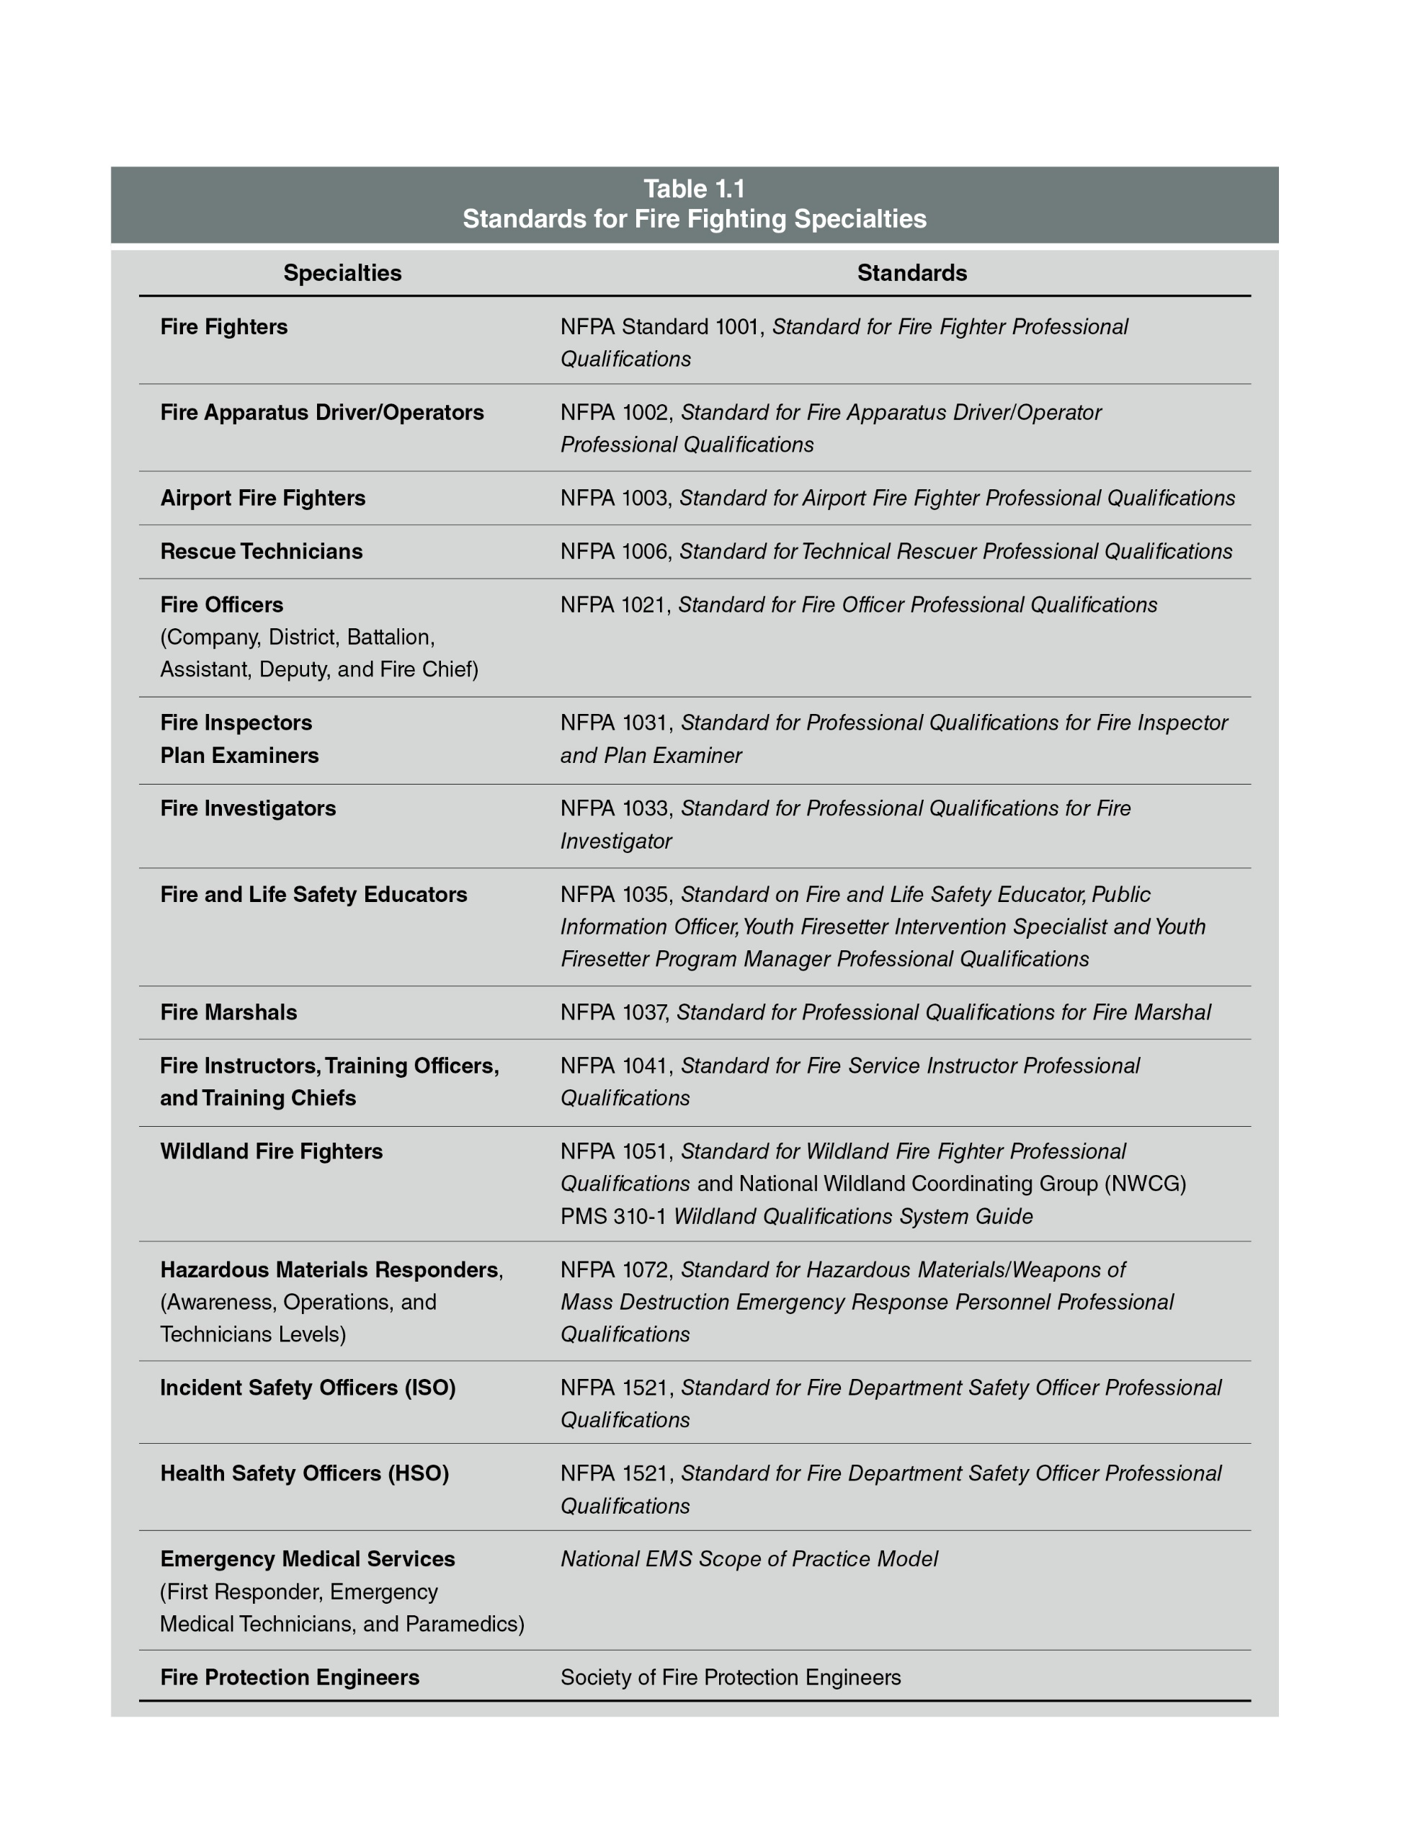
Standards For Fire Fighting Specialties
(Cont.)

Slide 27
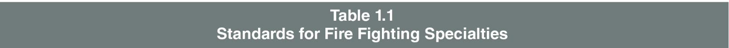
Standards For Fire Fighting Specialties

Slide 28
Fire Fighter I And II Training
Fire suppression
Search and rescue
Extrication
Ventilation
Salvage
Overhaul
EMS
Hazardous materials

Slide 29
Differences Between Fire Fighter I And Fire Fighter II
Fire Fighter I
Fire Fighter II
Under direct supervision of Fire Fighter II or company officer
Trained to coordinate Fire Fighter I and Fire Fighter II under supervision of company officer
Performs more complex tasks
Assumes and transfers command within ICS

Slide 30
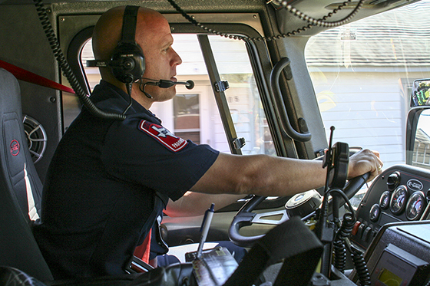
Fire Service Specialties
Apparatus Driver/operator
Hazardous materials technician
Rescue technician
Airport firefighter
Wildland firefighter
EMS personnel

Slide 31
Fire Service Officers
Company officers
Incident safety officers
Health and safety officers
District/Battalion chiefs
Assistant/Deputy chiefs
Fire marshals
Fire chief

Slide 32
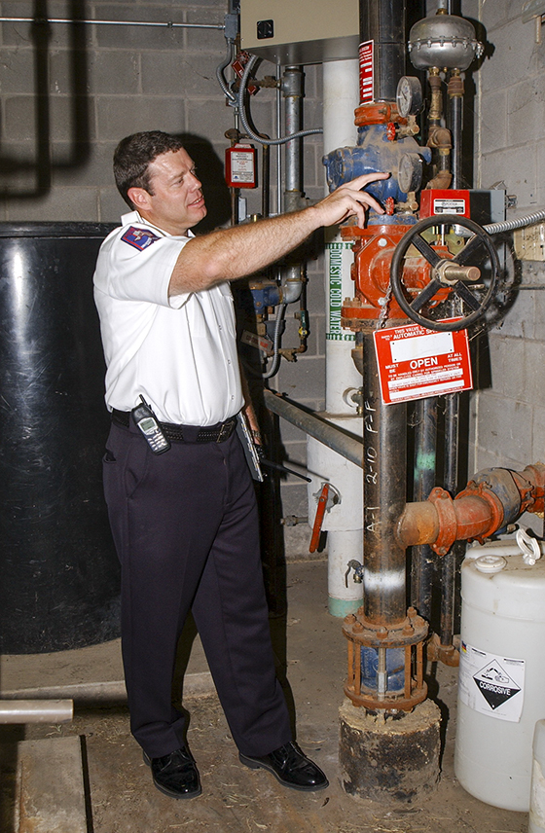
Fire Prevention Division
Deals with the public
Headed by chief officer or designated role
Building inspections
Code enforcement
Plans review
Community risk reduction (CRR)
(Cont.)

Slide 33
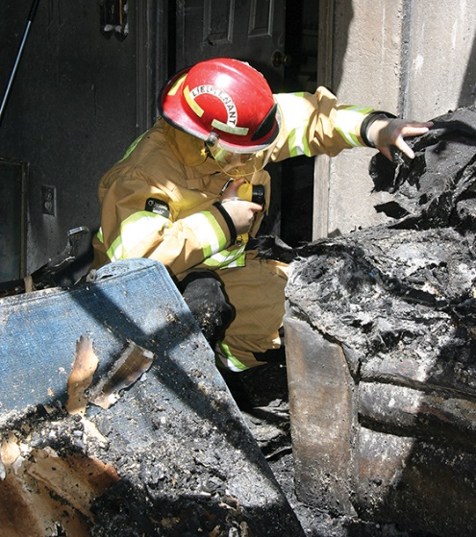
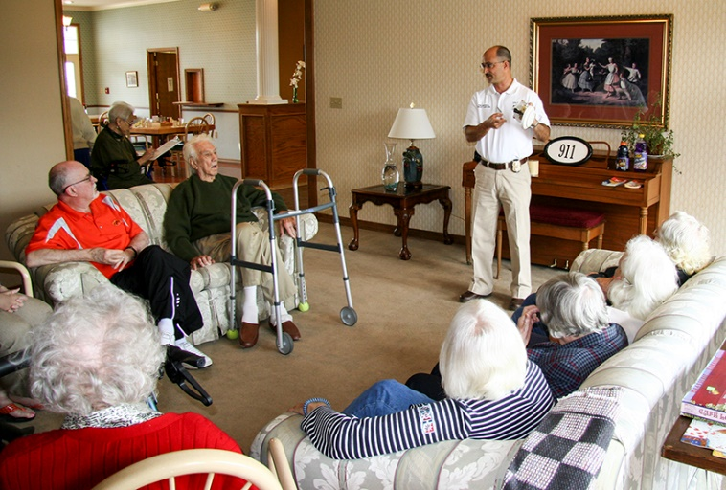
Fire Prevention Division
Positions
Fire prevention officers/inspectors
Plans examiners
Fire and arson investigators
Fire and life safety educators
Fire protection engineers/specialists

Slide 34
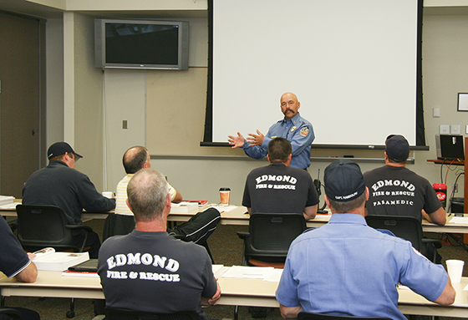
Training Division
Provides training to personnel
Entry level
Certification training
Refresher courses
Specialized courses may be provided by state/provincial, regional, national academies
Positions
Instructors
Training officer/chief of training

Slide 35
REVIEW QUESTION
What specialized jobs and divisions exist within the fire service?

Slide 36
DISCUSSION QUESTION
What specialized jobs within the
fire service interest you? Why?

Slide 37
Learning Objective 4
Describe fire department SOPs, rules, and regulations that affect a Fire Fighter I.

Slide 38
Written Regulations
Clarify expectations
Delegate authority
Assign responsibility
Policies and procedures
Municipal ordinances
State/provincial and federal laws
AHJ codes and standards
Labor contracts

Slide 39
Learn And Adhere To Department Regulations
Firefighters have responsibility to learn and adhere to department regulations
Be able to locate documents
Find parts that apply to duties, authority, and responsibility
Organizations must provide access to regulations
Written or electronic format
Communicate verbally to all members
Post in conspicuous place in all facilities

Slide 40
Finding Regulations
Ask supervisor
Always filed in administrative office
Copy in each station, facility, or division
New policies or amendments posted on bulletin boards

Slide 41
Policies
Guide to decision making within organization
Distributed from top management
Set boundaries and establish conduct standards
Address specific issues
May be created in response to government mandates
May be written or unwritten

Slide 42
Procedures
Detailed written plans that list specific steps for a problem or situation
Standard operating procedures (SOPs)
Standard operating guidelines (SOGs)

Slide 43
REVIEW QUESTION
What types of written regulations
affect firefighters?

Slide 44
DISCUSSION QUESTION
Why do you think that SOPs are critical to the fire service?

Slide 45
Learning Objective 5
Explain ways that fire departments may interact with other organizations and agencies.

Slide 46
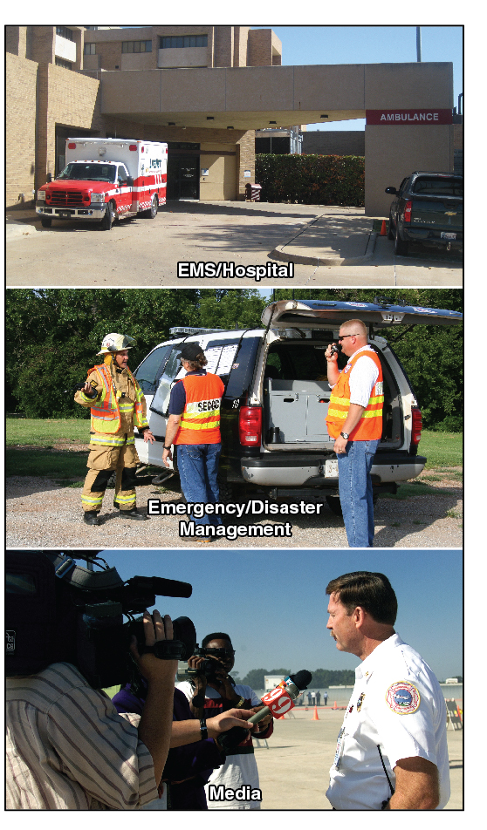
Interaction With Other Agencies And Organizations
EMS organizations
Provide complete medical services
Supplemental medical services provided by fire department
Local hospitals
Assist by radio
Dispatch medical professionals to the scene
(Cont.)

Slide 47
Interaction With Other Agencies And Organizations
Emergency/Disaster management
Scene security
Traffic and crowd control
Firefighter protection
Fire investigation
Explosives disposal
Coordinate multi-agency activities
May be local, state/provincial, or federal
Law enforcement
(Cont.)

Slide 48
Interaction With Other Agencies And Organizations
Utility companies and public works
Alert public of traffic incidents, evacuations, or fire department activities
Inform public about fire and life safety topics and initiatives
Shutting off utilities
Oversee construction of roads, buildings, sewers
May manage hydrants and hydrant testing
Media

Slide 49
REVIEW QUESTION
How do fire departments interact
with other organizations and
agencies?

Slide 50
DISCUSSION QUESTION
What are examples of organizations
and agencies within your
community that the fire service
may need to interact with?

Slide 51
Learning Objective 6
Explain the roles and duties of a Fire Fighter I.

Slide 52
Incident Priorities
Life safety
Incident stabilization
Property conservation

Slide 53
Emergency And Nonemergency Duties Of A Fire Fighter I Required By NFPA 1001
Establish work areas at emergency scenes
Force entry into structures
Set up and use ground ladders
Extinguish fires
Conduct search and rescue
Overhaul a fire scene
Set up electrical and lighting equipment
(Cont.)

Slide 54
Emergency And Nonemergency Duties Of A Fire Fighter I Required By NFPA 1001
Tie knots for hoisting tools
Connect pumpers to hydrants and perform hose lays
Turn off building utilities
Route emergency and nonemergency telephone calls
Communicate over department radios
Clean, inspect, and maintain equipment
Prepare apparatus hose loads

Slide 55
REVIEW QUESTION
What is the role of a Fire Fighter I?

Slide 56
Learning Objective 7
Describe fire and life safety initiatives aimed at reducing firefighter illnesses, injuries, and fatalities.

Slide 57
Firefighter Injuries And Fatalities
Highest risk factor to firefighters is cardiac arrest as a result of
Overexertion
Poor health habits
Occupational stress
Firefighters also injured and killed
In motor vehicle incidents
As result of emergency scene hazards

Slide 58
Firefighter Injuries And Fatalities Information Sources
NFPA®
United States Fire Administration (USFA)
National Institute for Occupational Health and Safety (NIOSH)
Occupational Safety and Health Administration (OSHA)
National Near-Miss Reporting System
National Institute of Standards and Technology (NIST)

Slide 59
NOTE
Reporting in Canada is performed at the provincial or territorial level. Canada has no national reporting system.

Slide 60
The National Fallen Firefighters Foundation (NFFF)
NFFF Mission
"To honor and remember America's fallen fire heroes, to provide resources to assist their survivors in rebuilding their lives, and work within the Fire Service Community to reduce firefighter deaths and injuries"

Slide 61
NFFF 16 Firefighter Life Safety Initiatives
Provide fire service a blueprint for making changes
Work to establish training on Fire and Life Safety Initiatives throughout the fire service in the U.S.
Also known as Everyone Goes Home®
(Cont.)

Slide 62
NFFF 16 Firefighter Life Safety Initiatives
Define and advocate the need for a cultural change relating to safety; incorporating leadership, management, supervision, accountability and personal responsibility
Enhance personal and organizational accountability for health and safety
Focus greater attention on integration of risk management with incident management at all levels, including strategic, tactical, and planning responsibilities
(Cont.)

Slide 63
NFFF 16 Firefighter Life Safety Initiatives
All firefighters must be empowered to stop unsafe practices
Develop and implement national standards for training, qualifications, and certification (including regular recertification) that are equally applicable to all firefighters based on the duties they are expected to perform
Develop and implement national medical and physical fitness standards that are equally applicable to all firefighters, based on the duties they are expected to perform
(Cont.)

Slide 64
NFFF 16 Firefighter Life Safety Initiatives
Create a national research agenda and data collection system that relates to the initiatives
Utilize available technology wherever it can produce higher levels of health and safety
Thoroughly investigate all firefighter fatalities, injuries, and near misses
Grant programs should support the implementation of safe practices and/or mandate safe practices as an eligibility requirement
(Cont.)

Slide 65
NFFF 16 Firefighter Life Safety Initiatives
National standards for emergency response policies and procedures should be developed and championed
National protocols for response to violent incidents should be developed and championed
Firefighters and their families must have access to counseling and psychological support
(Cont.)

Slide 66
NFFF 16 Firefighter Life Safety Initiatives
Public education must receive more resources and be championed as a critical fire and life safety program
Advocacy must be strengthened for the enforcement of codes and the installation of home fire sprinklers
Safety must be a primary consideration in the design of apparatus and equipment

Slide 67
International Association Of Fire Chiefs (IAFC) Fire Fighter Safety Stand-Down
Annual, day-long stand-down
Usually each work shift the third week in June
Purpose — Focus on firefighter safety
All non emergency work ceases
Safety training sessions are held

Slide 68
REVIEW QUESTION
What initiatives have been created
to help reduce firefighter line of duty illnesses, injuries, and
fatalities?

Slide 69
Learning Objective 8
Describe the aspects of NFPA 1500 related to firefighter safety and health.

Slide 70
Safety-Conscious Fire Service Culture
Traditionally accepted injuries, illnesses, and fatalities as part of the job
Fire service is progressing to be more safety-conscious
Firefighters understand that they are preventable and can be avoided

Slide 71
NFPA 1500 Minimum Requirements For A Department Health And Safety Program
Safety and health-related policies and procedures
Training and education
Fire apparatus, equipment, and driver/operators
Protective clothing and equipment
Emergency operations
Facility safety
Medical and physical requirements
Firefighter wellness programs
Member assistance programs
Infection and exposure control programs

Slide 72
Proactive Approach To Safety And Health
Firefighter and departments must take a proactive approach to
Safety
Health
Fitness
Anticipated hazards

Slide 73
NFPA 1500 Requirements For A Fire Department Training Program
Purpose
Prevent occupational illnesses, injuries, and fatalities
New recruit training
Methods for becoming proficient in firefighter duties
Evaluation of skills and knowledge
(Cont.)

Slide 74
NFPA 1500 Requirements For A Fire Department Training Program
Personnel may not be assigned until they complete required evaluation and training
Must meet requirements of NFPA 1000 series of ProQual standards
Thorough documentation
Annual proficiency training
Training in conditions close to actual emergencies
Training for updated policies or procedures

Slide 75
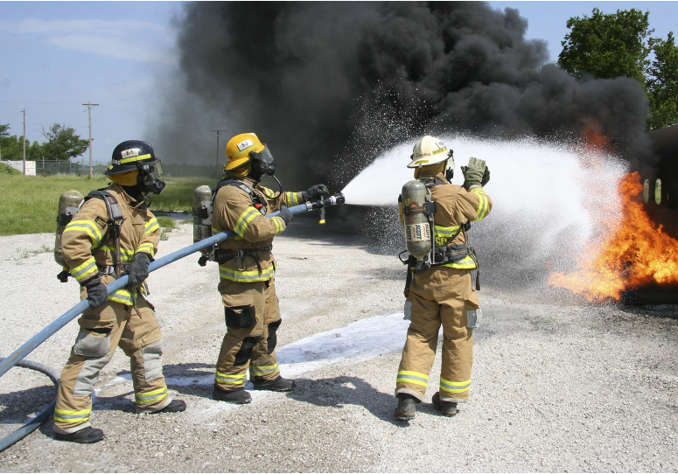
Safety During Training Evolutions
Use appropriate PPE
Maintain situational awareness
Be in good physical condition
Adhere to all safety regulations
Maintain PPE and training equipment
Be aware of physical condition

Slide 76
NFPA 1500 Safety Requirements For Apparatus And Driver/Operators
Apparatus
Seat belts for all occupants
Maintenance and inventory records maintained for all equipment
Driver/Operators
Wear seat belt
Obey traffic signals and regulations
Be thoroughly trained before operating apparatus in an emergency

Slide 77
PPE And SCBA Requirements
Departments must provide all members with appropriate protective clothing and equipment
Protective clothing must comply with the appropriate NFPA design standard
Personnel in IDLH atmosphere or hazardous area must be fully equipped with PPE and SCBA

Slide 78
Incident Management System (IMS)/ Incident Command System (ICS)
IMS must include
Risk management plan
Personnel accountability system
Emergency operations must include
Rapid intervention crews
Rehab facilities
Postincident analysis

Slide 79
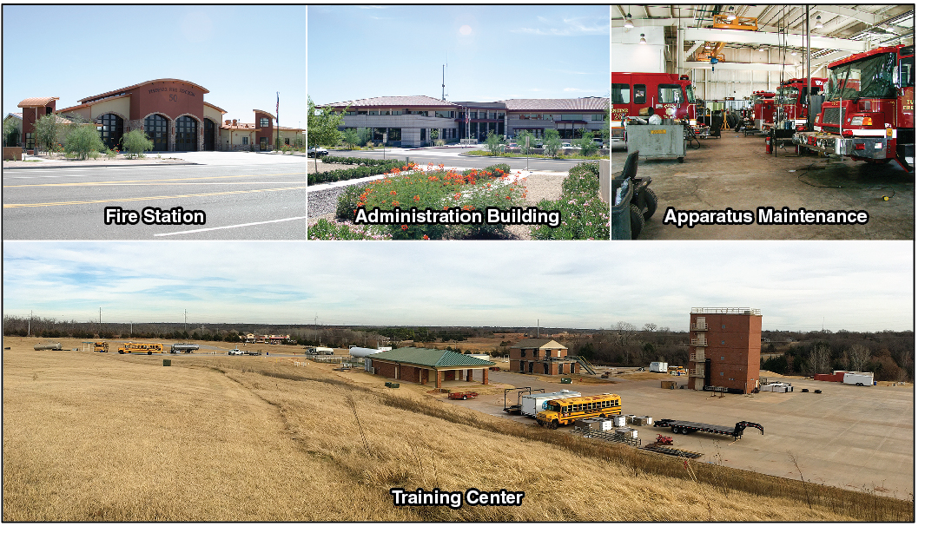
NFPA 1500 Minimum Requirements For Fire Department Facilities

Slide 80
NFPA 1500 Medical And Physical Requirements
Annual medical exams
Job-related physical fitness standards
Designated physician available
Physical performance standards for hiring
Medical evaluations to ensure candidates can perform duties
Fitness program
(Cont.)

Slide 81
NFPA 1500 Medical And Physical Requirements
Documentation of on-the-job injuries and exposures
Infection control program
Medical records kept confidential
Prohibits firefighters from operating while under the influence of alcohol or drugs

Slide 82
REVIEW QUESTION
What are some requirements of
NFPA 1500 that relate to firefighter
safety and health?

Slide 83
Learning Objective 9
Describe fire department programs intended to reduce firefighter illnesses, injuries, and fatalities.

Slide 84
Wellness Programs
Wellness programs and initiatives
Guide firefighters toward a healthy lifestyle and to maintain fitness for duty
Reduce illnesses, injuries, and fatalities

Slide 85
Guidelines For Maintaining Personal Health
Stay informed about job-related health issues
Wear appropriate PPE
Clean PPE at least twice annually and after every exposure to smoke
Follow recommendations for vaccinations
Maintain good nutrition
Adopt safe behaviors and healthy lifestyle
(Cont.)

Slide 86
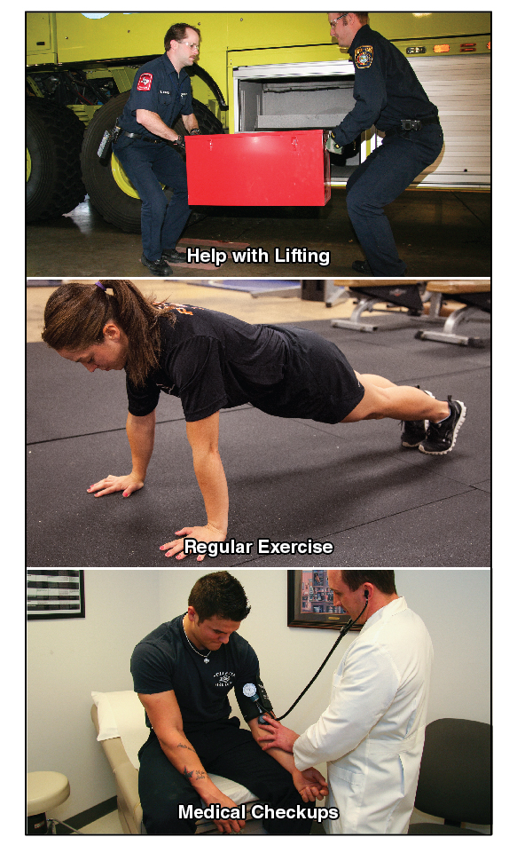
Guidelines For Maintaining Personal Health
Use precautions to avoid airborne and bloodborne pathogens
Use proper lifting techniques
Use lifting tools or get help lifting heavy objects
(Cont.)

Slide 87
Guidelines For Maintaining Personal Health
Maintain a regular exercise program
Clean, disinfect, and properly store patient care tools and equipment
Maintain a diet low in cholesterol, fat, and sodium
Maintain blood pressure and cholesterol levels
Eliminate tobacco products
Medical checkups

Slide 88
Health-Related Problems
Wellness programs should offer counseling
Nutrition
Hypertension
Weight control
Physical conditioning

Slide 89
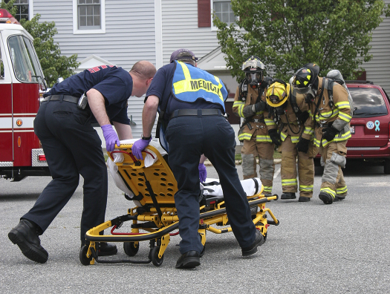
Injury Prevention
Effective training
Maintain company discipline and accountability
Follow safety-related SOPs
Use PPE
High levels of physical fitness
Follow risk management guidelines
Use rehab facilities at incidents

Slide 90
Illnesses Can Cause Lost Duty Time
Acute
Chronic

Slide 91
Cardiovascular Diseases
Work-related causes
Exposure to smoke and chemicals
Heat stress
Psychological stress
Long, irregular work hours
Non-job-related causes
Obesity
Tobacco use
Lack of physical fitness
Prevention
Adhere to policies and procedures
Wear required PPE
Reduce exposure to hazards
Healthy diet
Stop tobacco use
Exercise

Slide 92
Respiratory Diseases
Common respiratory diseases
Asthma
Lung cancer
COPD
Prevention
Wear proper respiratory equipment and follow departmental regulations
Healthy lifestyle
No smoking

Slide 93
Carcinogens At Fire Scenes
Toxic gases, vapors, and particulates contaminate protective gear
Risk of dermal contamination and inhalation injury
Modern fires have more contaminants and products that burn at higher temperatures
Higher temperatures increase skin’s absorption rates

Slide 94
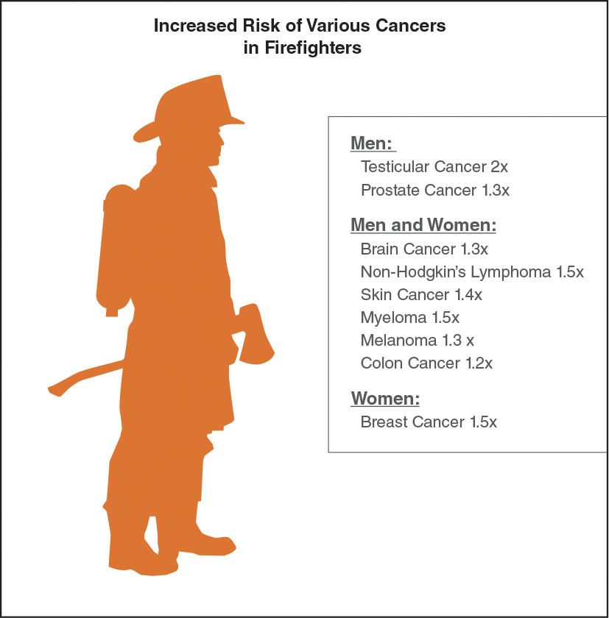
Cancer Risk

Slide 95
Actions To Prevent Or Limit Chemical Exposures
Always wear SCBA working in or around damaged structures
Remain upwind of fires and smoke
Doff contaminated gear before entering rehab area
(Cont.)

Slide 96
Actions To Prevent Or Limit Chemical Exposures
Do not wear or store contaminated turnouts inside the apparatus cab, personal vehicle or station or home living areas
Decontaminate equipment that contacts skin after each response
Wash hands and neck skin after fire and shower as soon as possible

Slide 97
Wellness Programs Combat Obesity
Problems caused by obesity
Harder to perform duties
Higher risk of
Type 2 diabetes
Coronary heart disease
Stroke
Hypertension
Some forms of cancer
Encourage healthy diet and exercise habits
Additional strain on the body

Slide 98
Acute And Chronic Health Consequences From Exposure To Various Substances
Infectious diseases
Chemicals
Products of combustion
Engine exhaust
Other occupational and environmental exposures

Slide 99
Infection And Exposure Control Programs
Limit exposures
Provide access to treatment
Document exposures

Slide 100
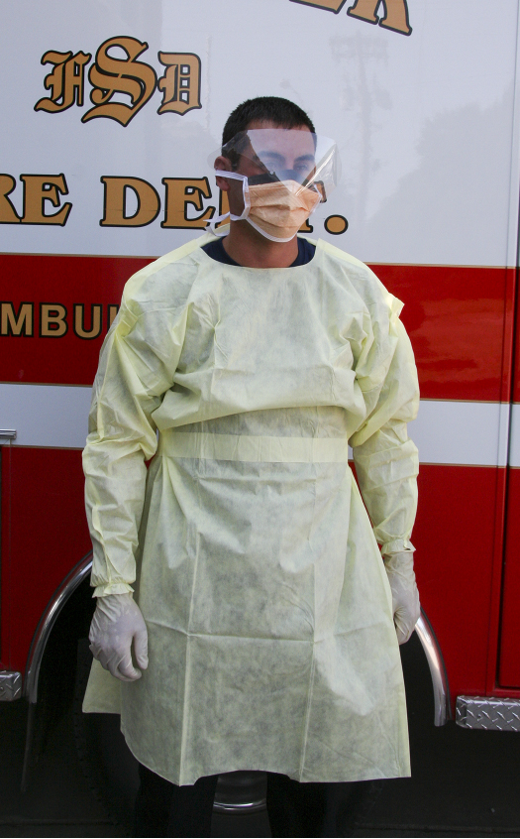
Precautions Against Exposures When Treating Medical Patients
Limit unnecessary physical contact
Maintain recommended separation distance
Wear appropriate PPE
Use BSI methods for all patients

Slide 101
REVIEW QUESTIONS
How do fire department programs help combat illnesses, injuries, and fatalities?
What are the most common line of duty illnesses and injuries that affect firefighters?

Slide 102
REVIEW QUESTION
How do physical fitness and healthy lifestyle practices affect firefighter performance and safety?

Slide 103
DISCUSSION QUESTION
What steps can you personally take to help reduce your chances of line of duty illness, injury, or fatality?

Slide 104
Member Assistance Programs
Provide accessible, confidential assistance with problems that can affect job performance
Substance abuse
Tobacco use
Personal problems
Stress
Depression
Anxiety
Marital problems
Financial problems

Slide 105
Drugs And Alcohol
Most departments prohibit firefighters from responding while under the influence
Some departments prohibit candidates from using alcohol
You are responsible for controlling use of drugs and alcohol while on-call and prior to duty
You must not respond to a call or report to the station if under the influence or if taking medication that causes impairment
Can impair ability to function and slow reaction time

Slide 106
CAUTION
Consuming drugs and alcohol can slow reaction times and impair judgement. These substances and fire fighting do NOT mix.

Slide 107
Tobacco Use
If you do not use tobacco, do not start
If you do, take advantage of a program to help stop

Slide 108
Mitigating Occupational Stress
Stay in good physical condition
Positive mental attitude
Relax when possible
Personal stress management program
Member assistance program

Slide 109
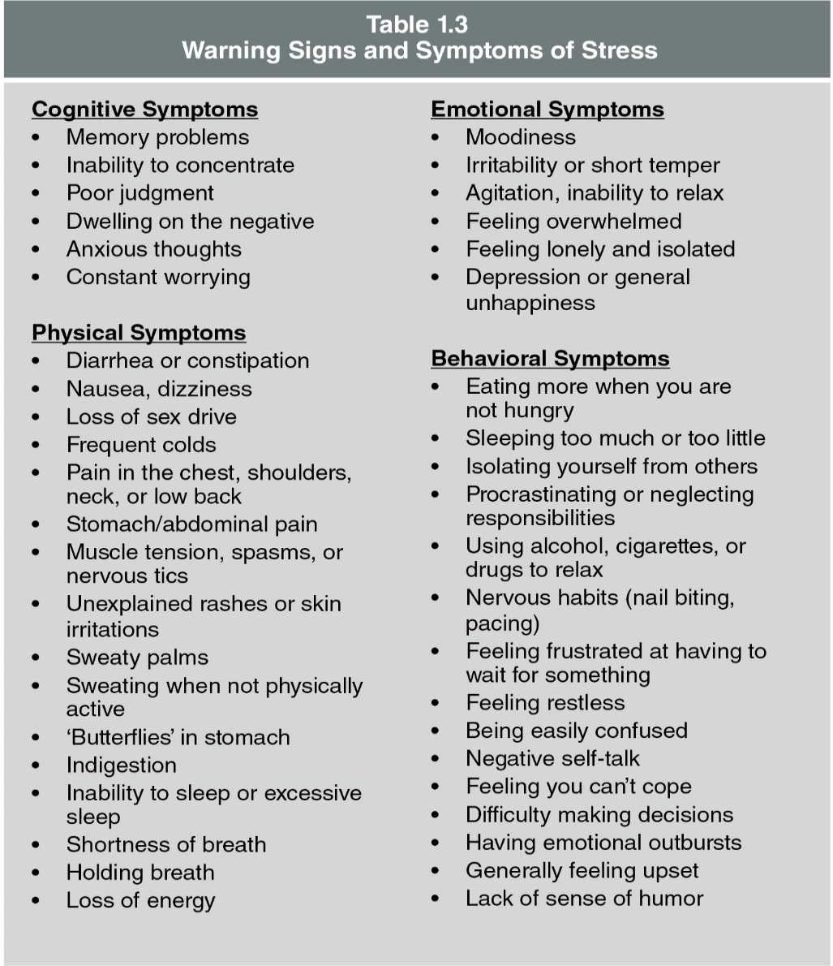
Warning Signs And Symptoms Of Stress

Slide 110
Atypical Stress
CISD is not as effective as once thought
Officers and supervisors should monitor personnel for signs of PTSD and recommend assistance from specialists

Slide 111
REVIEW QUESTION
How do fire department member assistance programs benefit firefighters?

Slide 112
DISCUSSION QUESTION
What methods do you use to deal
with stress?

Slide 113
Learning Objectives 10-11
Summarize general guidelines for operating safely at structural fire scenes.
Summarize safe practices for riding in fire service vehicles and apparatus.

Slide 114
Situational Awareness
Identify hazards
Remain observant of changing conditions
Evaluate changes against safety of your actions
Communicate what you see

Slide 115
Conditions You Should Observe At Every Incident
Location of fire and your proximity to it
Changes in fire behavior, spread, or growth
Changes to building’s structural integrity
Wind direction and strength
Hazards that may not have been seen during size-up

Slide 116
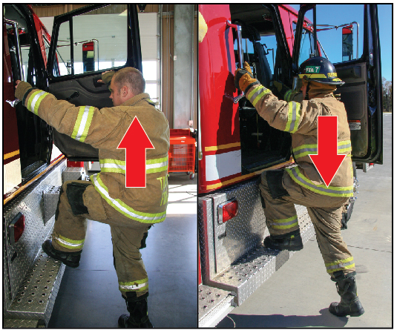
Response Safety
Don PPE
Mount apparatus
Fasten seatbelt
Dismount apparatus
Safely reach the apparatus

Slide 117
Hazards For Apparatus Passengers
Excessive noise levels
Loose equipment
Danger of falls
Vehicle accidents

Slide 118
CAUTION
Never stand on or in a moving apparatus.

Slide 119
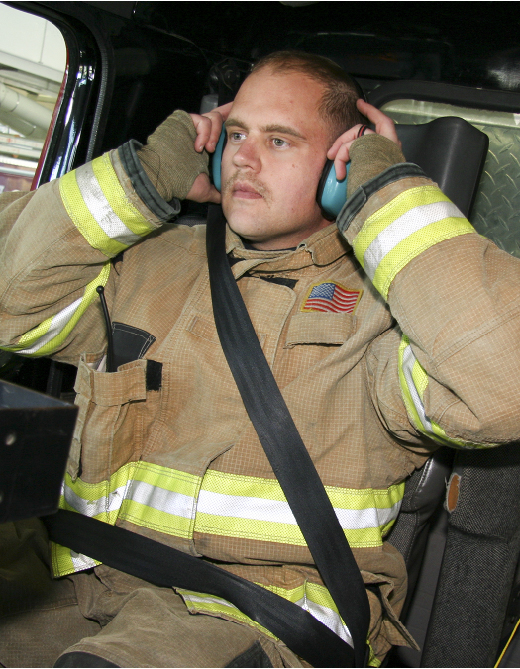
Safe Practices For Riding In Apparatus
No helmets in the cab
Seated, securely belted before the apparatus moves
Wear hearing protection
Secure loose tools and equipment
Close cab doors and safety gates or bars securely
Follow SOPs and NFPA 1500 requirements

Slide 120
REVIEW QUESTION
What safety guidelines should be followed when riding in fire department apparatus?

Slide 121
Operational Guidelines To Minimize Risk At Structural Fire Scenes
Follow supervisor’s orders and SOPs
Wear appropriate PPE
Work as a team
Maintain communication
Do a risk/benefit analysis for every action
Employ safe, effective tactics
Never operate alone or without supervision
Perform an initial assessment and maintain situational awareness

Slide 122
Situational Awareness
Critical at any incident
Understand what is going on around you
Recognize potential threats
Firefighters must train to develop this skill

Slide 123
NOTE
Many of the topics discussed in this section are also vital elements to incident types other than structural emergency scenes, such as a vehicle crash or a wildland fire.

Slide 124
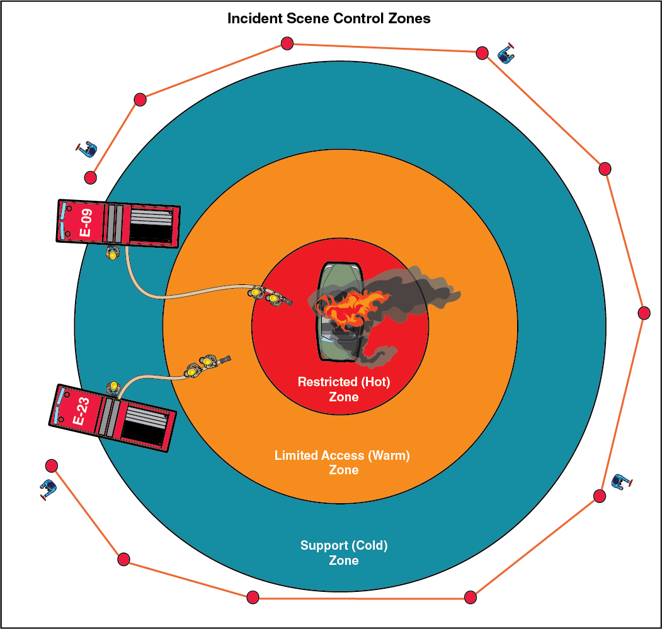
Scene Control Zones
(Cont.)

Slide 125
Scene Control Zones
Hot zone
Warm zone
Trained personnel work to resolve the problem
Only personnel directly involved in the incident are allowed
Immediately outside hot zone
Personnel support work in the hot zone
Full PPE
(Cont.)

Slide 126
Scene Control Zones
Cold zone
Immediately surrounds hot and warm zones
May include ICP, RIC, PIO, rehab, and staging areas
Outer boundary is the crowd-control line

Slide 127
Effects Of Environmental Conditions
Temperature extremes, heavy rains, winds, and lighting
Can influence
Operations
Duration of ability to perform assignments

Slide 128
REVIEW QUESTION
What should firefighters do to ensure safety at a structural fire scene?

Slide 129
DISCUSSION QUESTION
Situational awareness must be practiced so that it becomes automatic. Without looking around, how would you describe your immediate environment?

Slide 130
Learning Objective 12
Explain the use of emergency scene lighting and equipment.

Slide 131
Emergency Scene Lighting Equipment
Portable lights
Used in building interiors or remote areas of the scene
Some mounted on telescoping stands
Fixed lights
Mounted on a vehicle
Direct wired to vehicle-mounted generator or apparatus’ electrical system
Provide overall scene lighting
Usually mounted on telescoping poles
Some units are a bank of lights mounted on hydraulic booms
Number of units mounted on apparatus is limited by amount of power

Slide 132
Generators
Portable
Powered by small gasoline or diesel engines
110- and/or 220-volt outlets
Most light enough to be carried by two people
Useful when vehicle-mounted systems are not available
Vehicle-mounted
More power than portable units
Powered by gasoline, diesel, or propane gas engines or by hydraulic PTO systems

Slide 133
Apparatus Electrical System
Inverter
Used if small amount of power is needed
Convert’s vehicle’s 12 or 24-volt DC into 110- or 220-volt AC
Advantages
Fuel efficiency
Minimal noise
Disadvantages
Constant exhaust
Limited power supply
Limited mobility

Slide 134
Auxiliary Electrical Equipment
Electrical cables
Extension cords
Receptacles
Connectors
Junction boxes
Ground fault circuit interrupter devices
Adapters
(Cont.)

Slide 135
Auxiliary Electrical Equipment
Electrical equipment must be
Waterproof
Intrinsically safe
Designed for amount of electrical current it is intended to carry
(Cont.)

Slide 136
Auxiliary Electrical Equipment
Cables and extension cords
Carry limited electricity
Stored in coils, on reels, or on apparatus-mounted automatic rewind reels
Should have adequate insulation and no exposed wires
Twist-lock receptacles and connectors equipped with grounding wires
Safe as long as not immersed in water
Junction boxes
Provide multiple outlets or connections
Supplied through one inlet from the power source
(Cont.)

Slide 137
Auxiliary Electrical Equipment
Outlets
Must be equipped with GFCI devices
Meet requirements in NFPA 70E
Adapter connections
Used to permit different plugs and receptacles to be connected
Allow mutual aid departments to use each other’s equipment
May allow department lights and tools to plug into standard outlets

Slide 138
Safety Guidelines For Emergency Scene Lighting
Use two personnel to carry generators
Position generators downwind
Wear hearing protection when operating generators
Be aware that generator noise can make communications difficult
Adjust light so it is directed toward the scene but not into eyes of approaching drivers
Remove damaged cords from service
Do not immerse cords or connections in water
Never connect more lights than the power source can support

Slide 139
Scene Lighting Operation And Safety
Overtaxing a power source
Results in poor lighting
Can possibly damages the lights, generator, or electrical system
May restrict operation of other tools using same power source
Some units produce extreme heat
Can cause burns and melt paint and plastics
Be careful when moving or turning off lights
Placement
Gather equipment from the apparatus
Place equipment in safe location

Slide 140
REVIEW QUESTION
What safety guidelines should be followed when deploying and using emergency scene lighting?

Slide 141
Learning Objective 13
Explain the importance of personnel accountability systems.

Slide 142
Personnel Accountability Systems
Track personnel in and out of IDLH environment
Used at every incident
All personnel should be trained to use them
Should be part of all training exercises
Can save your life if
SCBA malfunctions
You become lost or trapped
Fire behavior changes unexpectedly
Only effective if properly implemented and used

Slide 143
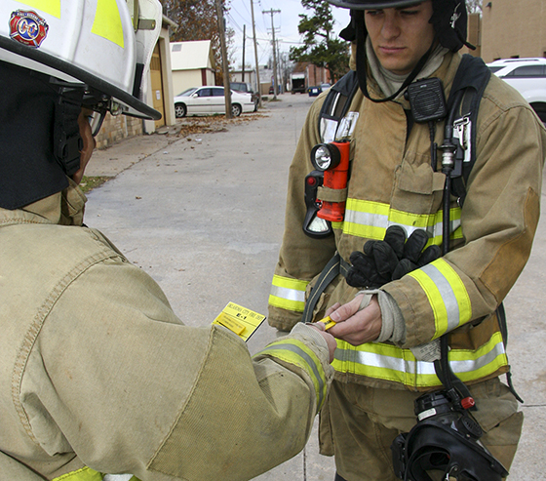
Types Of Personnel Accountability Systems
SCBA tag systems
Computer-based electronic accountability systems
Passport
systems

Slide 144
REVIEW QUESTION
What types of personnel accountability systems may be in use at an incident?

Slide 145
Learning Objective 14
Summarize general guidelines for operating safely at highway/roadway incidents.

Slide 146
Highway/Roadway Incident Safety
Firefighters and victims are in danger of being struck by traffic
Be visible
Work within protected areas
Exercise situational awareness

Slide 147
Apparatus Lights And Scene Lighting
Contribute to visibility
Can make situation more hazardous if improperly used
Some departments require responders to
Turn off forward facing lights
Minimize flashing lights on vehicle’s sides and rear
Turn off lights that face approaching traffic
Turn off headlights unless they are being used to illuminate the work area or warn motorists

Slide 148
Guidelines For Maintaining Situational Awareness At A Roadway Incident
Look before you move
Keep an eye on moving traffic
Walk facing oncoming traffic
Follow SOPs

Slide 149
Highway/Roadway Incident Hazards
Debris
Fuel spills
Hydraulic and battery fluid spills
Downed high-voltage power lines

Slide 150
WARNING
Do not approach downed power lines until the electric company has shut off power.

Slide 151
Traffic Incident Management
Establish control zones
Coordinate with law enforcement
Refer to Manual on Uniform Traffic Control Devices (MUTCD)

Slide 152
Traffic Control Measures And Devices
Emergency vehicles
Form barriers between traffic and personnel
Company officer and driver/operator position vehicles
Signs and traffic cones
Used to detour traffic around the scene
Close off at least one lane of traffic next to the scene
Request traffic control assistance from law enforcement

Slide 153
REVIEW QUESTION
What safety guidelines should be followed at highway/roadway incidents?

Slide 154
DISCUSSION QUESTION
What areas in your jurisdiction are prone to highway/roadway incidents? Why?

Slide 155
QUESTIONS
Are there any questions about this content?

