Slide 1
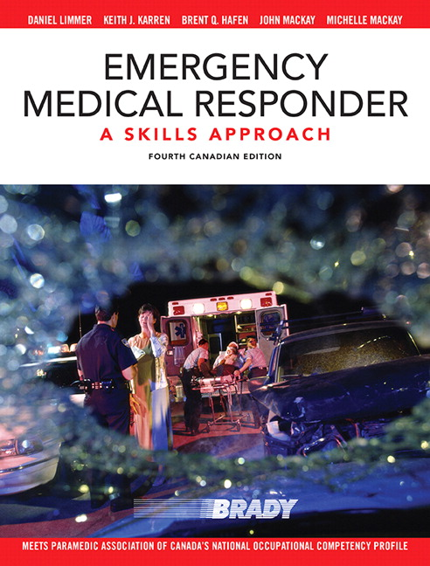
Chapter 29
EMS OPERATIONS
Copyright ♥ 2015 Pearson Canada Inc.

Slide 2
CHAPTER 29 - EMS OPERATIONS
Six General Phases of a Response
Preparation
Dispatch
En route to the scene
Arrival at the scene
Transfer of care
Post-run activities
Copyright ♥ 2015 Pearson Canada Inc.
Notes:
Six phases of a response

Slide 3
CHAPTER 29 - EMS OPERATIONS
Preparation
Unit check
Equipment
Patient assessment
Treatment
Protocols
Certifications and training
Copyright ♥ 2015 Pearson Canada Inc.
Notes:
Preparation: All equipment should be routinely checked and readied. Make sure all equipment is stocked and functional.
Know how to use your equipment. Know how to do a proper patient assessment and how to treat patient. Keep up to date with current protocols and certificates/training up to date
Review recommended EMS equipment list from text page 435.

Slide 4
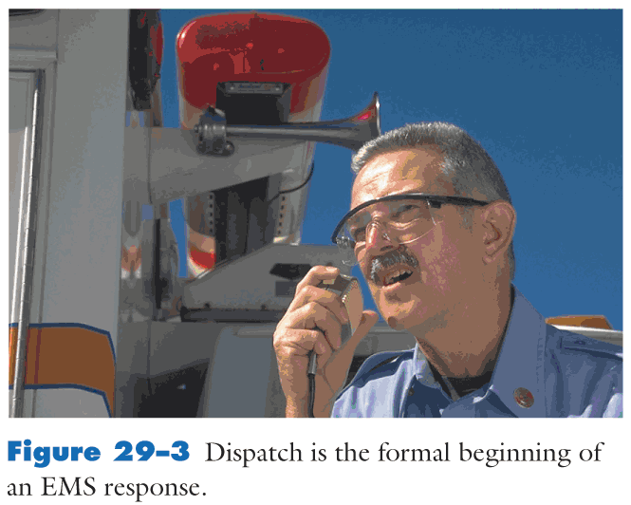
CHAPTER 29 - EMS OPERATIONS
2) Dispatch
Copyright ♥ 2015 Pearson Canada Inc.
Notes:
Dispatch is the formal beginning of an EMS response.
In Kananaskis we deal with 3 different dispatch organizations. KES, PSC (fire and EMS), AHS

Slide 5
CHAPTER 29 - EMS OPERATIONS
3) En route to the scene – know exact location
4) Arrival on-scene – approach cautiously, park in a safe place
5) Transfer of care – give concise and accurate patient hand-off report
6) Post-run – report availability to dispatch, clean/disinfect all equipment, restock
Copyright ♥ 2015 Pearson Canada Inc.
Notes:
Phases 3-6 of response.
3)En route to scene. 4)Arrival on scene. 5)Transfer of care. 6)Post-run activities.

Slide 6
CHAPTER 29 - EMS OPERATIONS
Driving Tips
Learn all local and provincial guidelines for driving an emergency vehicle
When possible, travel in pairs
Back up slowly and carefully
Know your territory
Exercise caution when in congested or rush hour traffic
Plan for sudden stops
Practice special caution on hills and curves
Copyright ♥ 2015 Pearson Canada Inc.
Notes:
Driving Tips.

Slide 7
CHAPTER 29 - EMS OPERATIONS
Seat belts – always wear them
Lights and sirens – always, day or night, during and only during an emergency
Hearing protection – windows closed, ear plugs or muffs
Copyright ♥ 2015 Pearson Canada Inc.
Notes:
Seat Belts: always wear in back of ambulance when able to do so
You cannot legally use lights or sirens independently from one another. Always use simultaneously.
Siren’s are better designed now to protect attendants from loud noise.

Slide 8
CHAPTER 29 - EMS OPERATIONS
Driving Guidelines
Do not exceed posted speed limit, except in critical situations
Start and stop smoothly
Drive at a steady rate of speed
Avoid rough roads if possible
Copyright ♥ 2015 Pearson Canada Inc.
Notes:
Driving Guidlines

Slide 9
CHAPTER 29 - EMS OPERATIONS
Look Out for Your Own Safety
Park for maximum safety
Exit a vehicle safely
Wear protective equipment
Channel traffic away from scene
Copyright ♥ 2015 Pearson Canada Inc.
Notes:
Look out for your own safety.

Slide 10
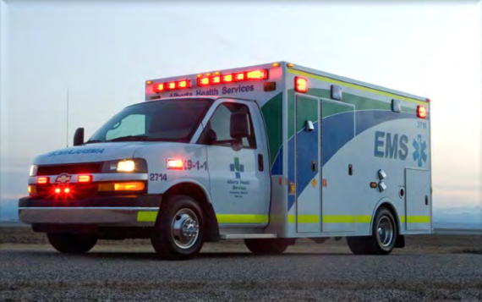
CHAPTER 29 - EMS OPERATIONS
KANANASKIS KEYS
Alberta Health Services Driving Policy

Slide 11
CHAPTER 29 - EMS OPERATIONS
KANANASKIS KEYS
Fire departments who are part of the MFR program are allowed (as per their specific department standards) to drive an AHS ambulance
Driver MUST have a class 1, 2 or 4 Operator’s License
Driver must have the permission of the “most responsible healthcare provider attending”
Lights and sirens MUST be used together
Notes:
“The most responsible healthcare provider attending to a patient(s) holds the discretion to allow an associated non-AHS EMS professional to operate an ambulance with the use of emergency warning devices if he or she has a strong belief there is sufficient medical evidence to warrant such transport” ** AHS Memorandum on Non-AHS Driver policy
Emergency warning devices must not be used independently
Remember that there is an EMS crew attending to the patient in the back of the ambulance and their safety is important. Drive cautiously,
FMR’s may also be requested to assist with patient care in the back of the ambulance.

Slide 12
CHAPTER 29 - EMS OPERATIONS
KANANASKIS KEYS
Must come to a full stop at stop signs, red lights, railway tracks, and when passing school buses with activated lights
Do not exceed the speed limit through school zones, playground zones, construction zones and emergency zones
Never exceed the speed limit by more than 15km/hr
Always drive safely while taking weather and road conditions into account
Notes:
It’s not our emergency!!
It’s more important to get to a destination safely than it is to get there quickly.

Slide 13
CHAPTER 29 - EMS OPERATIONS
KANANASKIS KEYS
Kananaskis Emergency Services can provide an authorized fire driver at the discretion of the Fire Chief
Drivers will often go as far as the Stoney Nakoda Casino to rendezvous with another agency who will continue with EMS to the city
Notes:
WHAT IS THE KES DRIVING POLICY?

Slide 14
CHAPTER 29 - EMS OPERATIONS
Safety in Patient Compartment
Keep a wide base of support
Keep both feet planted firmly on ground
When walking, hold on to a stable object with both hands
Practise bracing
Secure patient
Secure equipment
Copyright ♥ 2015 Pearson Canada Inc.
Notes:
If possible, remain seated with seatbelt fastened.
New ambulances are designed to minimize the need for standing and moving around in the patient compartment.
If standing, keep as many points of contact as possible.
Always be prepared for a sudden stop or turn.

