Slide 1
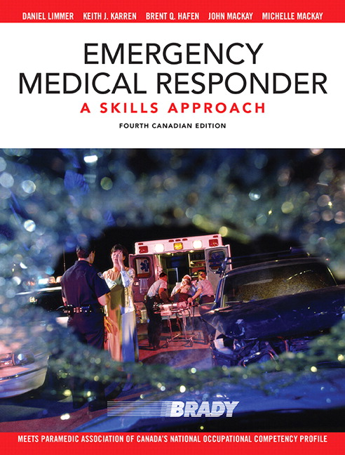
Chapter 4
THE HUMAN BODY

Slide 2
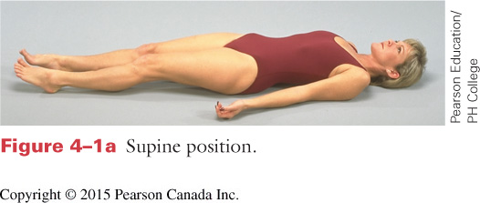
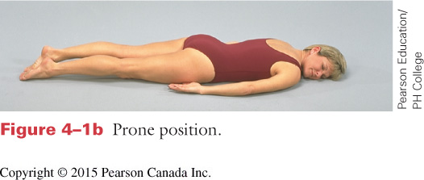
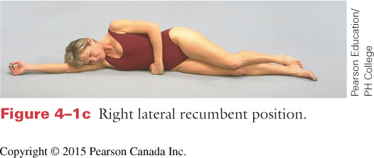
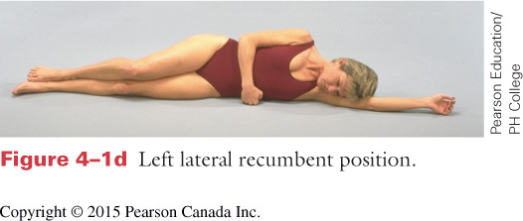
CHAPTER 4 – THE HUMAN BODY
ANATOMICAL TERMS
Anatomical Position
Supine Position
Prone Position
Lateral Recumbent (Recovery) Position
Notes:
Anatomical terms are important for clearly communicating and documenting your findings.
Anatomical Positions- Standing, arms at sides, palms facing forward (thumbs out)

Slide 3
CHAPTER 4 – THE HUMAN BODY
ANATOMICAL DIRECTIONS
Superior Inferior
Anterior Posterior
Medial Lateral
Notes:
Superior- towards heads Inferior- towards feet
Anterior- towards front Posterior- towards back
Medial- towards the midline/center Lateral- towards the left or right away from midline

Slide 4
CHAPTER 4 – THE HUMAN BODY
ANATOMICAL DIRECTIONS
Proximal Distal
Superficial Deep
Internal External
Notes:
Proximal- closer or near Distal- distant or far
Superficial- towards the surface Deep- far from surface
Internal- inside External- outside

Slide 5
CHAPTER 4 – THE HUMAN BODY

Slide 6
CHAPTER 4 – THE HUMAN BODY
Notes:
Review diagram looking at anatomical regions
The focus is on developing good terminology to use through assessment, verbal & written communication

Slide 7
CHAPTER 4 – THE HUMAN BODY

Slide 8
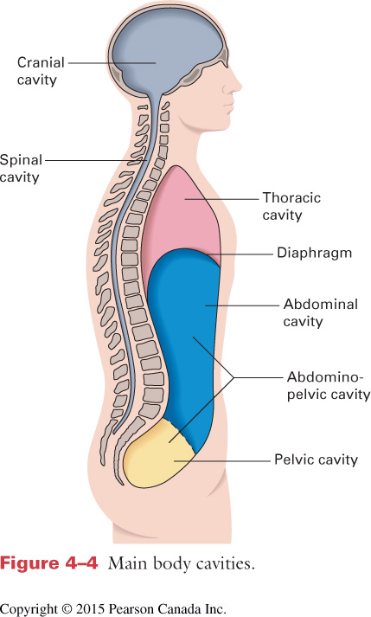
CHAPTER 4 – THE HUMAN BODY
Body Cavities
Thoracic (Chest)
Abdominal
Lungs and Heart
Pelvic
Digestive Organs
Excretory Organs
Reproductive Organs
Notes:
Body is divided into cavities which contain organs. These cavities are typically structured and protected by the skeleton

Slide 9
CHAPTER 4 – THE HUMAN BODY
Skeletal System
Body’s structure
Protects organs
206 bones in adult skeleton
Must balance protection, motion and flexibility
Notes:
Review components of the system, again focusing on use of correct terminology.

Slide 10
CHAPTER 4 – THE HUMAN BODY
Skeletal System
Ligaments connect bone to bone
Tendons connect muscle to bone
Spine (33 vertebrae)
7 Cervical
12 Thoracic
5 Lumbar
5 Sacrum
4 Coccyx

Slide 11
CHAPTER 4 – THE HUMAN BODY
Muscular System
Give the body its strength
Expand & contract with nerve impulses
Made of layers of fibers
Three types of muscle tissue

Slide 12
CHAPTER 4 – THE HUMAN BODY
Muscular System
Skeletal (voluntary)
Deliberate movements
Broad & flat in trunk
Long & round in limbs
Cardiac
Makes up heart
Can self stimulate
Smooth (involuntary)
Found in tube-like organs
Notes:
Have students identify a few types of skeletal muscle
Smooth muscle found in tube-like organs/ducts like esophagus, intestines as well as in the walls of arteries and veins.

Slide 13
CHAPTER 4 – THE HUMAN BODY
Respiratory System
Provides oxygen for the body
Inspirations -> exhalation process
Gas exchange takes place at alveoli
Diaphragm & intercostal muscles
Notes:
Airflow through the naso/oropharynx past the epiglottis and larynx into the trachea (wind pipe)
Trachea branches at the Carina into the left and right main BRONCHUS
Branches get smaller into BRONCHIOLES -> ALVEOLAR DUCTS -> ALVEOLAR SAC -> ALVEOLUS
Inspiration occurs with involuntary signals from the brain which cause the diaphragm and intercostal muscles to contract, drawing the chest up and the diaphragm down. This creates lower pressure in the chest (due to increased space) and draws air in.
Exhalation occurs when the muscles contact, resulting in increased pressure in the chest cavity, forcing air out.
Lungs are covered by PLEURA which allows them to move freely within the chest cavity without friction. 3 lobes in right lung and 2 on left

Slide 14
CHAPTER 4 – THE HUMAN BODY
Circulatory System
Provides nutrients & oxygen to cells & removes waste
Heart has 4 chambers
R/L Atria & Ventricles
Veins vs. Arteries
Artery, arterioles, capillaries, venuls, veins
Pulse points
Notes:
Heart chambers & flow: Superior/Inferior vena cava, right atria, right ventricle to lungs via pulmonary arteries, return via pulmonary veins to left atria, left ventricle out to body via aorta
Arteries are vessels at higher pressure transporting blood away from the heart
Veins are vessels at lower pressure transporting blood back to the heart
Pulse points: Carotid, Brachial, Radial, Femoral, Pedal

Slide 15
CHAPTER 4 – THE HUMAN BODY
Nervous System
Made up of
Brain (CNS)
Spinal Cord (CNS)
Nerves
Communication & control of body
Central Nervous System (CNS)
Peripheral
Notes:
Brain in the body’s computer. More critical systems are located closer to the center so they are more protected.
Much of our “higher-level” thinking comes from frontal lobe
Brain is fully contained within the skull, only opening is where the spinal chord passes through.
Brain and spinal chord protected and contained within 3 layers – Dura Mater -> Arachnoid -> Pia Mater -> Brain
Spinal chord is protected by vertebrae

Slide 16
CHAPTER 4 – THE HUMAN BODY
Nervous System
Some signals are controlled by us
Some are involuntary
Autonomic Nervous System
Sympathetic (fight or flight)
Parasympathetic (control mechanism)
Nerves branch off spinal chord
Notes:
Nerves are how we FEEL things
Autonomic Nervous System is automatic
Sympathetic- get scared, heart rate goes up, breathing increases, adrenaline released
Parasympathetic- once danger is gone works to return the body to normal. Also affected by certain drugs (suppressants like fentanyl)

Slide 17
CHAPTER 4 – THE HUMAN BODY
Integumentary System
Skin acts as a shield for the tissue and organs
Regulates body temperature
Vasculature is contained within the dermis
Has varying thicknesses
Notes:
Skin is a sealed system as long as there are no cuts, scrapes or holes
Review diagram for terms and structure

Slide 18
CHAPTER 4 – THE HUMAN BODY
Digestive System
Digestions occurs by mechanical & chemical means
Removes nutrients for use & excretes waste
Organs fill the abdominal cavity

Slide 19
CHAPTER 4 – THE HUMAN BODY
Digestive System
Abdomen is divided into 4 quadrants
Can be used during assessment to help identify differential diagnosis
Some organs fall into all 4 quadrants

Slide 20
CHAPTER 4 – THE HUMAN BODY
Urinary System
Filters blood and excretes waste in liquid form
Kidneys filter
Ureters transport
Bladder stores
Urethra excretes

Slide 21
CHAPTER 4 – THE HUMAN BODY
Endocrine System
Made up of glands which secrete hormones
Affect almost all body and system functions
Slight imbalances can lead to physical & mental effects

Slide 22
CHAPTER 4 – THE HUMAN BODY
Reproductive System
Males
Testes (2) & ducts
Accessory glands
Penis
Females
Ovaries (2)
Fallopian tubes
Uterus
Vagina & external genitals

