Slide 1
Hazardous Materials Technician
1st Edition
Chapter 5 — Exposure Assessment and Toxicology

Slide 2
Learning Objective 1
Explain exposure.

Slide 3

Exposure can occur through four routes of entry.
Click for next slide

Slide 4
REVIEW QUESTION
What are the routes of entry through which exposure may occur?

Slide 5
DISCUSSION QUESTION
Is it possible to be contaminated without being exposed? Is it possible to be exposed without being contaminated?

Slide 6
Contamination and exposure have different meanings.
Exposure
Contamination

Slide 7
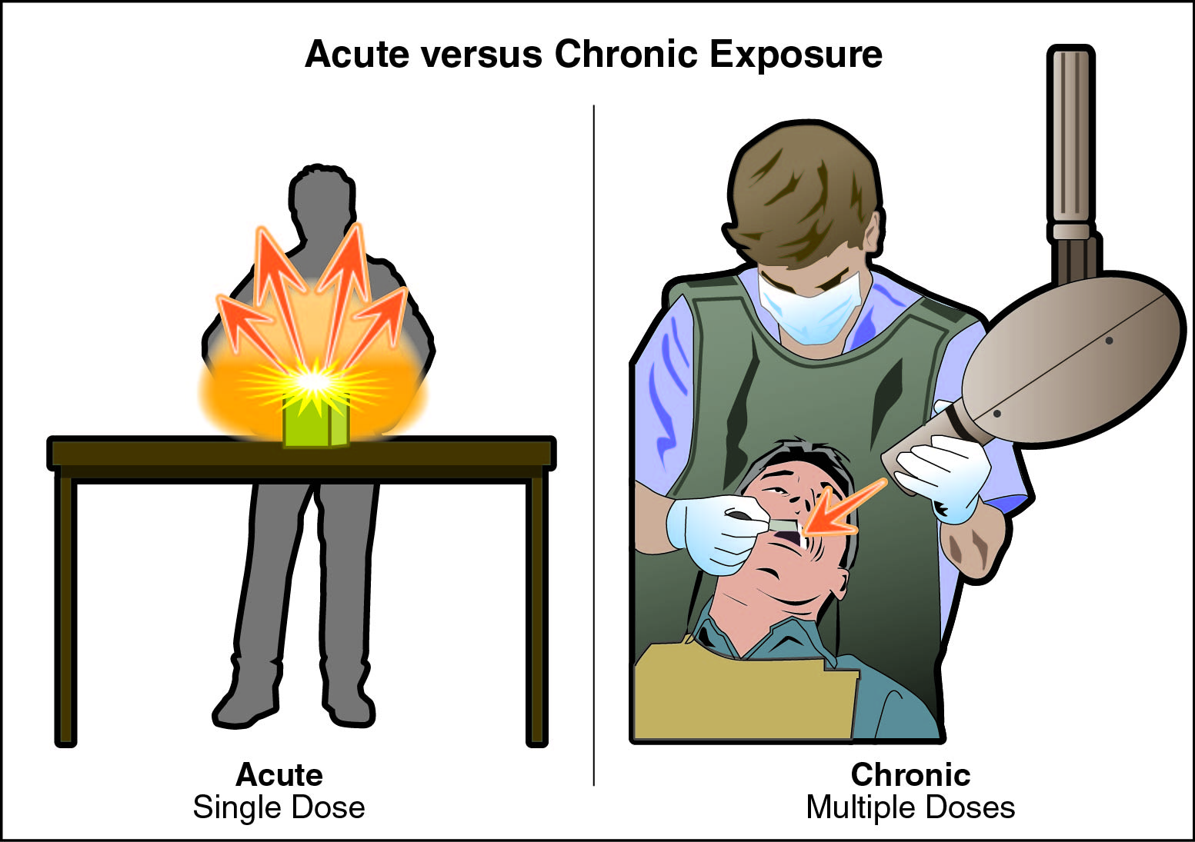
Acute and chronic exposure also have different meanings.

Slide 8
REVIEW QUESTION
What is the difference between contamination and exposure?

Slide 9
Learning Objective 2
Describe elements of toxicology.

Slide 10
Each type of toxin poses specifics types of hazards.
Asphyxiants
Corrosives
Irritants
Sensitizers
Carcinogens
Neurotoxins
Mutagens
Teratogens
Infectious substances

Slide 11
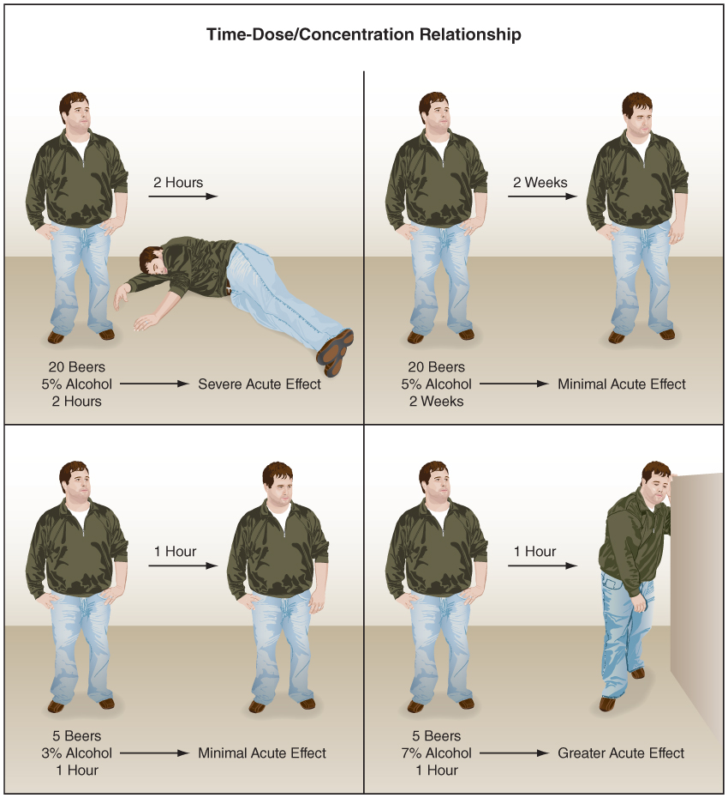
Dose-response relationships are fundamental to understanding toxicology.

Slide 12
Doses and concentrations are measured and expressed in specific ways.
Concentrations
Parts-per-million (ppm)
Parts-per-billion (ppb)
Dosages
Milligram per kilogram (mg/kg)
Milligram per square centimeter (mg/cm²)
Milligrams per cubic meter (mg/m³)
Milligram per square meter (mg/m²)

Slide 13
Toxicity measures the effect of a toxic substance on the population.
Bioassay
Lethal concentration 50 (LC₅₀)
Lethal dose 50 (LD₅₀)
(Cont.)

Slide 14

Toxicity measures the effect of a toxic substance on the population.
Click for next slide
Lethal dose 50 (LD₅₀)

Slide 15
REVIEW QUESTION
How are doses and concentrations measured?

Slide 16
Learning Objective 3
Define radiological and biological limits and values.

Slide 17
Exposure limits estimate potential harm and outcomes from haz mat incidents.
Immediately dangerous to life and health (IDLH)
National Institute for Occupational Safety and Health (NIOSH) definition
Occupational Safety and Health Administration (OSHA) definition
(Cont.)

Slide 18
Exposure limits estimate potential harm and outcomes from haz mat incidents.
Permissible exposure limits
(PEL)
Permissible exposure limit – ceiling
(PEL-C)
Recommended exposure limits
(REL)
Threshold limit value
(TLV®)
(Cont.)

Slide 19
Exposure limits estimate potential harm and outcomes from haz mat incidents.
Threshold limit value – ceiling (TLV®-C)
Threshold limit value – short term exposure limit (TLV®-STEL)
Threshold limit value – time weighted average (TLV®-TWA)

Slide 20
REVIEW QUESTION
What terms are used to define exposure limits?

Slide 21
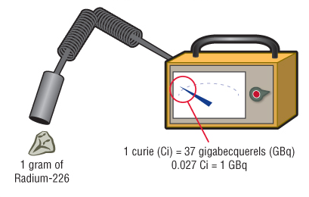
Radioactivity is measured in two different units.

Slide 22
Different terms are used to express and measure radiation doses and exposure.
Roentgen (R)
Radiation absorbed dose (rad)
Roentgen equivalent in man (rem)
Sievert
Counts per minute (cpm)

Slide 23
Biological limits and values can be more difficult to measure.
Incubation period
Infectious dose (ID)

Slide 24
Learning Objective 4
Differentiate between risk and harm.

Slide 25
Haz mat techs must weigh possible risks and benefits in any action.
Risk vs. Harm
Exposure
Life Safety
Benefits
Reduced risk
Rewards
✓ IFSTA Principles of Risk Management
✓ Risk/benefit assessment

Slide 26
REVIEW QUESTION
What is the relationship between risk and harm?

Slide 27
Learning Objective 5
Explain medical monitoring and exposure reporting.

Slide 28
Procedures for medical surveillance and exposure reporting come from several laws and regulations.
29 CFR 1910.120 Hazardous Waste Operations and Emergency Response
Environmental Protection Agency policy
National Fire Protection Agency® (NFPA®)
NFPA® 1500, Standard on Fire Department Occupational Safety and Health Program
NFPA® 1582, Standard on Comprehensive Occupational Medical Program for Fire Departments
IAFC and IAFF Health and Wellness Initiative

Slide 29
Medical surveillance and exposure reporting occurs in four phases.
Preemployment
Pre- and Post-Entry Medical Monitoring
Immediate Care
Post-Exposure Monitoring

Slide 30
REVIEW QUESTION
What types of testing and monitoring should be performed before employment, before and after entry, and after exposure?

Slide 31
Summary
A safe haz mat response begins well before the emergency is reported. Preplanning will help responders identify what products may be common to the area and what toxic effects may have.

Slide 32
Summary
Emergency responders must also make smart decisions during the response. The use of a risk/benefit analysis will allow personnel to make solid decisions.
Medical monitoring will help keep all response personnel safe. This monitoring starts with preemployment and continues until after the response.

