Slide 1
Ground Ladder Placement

Slide 2
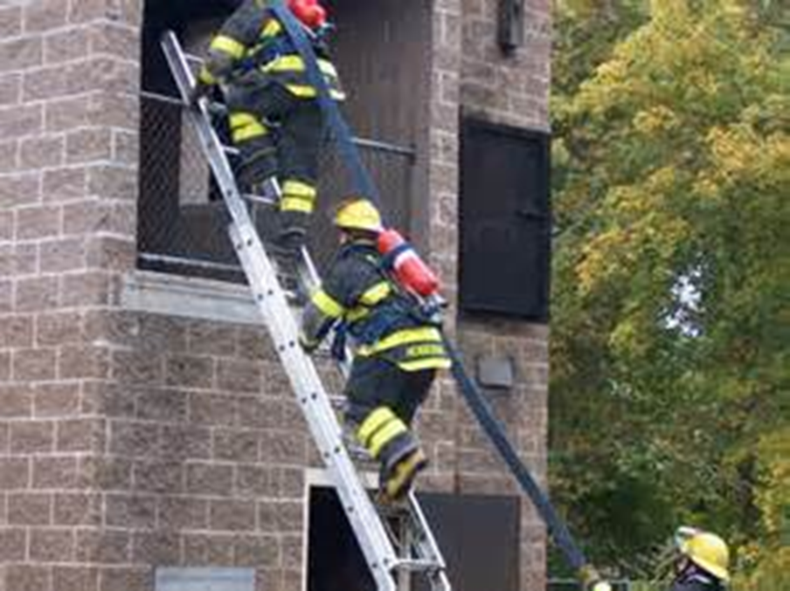
Ground Ladder Placement
Introduction
Objectives

Slide 3
The IC considers several factors when deciding where to place the ladder.
Needs of situation
Ladders available
Assigned task
Location of overhead obstructions
Structural features
Wind direction, velocity
Topography of area

Slide 4
Ladder selection also requires other important information.
Working on roof, upper story
Must have two means of escape
Selecting ladder requires ability to judge distances
Know averages for residential and commercial story

Slide 5
There are several guidelines to use for ladder length selection.
Extend ladder beyond roof edge
Tip placement for access or ventilation
Tip placement for rescue from window opening

Slide 6
A ladder’s reach is not the same as the designated length.
Less when set at 75 degrees for climbing
NFPA® 1931 requirements for single, roof, folding
Extension – May be as much as 6 inches (150 mm) less
Lengths of 35 feet (11 m) or less – One foot (300 mm) less
Lengths over 35 feet (11 m) – Two feet (600 mm) less

Slide 7
Acronym
Summary
Application
Evaluation

