Slide 1
Flashover Basics

Slide 2
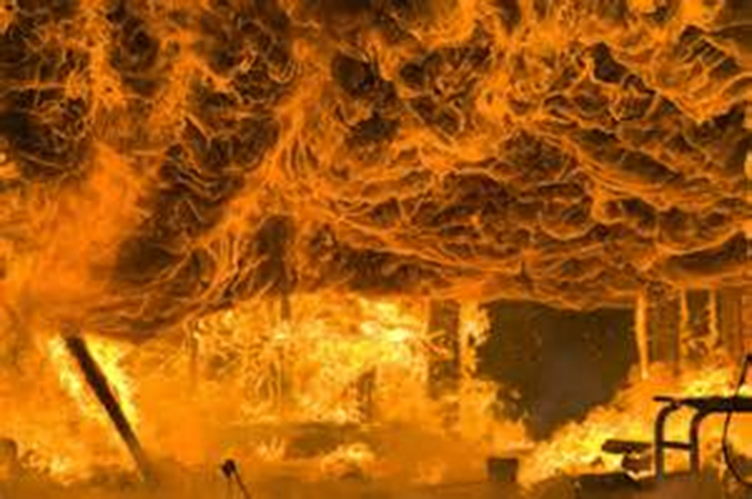
Flashover Basics
Introduction
Objectives

Slide 3
Rapid fire development is responsible for numerous deaths and injuries.
Protect yourself and your crew
Recognize indicators
Know conditions created by
Determine best action to take before

Slide 4
Flashover occurs when combustible materials in a compartment ignite almost simultaneously.
Typically occurs during growth stage – May occur during fully developed stage
Environment of room changes from two-layer condition to single well mixed, untenable hot gas condition
Transition between pre-flashover to post-flashover can occur rapidly
Conditions during
Volume of fire can increase to fill entire room
Burning gases push out of openings

Slide 5
There are several common elements in flashover to be aware of.
Transition in fire development
Rapidity
Compartment
Ignition of exposed surfaces

Slide 6
Progression to a flashover is determined by two factors.
Sufficient fuel, heat release rate
Ventilation – Must have sufficient oxygen

Slide 7
Firefighters should be aware of several flashover indicators.
Building
Airflow
Heat
Smoke
Flame
Rollover

Slide 8
Acronym
Summary
Application
Evaluation

