Slide 1
Firefighting Methods

Slide 2
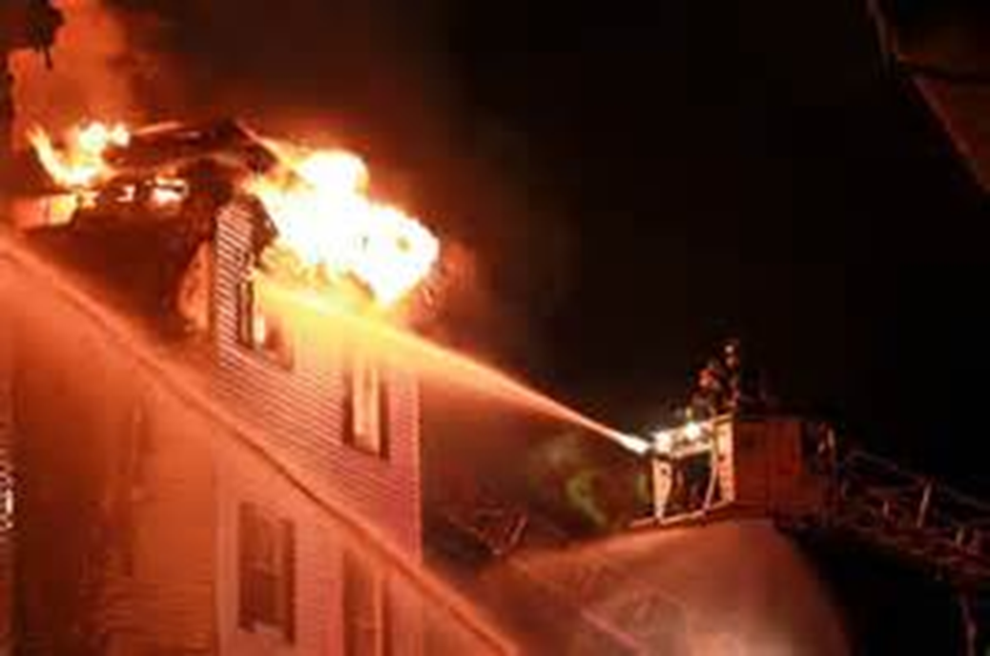
Firefighting Methods
Introduction
Objectives

Slide 3
Firefighters can influence fire behavior through temperature reduction.
Cooling with water most common method
Water used to control burning gases, reduce temperature of products of combustion
Water has greatest effect when converted to steam
Control steam production

Slide 4
Firefighters can influence fire behavior through fuel removal.
Simplest – Allow to burn until all is consumed
May allow fire to burn – Minimize groundwater pollution
Other methods

Slide 5
Oxygen exclusion reduces a fire’s growth and may extinguish it over time.
Methods – Will not work if fuel is self-oxidizing
Closing doors can limit air supply, help prevent flashover

Slide 6
Chemical flame inhibition uses agents to interrupt the combustion reaction.
Effective on gas, liquid fuels
Do not easily extinguish nonflaming fires
Not practical for smoldering fires

Slide 7
Acronym
Summary
Application
Evaluation

