Slide 1
Firefighter Fatalities, Injuries, and Illness

Slide 2
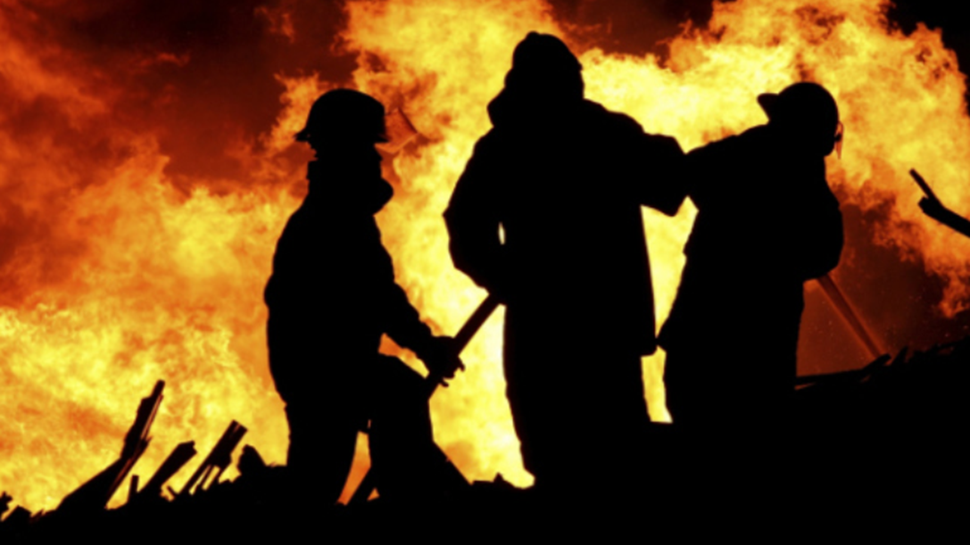
Firefighter Fatalities, Injuries, and Illness
Introduction
Objectives

Slide 3
Firefighter fatalities are caused by a variety of situations.
Leading causes
Stress or overexertion
Motor vehicle accidents
Remaining causes
Falls
Being struck by an object
Being trapped in structure fire
Gunshot wounds while tending medical patient

Slide 4
Firefighter injuries occur both on the fireground and at nonfire emergencies.
Main types
Strains and sprains
Cuts and bruises
Other
During training
Responding to or returning from incidents
Nonemergency incidents
Other on-duty activities

Slide 5
You must be aware of and protect yourself from certain chronic illnesses.
Cardiovascular diseases
Cancer
Respiratory diseases
Obesity
(Cont.)

Slide 6
You must be aware of and protect yourself from certain chronic illnesses.
Stress-induced hypertension
Tobacco use/ dependence
Exposure- related disease
Diabetes
Drug and alcohol use

Slide 7
Acronym
Summary
Application
Evaluation

