Slide 1
Victim Removal

Slide 2
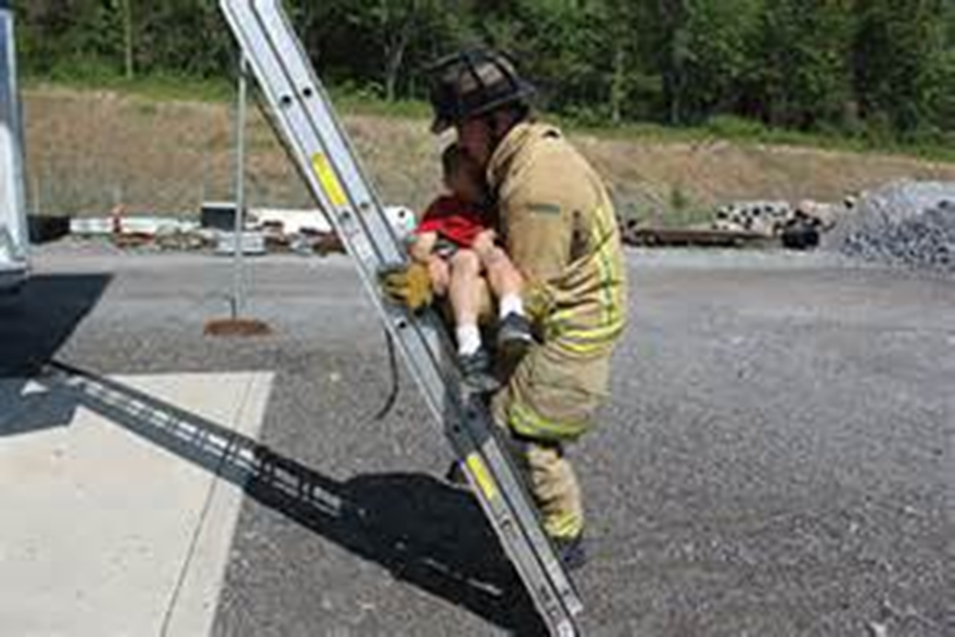
Victim Removal
Introduction
Objectives

Slide 3
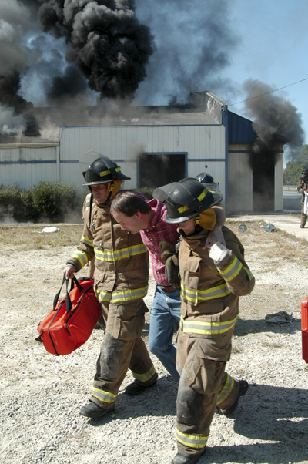
Many occupants can evacuate with little or no assistance from firefighters.

Slide 4
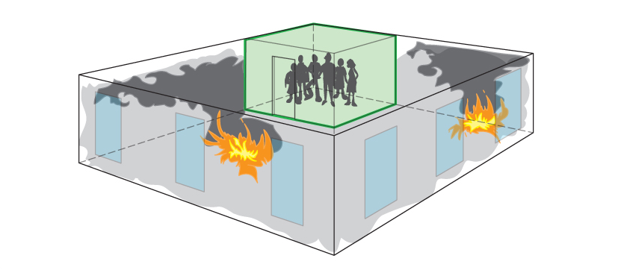
Use shelter-in-place method only in certain circumstances.

Slide 5
When rescue efforts are required, firefighters may have to take specific actions.
Extinguish fires preventing exit
Provide alternate exit
Remove debris
Carry injured victims

Slide 6
Improper lifting techniques can result in both victim and firefighter injury.
Straight back, lift with legs
One or more rescuers
Follow safety guidelines
Avoid hazard zones while with victim

Slide 7
Use the drag or lift/carry technique appropriate to the situation.
Incline drag
Webbing drag
Cradle-in-arms lift/carry
Seat lift/carry
Moving victims onto a litter
Extremities lift/carry

Slide 8
Acronym
Summary
Application
Evaluation

