Slide 1
Transfer of Heat

Slide 2
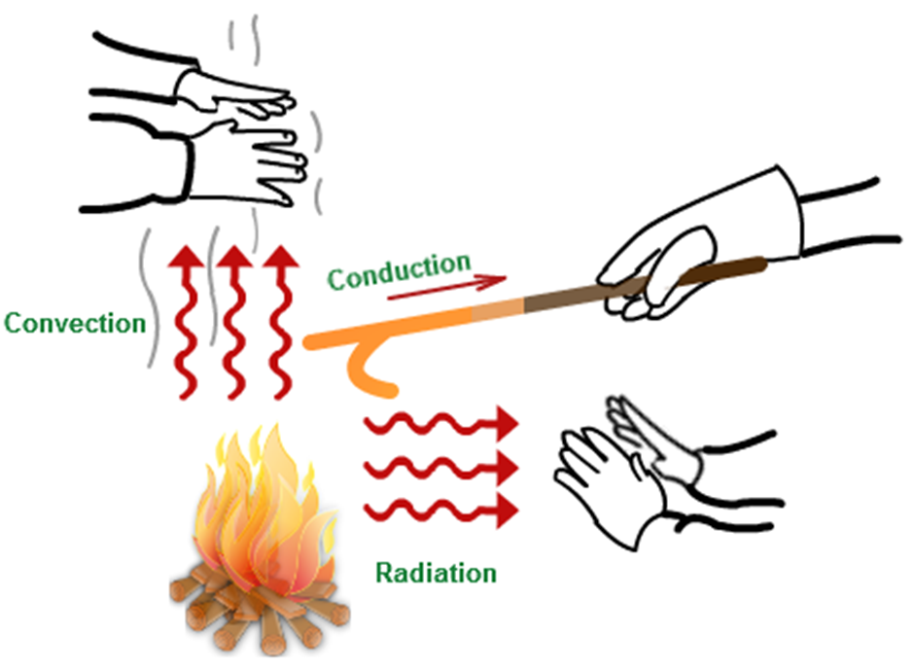
Transfer of Heat
Introduction
Objectives

Slide 3
Understanding the concept of heat transfer can help in several ways.
Understand transfer from initial fuel package to others
Estimate size of fire before attacking – Evaluate effectiveness of attack
Transfer occurs from warmer to cooler – Same temperature cannot transfer

Slide 4
The concept of transfer rate is influenced by several factors.
Related to temperature differential – Thermal conductivity
Greater temperature difference – Greater transfer rate
Heat flux

Slide 5
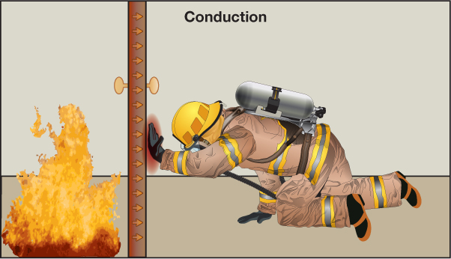
Conduction is the transfer of heat through and between solids.

Slide 6
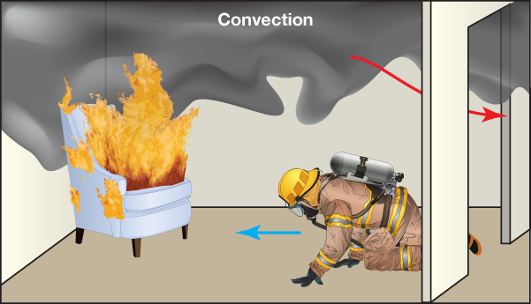
Convection is the transfer of thermal energy by circulation or movement of fluid (liquid or gas).

Slide 7
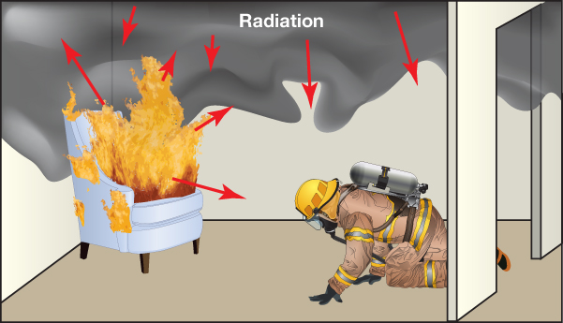
Radiation is the transmission of energy as an electromagnetic wave, without an intervening medium.

Slide 8
Acronym
Summary
Application
Evaluation

