Slide 1
Size-up

Slide 2
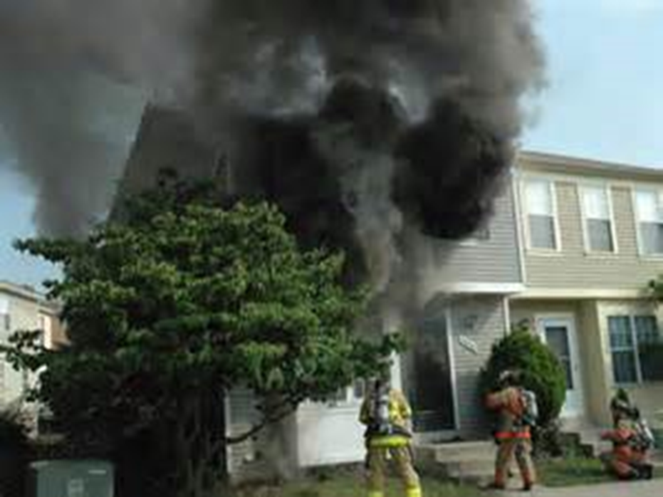
Size-up
Introduction
Objectives

Slide 3
Firefighters should take every opportunity to observe building layout.
Residential dwellings
Other structures in response area
Zoning meetings, open houses, and building officials

Slide 4
Size-up is a matter of safety for all personnel at an emergency incident.
Officer in Charge
All personnel
First Firefighter on scene
What has happened?
What is happening?
What is going to happen?

Slide 5
Use situational awareness at all times to keep all firefighters safe.
Begins at arrival
Communication
Courtesy of Bob Esposito

Slide 6
Use your senses after entering a structure to increase your situational awareness.
Sound floor before advancing
Feel wall, door with back of hand
Watch for color of smoke
Listen to sounds that indicate fire becoming more intense

Slide 7
Acronym
Summary
Application
Evaluation

