Slide 1
Escape

Slide 2

Escape
Introduction
Objectives

Slide 3
Follow these general safety guidelines when escaping a structure.
Stay calm
Maintain control of nozzle
Use points of reference
Stay low
(Cont.)

Slide 4
Follow these general safety guidelines when escaping a structure.
Keep contact with wall
Stay in radio contact
Remember which level of structure you’re on
Control your breathing
Check and report on air supply

Slide 5
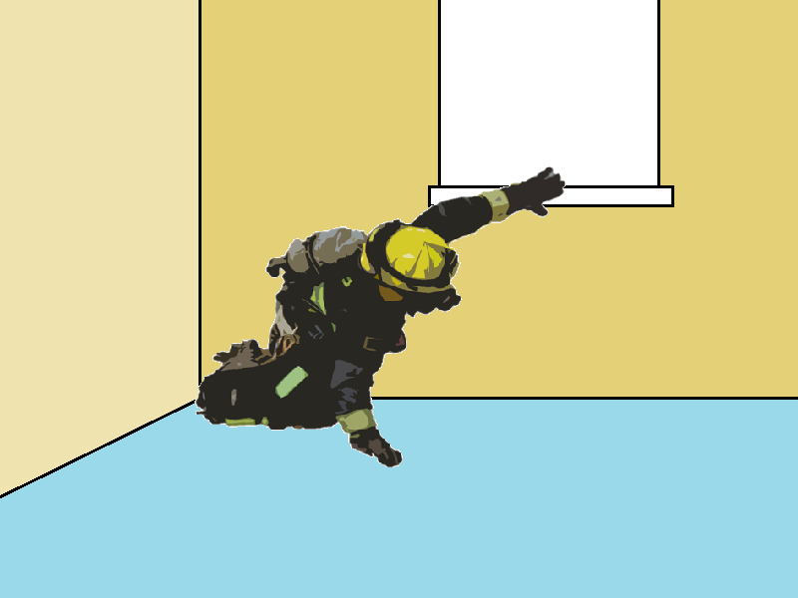

Follow these steps to search for an exit.
3. Sweep wall with other hand for window
4. Determine if window allows exit
5. Notify Command, ask about conditions
2. Sweep floor with one hand
1. Locate wall, crawl

Slide 6

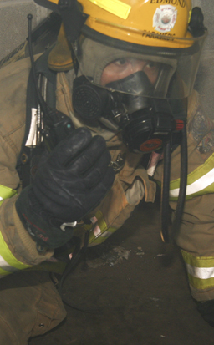
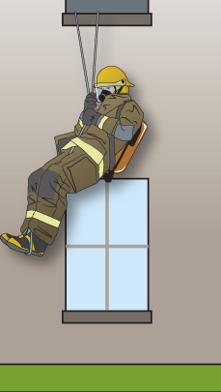
If on an upper story, follow these steps to exit a window.
Courtesy of Chris Mickal/District Chief, New Orleans (LA) FD Photo Unit
1. Find out if aerial or ground ladder is nearby
2. If not, report location and need for egress
3. Escape rope system if trained

Slide 7
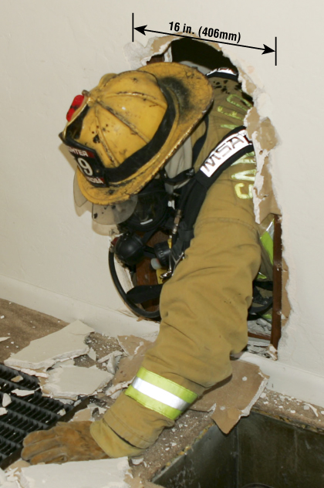
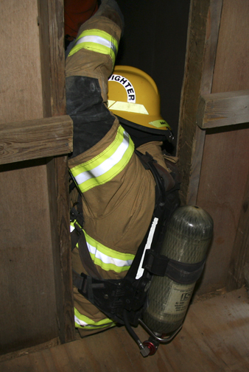
Breaching an interior wall may provide an exit route, but should be used only as a last resort.

Slide 8
Acronym
Summary
Application
Evaluation

