Slide 1
Search Techniques

Slide 2
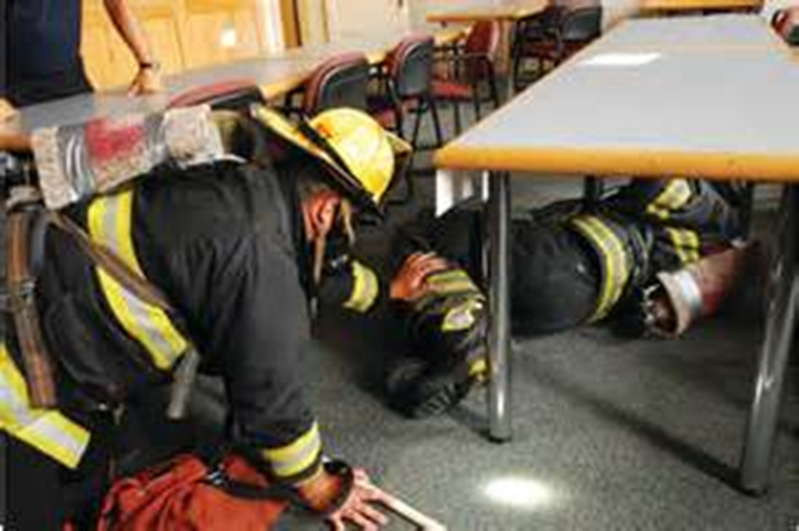
Search Techniques
Introduction
Objectives

Slide 3
How firefighters move during search depends on conditions.
Walk if possible
Crawl in extreme heat and smoke
Using stairs

Slide 4
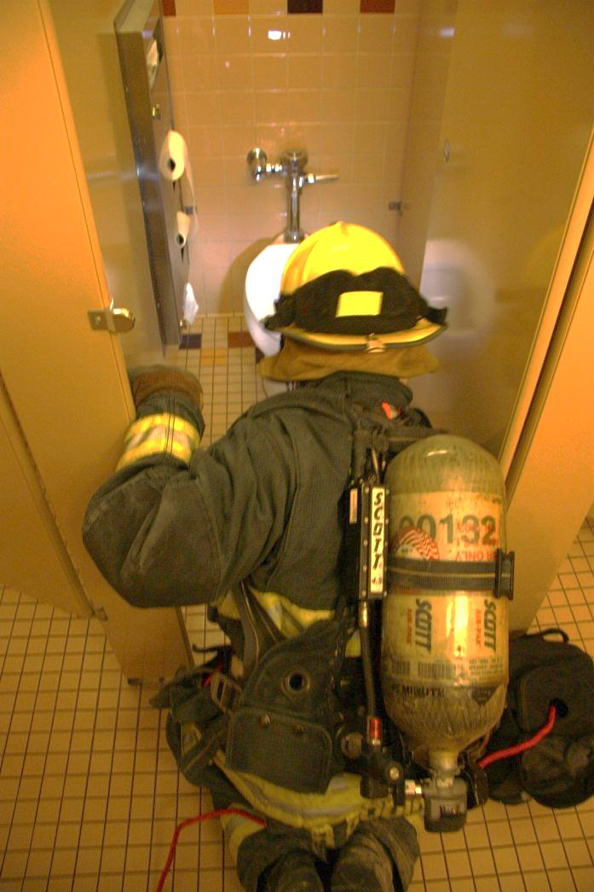
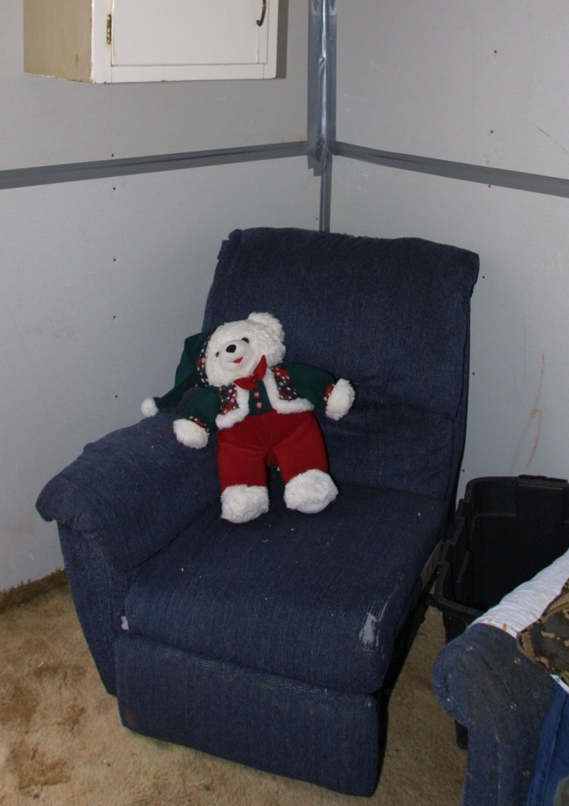
Victims may seek shelter from fire or be found in paths of egress.

Slide 5
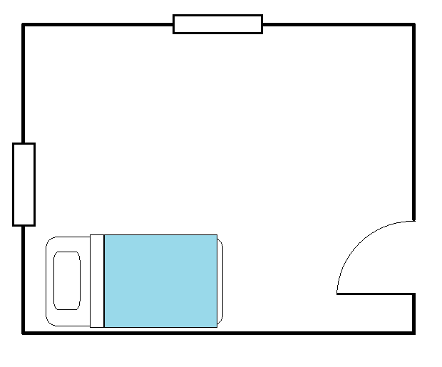


Search the perimeter and check where occupants may be overcome with smoke while attempting escape.
Floor below windows
Above & below beds and furniture
Behind doors

Slide 6




Place a tool against the wall and extend with arm or leg to search the middle of the room.

Slide 7
Remember the following actions while conducting structural searches.
Maintain radio contact with supervisor, IC
Close doors unless ventilating
Clear unused equipment from exit paths
Report progress and new information

Slide 8
Acronym
Summary
Application
Evaluation

