Slide 1
SCBA Components

Slide 2
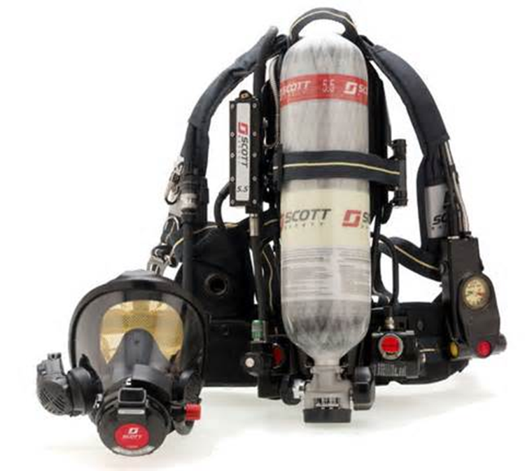
SCBA Components
Introduction
Objectives

Slide 3
Open-circuit SCBA consists of four basic components.
1. Backplate and harness assembly
(Cont.)

Slide 4
Open-circuit SCBA consists of four basic components.
2. Air cylinder assembly
(Cont.)

Slide 5
Open-circuit SCBA consists of four basic components.
3. Regulator assembly
(Cont.)

Slide 6
Open-circuit SCBA consists of four basic components.
4. Facepiece assembly

Slide 7
Additional components of SCBA provide safety features.
End-of-service-time indicator (ESTI)
Rapid intervention crew universal air coupling (RIC UAC) and remote pressure gauge
Courtesy of Kenneth Baum

Slide 8
Acronym
Summary
Application
Evaluation

