Slide 1
Safe Vehicle Operations

Slide 2
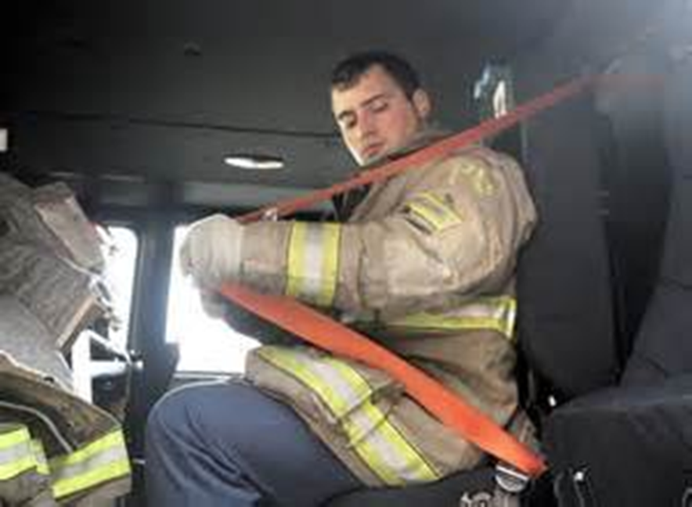
Safe Vehicle Operations
Introduction
Objectives

Slide 3
Apparatus and vehicle safety begins with awareness and responsibility.
Causes of Collisions
Improper backing
Responsibilities
Proper backing
Excessive speed
Lack of driving skill/experience
Reckless driving
Poor design or maintenance
Follow speed limits
Be aware
Proper maintenance
Wear seat belts
Restrict cell phone use

Slide 4
Safe vehicle operation requires situational awareness.
Situational awareness
Be aware of surroundings
Be aware of your conditions
Physical, mental, emotional
Drive defensively
Anticipate hazards
Anticipate hazards
Develop strategies

Slide 5
You must remember and use safety rules during emergency responses.
Before leaving station
While en route

Slide 6
Nonemergency operations require you to follow safety guidelines also.
Always use spotter when backing
Defensive driving
Do not ride on exterior
Avoid/combat skids
Courtesy of Pat McAuliffe

Slide 7
Acronym
Summary
Application
Evaluation

