Slide 1
R.I.T.

Slide 2
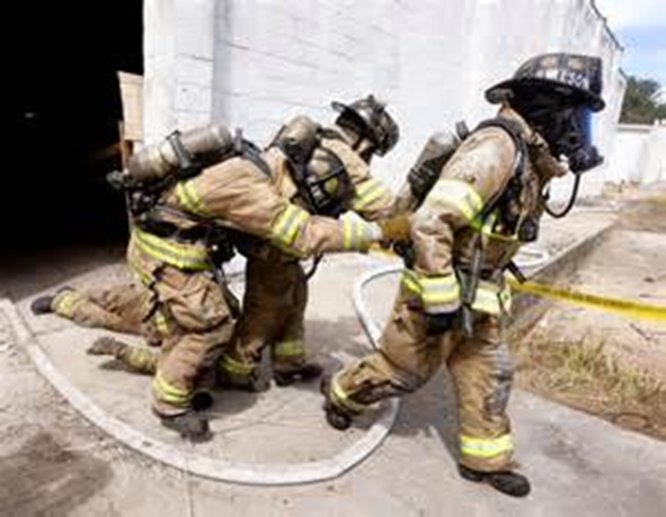
R.I.T.
Introduction
Objectives

Slide 3
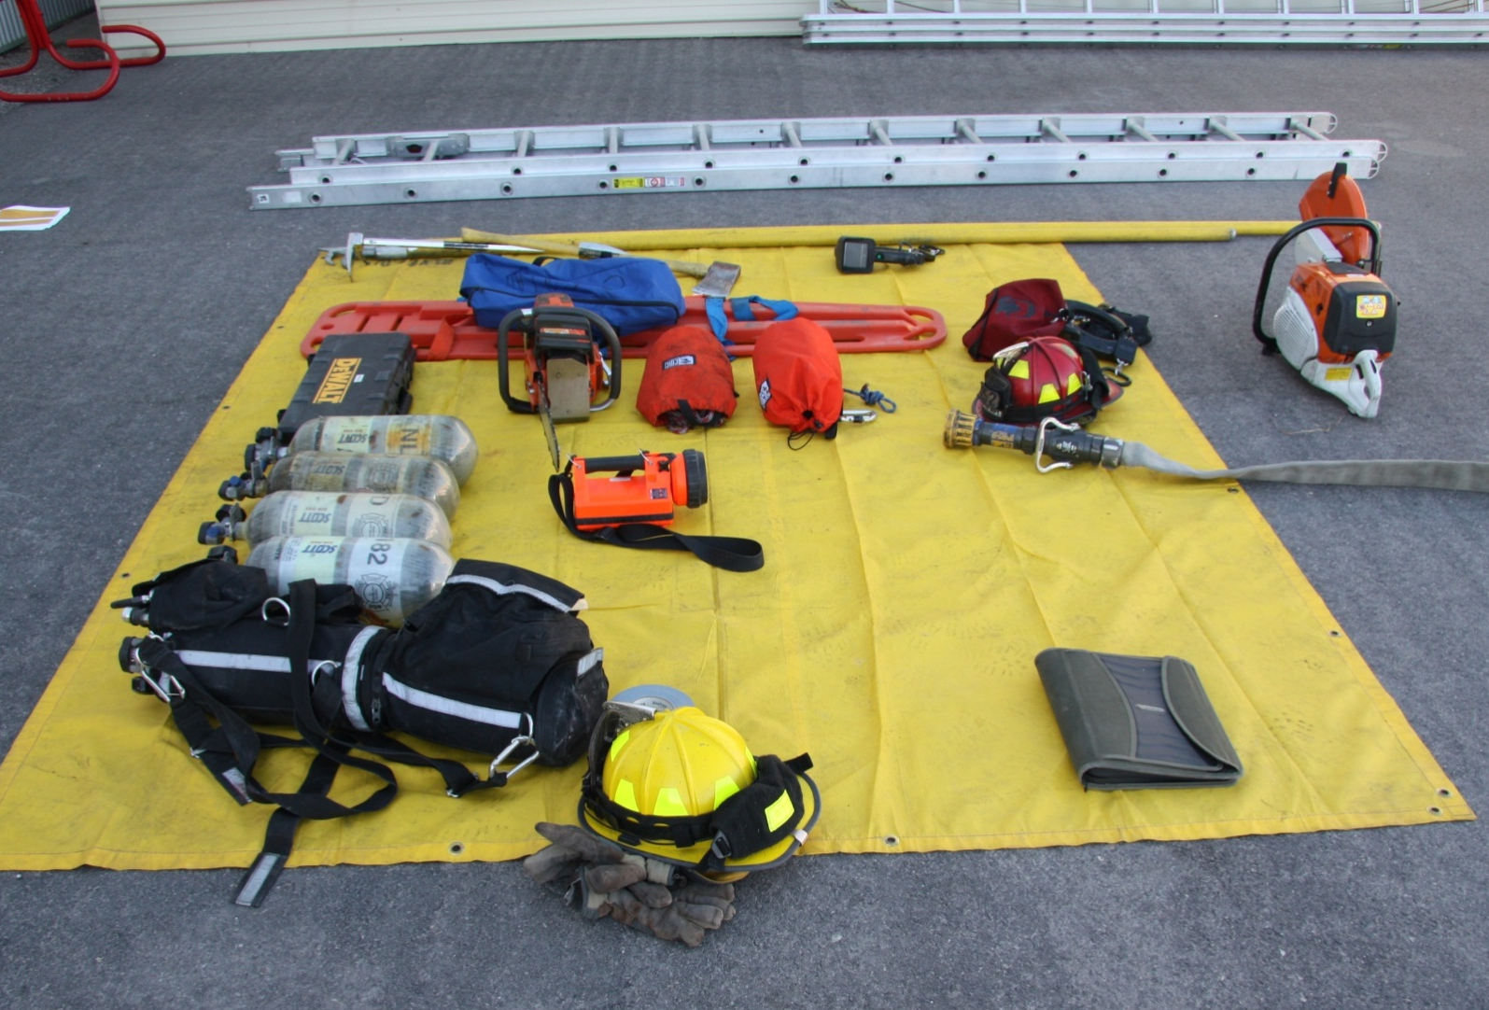
RIC/RIT carry a variety of tools with them.

Slide 4
RIC/RIT follow these steps after a MAYDAY transmission has been received.
Establish radio contact
IC may order brief shutdown to listen
If unsuccessful, follow hoseline, last known location
Stop frequently to listen for sound of PASS device or calls for help

Slide 5
After locating a downed firefighter, RIC/RIT take the following actions.
1. Check air supply
2. Deactivate PASS device
3. Confirm identity

Slide 6
RIC/RIT then notifies Command of the location and status of downed firefighter.
4. Request assistance if necessary
5. Mitigate any hazards
6. Move to safe shelter if necessary

Slide 7
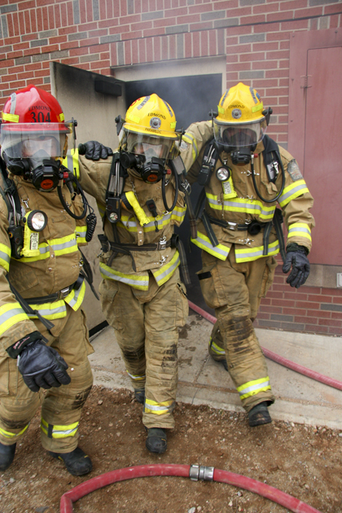
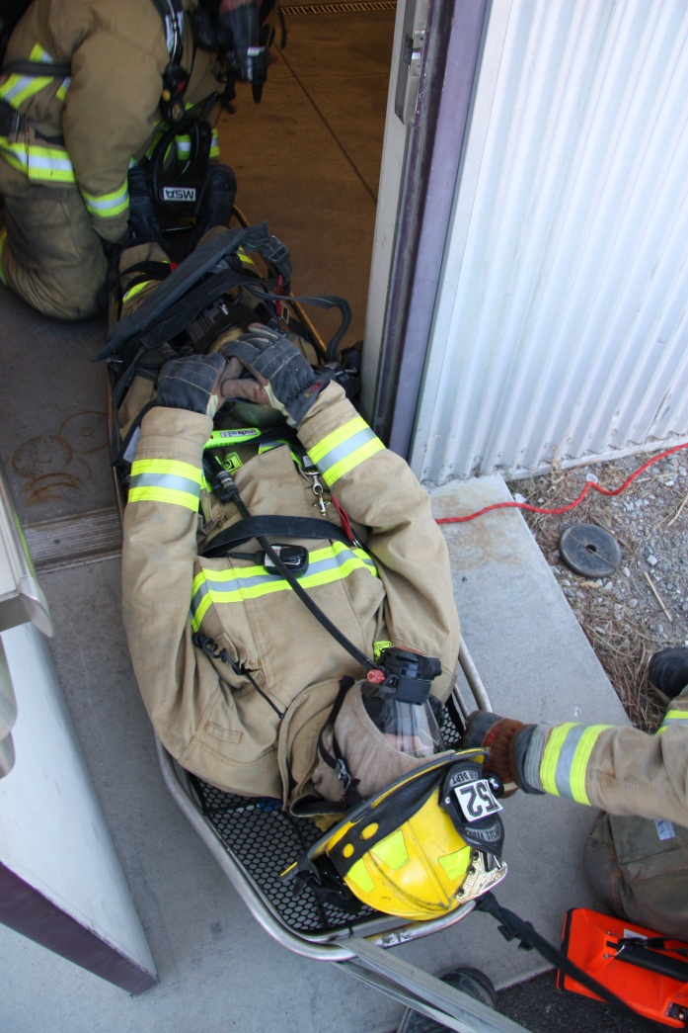
Exiting IDLH area usually takes priority over stabilizing injuries.

Slide 8
Acronym
Summary
Application
Evaluation

