Slide 1
Respiratory Hazards

Slide 2
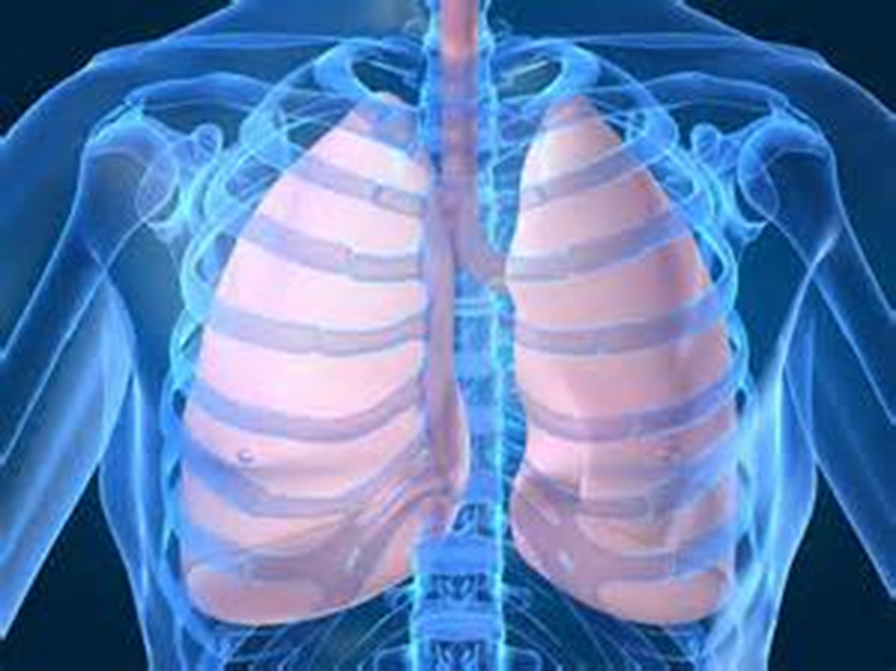
Respiratory Hazards
Introduction
Objectives

Slide 3
Respiratory hazards often occur in situations immediately dangerous to life and health (IDLH).
Common respiratory hazards
Particulate contaminants
Gases and vapors
Nonfire incidents
Airborne pathogens

Slide 4
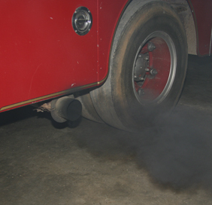
Particulate contaminants come from many sources and pose serious health risks.
APR unit
PAPR unit

Slide 5
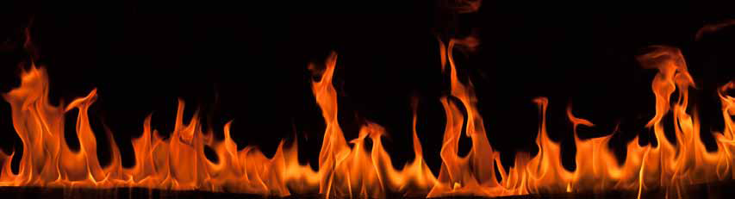
A variety of harmful gases and vapors can be formed by combustion.
Hydrogen Cyanide
Carbon Monoxide
Sulfur Dioxide
Carbon Dioxide
Formaldehyde
Hydrogen Sulfide
Hydrogen Chloride
Nitrous gases
Phosgene
Ammonia

Slide 6
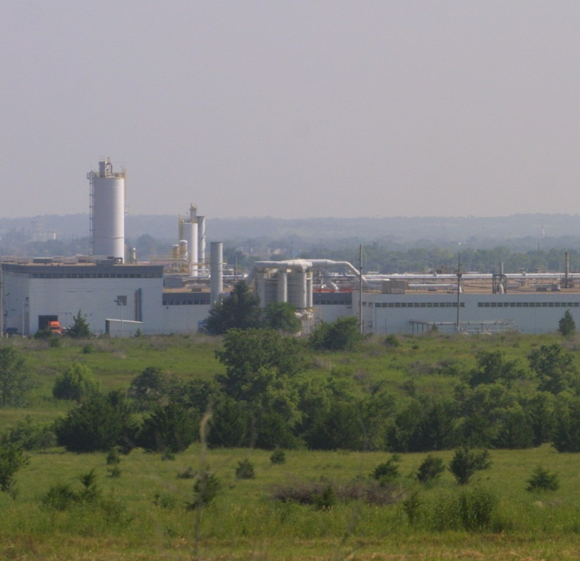
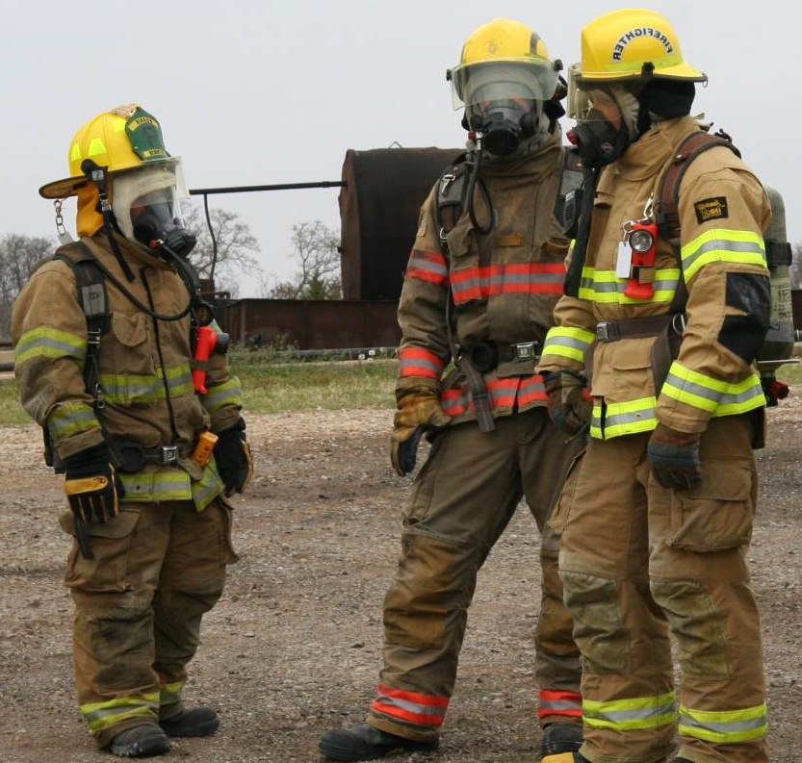
Nonfire incidents can also produce dangerous gases and vapors.
Keep distance
Wear SCBA

Slide 7
Airborne pathogens are disease-causing microorganisms suspended in air.
HEPA filters
Medical masks

Slide 8
Acronym
Summary
Application
Evaluation

