Slide 1
Properties of Liquid Fuels

Slide 2
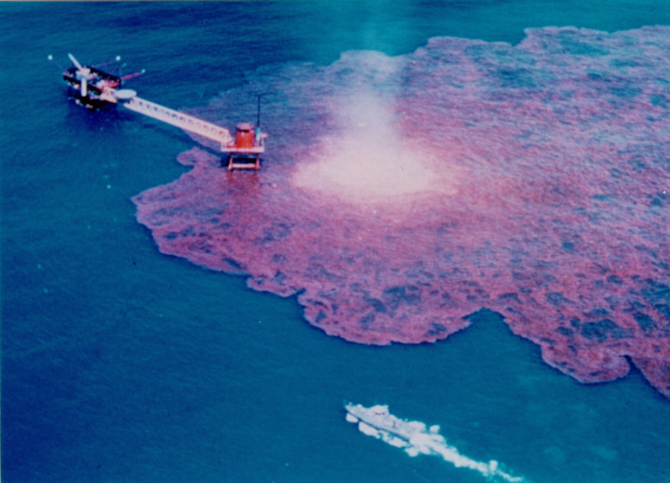
Properties of Liquid Fuels
Introduction
Objectives

Slide 3
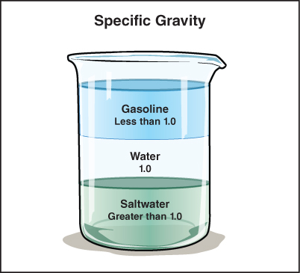
The properties of liquid fuel are important to understand.
Mass, volume but no shape
Will not expand to fill all of container
Will flow downhill, can pool in low areas

Slide 4
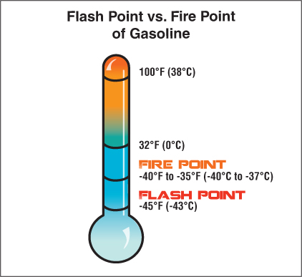
Vaporization is the transformation of a liquid to a vapor or gaseous state.
Flammable liquids with high vapor pressure present special hazard

Slide 5
Solubility is a factor to consider regarding liquid fuels.
Solubility – Extent to which substance will mix with water
Miscible – Mix in any proportion
Hydrocarbon – Do not mix
Polar solvents – Readily mix

Slide 6
Density is also a factor to consider regarding liquid fuels.
Fuel will not mix with water – Adding may disperse burning liquid
Extinguish with appropriate agent
Water-soluble mix with agent – Become less effective
Avoid use with foams specifically designed for polar solvents
Liquids less dense than water difficult to extinguish with water alone

Slide 7
Acronym
Summary
Application
Evaluation

