Slide 1
Portable Extinguisher Classifications

Slide 2
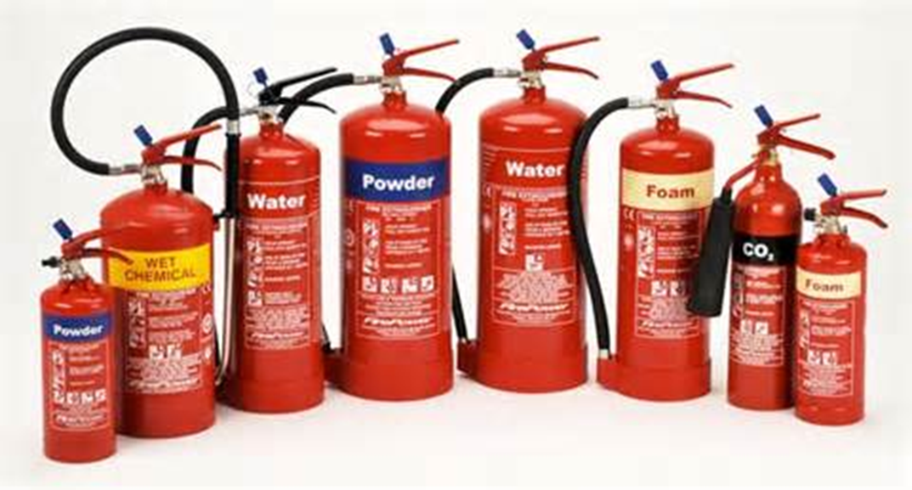
Portable Extinguisher Classifications
Introduction
Objectives

Slide 3
Portable fire extinguishers are chosen based on the type of fuel burning.
Class A
Class B
Class C
Class D
Class K

Slide 4
Class A fires involve ordinary combustibles.
Fuel
Textiles
Paper
Plastics
Rubber
Wood
Extinguished with:
Water
Water-based agents (Class A foam)
Dry Chemicals

Slide 5
Class B fires involve flammable, combustible liquids and gases.
Fuel
Alcohol
Gasoline
Lubricating Oils
Liquefied petroleum gas (LPG)
Extinguished with:
Carbon Dioxide
Dry Chemicals
Class B Foam

Slide 6
Class C fire involves energized electrical equipment.
Treat as Class A or B once power is off

Slide 7
Class D fires involve combustible metals and alloys.
Lithium
Magnesium
Potassium
Sodium

Slide 8
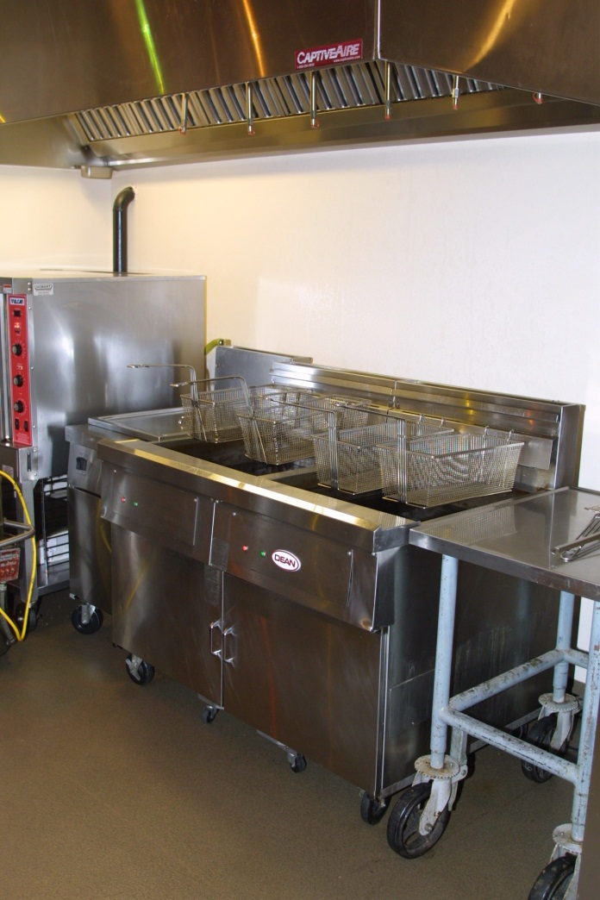
Class K fires involve combustible cooking oils.
Vegetable or animal fats
Burn at extreme temperatures
Found at commercial, institutional, industrial, home
Controlled by wet chemical systems, portable extinguishers

Slide 9
Acronym
Summary
Application
Evaluation

