Slide 1
Organization of Fire Departments

Slide 2
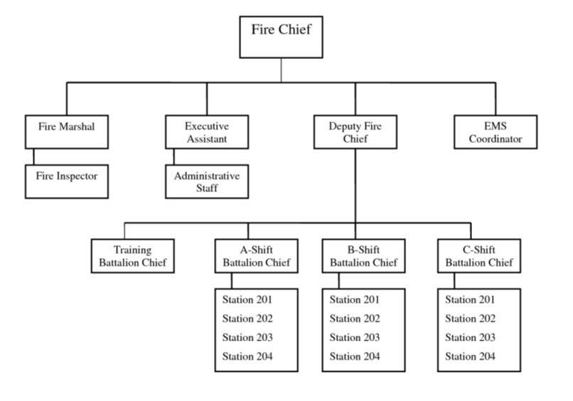
Organization of Fire Departments
Introduction
Objectives

Slide 3
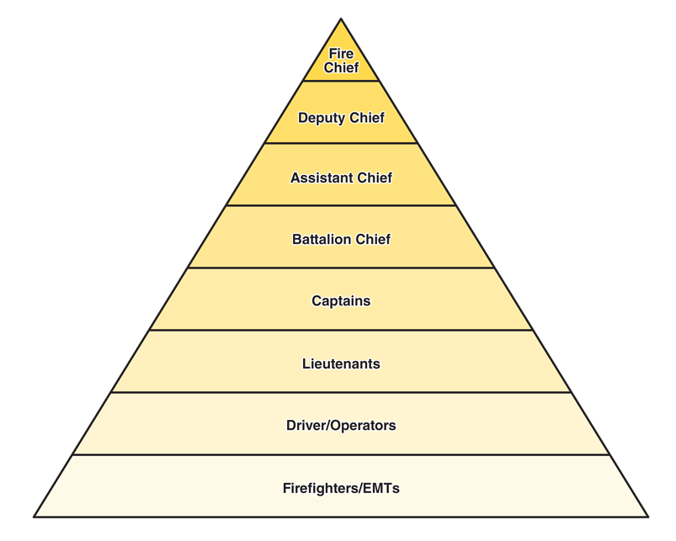
Department organization is based on a system of rank tied to specific duties.

Slide 4
Fire department types are determined by how the organization is funded.
Public
Private

Slide 5
Types of staffing vary based on funding and duties assigned at the station.
Career
Volunteer
On-call
Combination

Slide 6
Departmental duties are separated based on who personnel support.
Line personnel
Directly to external customers
Staff personnel
Support line personnel
Courtesy Bob Espositio

Slide 7
Acronym
Summary
Application
Evaluation

