Slide 1
MAYDAY

Slide 2
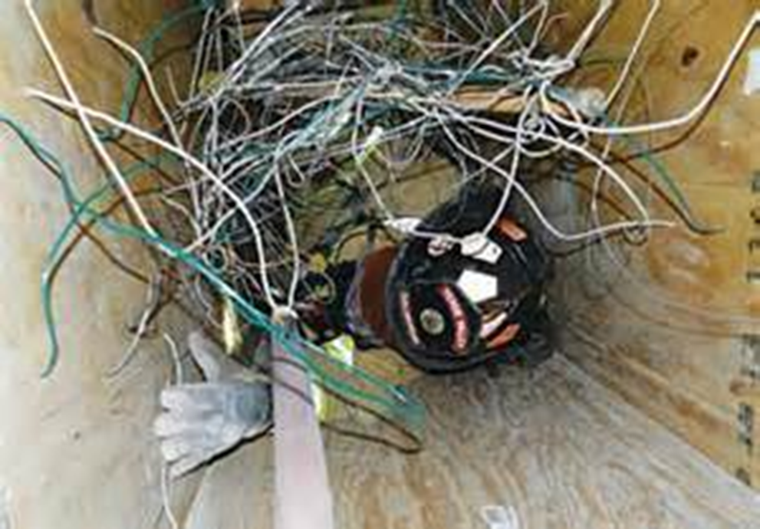
MAYDAY
Introduction
Objectives

Slide 3
Recognizing MAYDAY situations is vital to firefighter survival.
Air emergencies
Lost or disoriented
Entanglement
Courtesy of Iowa State
Fire Training Bureau
?
(Cont.)

Slide 4
Immediate communication increases the chance of survival.
1. Describe problem
2. Give location
3. Remain in place
If in immediate danger:
1. Transmit MAYDAY
2. Activate PASS 3. Communicate with IC

Slide 5
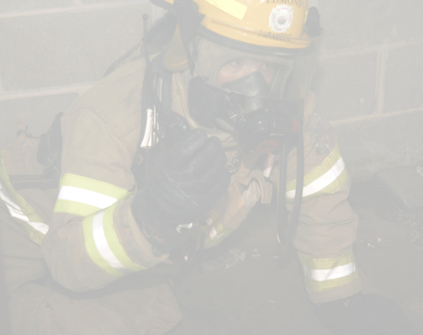
Use the acronym LUNARS to remember what information to communicate.
Location
Unit
Name
Assignment
Resources needed
Situation

Slide 6
Take the following actions whenever a MAYDAY is broadcast.
1. MAYDAY radio traffic only
2. Radio channel allocated for MAYDAY
3. Nonessential activities cease and search begins
4. RIC/RIT dispatched

Slide 7
Listen closely to radio transmissions being made.
May be able to assist downed firefighter nearby
Follow orders, do not freelance
IC may order personnel to exit
Must recognize department evacuation signals

Slide 8
Acronym
Summary
Application
Evaluation

