Slide 1
Impact of Fire on Wood & Masonry

Slide 2
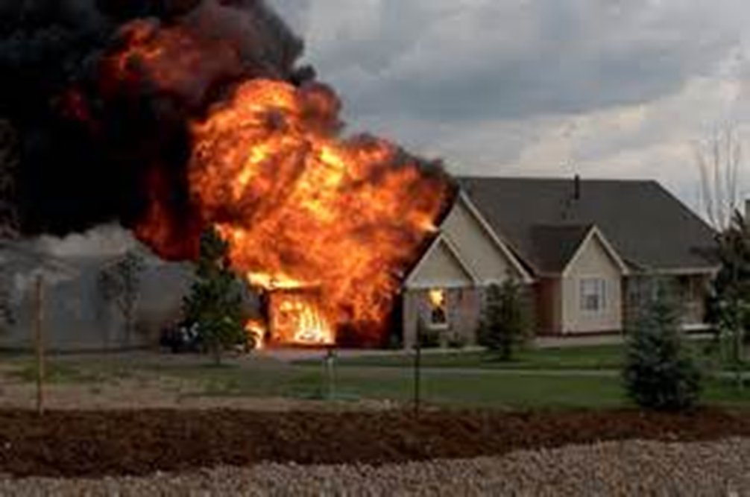
Impact of Fire on Wood & Masonry
Introduction
Objectives

Slide 3
A wide variety of building materials are used in construction.
All react differently to heat of fire
Knowing reaction can help
Courtesy of Ron Moore and
McKinney (TX) FD

Slide 4
Wood is the most common material used in North America.
Also main component in structural assemblies

Slide 5
The size and moisture content of wood affects how it reacts to fire.
Small vs. large dimensions
Moisture and burn rate
New vs. old construction

Slide 6
Each type of masonry shows signs of deterioration in different ways.
Brick
Stone
Concrete/
Concrete Block
Courtesy of Ron Moore and
McKinney (TX) FD

Slide 7
Acronym
Summary
Application
Evaluation

