Slide 1
Backdraft Basics

Slide 2
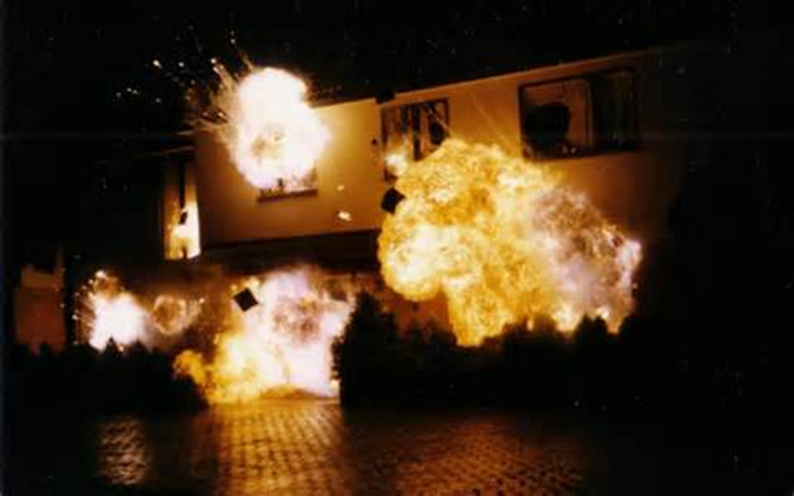
Backdraft Basics
Introduction
Objectives

Slide 3
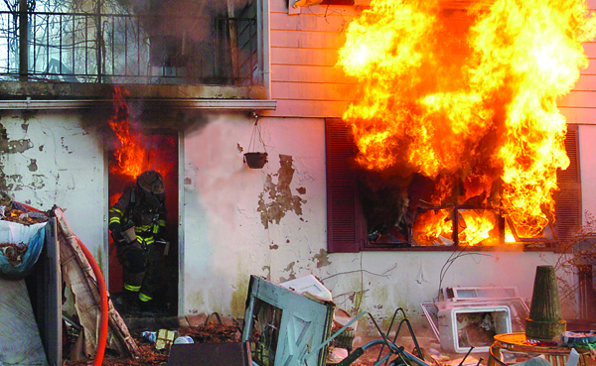
Backdraft is a change in ventilation that results in explosively rapid combustion of flammable gases.
Courtesy of Bob Esposito

Slide 4
Firefighters should know about several backdraft indicators as well.
Building
Smoke
Airflow
Heat
Flame

Slide 5
Backdraft effects vary depending on several factors and will not always occur immediately after the opening is made.
Factors
Volume of smoke
Not always occur immediately
If mix of hot flammable products, air is slow – Unlikely to occur
Violence depends on
Extent of confinement
More confined – More violent
Degree of confinement
Pressure
Speed with which fuel and air are mixed
Location where ignition occurs
May not occur until air is fully introduced

Slide 6
A smoke explosion may occur before or after the decay stage as unburned fuel gases contact an ignition source.
Cooling smoke can accumulate in other areas, mix with air
Violent because involve premixed fuel, oxygen
Smoke
Generally cool – Less than 1,112º F (600º C)
Located in void spaces or uninvolved areas

Slide 7
Acronym
Summary
Application
Evaluation

