Slide 1
Fire Inspection and Code Enforcement
8th Edition Inspector II
Chapter 15 — Plans Review and Field Verification

Slide 2
Learning Objective 1
Explain the impact of local codes and ordinances on the plans review process.

Slide 3
Reviewing documents and issuing permits are official government acts.
Many agencies use third-party agencies to assist with construction document review
In this instance, they should coordinate the review with the fire department to make sure locally adopted statutes and codes are addressed
Many plans review agencies publish a process guide that outlines the plans review process
Individuals can review a copy and ask questions before they submit applications
Courtesy of Rich Mahaney

Slide 4
Understand the general steps in the plans review process.
Application and Submittal
Building owner, design professional, or contractor acquires an application form from the jurisdiction and completes it
Completed application, with complete construction documents including drawings and specifications, is submitted
(Cont.)

Slide 5
Understand the general steps in the plans review process.
Review
Plans examiners from the building and fire departments review the documents
Note corrections or alterations needed to meet code requirements
(Cont.)

Slide 6
Understand the general steps in the plans review process.
Resubmittal
Plans review report is given to the design professional in charge
Owner/design professional/contractor may meet with the plans examiners or building official to discuss any needed changes
Documents are resubmitted for final review after corrections are made
(Cont.)

Slide 7
Understand the general steps in the plans review process.
Accept
Final set of plans and documents are stamped and signed to indicate official acceptance
Building department retains one copy
These plans are the official construction set used as the basis of inspection
Fire department retains one copy
One copy is returned to the owner, design professional, or contractor; must be kept at the construction site until the project is completed
(Cont.)

Slide 8
Understand the general steps in the plans review process.
Authorize
Permit to begin construction is issued for the specific site and project
Permit is usually required to be displayed at the construction site

Slide 9
Administrative chapter of the model building code contains specific provisions for permit applications.
Requirements
Legal address of the property
Intended use and occupancy
Description of the work to be done
Estimated value of the work
Other items as required by building officials
Local jurisdiction may require that contractors be bonded and licensed

Slide 10
Understand the importance of tracking project changes.
Clients may make minor revisions, called change orders
Plans examiners must maintain records of these communications for possible reference
Inspectors should be aware of all changes to the construction plans; inspect the project to verify that the changes are made as approved
In some locations, all changes made throughout the project must be collated into a single set of documents and submitted as a record set of construction documents for the project; known as an “as-built” set of documents

Slide 11
The local jurisdiction determines manner in which plans are handled or routed through the review process.
In some jurisdictions, building department examiners review the plans before plumbing, electrical, mechanical, or fire protection reviewers
There are times when this procedure is not best
Ideally, all plans for a project are submitted to the reviewing authority at the same time

Slide 12
Agencies that review construction documents may charge a fee.
Used to defray administrative costs associated with the review
Fees are established by ordinances and are similar to other municipal fees
Manner in which fees are determined varies with the jurisdiction

Slide 13
Submitted plans should have all information necessary to evaluate compliance with locally adopted code.
Help an inspector know what to expect during construction
All information must be clearly visible and not obscured because of the size or print quality of the drawing
Details may be required to be in a larger scale than the floor plan or elevation drawings

Slide 14
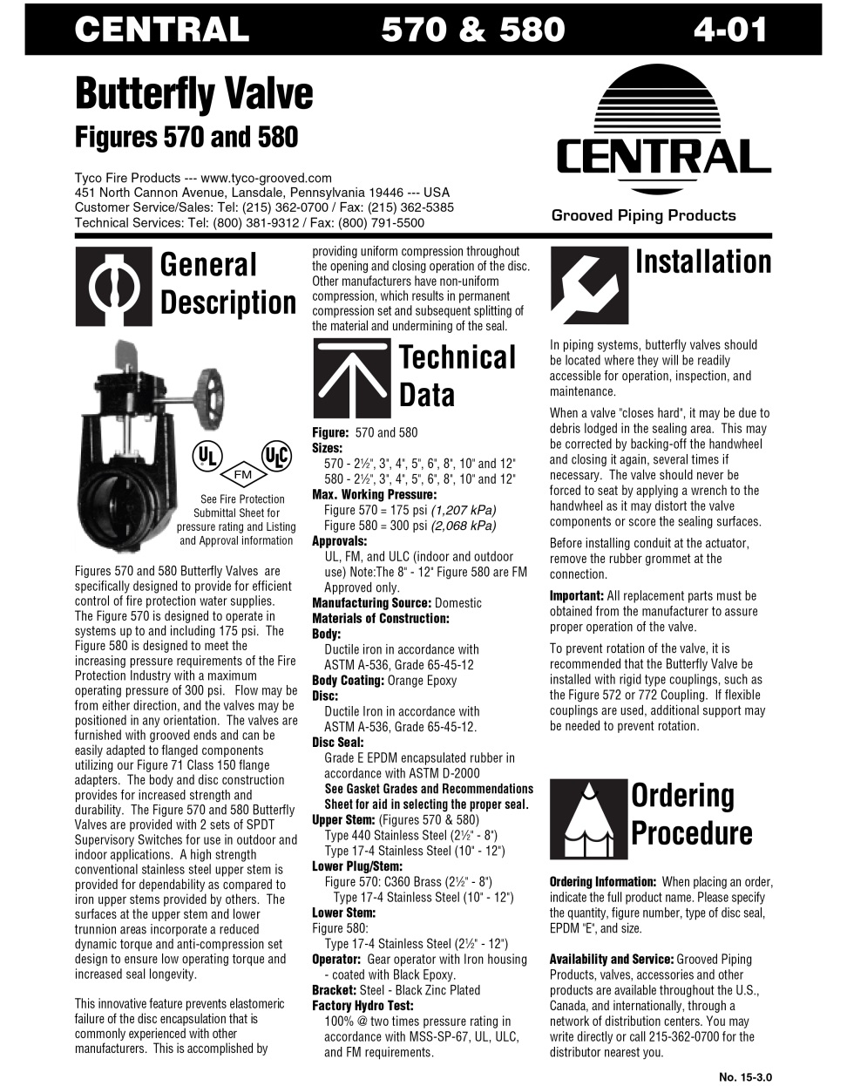
Know the different types of supporting documentation that may be required for review.
Hydraulic calculations
Material specifications
Safety data sheets (SDS)
Manufacturers’ product submittal information sheets; called cut sheets
Project manuals or specification books

Slide 15
REVIEW QUESTION
What are the general steps of the plans review process?

Slide 16
Learning Objective 2
Describe the different views for building construction plans.

Slide 17
Working drawings detail the design and building’s construction using four main views.
Plan
Elevation
Sectional
Detailed

Slide 18
Each of these drawings should have a title block that contains specific information.
Title of the drawing, such as Basement Floor Plan or Site Plan
Description of the project
Scale of the drawing; for example, 1/8” = 1’0”
(Cont.)

Slide 19
NOTE
Scaling the drawing provides a view in exact proportion to the actual size of the building. Sometimes the scale is placed on the drawing rather than in the title block. If a drawing is not to scale, there will be a note indicating that it is not. Copies of old drawings are often not drawn to scale.

Slide 20
Each of these drawings should have a title block that contains specific information.
Date the drawing was completed
Name of the firm producing the drawings
Name (usually initials) of the person who made the drawings; person responsible for checking the final drawings
Sheet number in the set
Design professional's official stamp or seal
Revision dates

Slide 21
Working drawings on commercial projects are typically divided into groups by individual discipline.
Architectural
Structural
Mechanical
Electrical

Slide 22
Inspectors need to understand plan views.
A two-dimensional view of the site or the building as seen from directly above the area
Provides information concerning the overall layout of the site or building
An inspector or plans examiner will commonly see two basic plan views: site and floor
Occasionally, ceiling and roof plans will also be submitted

Slide 23
Inspectors need to understand plan views.
Usually one of the first sheets of a set of construction drawings
Identifies conditions currently existing on the site
Relates information needed to locate the building

Slide 24
Know what information is usually found on a site plan.
North direction symbol
Usually points toward the top of the sheet
Often shown as a broken line with the dimensions expressed in feet (meters) and decimal fractions of a foot (meter)
Property lines are legal instruments that define the land boundaries
Lot dimensions
Location of the building in relation to the property line determines the fire-resistance rating of the exterior wall of the building
(Cont.)

Slide 25
Know what information is usually found on a site plan.
Utility lines
Shown as broken lines marked at intervals with a letter (gas, water, sewer, power, and communication)
In addition to the character in the broken line, a legend on the map also identifies the type of utility service line
(Cont.)

Slide 26
Know what information is usually found on a site plan.
Structures to be removed
Drawn with a light broken line
Brief identification of these structures and objects is also provided on the plan
(Cont.)

Slide 27
Know what information is usually found on a site plan.
Contour lines
Proposed contour lines show the planned elevations after grading is completed
Information is important when determining grade elevations for fire apparatus access to the site
Information is also useful in determining the ability of the fire department to place aerial apparatus and ground ladders for access to upper stories of a structure
Display the elevation of the property above sea level (ASL) or based on the elevation of the benchmark
(Cont.)

Slide 28
Know what information is usually found on a site plan.
Fire apparatus access
Will include width, turning radius, and load-bearing capacity
Locations for fire department connections (FDCs), hydrants, or aerial apparatus placement are shown
Illustrate the private road network serving one or more buildings on a property

Slide 29
Placing of the building on a site plan is called dimensioning.
Dimensions are usually placed some distance away from the shapes on the drawing through the use of extension lines
Dimensions are expressed in feet and inches (meters and millimeters)

Slide 30
REVIEW QUESTION
What information is provided by a site plan?

Slide 31
Floor plans provide general information about building components.
External walls
Internal walls and partitions
Fire separation walls
Doors
Windows
Ceiling and roof joists or trusses
Stairs
Ramps
Building services
Elevators or escalators
(Cont.)

Slide 32
Floor plans provide general information about building components.
Items that may be listed
Permanent walls
Doors
Lighting and plumbing fixtures
Electrical outlets
May reflect the location
Movable walls or partitions
Cabinets
Shelves
Work spaces

Slide 33
Understand symbols used on floor plans.
Walls
Windows
Interior and exterior is a pair of parallel lines
Materials may be listed
Room dimensions should be shown as clear dimensions
Coded by letters or numbers enclosed in a circle or other geometric shape
Sizes are found on some floor plans
(Cont.)

Slide 34
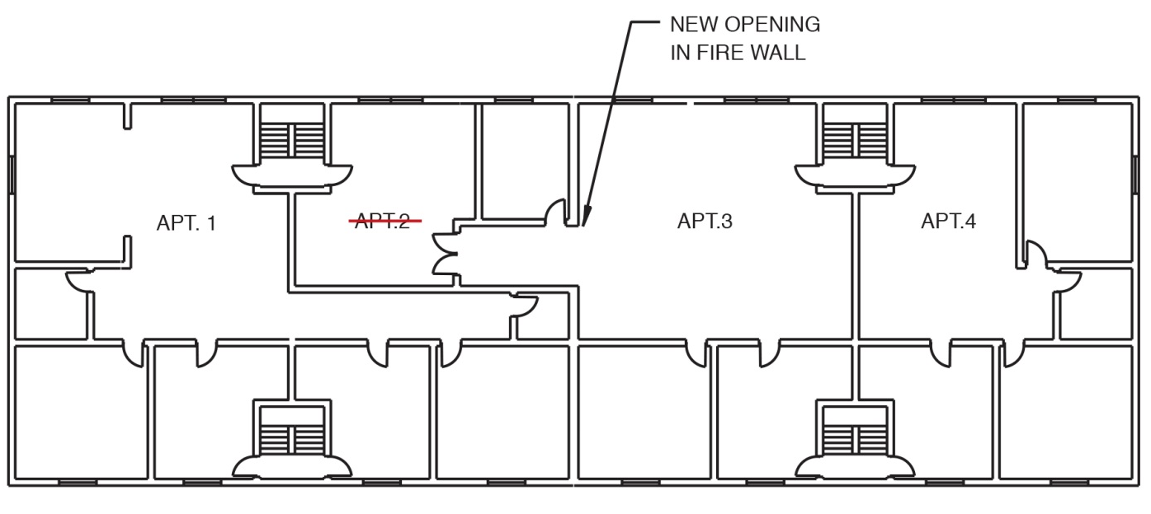
Understand symbols used on floor plans.
Doors
Coded by letters or numbers enclosed in a circle or other geometric shape
Symbol for a standard hinged door is a single line drawn from the hinge side of the doorway
Arc indicates swing direction
Be able to determine whether location and swing of the door meet local codes

Slide 35
Elevation view is a two-dimensional view of a building as seen from the exterior.
Labeling and orientation of the drawing are usually defined by the AHJ
There are four exterior elevation views on any rectangular building
There are two labeling methods commonly used
Contain information about the exterior components of the building
Grade level is shown as a dark line
Utility service line connection points and FDCs will also appear

Slide 36
A sectional view is a vertical view of a building cut into two parts.
Purpose is to show the internal construction of each assembly
Three types of sectional views: cross-section, typical cross section, detailed cross section

Slide 37
Sectional views show a number of construction details.
Exterior walls
Interior walls
Floor
Roof
Foundation
Exterior finishes, sheathing, studs, plates, insulation, vapor barrier, interior finish, base detail
Interior finishes, insulation, studs, sills and plates
Finished floor/subfloor, size/type of floor joists, bridging, support beams
Pitch, materials, eaves protection, sheathing, eave troughs, soffit/fascia details, roof structure, insulation
Wall height/thickness, width/thickness of footings, location/size of weeping tile, location/depth of granular fill, thickness of floor slabs

Slide 38
Listing the construction materials is referred to as “calling up the materials”.
Procedure is used to describe wall, floor, and ceiling/roof assemblies
Materials are listed on the drawing or in construction documents

Slide 39
REVIEW QUESTION
What is the purpose of a sectional view?

Slide 40
Detailed views show features in larger sizes than other views.
Additional information is provided in a larger scale on a separate sheet of the plans
Floor plan drawing may show a fire door; a detailed view will show the exact construction of the fire door and its activation mechanism

Slide 41
REVIEW QUESTION
What are the four main views for building construction working drawings?

Slide 42
Learning Objective 3
Describe building system plans.

Slide 43
System plans provide details of the various systems in the building.
Mechanical systems
Electrical systems
Plumbing systems
Automatic sprinkler systems
Standpipe and hose systems
Special-agent fire extinguishing systems
Fire detection and alarm systems

Slide 44
Know what inspectors need to understand about system plans.
May only be concerned with the fire protection systems plans
Elements of the other plans may influence review of the fire protection systems plans

Slide 45
Mechanical systems provide occupants with HVAC and access to upper and subgrade floors.
Systems included should be designed by a mechanical engineer or building systems engineer
Mechanical systems are capable of spreading fire and smoke
Must verify that all detection and alarm systems and control dampers are included in the plans

Slide 46
Inspectors should verify the style and design of the HVAC system.
Type of refrigerant used in the system and listed in the construction documents should be checked
Be familiar with code requirements concerning the automatic de-energizing of heating systems
Plans must indicate location and type of smoke detectors inside the ductwork used to de-energize air handlers

Slide 47
Fire and/or smoke dampers may be required where the ductwork penetrates fire-resistive walls/floors.
Plans will indicate the location of these features
Some codes prohibit ductwork from penetrating exit areas
Exits are not permitted to be used for supply or return air
Additional references for damper placement and installation of ductwork are contained in NFPA® 90A, 90B, 92A, 92B, or the locally adopted mechanical code

Slide 48
Know code requirements for commercial kitchen equipment and systems.
Cooking appliances
Range ventilation hoods
Fuel shutoffs
Automatic fire suppression systems
Fire alarm systems

Slide 49
Know what to verify when reviewing electrical systems.
Location of exit signs
Means of egress lighting
Emergency and standby power
Power supply to fire detection and alarm systems
Emergency or standby power systems
Hazardous location electrical equipment
NFPA 70 regulates design/installation of electrical systems

Slide 50
Plumbing systems include the layout of the water distribution system.
Wastewater piping
Storm drains
Roof drains
Secondary containment and drainage systems for hazardous materials

Slide 51
Inspectors may review plumbing systems to determine the adequacy of the water supply.
Adequate water supply is important when residential automatic sprinkler systems are installed
Other fire protection system components that may appear on the plumbing plans are water supply connections to the standpipe system and fire pump

Slide 52
A thorough, accurate review of sprinkler systems plans is necessary to verify compliance and effectiveness.

Slide 53
Inspectors need to be familiar with different types of automatic sprinkler systems.
Be familiar with operations and specifications for each type of system
When required, an inspector needs to be able to develop a field inspection checklist of the specific requirements for sprinkler systems and the code sections that relate to the requirements
This checklist can be used as a guide during sprinkler plans review

Slide 54
Verify that the proper NFPA® standard has been applied.
Occurs before plans review begins
Involves classifying hazards
Occupancy (light, ordinary, or extra hazard)
Storage commodity (shelf, high-piled, rack, or warehouse)
Or by both
Evaluate mixed occupancies very carefully

Slide 55
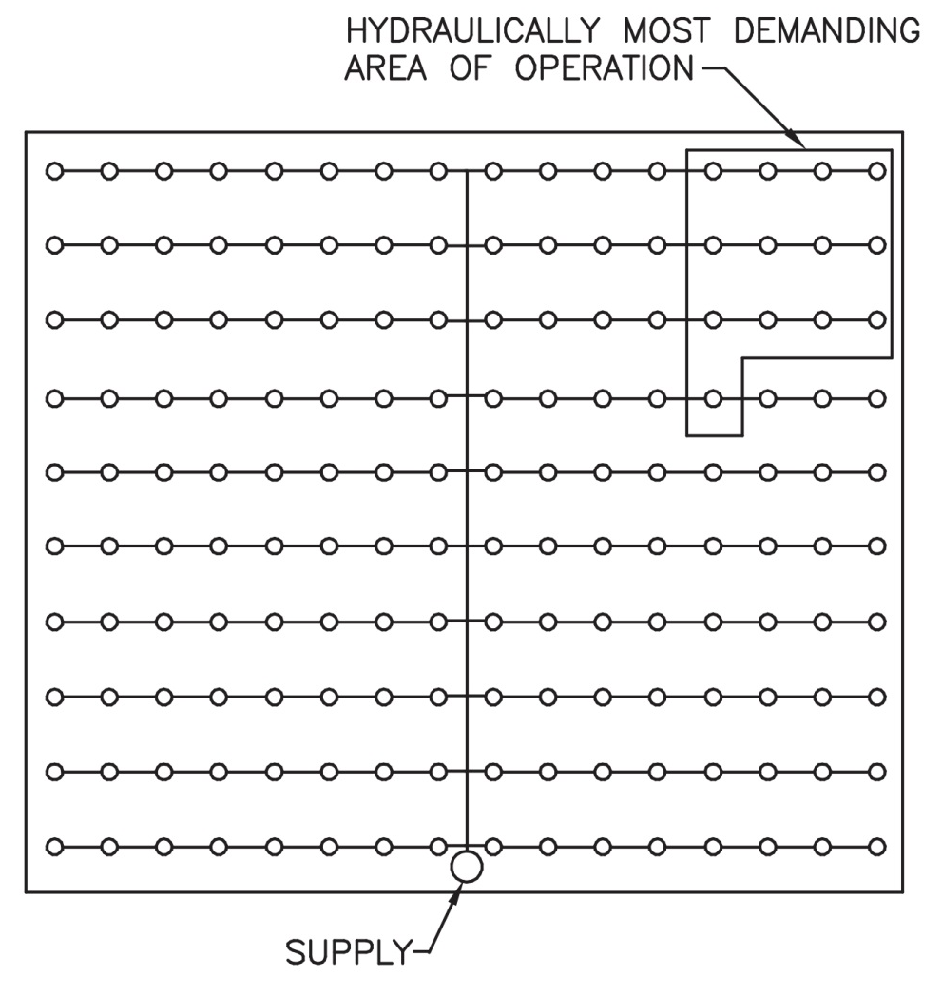
Drawings for hydraulically calculated sprinkler systems require supporting documentation.
Proves the design complies with code
System designer provides all necessary information including calculations and applicable data
All documentation must be reviewed carefully for accuracy

Slide 56
Plans reviewers need to check several sprinkler design factors.
Extent of coverage
Design area of system
Type of system
Size of system
Water supply connections and valves
Water supply capacity at site
Fire department connection (FDC)
Sprinkler types, temperature ratings, and locations
Pipe sizes and lengths
Number of pipe elbows and tees
Type and number of pipe hangers
Requirements for seismic bracing

Slide 57
Become familiar with other items that require review.
Sprinkler cut sheet
Installation
Installation standards determine
Size of the systems, based on the total floor area that a single riser and control valve can protect
Number of individual systems and system control valves needed
Verify that the sprinkler is installed in accordance with its UL listing
Should be installed so that they provide complete coverage of the building
(Cont.)

Slide 58
Become familiar with other items that require review.
Specifications to verify
Drawings should clearly indicate
Temperature rating
Type
Orifice size
Area of coverage
Use in special areas
Spacing
Location of sprinklers
All supports
Bracing
Connections
Piping
Valves
Drains
Gauges

Slide 59
Know how water supplies directly impact sprinkler performance.
Water supplies for sprinklers must have sufficient capacity and pressure to satisfy the calculated requirements for hydraulically designed systems
System designer must include a graph that shows the water demand compared to the available water supply

Slide 60
Fire protection and plumbing system plans are to determine several things.
System type
System classification
FDC location(s)
Water supply main location and capacity
Riser control valve type and location
Location of hose cabinets or discharges
Discharge control valves locations
Pressurized air supply type, capacity, and locations
Waterflow calculations

Slide 61
Be familiar with requirements for each type of special-agent fire extinguishing system.
Calculation sheets used to design the system
Definition of the area or equipment to be protected
Type of system (local application or total flooding)
Type of extinguishing agent being used
Amount of agent required
Concentration of extinguishing agent to be developed
Storage container size
(Cont.)

Slide 62
Be familiar with requirements for each type of special-agent fire extinguishing system.
Type of expellant gas
Rate of discharge
Duration of flow
Layout and type of piping included (whether engineered or pre-engineered)
Location and type of discharge nozzles
(Cont.)

Slide 63
Be familiar with requirements for each type of special-agent fire extinguishing system.
Method of actuation and auxiliary alarm functions such as turning off ventilation
Type of presignaling devices used if required
Area and volume of the protected space
Sequence of operation

Slide 64
Plans for fire protection and alarm signaling systems contain information on system components.
Signal initiation devices
Signal notification appliances
Automatic door closing devices
Lightning protection devices
Smoke control devices
Damper control devices
Fire pumps
Power supply
Auxiliary power supply

Slide 65
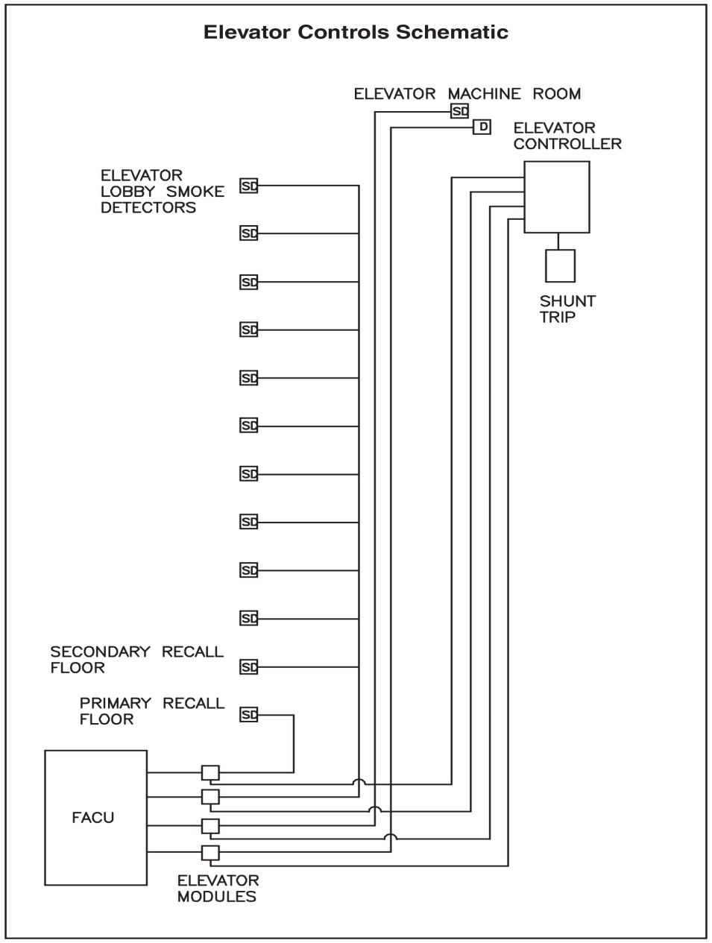
Plans for fire protection and alarm signaling systems contain information on system functions.
Supervision of alarm systems
Elevator control
Stair pressurization
Doors that unlock or close automatically when the alarm activates

Slide 66
NOTE
Consult NFPA 72®, Chapter 4, for information on detection and alarm system components.

Slide 67
Be familiar with additional information found in manufacturer documents.
Battery load and voltage drop calculations
Manufacturers’ cut sheets
Point-to-point wiring diagrams

Slide 68
Be familiar with additional information found in various other specifications.
Type and gauge of wire
Protection provided for the wire
Wiring methods
Methods of supervision
Sequence of operation

Slide 69
Be familiar with additional requirements for electrical systems.
All fire detection and alarm systems must have electrical supervision
All fire detection and alarm equipment must be listed by a nationally recognized testing agency for their intended use
Specified maximum travel distances to manual pull boxes
Code requirements concerning pull station placement for accessibility to persons with disabilities

Slide 70
REVIEW QUESTION
List various types of system plans.

Slide 71
Learning Objective 4
Explain the process of systematic plans review.

Slide 72
General elements should be systematically reviewed.
Overall size of building (height and area)
Occupancy classification
Occupant load
Means of egress
Exit capacity
Building compartmentation

Slide 73
Review the overall size of the building in terms of height and area.
Based on
Know local code information for
Local building code and zoning regulations
Occupancy classification
Construction type of the building
Sloping grades
Basements
Parapet walls
Penthouses
Courtesy of David DeStefano

Slide 74
Review the overall size of the building in terms of area.
Fire control and suppression operations
Basis for area increase or decrease
Area limitations are intended to facilitate fire control and suppression
Several factors and conditions are considered during a plans review of area
Each of the model building codes has different area limitations based on local requirements and resources
Automatic sprinkler protection
Accessible building perimeter
Fire separation distance between buildings
Increases and decreases are usually expressed in percentages

Slide 75
Know inspector duties regarding occupancy and construction classification.
Occupancy
Evaluate the fire and life safety requirements throughout the building
Construction
Intended construction is identified on the drawings
Critical for required fire flow determination in some model codes
Refer to the appropriate fire resistance rating lists
Must be familiar with the applicable codes concerning mixed occupancies and special-use requirements
Verify occupancy classification is consistent with the intended use of the structure
Consider only the factors necessary to define the building types

Slide 76
A plans examiner verifies the occupant load.
Before evaluating the life safety and fire protection features of a building
Inspectors can use the occupant density or occupant load factors given in the codes to determine the occupant load
Design professionals are required to provide the occupant load calculations for verification

Slide 77
Know inspector duties regarding means of egress.
Should be highlighted on the construction, mechanical, and electrical drawings
Building plans must show details of the separation walls as well as fire door opening protectives information
(Cont.)

Slide 78
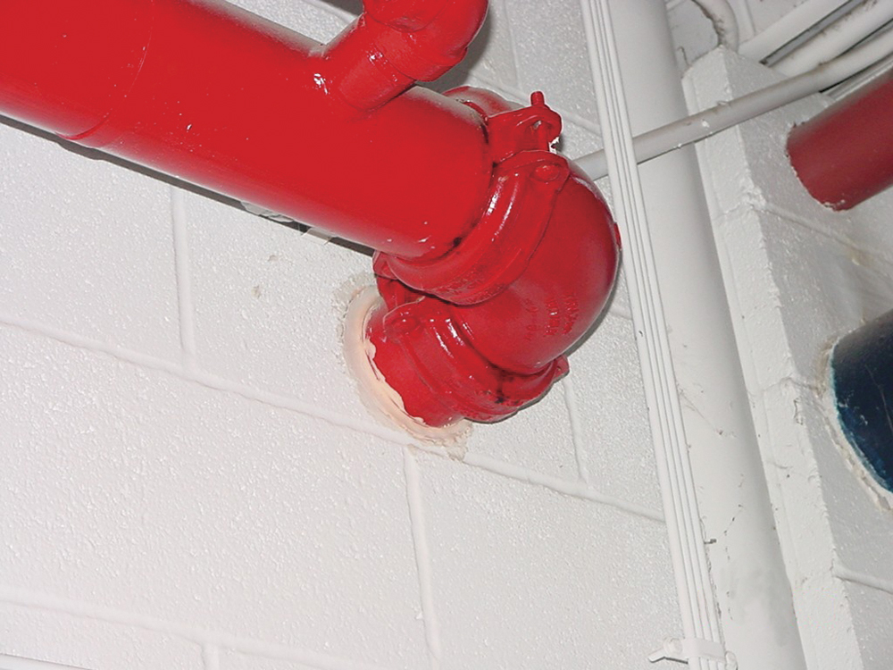
Know inspector duties regarding means of egress.
Codes
There are no unnecessary openings
All penetrations are sealed
Fire-resistance ratings of the fire door and opening protectives are correct
Separation from exit discharges and exit accesses is verified
Require that construction with a specified fire-resistance rating must separate exits from other parts of a building
Items to verify

Slide 79
Know inspector duties regarding means of egress and exit capacity.
Additional means of egress items to verify
All the various components of the exit system are in place
Each means of egress provides a continuous path of travel to the level of exit discharge or area of refuge
Interior finishes
Headroom
Elevation changes
Emergency lighting
Obstructions
Exit capacity
Done after means of egress items are verified and evaluated
Evaluate according to the specifications of the appropriate codes

Slide 80
Inspectors should understand building compartmentation.
Theory
Includes
Fire walls
Fire barriers
Horizontal assemblies
Shafts
Protection of vertical openings and concealed spaces
Opening protectives such as fire door assemblies, fire dampers, and fire-stop assemblies
To limit any fire and resulting products of combustion to one area of a building

Slide 81
Know what to look for when it comes to building compartmentation.
Verify the fire-resistance rating of the construction separating all vertical openings
Locate and check fire and smoke barriers for continuity, fire-resistance rating, and opening protection
During field inspections, it is often difficult to verify the existence of fire-stops in concealed spaces and penetrations
When evaluating hazardous areas, verify the required separation and/or automatic sprinkler protection has been provided
Design professional must provide plans that clearly show the location of required fire-stops and the building system that is being installed

Slide 82
Be aware of additional concerns when evaluating plans.
Omissions
Interior finishes
Some items may be left out
Can be intentional or unintentional
Can impact fire and life safety
Materials that produce smoke and toxic gases when burning
Code requirements exclude the use of certain materials with high smoke production or smoke densities
Requirements usually apply only to walls and ceilings
Codes often permit less stringent requirements for interior finishes when automatic sprinkler systems are installed
(Cont.)

Slide 83
Be aware of additional concerns when evaluating plans.
Furnishings and decorations
Portable fire extinguishers
Locations and capacities of portable fire extinguishers may be found on the floor plan
If they are missing, require the architect or designer to include them
Must be provided with flammability information for certain furnishings
Verify that extinguishers are located and installed according to the adopted code
(Cont.)

Slide 84
Be aware of additional concerns when evaluating plans.
Insulation materials
Both exposed and concealed insulation materials can contribute to fire spread or smoke development
Construction documents must contain the type, fire-resistance rating, and smoke-development index as determined in the building code
Special hazards
Contents as well as processes that may occur in the completed structure must be considered
Existence of special hazards will mandate the types of fire and life safety protection to be installed in the structure as well as the fire flow capacity of fire hydrants in the area

Slide 85
REVIEW QUESTION
What are the general elements that should be reviewed in a systematic plans review?

Slide 86
Summary
Inspectors and plans examiners from the fire department play an important role in the plans review and field verification process. A Level II Fire Inspector may perform some plans review activities.
(Cont.)

Slide 87
Summary
The inspector needs to be able to verify that all code requirements regarding occupant fire and life safety are met before and during the construction of the building or structure. This activity may require coordinating with inspectors from other fields such as mechanical or electrical.
(Cont.)

Slide 88
Summary
Construction plans review and field verification are keys to the proactive approach to fire and life safety. Verifying that a building provides an acceptable level of fire and life safety construction and systems saves lives, reduces property loss, and reduces fire protection costs to the community.

