Slide 1
Fire and Emergency Services Instructor
8th Edition
Chapter 7 — Skills-Based Training Beyond the Classroom

Slide 2
Learning Objective 1
Discuss agencies and organizations where instructors can find the most current information about safety guidelines and regulations.

Slide 3
Know where information is available for safety guidelines, regulations, and information.
Federal government agencies
State/provincial and local governmental occupational safety and health agencies
Standards-writing organizations
Professional organizations and associations

Slide 4
Federal government agencies are responsible for developing, regulating, and ensuring policies.
National Institute for Occupational Safety and Health (NIOSH)
Occupational Safety and Health Administration (OSHA)
Canadian Centre for Occupational Health and Safety (CCOHS)
National Institute of Standards and Technology (NIST)

Slide 5
Agencies provide information on WMD, PPE, and bioterrorism training.
Department of Homeland Security (DHS)
Centers for Disease Control and Prevention (CDC)
Environmental Protection Agency (EPA)
U.S. Department of Transportation (DOT)
U.S. Department of Defense (DOD)

Slide 6
Instructors should know federal, state/provincial, and local regulations that impact training.
State/provincial and local agencies may have safety regulations written for other industries
Regulatory agencies may have consultants to review pertinent safety regulations with instructors
State/provincial and local health departments or agencies can provide statistical data and safety programs

Slide 7
Standards-writing organizations develop operating procedures for various industries.
National Fire Protection Association® (NFPA®)
American National Standards Institute (ANSI)
Underwriters Laboratories Inc. (UL): U.S. and Canada (ULC)

Slide 8
Professional organizations are important sources of safety information.
International Association of Fire Chiefs (IAFC)
Canadian Association of Fire Chiefs (Association canadienne des chef de pompiers) (CAFC/ACCP)
International Association of Fire Fighters (IAFF)
National Volunteer Fire Council (NVFC)
North American Fire Training Directors (NAFTD)

Slide 9
Some organizations provide safety information to instructors who are not members.
Fire Department Safety Officer Association (FDSOA)
International Society of Fire Service Instructors (ISFSI)
American Society of Safety Engineers (ASSE)

Slide 10
Instructors should know accrediting and certifying organizations.
National Registry of Emergency Medical Technicians (NREMT)
International Fire Service Accreditation Congress (IFSAC)
National Board on Fire Service Professional Qualifications (ProBoard)

Slide 11
REVIEW QUESTION
Where can instructors receive the most current information about safety guidelines and regulations?

Slide 12
Learning Objective 2
Describe the responsibilities of the instructor as a safety role model.

Slide 13
Instructors can increase awareness and help prevent accidents.
Providing rules and guidelines in writing
Reading the written rules and guidelines aloud as the students read them silently
Having students sign a statement that they have read and understood all safety rules and regulations

Slide 14
Instructors must enforce safety regulations.
Brief all instructors and students on the IAP before training begins
Brief students on relevant techniques, procedures, tools, facility characteristics, and appropriate safety rules before starting the evolution
Describe the proper safeguards and equipment used for preventing accidents
Describe possible hazards and explain the necessary precautions
(Cont.)

Slide 15
Instructors must enforce safety regulations.
Plan carefully for training scenarios
Ensure that appropriately trained personnel assist in supervising scenarios
Review emergency procedures, emergency evacuation plans, and verbal or alarm alerts with students before the evolution
Inspect and repair tools, equipment, props, and apparatus before starting training sessions
(Cont.)

Slide 16
Instructors must enforce safety regulations.
Assign a safety officer to each training scenario based upon a prepared IAP
Assign additional personnel for safety positions depending upon the scale of the training evolution and the severity of danger
Model and reinforce safety policies and procedures by personally adhering to them
Be aware of human factors among students that can contribute to unsafe conditions

Slide 17
Instructors must identify and eliminate potential hazards.

Slide 18
REVIEW QUESTION
How can instructors increase awareness and help prevent training accidents?

Slide 19
Learning Objective 3
Explain the details required to plan for safe training.

Slide 20
Identify skill level.
Be honest about ability levels and knowledge
Skills may decline due to lack of practice
Seek out courses to gain skills or recommend a better qualified instructor if they are not qualified
Training cannot continue until the available instructor has completed the skills training needed to be qualified
It is important to acquire the necessary skills as soon as possible

Slide 21
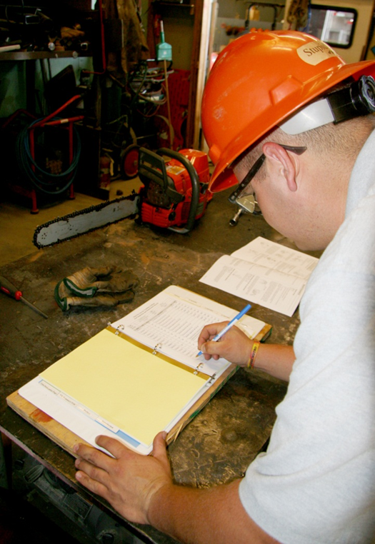
Instructor should report unsafe equipment to the AHJ.
Reschedule training
Train without the faulty equipment
Conduct the training at a facility with functional equipment

Slide 22
Level I Instructors should be familiar enough to identify the hazards associated with training.

Slide 23
REVIEW QUESTION
What actions are required for planning for safe training?

Slide 24
Learning Objective 4
Discuss the elements of evolution control.

Slide 25
Know the elements that control an evolution.
Supervising
Monitoring
Teaching
Managing

Slide 26
A ratio of 5 students to 1 instructor should be used when supervising students.

Slide 27
REVIEW QUESTION
What are the elements involved with evolution control?

Slide 28
Learning Objective 5
Describe the information given during a psychomotor skills demonstration.

Slide 29
Know how skills demonstrations begin.
An explanation of the skill
Why it is important
How it relates to other skills
How many people are required to perform it
When it should be performed

Slide 30
REVIEW QUESTION
What information is needed to begin a skills demonstration?

Slide 31
Learning Objective 6
Explain a simple training evolution.

Slide 32
Simple training evolutions involve small numbers of students performing a single skill.

Slide 33
Know the actions to take to begin an evolution.
Explain the learning objectives or outcomes
Demonstrate the evolution; this may require the use of an experienced group of responders to perform the evolution for students to observe
Emphasize the safety requirements for the evolution
Relate the evolution to the classroom lecture

Slide 34
REVIEW QUESTION
What is the difference between a psychomotor skills training and simple training evolution?

Slide 35
Learning Objective 7
Explain the safety concerns surrounding live-fire training.

Slide 36
Increased hazard exposure training is dangerous even under controlled conditions.

Slide 37
Know the categories of live-fire training evolutions.
Structures acquired with the specific purpose for interior live-fire training
Purpose-built structures at training facilities built for interior live-fire training
Exterior fires, including transportation fires, wildland fires, flammable/combustible liquid fires at a remote site or a training facility

Slide 38
Acquired structure training must meet the safety requirements of NFPA® 1403.
Making improvements to the structure before training
Any building or structure that cannot be made safe may not be used for interior structural fire-fighting training

Slide 39
Know the limits of acquired training structures.
Total number of students
Instructor to student ratio
Students possess the necessary prerequisite skills
Safety considerations
Equipment available
Location and access

Slide 40
Know the issues to address before live-fire training.
Environmental conditions
Structural condition
Training possibilities
Instructor responsibilities
Fuel usage
Water supply requirements

Slide 41
Know the different rules for purpose-built structures.
Multiple fires can be lit in purpose-built structures
A single water supply may be used
Additional requirements for testing and inspection of burn structures

Slide 42
Know evolutions that are included in exterior fires.
Evolutions that simulate:
Low fire load fires
Transportation fires
Flammable/combustible liquids fires
Wildland fires

Slide 43
Know the types of exterior fires.
Small prop fires
Medium to large prop fires
Flammable/combustible liquid fires
Wildland fires

Slide 44
REVIEW QUESTION
What conditions affect safety during live-fire training?

Slide 45
Learning Objective 8
Identify types of increased hazard exposure training other than live-fire training.

Slide 46
Know additional increased hazard exposure training.
Emergency vehicle operations
Vehicle and machinery extrication
Surface-water, swift-water, and dive rescues
Building collapse search and rescue operations
Hazardous materials technician skills
(Cont.)

Slide 47
Know additional increased hazard exposure training.
High angle rescue operations
Trench shoring and rescue operations
Ice rescues
Power tool and equipment operations
Confined-space entry rescue operations

Slide 48
REVIEW QUESTION
What are five examples of increased hazard exposure training other than live-fire training?

Slide 49
Learning Objective 9
Identify topics that an EMS instructor is qualified to teach.

Slide 50
Know the skill topics for EMS training.
Emergency vehicle operations
Mass casualty and triage operations
Patient handling
Bloodborne Pathogens and Body Substance Isolation (BSI)
Invasive skill training
Patient care
Scene safety
Equipment training
Documentation

Slide 51
REVIEW QUESTION
What are some skills-based training topics that an EMS instructor would be qualified to teach?

Slide 52
Learning Objective 10
Describe legal liability.

Slide 53
Know the situations in which an instructor will be held liable.
Providing incorrect information
Teaching a topic they are unqualified to teach
Failing to instruct in a topic they are responsible for teaching

Slide 54
Know how to reduce potential liability or legal action.
Being aware of standard expectations
Teaching to the standards
Teaching only topics for which they meet all qualifications
Providing a safe learning environment

Slide 55
What questions should an instructor ask when planning a training evolution?
Can instructors be held liable for actions of students who irresponsibly act on their own?
Can individuals be held personally liable for contributing to their own injuries and the injuries of others?
To what extent are employers liable for injuries caused by their employees?

Slide 56
Instructors should educate themselves on the concepts associated with liability.
Vicarious Liability
The blame for the actions of one person can be placed on another
Foreseeability
Legal concept that reasonable people should be able to foresee the consequences of their actions
Liability Reduction
Develop an IAP or safety plan, then follow it during training

Slide 57
Know the precautions an instructor should take to avoid liability.
Maintain written objectives and document each training session
Provide students with a written course description so they can understand all requirements
Ensure that students are physically fit for the tasks, based upon the benchmarks for fitness set by the AHJ
Train all students how to safely operate equipment
Do not leave students unattended while they are practicing potentially dangerous skills
(Cont.)

Slide 58
Know the precautions an instructor should take to avoid liability.
Do not exceed personal skill level when training students or working with other instructors
Do not ignore, shortcut, or exceed protocols or policies
Ensure that students understand the intent and outcome of all directives
Do not joke about serious situations or belittle the actions of others
Never disclose personal information about students, other personnel, or any victim or patient
(Cont.)

Slide 59
Know the precautions an instructor should take to avoid liability.
Follow your organization’s policy on disclosing information to insurance companies, hospital personnel, legal representatives, news reporters, or other persons
Maintain current certifications through credible refresher courses
When in doubt, seek advice from a higher authority
Accurately document all issues of discrepancy, complaint, and injury, including details on dates, times, conversations, suggested resolutions, and follow-up plans

Slide 60
REVIEW QUESTION
When can an instructor be considered liable?

Slide 61
Summary
Safety is an instructor’s most critical responsibility during training, whether it is psychomotor skills training, a simple training evolution, or high-hazard training.
Ensuring safety requires careful planning, inspection of training locations, and thorough knowledge of appropriate standards, especially during live-fire training at an acquired structure.
(Cont.)

Slide 62
Summary
Instructors should use every resource at their disposal to plan safe training.
Instructors should understand their legal liability and take steps to minimize it.

