Slide 1
Fire Inspection and Code Enforcement
8th Edition Inspector I
Chapter 3 — Fire Behavior

Slide 2
Learning Objective 1
Describe the various components of fire behavior.

Slide 3
All fires involve a heat-producing chemical reaction between a fuel and an oxidizer.
Fuel
Oxidizer (Oxygen)
Fire

Slide 4
When material burns, heat is generated faster than it dissipates, causing temperature to increase.
Material burns
Generates heat
Temperature increases

Slide 5
Theoretical foundations of physical science must be translated into fire science.
Fire Science
Chemistry
Physics
Laws related to matter
Laws related to energy

Slide 6
Understand the many factors that contribute to the science of fire.
Physical/ chemical changes
Modes of combustion
Temperature, energy, heat
Sources of thermal energy
Heat transfer
Passive agents
Fuel
Oxidizer
Self-sustained chemical reaction
Classification of fires

Slide 7
Understanding the concept of fire enables inspectors to identify and mitigate hazards.
Excessive fuel loading
Improper storage
Unclean commercial cooking equipment

Slide 8
Knowledge of fire protection issues prepares inspectors to determine occupancy requirements.
Fire separation
Interior finish
Sprinkler coverage

Slide 9
Physical change occurs when substances remain chemically the same, but change in size, shape, appearance.
Water (Liquid)
Freezing temperature
Ice (Solid)
Water (Liquid)
Heat
Steam (Gas)

Slide 10
Oxidation is a chemical reaction that involves the combination of an oxidizer with other materials.
Oxidation can be slow (rust) or rapid (combustion)

Slide 11
Physical and chemical changes involve an exchange of energy.
Potential energy converts to
Kinetic energy
Combustion releases potential energy

Slide 12
Know the difference between exothermic and endothermic reactions.
Reactions that give off energy (fire) = exothermic Reactions that absorb energy (steam) = endothermic

Slide 13
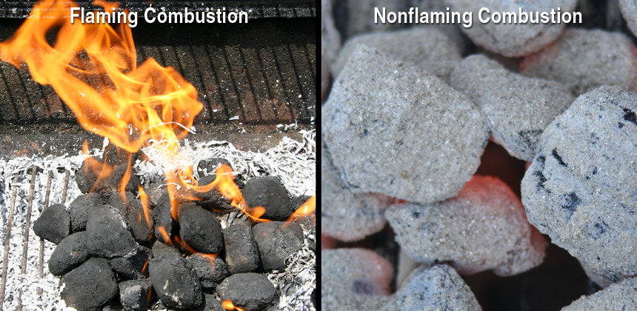
Know the difference between flaming and nonflaming combustion.
Produces a visible flame above material’s surface
Occurs more slowly, lower temperatures; smoldering glow

Slide 14
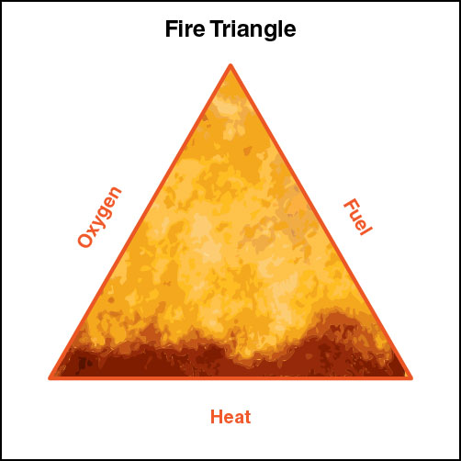
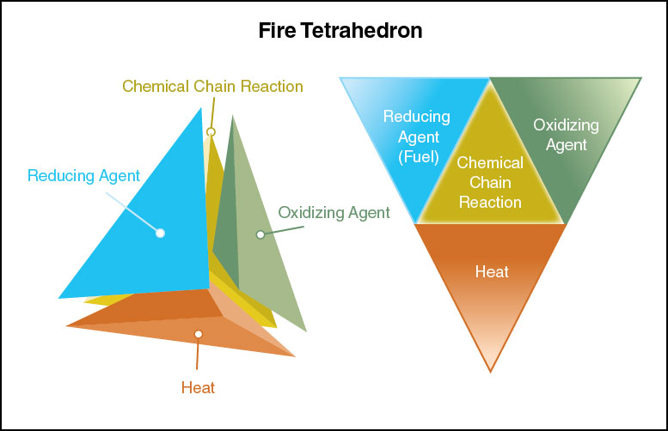
Inspectors need to know the two models of fire.
Both explain the elements of fire and how fires can be extinguished

Slide 15
The fire triangle is the oldest and simplest model.
Shows 3 elements necessary for fire
Remove any one of the elements, fire will extinguish

Slide 16
The fire tetrahedron explains fires involving certain types of substances and agents needed to extinguish them.
Created after determining an uninhibited chemical reaction is needed for a fire to occur

Slide 17
Know the characteristics of nonflaming combustion.
Occurs when burning is localized on or near the fuel’s surface
Occurs more slowly
Occurs at lower temperatures
Produces a smoldering glow

Slide 18
Know the characteristics of flaming combustion.
Oxidation involves fuel in the gas phase
Requires liquid/solid fuels to be vaporized
When heated, fuels give off vapors
Vapors mix with oxygen
Produces flames
All elements of the fire tetrahedron must be present
Stopped by interrupting the chemical chain reaction

Slide 19
Have a clear understanding of temperature, energy, and heat.
Terms should not be used interchangeably
Causes confusion
Inspectors need to know the difference

Slide 20
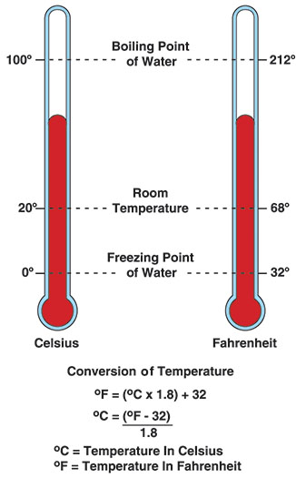
The freezing and boiling points of water provide a simple way of comparing temperature scales.
A measure of kinetic energy of the particles in a sample of matter
Expressed in terms of units or degrees
Celsius = metric system
Fahrenheit = customary system

Slide 21
Inspectors need to understand the characteristics of energy.
It is the capacity to perform work
Work occurs when
Force is applied to an object over distance
A substance experiences a chemical, biological, or physical transformation
Not possible to measure energy directly
Necessary to measure the work that it does

Slide 22
Inspectors should know energy exists in many forms.
Chemical
Mechanical
Electrical
Light
Nuclear
Sound

Slide 23
Inspectors need to know energy classifications.
Potential
Energy possessed by an object that may be released in the future
Kinetic
Energy possessed by a moving object
Energy can change from one to the other

Slide 24
Inspectors need to understand the concept of power as it relates to combustion.
It is the rate at which work is performed
Important to understanding the rate of heat transfer
Important to understanding the rate at which energy is released
The size of the fire relates to the rate at which energy is released

Slide 25
Inspectors should know the unit of measure for power.
Units of Measure
1 watt = 1 joule per second (J/s)
Standard international unit = watt (W)

Slide 26
Inspectors need to know the characteristics of heat.
Heat is energy in transit
Transfer of energy from a high-temperature substance to a low-temperature substance
“Heat” is commonly used to describe thermal energy
Heat is kinetic energy associated with the movement of atoms and molecules that comprise matter

Slide 27
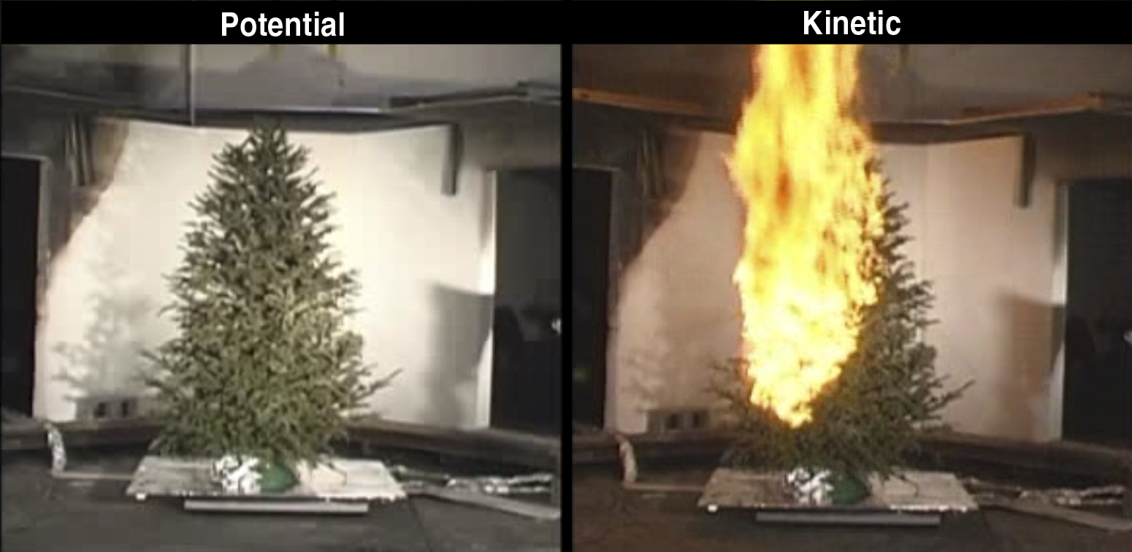
Inspectors need to understand heat as it relates to fire behavior.
Courtesy of Dan Madrzykowski/NIST
The conversion of chemical potential energy in fuel to thermal kinetic energy (heat) is the energy element in both the fire triangle and the tetrahedron

Slide 28
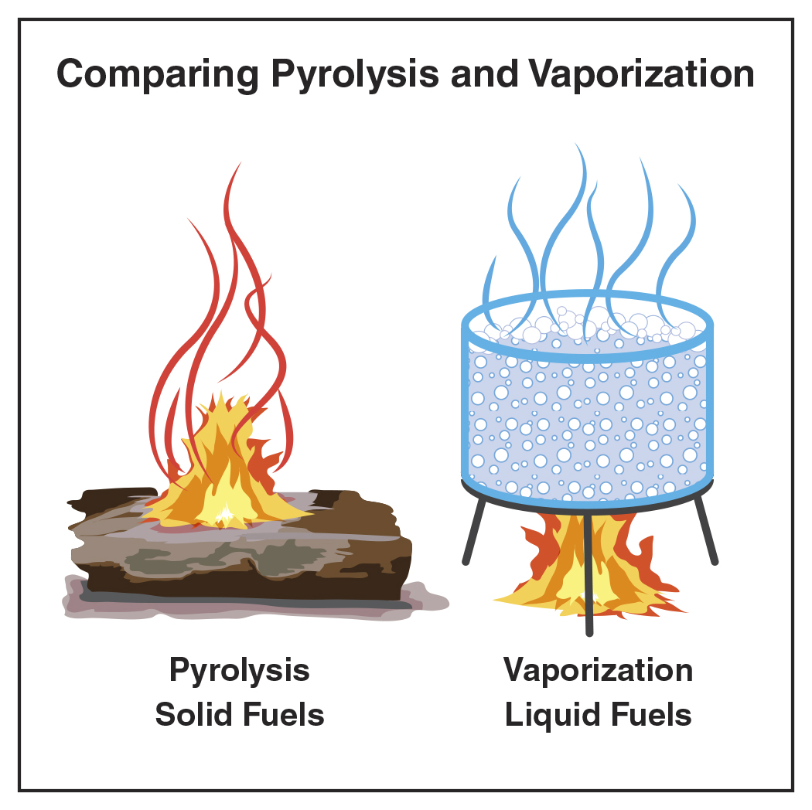
Understand the characteristics of forms of ignition.
Heat fuel = temperature increase
Sufficient heat causes
Pyrolysis in solid fuels
Vaporization in liquid fuels
Ignition results from
External source
Fuel heated until it ignites
Once ignited, process continues; sustains combustion

Slide 29
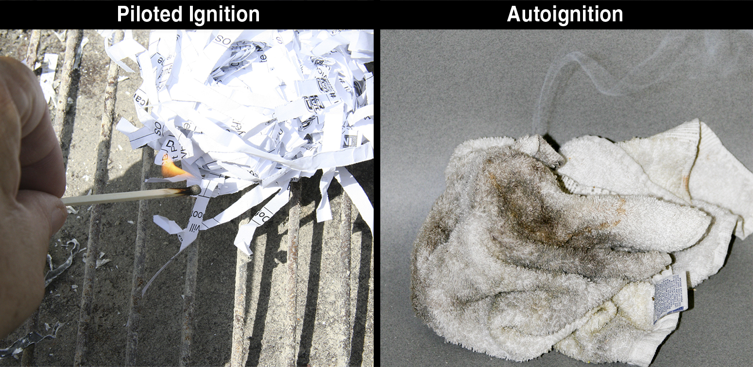
Inspectors need to be familiar with the two forms of ignition.
Most common form
Occurs when a mix of fuel and oxygen encounter a sufficient external heat source
(Cont.)

Slide 30
Inspectors need to be familiar with the two forms of ignition.
Occurs without any external flame or spark
Fuel surface is chemically heated to the point where a combustion reaction occurs

Slide 31
Inspectors need to be familiar with autoignition temperature characteristics.
Minimum temperature to which a fuel in the air must be heated in order to start self-sustained combustion
Temperature always higher than its piloted ignition

Slide 32
Many types of energy can be transformed into thermal energy.
Chemical
Mechanical
Electrical
Light
Nuclear
Sound

Slide 33
Understand the characteristics of chemical energy.
Most common source of heat in combustion reactions
Potential for oxidation exists when any combustible is in contact with oxygen
Almost always produces thermal energy
Self-heating may be a result

Slide 34
Self-heating is both a form of oxidation and an exothermic chemical reaction.
Reaction that increases the temperature of a material without the addition of heat
Normally produced slowly by oxidation
Normally lost to the surroundings as fast as it is generated
External heat sources can accelerate the process

Slide 35
Understand what makes self-heating move to spontaneous ignition.
Self-heating
Heat cannot dissipate as quickly as it is being generated
Heat production is great enough to raise the temperature of the material
Air supply in and around the material is adequate to support combustion
Autoignition temperature = Spontaneous ignition

Slide 36
Oxidation rates increase as more heat is generated and held by the materials insulating fuels.
Rate of most chemical reactions increases as temperatures of reacting materials increase
More heat generated and absorbed by the fuel = faster reaction causing the heat generation
When heat generated by a self-heating reaction exceeds the heat being lost, material may ignite spontaneously

Slide 37
Electrical heating can occur in several ways.
Resistance heating
Occurs when electric current flows through a conductor
Some electrical appliances are designed to make use of resistance heating
Limited under normal operating conditions in some electrical equipment
(Cont.)

Slide 38
Electrical heating can occur in several ways.
Overcurrent or overload
When current flowing through a conductor exceeds its design limits, it may overheat
Can present an ignition hazard
Unintended resistance heating
(Cont.)

Slide 39
Electrical heating can occur in several ways.
Arcing
High-temperature luminous electric discharge across a gap or through a medium
May be generated when a conductor is separated; or by high voltage, static electricity, or lightning
(Cont.)

Slide 40
Electrical heating can occur in several ways.
Sparking
Occurs during an electric arc
Luminous particles can be formed
Particles spatter away from the point of the arc

Slide 41
Mechanical energy is generated by friction or compression.
Heat of friction
Results in heat and/or sparks
Heat of compression
Occurs when two surfaces move against each other
Occurs when gas is compressed through mechanical means
Why SCBA cylinders feel warm to the touch after filling

Slide 42
REVIEW QUESTION
Describe and name an example of chemical, electrical, and mechanical energy.

Slide 43
Use knowledge of heat transfer to evaluate fire safety features.
Fire-rated walls
(Passive feature)
Sprinkler systems
(Active feature)

Slide 44
Structural components and interior finishes have a significant effect on heat transfer.
Drywall
Masonry
Fire doors
Fuel loads
Combustible waste and storage

Slide 45
Use heat transfer knowledge when considering the potential for fire spread.
Important when fire extends beyond the point of origin
For heat to transfer, objects must be at different temperatures
Rate of transfer related to the temperature differential of the objects and thermal conductivity
Greater temperature differences = Greater transfer rates
(Cont.)

Slide 46
Use heat transfer knowledge when considering the potential for fire spread.
Heat flux = Transfer of thermal energy
Typically measured in kilowatts per meter squared (kW/m²)

Slide 47
Inspectors need to know heat transfer mechanisms.
Conduction
Convection
Radiation

Slide 48
Conduction is the transfer of heat through and between solids.
Occurs when a material is heated as a result of direct contact with a heat source
Heat flow dependent upon
Area being heated
Temperature differences between heat source and material
Conductivity of material

Slide 49
Be familiar with the thermal conductivity temperatures of some common materials.

Slide 50
Know what materials delay heat transfer primarily by slowing conduction.
Insulating materials
Best commercial insulation materials
Good insulators are materials that do not conduct heat well
Disrupt the point-to-point transfer of heat
Made of fire particles/fibers
Void space between them filled with a gas

Slide 51
Convection is the transfer of thermal energy by the circulation or movement of a fluid.
Usually involves heat transfer through movement of hot smoke and fire gases
Flow of heat is from high temperatures to low temperatures
May occur in any direction
Generally rise; smoke and gas are buoyant
Lateral movement can be from windward to leeward

Slide 52
Radiation is the transmission of energy as electromagnetic waves without an intervening medium.
Includes light waves, radio waves, X-rays
Can become the dominant mode of heat transfer
Significant effect on the ignition of objects located away from the fire
Significant factor in fire development, spread in compartments

Slide 53
Be aware that radiation is a common method of heat transfer in buildings with radiant heat systems.
Radiant heat systems are usually located under the floor of a room
Courtesy of Greg Havel

Slide 54
Know the factors that influence radiant heat transfer.
Nature of exposed surfaces
Distance between the heat source and exposed surfaces
Dark materials emit and absorb more effectively than light-colored materials
Smooth, highly polished surfaces reflect more than rough surfaces
Increased distance = reduced radiant heat effect
(Cont.)

Slide 55
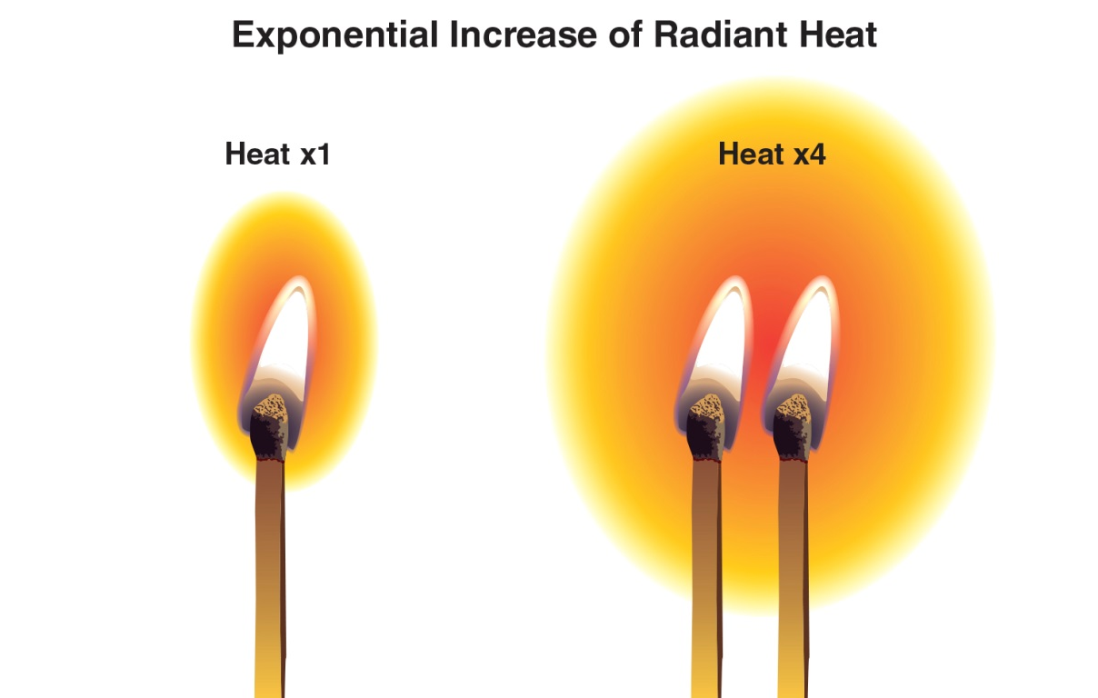
Know the factors that influence radiant heat transfer.
Temperature differences between heat source and exposed surfaces
Major effect on heat transfer through radiation
Heat source temperature increased = radiant heat increases to the fourth power

Slide 56
Energy is an electromagnetic wave that travels at the speed of light in a straight line.
Sun
Earth
Speed of light
Energy

Slide 57
Radiation is a common cause of exposure fires.
As fire grows, it radiates more heat
Objects absorb energy
Convert energy to heat
Exposure fire
Exposure fire = fire ignited in fuel packages or buildings a considerable distance from the area of origin

Slide 58
Materials that reflect radiated energy will disrupt the transmission of heat.
Radiated heat travels through vacuums and air spaces that would disrupt heat transfer by conduction and convection
Flames have high temperature, resulting in the emission of significant radiant energy
Hot smoke in the upper layer also transmits significant energy

Slide 59
REVIEW QUESTION
What are the ways heat can be transferred to an object?

Slide 60
Know what impact passive agents can have on ignition and fire development.
Materials that absorb heat
Do not contribute fuel in the combustion reaction
Examples
Gypsum board
Dry wall

Slide 61
Fuel is the substance that is burned in the combustion process.
In scientific terms, fuel is a reducing agent
Inorganics do not contain carbon (Hydrogen, magnesium)
Organics contain carbon and are the most common type of fuel
Hydrocarbon-based fuels: gasoline, fuel oil, plastics
Cellulose-based materials: wood and paper

Slide 62
Understand the influences of the chemical content of fuel.
Heat of combustion
Heat release rate (HRR)
Significant to inspectors because of the widespread use of synthetics in building construction materials

Slide 63
Inspectors should understand heat of combustion.
Total amount of thermal energy released when a specific amount of fuel oxidizes
Usually expressed kilojoules/gram (kJ/g)
Many plastics, flammable liquids/gases contain more potential heat (thermal energy) than wood

Slide 64
Inspectors should understand Heat release rate (HRR).
Energy released per unit of time as a fuel burns
Usually expressed in kilowatts (kW) or megawatts (MW)
Dependent upon type, quantity, orientation of fuel
Fuel may be gas, solid, liquid: Flaming combustion requires gases and thermal energy is required to change solids/liquids into gas

Slide 65
Gaseous fuels can be the most dangerous of fuel types.
Methane
Hydrogen
Acetylene
Already in the state required for ignition

Slide 66
Inspectors should be familiar with common flammable gases.

Slide 67
Inspectors need to know the characteristics of gases.
Gases have mass
Placed in a container, gas will fill the space available
Released, gas will rise or sink depending upon vapor density
No definite shape or volume

Slide 68
Inspectors should understand gas and vapor density.
Vapor density = density of gases in relation to air; air = 1
Gases < 1 = rise
Gases > 1 = sink
Heated gases become less dense
Cooled gases become more dense

Slide 69
Inspectors need to know the characteristics of liquid fuels.
Have mass and volume
Assume shape of their container
When released, flow downhill
Can pool in low areas

Slide 70
Inspectors should understand liquids and specific gravity.
Specific gravity = ratio of mass of a liquid compared to the mass of an equal volume of water (same temperatures)
Water = 1
Liquids < 1 = float
Liquids > 1 = sink
Most flammable liquids float

Slide 71
Vaporization is the transformation of a liquid to vapor or gaseous state.
Liquids must be vaporized in order to burn
Liquids must overcome the pressure exerted by the atmosphere
Liquid heated = vapor pressure and rate of vaporization increases
Rate of vaporization = vapor pressure of substance + amount of thermal energy applied to it
Volatility influences how easily a liquid can be ignited

Slide 72
Know the difference between flash point and fire point.
Flash point
Minimum temperature at which liquid gives off sufficient vapors to ignite
Cannot sustain combustion
Commonly used to indicate flammability hazards
Fire point
Temperature at which sufficient vapors generated to sustain combustion

Slide 73
Solubility describes the extent to which a substance will mix with water.
Hydrocarbon fuels are lighter than water and do not mix
Can be expressed in qualitative terms, i.e. slightly, completely
Can be expressed as a percentage
“Miscible” materials mix in water in any proportion
Polar solvents like alcohols mix readily with water

Slide 74
Know the characteristics of solid fuels.
Have definite size and shape
Some will readily change shape and melt
Others will not
Wood, thermosetting plastics
Wax, thermoplastics, metals
Primary fuels found in room or compartment fires
Wood, paper, fabric, plastic

Slide 75
Pyrolysis occurs as solid fuels are heated and begin to decompose and give off combustible vapors.
If sufficient fuel and heat, process generates enough vapors to ignite
Requires sufficient oxygen or another oxidizer
Must occur to generate the flammable vapors required for combustion
Pyrolysis of wood begins at temperatures below 400°F (204°C)
These temperatures are lower than required for ignition of the vapors being given off
Similar with synthetic fuels like plastic and some fabrics
Plastics generally do not contain moisture

Slide 76
Solid fuels have a defined shape and size, which significantly affects how easy or difficult they are to ignite.
Surface-to-mass ratio = surface area of the fuel in proportion to the mass
Small fuel particles = high surface-to-mass ratio = easier to ignite
Larger fuel particles = low surface-to-mass ratio = harder to ignite

Slide 77
The proximity and orientation of a solid fuel relative to the source of heat also affects the way it burns.
When a solid fuel like a sheet of plywood is lying horizontally (flat), fire will consume the fuel at a relatively slow rate; the same type of material in a vertical position (standing on edge) burns much more rapidly

Slide 78
Know the impact of oxidizers on combustion.
Fuels in gaseous states need oxidizers for combustion
Oxygen is the primary oxidizer
Not combustible, but will support or enhance combustion

Slide 79
Inspectors need to be familiar with other common oxidizers.

Slide 80
Inspectors need to know what happens when oxygen is limited.
Materials can ignite and burn at concentrations as low as 14%
Flaming combustion will diminish
Nonflaming combustion can continue
Even when surrounding temperatures are low
Flaming combustion can continue at high ambient temperatures
Even with low oxygen concentrations

Slide 81
Inspectors need to know what happens when oxygen is higher than normal.
Materials can burn more intensely
Some petroleum-based materials will autoignite
May ignite more readily
Materials that do not burn at normal oxygen levels may burn more readily
Nomex® fire-resistant fabric
Fires more difficult to extinguish
Pay special attention to hospitals, heath care facilities, homes where oxygen is in use

Slide 82
Flammable range is the range of concentrations of fuel vapor and air.
Reported using the percent by volume of gas/vapor in air for the lower flammable limit (LFL) and the upper flammable limit (UFL)
Below LFL = too lean to burn
Above UFL = too rich to burn
Within flammable range = ideal concentration at which the exact amounts of fuel and oxygen for combustion are present

Slide 83
Be familiar with the flammable ranges for some common materials.
Flammable limits are normally reported at ambient temperatures and pressures; variations in temperatures and pressure can cause the range to vary considerably.

Slide 84
The self-sustained chemical reaction involved in flaming combustion is complex.
Flaming combustion occurs
Free radicals form
Combustion produces flammable and toxic products
Increases speed of oxidation
Initiates the self-sustained chemical reaction
Will continue until oxygen is consumed or chemical reaction is interrupted

Slide 85
Be familiar with chemical flame inhibition.
Occurs when an extinguishing agent interferes with the chemical reaction
Application forms a stable product
Agents include dry chemical, Halon-replacement
Terminates the combustion reaction

Slide 86
Understand why smoke causes the largest percentage of fire deaths.
Aerosol comprised of gases, vapor, solid particulates
Gases are generally colorless
Vapor and particulates give smoke its colors
Generally, all smoke is toxic
Toxic effects of smoke are a result of interactions of all the toxic products present

Slide 87
Know the common products of combustion and their toxic effects.
(Cont.)

Slide 88
Know the common products of combustion and their toxic effects.
(Cont.)

Slide 89
Know the common products of combustion and their toxic effects.

Slide 90
Inspectors need to know how fires are classified.
Type of fuel involved
Type of extinguishing agent required
Class A
Class B
Class C
Class D
Class K
Classifications

Slide 91
Class A fires involve ordinary combustible materials.
Typically involves
Wood
Cloth
Paper
Rubber
Grass
Many plastics
Primary method of extinguishment
Cooling with water to reduce temperature of the fuel
Slows or stops release of flammable vapors

Slide 92
Class B fires involve flammable liquids and gases.
Typically involves
Gasoline
Primary method of extinguishment
Extinguishing agents like foam and/or dry chemical
Oil
Lacquer
Methane
Mineral spirits
Alcohol
Inspector concerns
Inspectors must verify procedures for shutting off gas supply

Slide 93
Class C fires involve energized electrical equipment.
Typically involves
Household appliances
Primary method of extinguishment
Extinguishing agent that does not conduct electricity
Computers
Transformers
Electric motors
Overhead transmission lines
Usually involves wiring (Class A) or lubricants (Class B)
Inspector concerns
Electrical equipment must be de-energized before extinguishing

Slide 94
Class D fires involve combustible metals.
Typically involves
Aluminum
Primary method of extinguishment
No single agent effectively controls fire in all combustible metals
Inspector concerns
Some Class D materials react violently with water or other extinguishing agents"
Magnesium
Potassium
Sodium
Titanium
Zirconium
Particularly hazardous in powdered form
Materials may be found in industrial or storage facilities
Airborne metal dusts can cause explosions

Slide 95
Class K fires involve vegetable-based oils and greases.
Typically involves
Commercial kitchens
Primary method of extinguishment
Agents specifically formulated for the involved materials
Inspector concerns
Vegetable cooking oils are heated to higher temperatures and therefore pose greater hazards
Food preparation facilities and facilities using deep fryers
Saponification = agents turn fats and oils into soapy foam

Slide 96
REVIEW QUESTION
Describe the five classifications of fire.

Slide 97
Learning Objective 2
Describe fire development.

Slide 98
Inspectors need to know the stages of fire development.
(Cont.)

Slide 99
Inspectors need to know the stages of fire development.
Developed as a result of lab studies in a single compartment
Important for inspectors when evaluating fire protection systems
Actual conditions, with multiple compartments, may differ
Stages may not progress in order
Important for inspectors when evaluating fire extinguishing equipment

Slide 100
A number of factors influence fire development within a compartment.
Fuel type
Availability and location of additional fuels
Compartment volume and ceiling height
Ventilation
Thermal properties of the compartment
Fuel load

Slide 101
The type of fuel involved in combustion affects the heat release rate (HRR).
Class B and C fuels eventually spread to contents and turn into Class A fueled fires
Surface-to-mass ratio is a fundamental characteristic influencing fire development in compartment fires
High surface-to-mass ratios are more easily ignited, burn more quickly
(Cont.)

Slide 102
The type of fuel involved in combustion affects the heat release rate (HRR).
Class B fires are also influenced by surface area and fuel type
When spilled, a liquid’s surface-to-volume increases; generates more flammable vapors
Increased vapors allows for more fuel to ignite; greater heat over shorter time

Slide 103
Structure fires rarely involve only a single type of fuel.
Today’s homes/businesses are filled with petroleum-based materials
They produce higher HHRs and have a higher heat of combustion
Produce large quantities of solid and liquid particulates and unburned gases

Slide 104
Inspectors need to verify procedures to shut off Class B fuel sources.
Compartment fires can result from a flammable/combustible gas leak
May begin with a rapid ignition of gas and an explosion
Inspectors verify procedures for reducing or eliminating Class B fuel
The resulting Class A fire will continue to burn unless there is a sprinkler system in place

Slide 105
Many factors influence the availability and location of additional fuels.
Building configuration
Contents
Construction materials
Interior finish materials
Fuel proximity
Fire location

Slide 106
Building configuration refers to the layout elements of the structure.
Number of stories above or below grade
Compartmentation
Floor plan
Openings between floors
Continuous voids or concealed spaces
Barriers to fire spread
(Cont.)

Slide 107
Building configuration refers to the layout elements of the structure.
These elements may contribute to fire spread or containment
Open floor plan may contain furnishings that provide fuel on all sides of point of ignition
May also contain fire prevention features
Compartmentalized configuration may have fire-rated barriers
These items separate fuel sources and limit fire development in an individual compartment

Slide 108
The contents of a structure are often the most readily available fuel source.
When contents release a large amount of heat rapidly, it increases
Intensity of the fire
Speed of development
Synthetic furnishings will begin to pyrolize rapidly
Even when located some distance from the origin
Due to the chemical makeup of the materials; high surface-to-mass ratio
Speeds the process of fire development overall
Once liquefied, polyurethane will continue to burn

Slide 109
The materials used to construct the building contribute to the fuel load.
Materials include
Wall studs
Floor and ceiling joists
Roof supports
Sheathing
Each type of construction is symbolized by a different quantity of fuel

Slide 110
Types of construction materials used in a structure also influence fuel load.
In some types of buildings, the construction materials can be affected by fire
Adds to fuel load
Combustible interior finishes can be a significant factor in fire spread
Wood paneling
Rate and intensity of fire spread influenced by
The orientation of these fuels
Surface-to-mass ratio
Window coverings

Slide 111
Proximity and continuity of contents and structural fuels also influence fire development.
Fuels located in the upper level of adjacent compartments will pyrolize more quickly
Continuous fuels will rapidly spread the fire from compartment to compartment
Combustible interior finishes

Slide 112
Location of fire within the building will influence fire development.
Fire located in lower levels will cause vertical extension
Atriums
Vertical shafts
Concealed spaces
Fires originating in upper levels extend downward
Move more slowly
Following fuel path or as a result of structural collapse
Unprotected stairways

Slide 113
Fire in a large compartment will develop more slowly than one in a small compartment.
If all other factors are equal
Greater volume of air
Increased distance radiated heat must travel from fire to contents
High ceilings may hide extent of fire development

Slide 114
Ventilation in a compartment significantly influences how fire develops and spreads.
All buildings exchange air inside with air outside
Constructed openings like windows, doors
Passive ventilation
Cracks, other gaps
Compartment fires that involve the contents of a room are ventilation controlled
Limited by available air supply
When oxygen depletes, the burning rate decreases

Slide 115
Know how potential openings can change ventilation.
Windows can fail and doors can be left open
Under fire conditions
Available air supply will determine fire development
When a fire becomes ventilation controlled
Determines speed, extent, and direction
Fire seeks fresh air
Fire will grow in the direction of ventilation openings
Increases ventilation into the compartment
(Cont.)

Slide 116
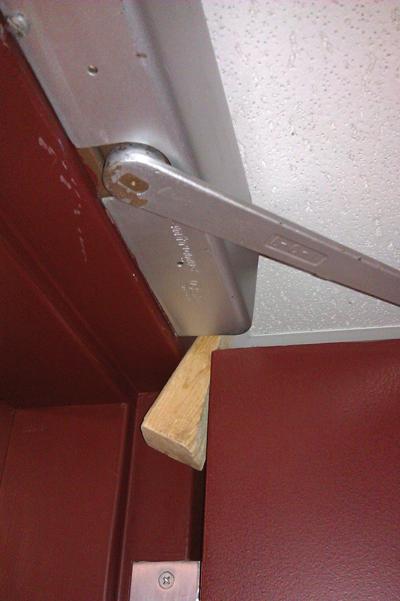
Know how potential openings can change ventilation.
Inspectors often encounter open fire doors
Doors are blocked open
Must be noted and corrected
Courtesy of Scott Strassburg

Slide 117
Thermal properties of compartments contribute to rapid fire development and difficult extinguishment.
Insulation
Contains heat within the compartment
Causes localized increase in temperature and fire growth
Heat reflectivity
Increases fire spread
Transfer for radiant heat from wall surfaces to fuel sources
Retention
Maintains temperature
Absorbs and releases large amounts of heat slowly

Slide 118
The total quantity of combustible contents of a building, space, or fire area is referred to as the fuel load.
Some use the term “fire load”
Includes all of a structure’s contents and structural components
Fire protection engineers can generate an accurate estimate using mathematical equations
Inspectors may only be able to generate an estimate based on knowledge and experience
Knowledge of building construction and occupancy types are essential

Slide 119
REVIEW QUESTION
List some factors that influence fire development within a compartment.

Slide 120
Inspectors need to understand the incipient stage of fire.
All fires occur as a result of piloted ignition or autoignition
Starts when 3 elements of the fire triangle come together
Fire is small
Confined to material first ignited
Development depends on characteristics and configuration of fuel
Adequate oxygen
Radiant heat warms adjacent fuel
Courtesy of Dan Madrzykowski/NIST
(Cont.)

Slide 121
Inspectors need to understand the incipient stage of fire.
Plume of hot gases and flame rises
Mixes with cooler air of the room
As it reaches the ceiling, hot gases spread horizontally
Mushrooming
Ceiling jet
Hot gases in contact with surfaces transfer heat
Heat transfer begins to increase temperature of the room
Courtesy of Dan Madrzykowski/NIST

Slide 122
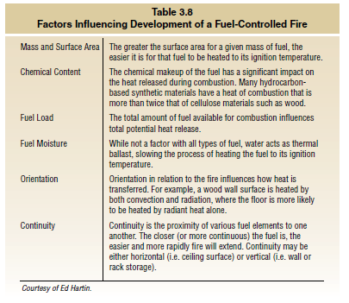
Know the factors that influence the development of fuel-controlled fires.

Slide 123
Know the characteristics of the incipient stage of fire.
Fire has not yet influenced the environment significantly
Temperature is only slightly above ambient
Occupants are more likely to escape
Growth from incipient stage can occur quickly
Essential to recognize the transition
Concentration of products of combustion is low
Fire could be safely extinguished with portable extinguisher or small hoseline

Slide 124
Inspectors need to understand the growth stage of fire.
Fire begins to influence the environment
Fire is influenced by
Environment
Amount of ventilation
Ceilings and walls affect the plume
Amount of air entrained into the plume
Location of fuel package in relation to walls affects air and cooling
Courtesy of Dan Madrzykowski/NIST

Slide 125
Know how unconfined fires reduce flame length and vertical extension.
Draw air from all sides
Entrainment of air cools the plume
Fires in fuel packages near walls can on entrain air from three sides
Fires in fuel packages in corners can only entrain air from two sides
Fuel packages in the middle of the room can entrain air from all sides

Slide 126
Understand the concept of vertical extension.
Occurs when fuel packages are not located in the middle of the room
Temperatures at ceiling level affected
Combustion zone expands vertically
Higher plumes result
Flame stretches further
Impacts hot-gas layer
Increases the speed of fire development
Wall surfaces become hot
Burning fuel receives more reflected radiant heat
Further increases speed of fire development

Slide 127
Thermal layering of gases is the tendency of gases to form into layers according to temperature.
Hottest gases
Coolest gases

Slide 128
Several things impact thermal layering of gases.
Heat transfer through radiation
Heat transfer through convection
Radiation from the hot gas layer acts to heat interior surfaces, contents
Changes in flow path and ventilation

Slide 129
Pressure increases as the volume and temperature of the hot gas layer increases.
Causes the hot gas layer to spread downward and out through openings
As hot gases exit through top of opening, cooler air from outside enters through the bottom of opening
Pressure is neutral where two layers meet (neutral plane)
(Cont.)

Slide 130
Pressure increases as the volume and temperature of the hot gas layer increases.
Neutral plane only exists at openings where
Hot gases are exiting
Cool air is entering
Inspectors can limit spread of gases and fire
Verify that all fire doors are equipped; make sure door closers are functioning
Courtesy of Dan Madrzykowski/NIST

Slide 131
Isolated flames may be observed moving through the hot gas layer.
Can occur as fire
Moves through growth stage
Becomes ventilation controlled
Indicates that portions of the hot gas layer are
Within their flammable range
Sufficient temperature for ignition
Find sufficient oxygen on the outer edges of the plume
Frequently observed prior to more substantial involvement
Courtesy of NIST

Slide 132
Rapid transition from growth stage to fully developed stage is known as flashover.
Environment of the room changes
Transition period can occur rapidly
During flashover, fire volume increases
From 2-layer condition to 1-layer condition
Becomes a well-mixed, hot gas condition from floor to ceiling
Between pre-flashover to post-flashover
From approximately ¼ to ½ of the room’s upper volume to filling the entire volume of the room
Potentially extending out of any openings in the room
Not survivable
Combustion can be flaming or nonflaming

Slide 133
Flashover does not occur in every compartment fire.
If a fire becomes ventilation controlled
Limits HHR
Causes fire to enter decay stage while continuing pyrolysis
Increases the fuel content of the smoke

Slide 134
Most fires that develop beyond the incipient stage become ventilation controlled.
Insufficient air to allow the fire to continue to develop based on fuel
If windows are intact and doors closed, becomes ventilation-controlled more quickly
Reduced HHR
Fuel will continue to pyrolize
Extremely fuel-rich smoke

Slide 135
Be aware of the type and amount of combustible furnishings and fuel load present during an inspection.
Decorations
Furniture
Wall coverings

Slide 136
Understand the fully developed stage of fire.
All combustible materials in compartment are burning
Releases maximum heat
Produces large volumes of fire gases
Ventilation controlled
Any increase in available air will result in higher heat release
(Cont.)

Slide 137
Understand the fully developed stage of fire.
Flammable products of combustion are likely to flow
From compartment of origin to adjacent compartments
Out through exterior openings
Flames will extend out of openings because there is insufficient oxygen
If no openings, unlikely fire will reach fully-developed stage

Slide 138
Inspectors need to know the characteristics of the decay stage of fire.
Occurs as
Fuel is consumed
Oxygen concentration falls to the point that flaming combustion diminishes
Decay due to reduced oxygen concentration can follow a considerably different path if
Ventilation changes before combustion ceases
Temperature lowers
Courtesy of Dan Madrzykowski/NIST

Slide 139
Understand fuel consumption in the decay stage of fire.
When fire enters the decay stage
Fire can become fuel controlled
HRR will drop
Consumes the available fuel
HRR begins to decline
If there is adequate ventilation
Temperature in the compartment will remain high for some time
Products of combustion can accumulate
Within compartment or adjacent spaces

Slide 140
Understand limited ventilation in the decay stage of fire.
HRR declines
May maintain an extremely high temperature within the compartment
Continuing combustion reaction
Temperature drops
Pyrolysis can continue

Slide 141
REVIEW QUESTION
What are the stages of fire?

Slide 142
Summary
The inspector’s job is to reduce risk. To this end, the inspector needs to understand the combustion process and how fire behaves in different materials and environments.
Understanding fire behavior will help the inspector evaluate fire protection systems that are designed to prevent fire or fire spread.
(Cont.)

Slide 143
Summary
The inspector must also be able to recognize how building design, construction materials, fuel loads, and combustible furnishings affect fire behavior and fire spread.
The inspector needs to understand that a solid working knowledge of fire behavior will help reduce the loss of life and property from fire and help businesses to operate more safely and provide for business continuance.

