Slide 1
Fire Inspection and Code Enforcement
8th Edition Inspector I
Chapter 15 — Plans Review and Field Verification

Slide 2
Learning Objective 1
Recognize the need for a plans review.

Slide 3
AHJ establishes a plans review and permitting process.
Involves representatives of the building and fire departments and other agencies
Members of the zoning department may also review plans to verify they meet zoning requirements

Slide 4
AHJ establishes and administers the plans review and permitting process.
Design Process
Architectural Design Concept
Planning and Zoning Review
Site/Civil Engineering
Complete Architectural Design
(Cont.)

Slide 5
AHJ establishes and administers the plans review and permitting process.
Permitting Process
Submittal
Review
Corrections
Approval
(Cont.)

Slide 6
AHJ establishes and administers the plans review and permitting process.
Construction Process
Construction
Final Inspection/Certificate of Occupancy

Slide 7
Building department plans examiners include specialists in design and installation.
Electrical
Plumbing
Structural
Mechanical (HVAC)

Slide 8
Fire department plans examiners receive additional training.
Fire protection systems
Fire and life safety requirements of locally adopted codes
Sprinklers
Standpipes
Fire detection and alarm devices

Slide 9
Inspectors are responsible for verifying activities and permits.
Make sure construction activities conform with what was approved by plans examiner
Verify permit documents
Be familiar with plans review and permitting processes

Slide 10
In some jurisdictions, the inspector who reviews plans may be responsible for field verification.
This method is most efficient because the reviewer is very familiar with the code requirements for the project
Can also cause problems because there is only one person looking at the documents

Slide 11
Develop a good working relationship with the plans examiner.
Get an orientation on the project
Review any areas that may be confusing or require particular care during inspection
(Cont.)

Slide 12
Develop a good working relationship with the plans examiner.
Verify contractor/owner statements about altered plans, materials, or requirements
Inspectors must not accept this statement as fact unless proper verification is made with an appropriate building or fire official
Team approach also helps to prevent owner/occupant or contractor from
Omit a requirement
Use nonapproved alternative materials or methods

Slide 13
Policies established by the AHJ will dictate procedures for accepting field changes.
May not have authority to approve or make any changes to approved plans
Authority to approve changes may rest solely with the fire marshal or building official
Recognize when unapproved changes have been made
Determine whether construction should be stopped

Slide 14
REVIEW QUESTION
What is the role of the Fire Inspector I in the plans review and permitting process?

Slide 15
Be familiar with the benefits of plans review.
Main reason construction permits and plans review are required is community safety
Building design and construction affect
Electrical safety
Plumbing
Ventilation
Fire and life safety
Structural integrity

Slide 16
The plans review process enables reviewers to verify or improve construction standards.
Enforcement protects public from shoddy construction and inferior workmanship
Ensures methods conform to existing infrastructure and other off-site considerations

Slide 17
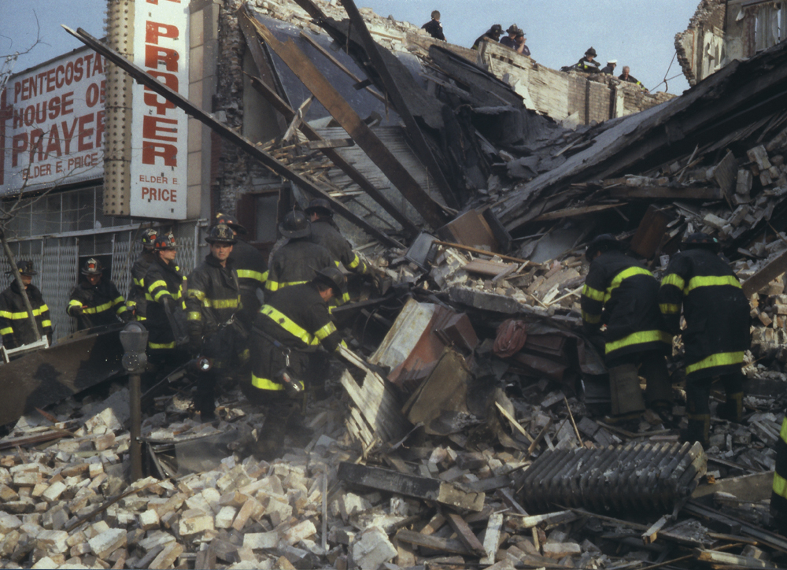
The plans review process enables reviewers to verify or improve firefighter and responder safety.
Information learned in the areas of building remodeling and renovation improves safety
Permits ensure firefighters and emergency responders do not face unknown and potentially dangerous structural conditions

Slide 18
The plans review process enables reviewers to have input in the design process.
Verify fire code requirements are met for many variables
Hazardous materials storage
Use and handling operations
Installation of fire protection systems and/or assemblies
Emergency vehicle access

Slide 19
The plans review process enables reviewers to verify or improve information about construction projects.
Useful for preincident planning
Provides ongoing information on evolving construction technology

Slide 20
The plans review process provides an opportunity to correct errors.
Enables plans examiners to discover any errors or omissions in a building plan
Corrections to fire and life safety issues before construction begins, ultimately saves money and time

Slide 21
REVIEW QUESTION
What is the main reason local governments require a plans review?

Slide 22
Learning Objective 2
Identify actions an inspector should take during a plans review.

Slide 23
During construction, an inspector should visit the site often for two reasons.
1. To verify each code requirement is being met based on the approved plan
At the initial visit, an inspector meets the general contractor or project manager
Contractor can supply a list of target completion dates for inspection
Coordination makes inspector’s efforts more efficient and effective
Explains purpose of field verification inspections
(Cont.)

Slide 24
During construction, an inspector should visit the site often for two reasons.
2. To verify fire and life safety requirements needed during construction are met
Site access
A reliable water supply
Inspection of temporary fire protection systems

Slide 25
Know what requirements inspectors need to comply with on construction sites.
Occupational Safety and Health Administration (OSHA) regulations or locally adopted requirements for the use of personal protective clothing and equipment

Slide 26
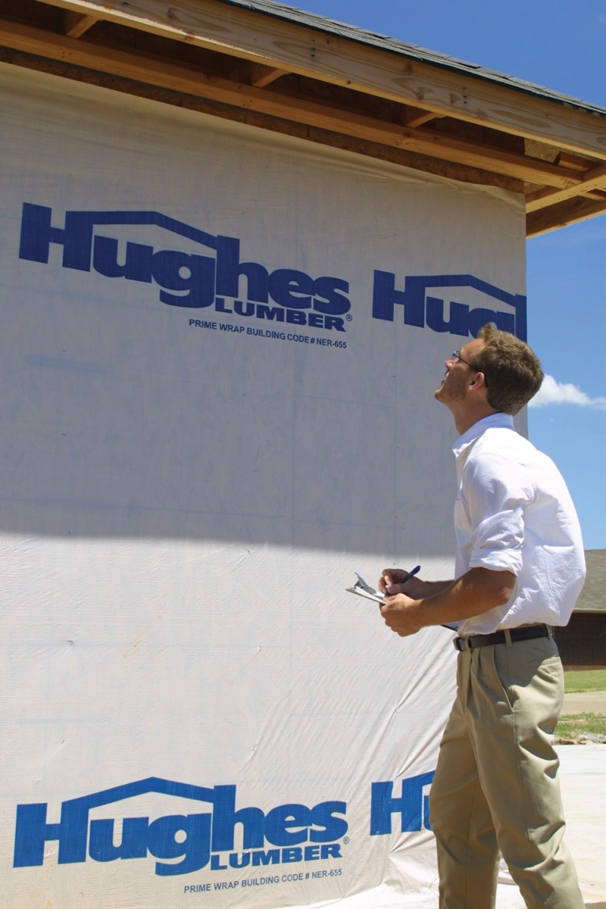
Know what actions an inspector should perform at a construction site.
Check in with general contractor, project manager, or superintendent before entering
Compare approved construction plans kept on site with the ones maintained by the building or fire prevention office
Use a checklist to record items as they are inspected
Explain specific items or activities that must be verified
(Cont.)

Slide 27
Know what actions an inspector should perform at a construction site.
Notify general contractor when violations are found and verify corrections are made
Develop a report noting items inspected
Contact general contractor or other responsible party before leaving the site
Depending on jurisdiction's fire code, construction may not resume until violations are corrected

Slide 28
Understand the importance of thorough record keeping.
Accurate and complete records establish the basis for all future inspections of the building
Records may be required for use in any legal actions

Slide 29
Occupants and their belongings may remain in the building during construction.
Their possessions, in addition to accumulated debris, construction materials, and equipment can increase the fire load
Verify all means of egress are clear
Fire detection or alarm systems should remain intact for the duration of construction
If a system will be nonfunctional for any length of time, a fire watch should be posted

Slide 30
NOTE
The same precautions should be followed for renovations.

Slide 31
Documents should be submitted in a professional and uniform manner.
Building plans
Construction drawings
Support documents
(Cont.)

Slide 32
Documents should be submitted in a professional and uniform manner.
AHJ usually establishes exact manner in which plans must be submitted
Plans submitted to an AHJ are official documents
Sketches, incomplete drawings or plans, or documents with inaccurate calculations are unacceptable
Local ordinances may require that a registered design professional submit plans

Slide 33
Become familiar with abbreviations and symbols used on construction drawings.
Increase efficiency with which drawings convey information
Reduce clutter that would result from describing every detail
Large number of abbreviations can be used on construction drawings
It is not necessary to memorize all of them
Be familiar with some of the more commonly used abbreviations and symbols
(Cont.)

Slide 34
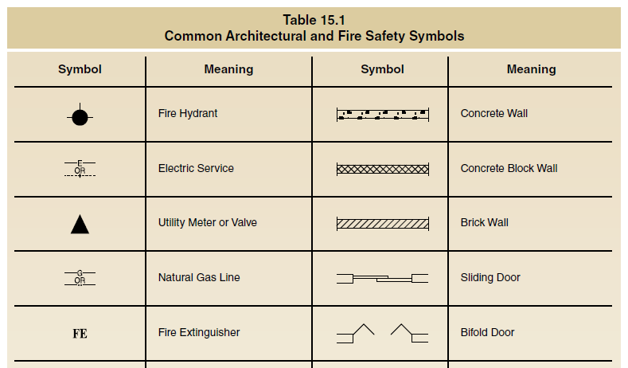
Become familiar with abbreviations and symbols used on construction drawings.
(Cont.)

Slide 35
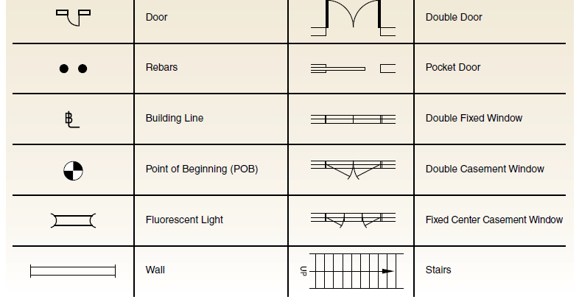
Become familiar with abbreviations and symbols used on construction drawings.

Slide 36
REVIEW QUESTION
Why should an inspector visit the site often during construction?

Slide 37
Summary
Inspectors and plans examiners from the fire department play an important role in the plans review and field verification process.
A Level I Fire Inspector is only required to be able to read construction plans and verify that the requirements are being met during construction.
(Cont.)

Slide 38
Summary
The inspector needs to be able to verify that all code requirements regarding occupant fire and life safety are met before and during the construction of the building or structure. This activity may require coordinating with inspectors from other fields such as mechanical or electrical.
(Cont.)

Slide 39
Summary
Finally, construction plans review and field verification are keys to the proactive approach to fire and life safety. Verifying that a building provides an acceptable level of fire and life safety construction and systems saves lives, reduces property loss, and reduces fire protection costs to the community.

