Slide 1
Fire Inspection and Code Enforcement
8th Edition Inspector I
Chapter 9 — Fire Hazard Recognition

Slide 2
Learning Objective 1
Identify unsafe behaviors that may require code enforcement.

Slide 3
Inspectors can educate occupants about several important problem areas.
Inadequate housekeeping
Unintentional ignition sources
Open burning
Improper use of electrical equipment
Improper use and storage of flammable and combustible liquids

Slide 4
Inadequate housekeeping can contribute to fire load and prevent safe exit during an emergency.
In terms of fire and life safety, housekeeping involves creating and maintaining a clean and safe environment
Enforcing appropriate sections of the locally adopted fire code can help increase safety and reduce or eliminate fire hazards
Courtesy of Scott Strassburg

Slide 5
Know what poor housekeeping looks like.
Accumulations of trash or litter, particularly near ignition sources
Oily rags in open waste containers
Overgrown grass, weeds, and brush
Obstructions that prevent safe and orderly exit and/or clear exit access
Courtesy of Rich Mahaney

Slide 6
Unintentional ignition sources include any material that can initiate combustion in a fuel.
Open flame
Spark
Heat that friction creates
Heating device
Overheated circuit, or damaged cord or electrical equipment
Any number of other sources

Slide 7
Complacency leads to unsafe behaviors related to ignition sources.
Disposing of smoking materials improperly
Igniting a flame in a flammable atmosphere
Ignoring prohibitions on open flames or smoking
Leaving items unattended on a stove
Placing portable heating devices too close to combustible materials
Leaving any open fire unattended
Allowing children access to ignition sources
Using candles improperly
Plugging too many electrical appliances into a circuit
Failing to control or supervise hotwork
Failing to verify that fire is completely out

Slide 8
Know which agencies are responsible for regulating open burning.
Agricultural commissioner
Air quality management district
Fire district

Slide 9
Know what regulations apply to open burning.
Permissible (or forbidden) times, air quality, or weather conditions
Mandatory attendance during the burning period
Availability of fire extinguishing equipment
Separation distances from exposure buildings or properties
Clearance of vegetation around the burn site
Acceptable fuels used to ignite combustible materials

Slide 10
Most model fire codes require that an individual apply for a permit before the desired burn date.
Application receipt
Issue a burn permit that describes the required conditions
Visit the site to verify that conditions are in compliance with adopted regulations

Slide 11
NOTE
Inspectors should only approve burn permits when all conditions are in compliance with the jurisdiction’s open burning regulations.

Slide 12
Inspectors need to know how model codes describe open burning.
Burning of combustible waste
In metal drums or excavated pits
In debris piles
At construction or demolition sites (combustible construction materials)
Usually organic waste such as trees, leaves, and brush
(Cont.)

Slide 13
NOTE
Certain areas no longer allow the use of barrels for burning of trash and other debris. Check your local open burning regulations for specific requirements.

Slide 14
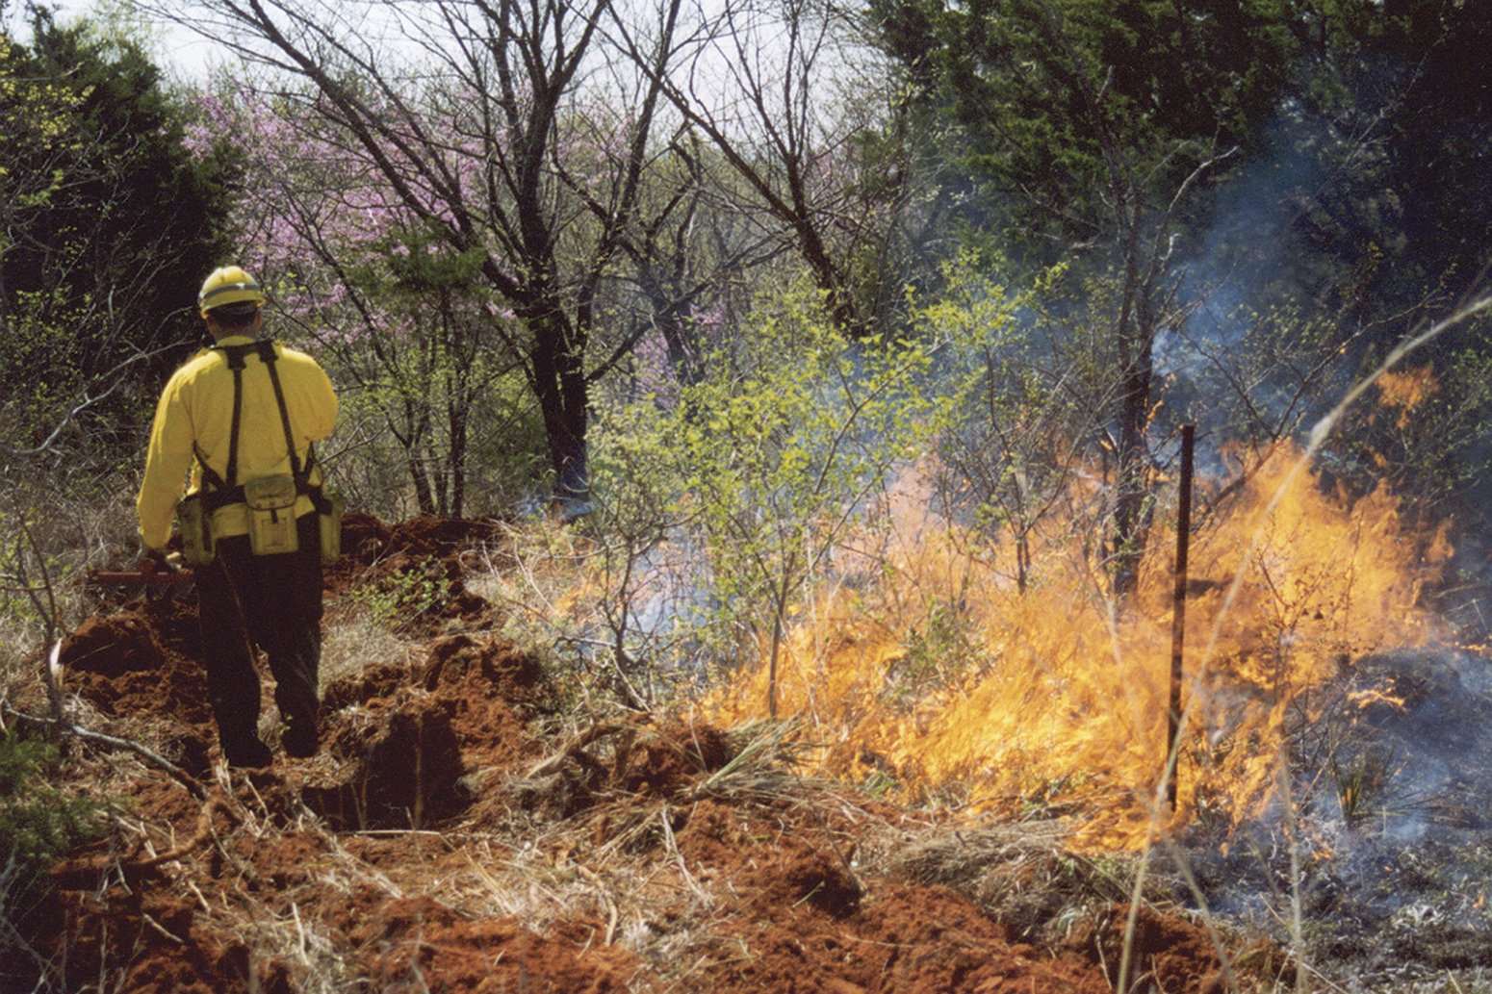
Inspectors need to know how model codes describe open burning.
Prescribed burning to control vegetation
Dead fuels in wildland-urban interface areas
Natural areas such as forests and agricultural fields
(Cont.)

Slide 15
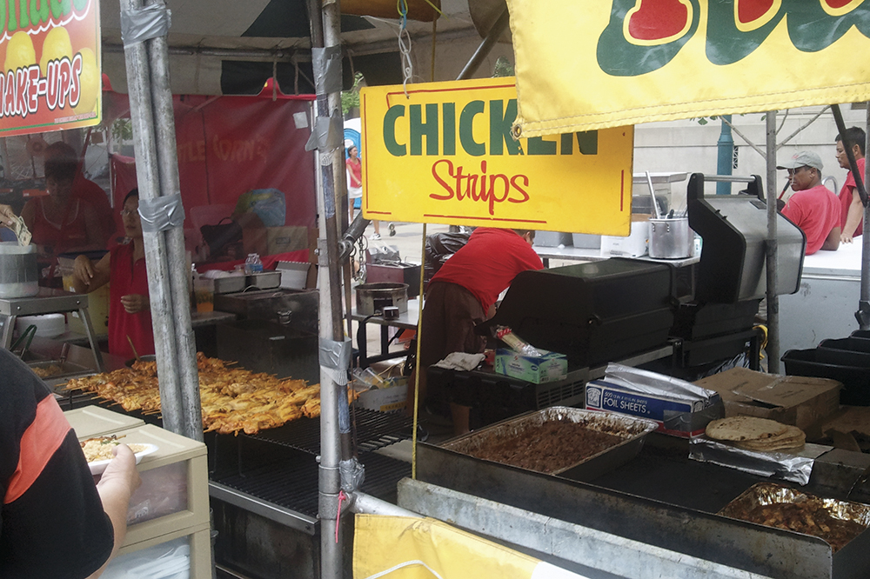
Inspectors need to know how model codes describe open burning.
Torches
Flaming food or beverages in restaurants
Disposing of a worn or damaged American Flag
Recreational fires
Courtesy of Scott Strassburg

Slide 16
NOTE
Recreational fires do not include burning of rubbish and waste, or fires that are contained in an incinerator, outdoor fireplace, barbeque pit, or similar appliance. Cooking equipment hazards are described later in this chapter. Fires that are contained to outdoor fireplaces and barbeque grills/pits that are used to cook food and provide warmth are typically not classified as open burning.

Slide 17
NOTE
The jurisdiction’s locally adopted fire codes may limit recreational fire activities because of unfavorable weather conditions or materials that exceed fire area and height restrictions.

Slide 18
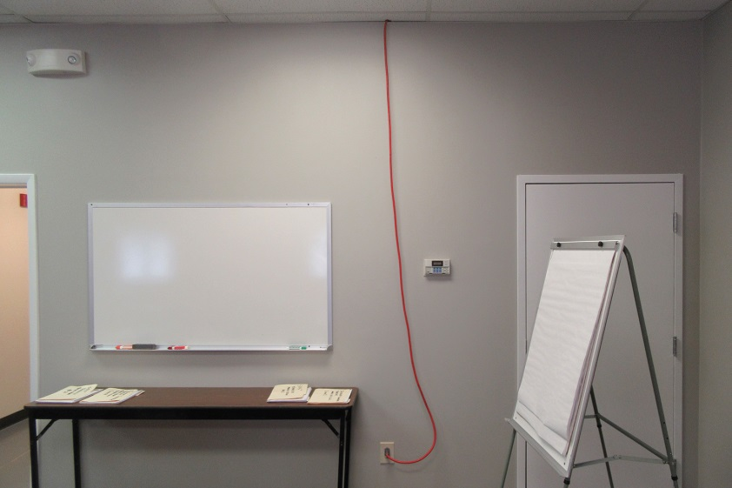
Know how to recognize unsafe uses of electrical equipment.
Overloaded wiring or receptacles
Daisy chains
Frayed or damaged extension cords
Extension cords used for permanent wiring, affixed to walls, or run through doors, ceilings, or joists
Extension cords that are undersized in amperage capacity for the equipment plugged into them
(Cont.)
Courtesy of Rich Mahaney

Slide 19
Know how to recognize unsafe uses of electrical equipment.
Tools that can cause electrical shorts
Unprotected temporary lights
Tampering with grounded circuits
Courtesy of Rich Mahaney
(Cont.)

Slide 20
Know how to recognize unsafe uses of electrical equipment.
Unauthorized alterations to electrical systems
Disabled or bypassed shutoff switches, circuit breakers, or other required electrical disconnects
Courtesy of Rich Mahaney

Slide 21
Know what hazards unsafe use of electrical equipment present.
Present potential ignition sources
General-purpose electrical equipment can cause explosions in certain atmospheres
Equipment used in areas where explosive concentrations of dusts or vapors may exist
Increase the danger of electrocution or shock
Motors in particular may need to be nonsparking and intrinsically safe equipment

Slide 22
Understand how NFPA® 70, National Electrical Code classifies electrical hazards.
Class I locations
Class II locations
Class III locations
Flammable vapors and gases may be present
Combustible dust may be found
Ignitable fibers may pose a hazard
Further breakdown
Analyzing locations
Based on materials and divisions based on operating conditions
Enable protective measures to be taken that account for both cost and safety

Slide 23
REVIEW QUESTION
What are some examples of unsafe behaviors?

Slide 24
Learning Objective 2
Identify improper use or storage of flammable and combustible liquids.

Slide 25
Learn how to recognize unsafe use of flammable and combustible liquids.
Improperly dispensing, mixing, or transferring flammable and combustible liquids
Using flammable liquids for cleaning
Storing flammable or combustible liquids in unapproved containers or location
Using a flammable liquid such as gasoline to ignite a solid fuel, such as charcoal briquettes

Slide 26
NOTE
Powered industrial trucks can also be ignition sources, as can vapors from distilleries.

Slide 27
Know the rules that apply to the safe handling of hazardous liquids.
Classes IA through IC and Class II liquids
Classes IA through IC liquids
Classes IA through IC liquids
Electrical bonding and grounding
Must be kept in covered safety containers when not in use
Must not be used in presence of possible ignition source such as open flames, electrical arcs, or heating elements
Cannot be stored in containers that are pressurized with air
May be stored in containers pressurized with an inert gas
Appropriate procedures must always be followed

Slide 28
Know the rules that apply to dispensing hazardous liquids.
Loading and unloading stations for Classes IA through IC liquids must be located no closer than 25 feet (8 m) from storage tanks, property lines, or adjacent buildings
(Cont.)

Slide 29
Know the rules that apply to dispensing hazardous liquids.
Loading/unloading stations for Class II and Classes IIIA and IIIB liquids must be located no closer than 15 feet (5 m) from these same objects
Loading/unloading stations must be constructed on level ground
Curbs, drains, natural ground slope, or other means are required
Adequate ventilation must be maintained

Slide 30
Understand the risk of static electricity.
Some types of liquids, including light fuel oils, toluene, gasoline, and jet fuels can develop static electrical charges on their surfaces
If a static discharge occurs at the same time that a flammable mixture is near, a fire or explosion can result

Slide 31
Know how to protect against static discharges.
Tanks must be bonded together with a metal chain or strap

Slide 32
Be aware of other reasons for bonding and grounding.
Bonding and grounding are also necessary when Class II or Classes IIIA and IIIB liquids are loaded into containers that have previously contained Classes IA through IC liquids
All bonding connections must be completed before dome covers, lids, or caps are removed
Bonding is also needed between the dispensing device and receiving containers

Slide 33
Pumping liquids from underground tanks, using pipes, to dispensing equipment is the safest handling procedure.
Perhaps the safest procedure for dispensing from a fire-protection standpoint
Dispensing equipment must be kept in specially designed rooms or outside the structure
Piping materials must resist any corrosion from the material being transferred
Piping must be able to withstand the maximum service pressure and temperature, thermal shock, and physical damage

Slide 34
Know other requirements for dispensing.
All transfer systems must be designed so that liquids do not continue to flow by gravity or by siphoning if a pipe breaks
Control valves must be located at easily accessible points along the piping to control the flow
Ensure that all piping and connections are inspected on a regular basis for signs of deterioration or leakage and replaced as necessary

Slide 35
Know requirements for transfer of compressed/liquefied gases.
Usually transferred by replacing storage cylinders or refilling cylinders or tanks
Must be a standard procedure for all disconnect and transfer operations
When deliveries are made, the receiver must verify that the cylinders are in good condition and labeled properly
Written SOP must be in place
Delivery truck drivers must be warned when unloading operations are in progress so they do not attempt to drive away while hoses are still connected

Slide 36
Know requirements for cylinders on loading stations.
Labels
Loading hose
Bonding
Color coding
Must be clear; name of the gas
Can be useful; but must not be relied upon totally
Must be properly maintained
Replaced at least every 5 years
Must be stored away from direct sunlight
Generally not required if the hose has vapor-tight connections

Slide 37
Dispensing of flammable solids or explosives and blasting agents may also result in spills or releases.
Spills are not as dangerous as the release of liquids or gases
Easier to contain and clean up
Disposal of spills must conform to the appropriate federal regulations for hazardous materials

Slide 38
The most obvious forms of transport for flammable and combustible liquids are bulk packaging containers.
May be found on railway lines, highways, and at loading and unloading facilities
Boxcars, cargo trucks, and delivery vehicles are less obvious
Shipments may be contained on pallets or in mixed shipments of other products
(Cont.)

Slide 39
The most obvious forms of transport for flammable and combustible liquids are bulk packaging containers.
Must be familiar with the local fire and zoning codes that regulate the parking
Other ordinances may regulate the streets or roads
Small commodities may be mixed in with others that create a much greater hazard; vehicles containing them may not be required to have markings

Slide 40
REVIEW QUESTION
Name some of the unsafe behaviors inspectors may encounter when dealing with flammable and combustible liquids.

Slide 41
Know what to look for when inspecting handling of compressed/liquefied gases.
Verify that workers are properly trained and under competent supervision
Review a company’s administrative and engineering control policies/guidelines to expose potential unsafe behaviors

Slide 42
Know what actions control hazards when handling compressed/liquefied gas cylinders.
Use only cylinders approved for interstate transportation
Roll cylinders on their bottom edges instead of dragging
Use manufacturer-approved lifting devices and methods for moving cylinders
Ensure numbers or marks stamped on cylinders remain in place and unchanged
Protect cylinders from cuts or other physical damage
(Cont.)

Slide 43
Know what actions control hazards when handling compressed/liquefied gas cylinders.
Ensure employees do not drop cylinders or let them strike each other
Ensure employees do not use cylinders for rollers, supports, or any purpose other than to contain gas
Ensure employees do not tamper with safety devices
Contact supplier or manufacturer when in doubt about proper handling
Mark empty cylinders with the word Empty or the letters MT; secure valve caps in place

Slide 44
Inspectors must ensure certain safety precautions are observed in areas containing gas cylinders.
Prohibit smoking in area where cylinders are stored or used
Provide adequate ventilation to prevent accumulation of flammable gas vapors
Enclose electrical elements in glass to prevent direct contact with flammable gases, and keep electric lights in a fixed position
Locate electrical switch devices outside the storage room and ensure they are designed to be explosion-resistant
Equip glass light enclosures with a guard to prevent breakage
(Cont.)

Slide 45
Inspectors must ensure certain safety precautions are observed in areas containing gas cylinders.
Cover cylinder valves with safety caps when cylinders are not in use to protect valves and male threads
Anchor stored cylinders to a wall or other secure object with chains around the tank so they cannot be knocked over accidentally
Nest bulk cylinders as opposed to anchoring and chaining them
Ensure that owner/occupant provides a written list of procedures for handling and storage of all gases present
Store and/or use cylinders at ground (grade) level and in areas that have sufficient ventilation
(Cont.)

Slide 46
Inspectors must ensure certain safety precautions are observed in areas containing gas cylinders.
Always disconnect a cutting torch head or instrument from the supply hose before storing it in a tool box or cabinet
Ensure that oxygen cylinders, hoses, and connections are free of oil, grease, or other hydrocarbon (petroleum-based) lubricants
Secure cylinders properly with caps in place
Maintain gas cylinders as prescribed by DOT specifications
Store incompatible gases in separate areas
(Cont.)

Slide 47
Inspectors must ensure certain safety precautions are observed in areas containing gas cylinders.
Store cylinders in an area that is clean and free of accumulated combustible materials
Remove cylinders that have been abused, dented, arc-struck, damaged, or are severely corroded from service and replace
Remove cylinders that have expired hydrostatic test dates from service
Install and maintain pressure-relief devices with appropriate settings and adequate pressure-relief capacities

Slide 48
REVIEW QUESTION
Name some of the actions that must be taken to control hazards when handling compressed/liquefied gas cylinders.

Slide 49
Learning Objective 3
Recognize unsafe conditions that have hazardous fire growth potential and may require code enforcement.

Slide 50
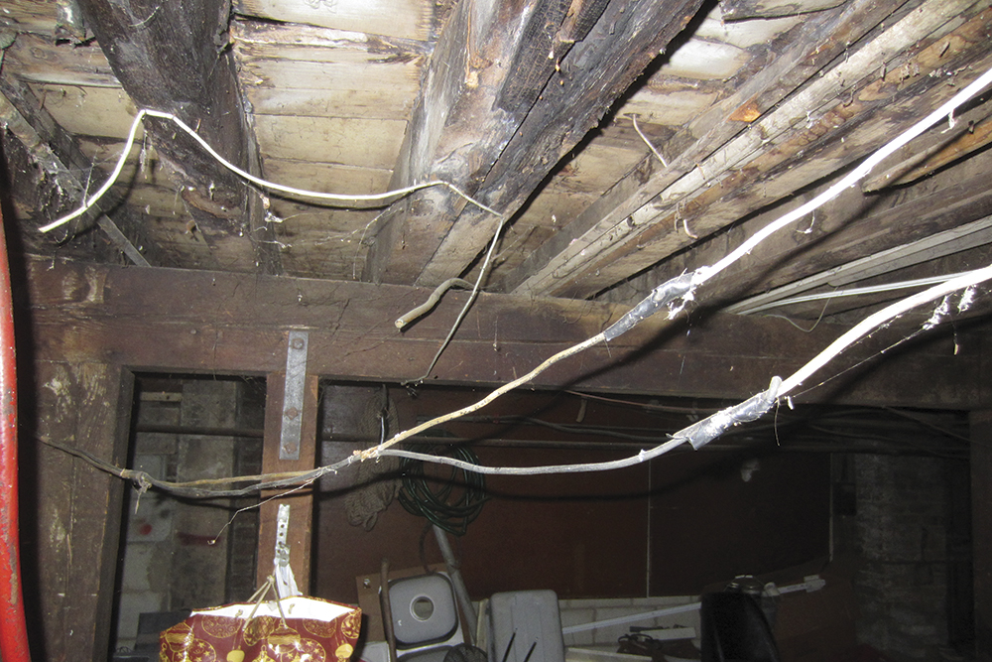
Proper application of locally adopted codes reduce unsafe conditions.
Electrical hazard conditions (pictured)
Material storage facilities
Recycling facilities
Courtesy of Rich Mahaney

Slide 51
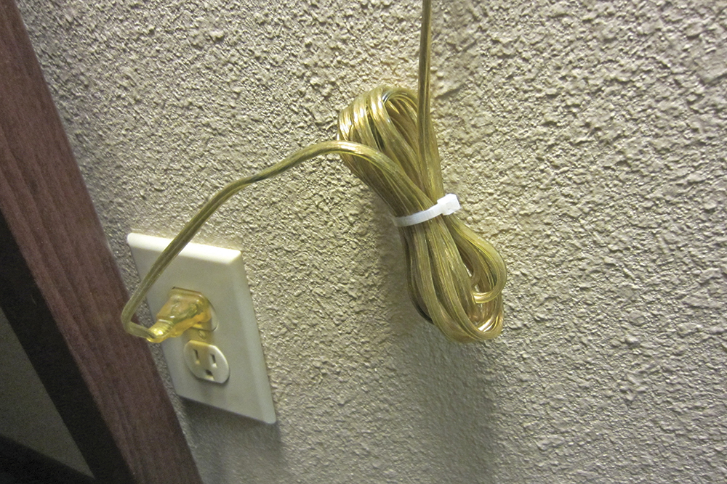
Know inspector duties regarding electrical hazards.
Typically the responsibility of qualified electrical inspectors
Inspectors should have a basic knowledge of electrical theory
Report any concerns to electrical inspectors for correction
Inspector needs to be able to recognize potential electrical hazards
Courtesy of Rich Mahaney

Slide 52
Understand the risks of worn electrical equipment.
May be prone to arcing and subsequent overheating of surrounding materials to their ignition point
Wear may be due to improper equipment maintenance or equipment that has reached the end of its lifespan

Slide 53
Arcing is the movement of a current between two electrodes or conductors.
Arcing inside electrical equipment may heat the appliance housing or nearby materials to ignition temperature
Arcing can ignite combustible materials
Ignition usually occurs when electrical connections become loose through usage, vibration, or normal wear

Slide 54
A common electrical hazard occurs when electrical equipment is used improperly.
Overloading circuit beyond its design capabilities
Exposes nearby combustibles to heat and may ignite
Overloads results in exponential growth of heat
Courtesy of Scott Strassburg

Slide 55
Several factors contribute to defective and improper electrical installations.
Unpermitted electrical work
Unskilled technicians
Installation mistakes

Slide 56
Know where to find installation documentation.
Permit/electrical plan
Created at the time of system design or certificate of occupancy
Requirements
Consult to help determine the cause
Manufacturer’s specifications and requirements
NFPA® 70®, National Electrical Code®
ICC Electrical Code™ from International Code Council® (ICC®)
Any other applicable codes and standards
Those specified by the electrical engineer

Slide 57
NOTE
The Consumer Product Safety Commission (CPSC) can recall even properly installed equipment or the equipment can become obsolete or unrepairable.

Slide 58
Know other risks of improperly installed of maintained electrical equipment.
Significant contributing factor in fires caused by electricity
Usually, the affected equipment is not suited for the type of installation, location, or intended use
Most fires in electrical equipment are caused by arcing or overheating of surrounding materials
As changes are made to an electrical system, a building custodian or responsible party should track the changes

Slide 59
REVIEW QUESTION
What are some of the signs that could indicate electrical hazards are present?

Slide 60
Know potential hazards of material storage.
Storing products too close to ceilings
Obstructing or blocking fire sprinkler system components
Improperly storing flammable liquids

Slide 61
Storage facilities frequently change stock inventories and locations.
Changes in contents
Changes in storage arrangement
Includes changes in height
May increase fuel load
Can result in a hazard that is under-protected, even in a facility with an automatic sprinkler system
Storage systems
In-rack sprinkler arrangements
Width of access aisles

Slide 62
The growth in big-box stores presents additional storage concerns.
Thousands of square feet (m²) of space under a high roof
Products stored and sold from high-piled shelving
Products range from lawn and garden supplies to hardware and appliances
Combustible materials such as lumber and tires may be stored inside the store, outside the store, or both

Slide 63
NOTE
ICC High-Piled Combustible Storage Application Guide is a resource for the inspector.

Slide 64
Review documentation to verify fire protection systems are maintained.
Responsibilities
Fire protection systems
Supervised automatic sprinkler systems
Fire hose valves in areas of high-piled storage
Smoke removal systems
Portable fire extinguishers
Store owners usually responsible for design, installation, and maintenance of these systems
Inspectors verify that systems have been maintained according to manufacturer’s specifications

Slide 65
Inspectors are responsible for informing fire suppression units about storage conditions.
Recognize appropriate distances between materials
Note housekeeping issues
Be aware of fire protection measures specified for materials regardless of location
Be aware of code requirements for minimum aisle widths, compatible materials, and fire protection systems

Slide 66
Inspectors need to know code requirements for three primary storage methods.
Pallet storage
Rack storage
Solid piling

Slide 67
Know the characteristics of pallet storage.
Uses pallets to store materials
Multiple stacked pallets make it more difficult for water from a sprinkler to reach, wet, and control a fire
May include encapsulating the pallets with plastic wrap, which creates additional hazards

Slide 68
Inspectors should know hazards related to pallet storage.
Materials are generally stacked in a way that allows several pallets to be stacked on top of each other
Materials on pallets are often completely encapsulated in plastic wrap
Plastic encapsulation prevents water from a fire suppression system from penetrating the surface of the materials stored
Air space between top and bottom layers of the pallets provides a natural path for promoting the spread of fire
(Cont.)

Slide 69
Inspectors should know hazards related to pallet storage.
Packing/wrapping materials also add to the fuel load; may be regulated for type and amount used
Pallets stacked several layers high prevent water from sprinklers from reaching bottom layers
Plastic pallets will change the commodity class if the sprinkler system was not designed for Group A plastics

Slide 70
Inspectors should know the characteristics of rack storage.
Uses a structural framework (racks) onto which pallets or other materials are placed
Height varies depending on inside height and equipment available to load and retrieve items
Warehouses and retail outlets may have sprinklers located within the racks themselves
Requirements may be found in NFPA® 13, Standard for the Installation of Sprinkler Systems

Slide 71
Inspectors should know the hazards related to rack storage.
Presents the most challenging fire protection problem because it exposes more surface area to a fire
Provides pathways for the spread of fire, such as flue spaces

Slide 72
Inspectors should know the characteristics of solid piling.
Involves stacking materials directly on top of each other manually or with a forklift
Gives a fire the least chance to develop
Limits the air space between the fuel units

Slide 73
Know requirements for commodities in high-piled combustible storage.
Vehicle tires
Plastics
Flammable liquids
Unused pallets

Slide 74
Know inspection guidelines for storage facilities or retail outlets.
Before you go
Building construction characteristics
Review storage documentation
Onsite
Location of fire walls, fire door assemblies, and fire barriers
Types and classifications of stored commodities, including plastics
Type of packing material used
Methods of storage
Maximum storage height of commodities
(Cont.)

Slide 75
Know inspection guidelines for storage facilities or retail outlets.
Onsite
Type and design of automatic sprinkler system; fire pump if provided
Type of water system; meet minimum flow and pressure
Locations of water sources, hydrants, standpipes, and fire department connections
Locations and types of smoke and fire detectors
Method of smoke removal
Training records for facility personnel
Disposal method/storage of waste and packing materials
Aisles and doors are clear

Slide 76
Know when to return for additional inspections.
Request information
Methods used to change inventory
Way inventory is located and positioned
Look for patterns
Return to conduct an inspection at those times
If there is a pattern of higher activity in the warehouse when it approaches capacity or when higher-risk materials are stored

Slide 77
Understand the issues that are important to inspectors.
Introduction of high-risk commodities
Maintaining required clearances between automatic sprinklers and stored materials
Maintaining specified aisle dimensions

Slide 78
Inspectors need to know which items need to evaluated.
Fire detection and reporting systems
Security systems
Structural and electrical systems
Storage methods and practices
Locator and lot identification systems
Descriptive inventories, weight tickets, warehouse receipt, service orders

Slide 79
REVIEW QUESTION
What kinds of information should an inspector be prepared to verify when onsite at a storage facility or retail outlet?

Slide 80
Warehouses present extreme challenges to fire suppression operations.
Be alert for conditions that will contribute to rapid fire growth
Assess configuration and type of fuels within the structure
Diligently inspect automatic sprinkler systems
Examine storage heights to determine whether materials are too close to sprinklers
Verify that storage methods do not impede fire detection systems
Examine records to verify sprinklers are functional and serviced as required
Consult NFPA® 25

Slide 81
Inspectors need to know what recommendations to make regarding exposure protection.
Perimeter storage
Separation distances
If separation is not possible, fire-resistive walls can be used
Vegetation
Mow areas prone to growth
Treat with effective weed-control herbicide
Waste
Store or stack noncombustible materials to act as a barrier between yards and adjacent property
Maintain required distances between materials specified in the fire code
Height and area of storage can be reduced
Control weeds and vegetation away from storage areas
Do not allow materials such as sawdust, dry vegetable matter, and bark to accumulate
(Cont.)

Slide 82
Inspectors need to know what recommendations to make regarding exposure protection.
Smoking and hot-work
Permit smoking and hot-work operations only in designated areas
Signs should be posted
Heating devices
Do not allow portable heating devices or open fires in lumber storage area
If permitted, they should be limited to approved-type equipment installed in an appropriate manner

Slide 83
High fuel load is the primary hazard associated with lumberyards.
High fuel load is created by large quantities of combustible materials stored on the site
Quantity and variety these materials contributes to a fire that can overwhelm local fire suppression resources
May be required to adhere to different building code requirements

Slide 84
Know what conditions can influence the growth of lumberyard fires.
Large, undivided stacks of materials
Congested storage conditions
Delayed fire detection
Inadequate fire protection
Combinations of Class A and Class B materials in close proximity

Slide 85
Know important code provisions for open-yard lumberyards.
Lumber stacks must be located on solid ground
Preferably paved
Surfaced with materials such as cinders, fine gravel, or stone
Courtesy of Rich Mahaney
(Cont.)

Slide 86
Know important code provisions for open-yard lumberyards.
Heights of stacks must not exceed 20 feet (6 m)
Turning radius of all driveways must meet requirements of largest fire apparatus that could respond to that location
Fire department-approved padlocks or key boxes must be used to secure the facility
Gates and driveways must be wide enough to accommodate fire department’s largest vehicle
Courtesy of Rich Mahaney

Slide 87
Understand the hazards presented by tire storage facilities.
Fires involving tires produce intense heat, enormous amounts of smoke, and toxic oil
Readily allow for the spread of heat and flames
Fires involving tires not protected by sprinklers usually burn for long periods
Adequate separation of manageable areas of tires must be planned and enforced
Courtesy of Rich Mahaney

Slide 88
Know where inspectors may encounter tire storage.
Inside tire storage
Outside tire storage
Problems
Facilities are often closely related to scrap tire processing and burning operations
May be found in tire or automotive stores, warehouses, big-box retail outlets, and tire manufacturing facilities
Junkyards or scrap tire storage facilities
Scrap tire storage facilities have resulted in numerous serious fires

Slide 89
Know the characteristics of pallet storage facilities.
Found in facilities that store, ship, and receive large quantities of materials
Loaded pallets will be present on loading docks and in storage areas
Idle pallets can be stored inside or outside the facility
Damaged pallets found in piles around the perimeter
Majority of pallets are wooden
Controlled the same way waste inside a facility

Slide 90
Inspectors need to know the standards set by NFPA® 13.
Present stricter standards for warehouses using plastic pallets
Storage facilities with the highest levels of built-in protection can safely use plastic pallets that have no fire retardants
Older facilities with lower levels of fire protection cannot

Slide 91
Know the hazards presented by recycling plants.
Bulk storage of combustible materials
Hazardous processes conducted on the premises
Facilities that handle wastepaper and cardboard have extremely high fuel loads; usually contained in large bundles
Same general rules for outdoor lumber storage apply to bulk storage outside a building
Be aware that bundled materials may be found at large retail outlets
Many other types of materials can be recycled

Slide 92
Recycling facilities process different types of materials on the same site.
Most types of metals and plastics
Batteries
Motor oil
Cooking oils from restaurants

Slide 93
Know the characteristics of waste recycling operations.
May also be located inside buildings
Buildings are usually large, with separations for the different materials being processed
Conveyor belts may run through the structure
Structure may also be designed to enable tractor-trailer-type trucks to drive through

Slide 94
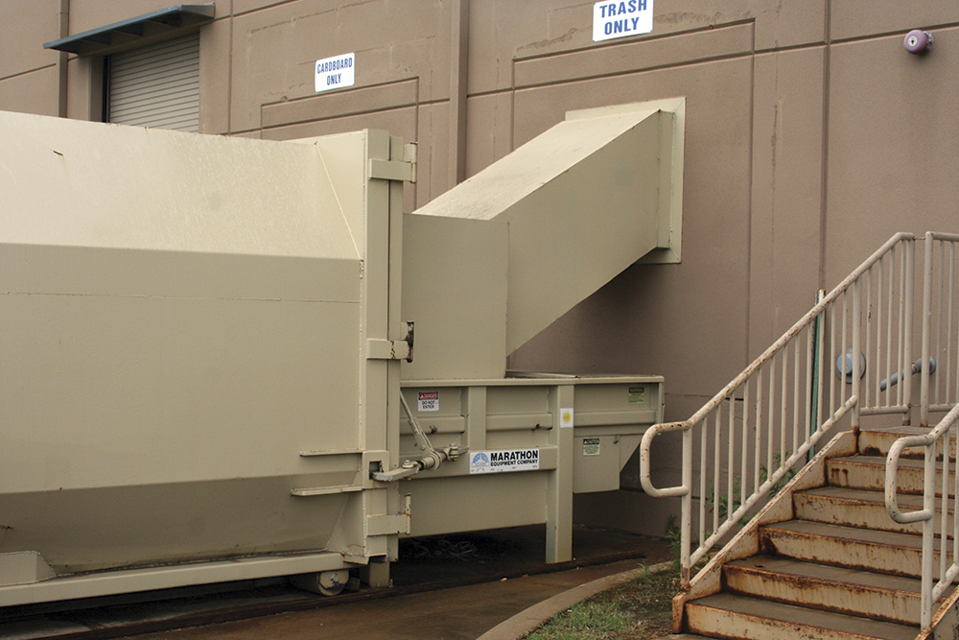
Check all material-handling equipment within the occupancy.
Waste chutes and handling systems
Shredders
Extruders
Conveyor belts
Compacting machines

Slide 95
Verify that safety measures are being taken while processing different materials.
Piles of combustible materials should not be stored in the same area where cutting torches are used
Hot ashes, coals, cinders, or materials subject to spontaneous heating should be stored in approved metal containers
Containers should not be located near stored combustible materials

Slide 96
Know the characteristics of waste-handling facilities.
Involve disposal of nonrecyclable materials
Operations of this type are extremely complex
Require ever-increasing level of expertise on the part of an inspector
Present unique challenges to inspection and fire suppression personnel
Includes everything from municipal trash to hazardous or biological materials

Slide 97
Know methods uses to dispose of waste materials.
Burning
Steaming
Microwaving
Ozone sanitizing

Slide 98
Work closely with fire suppression personnel.
Can limit the potential risk to the community and emergency response personnel resulting from incidents occurring at waste-handling facilities

Slide 99
Know how waste-handling operations should deal with materials accumulation.
Usually collects during the time between collection and disposal
Collected materials are retained at a transfer station until they are compacted and removed to a waste-disposal/dump site
Fire protection and access requirements should be similar to those at other outside storage yards
Verify that adequate access and fire lane widths are provided and maintained

Slide 100
Inspectors need to know that sites have specific design requirements.
Type of soil they are located on (to avoid ground contamination)
Safety features (plans and placards)

Slide 101
Know inspection expectations for waste-handling sites.
In some specialized sites, even inspectors are not permitted on the site unless they have the required training/qualifications; proper PPE
Rights of entry for inspection do not outweigh safety requirements designed to protect persons from hazards
Be aware of different wastes and their hazards on any site
Inspector must follow all safety rules that apply to the facility being inspected, including the use of PPE

Slide 102
Know the characteristics of sites with incinerators.
Incineration of most domestic garbage is acceptable in many areas if the proper environmental controls are followed
Local authorities may require a permit before waste is burned
Can reduce the bulk of waste by as much as 95 percent
Effective in destroying medical, chemical, and biological wastes

Slide 103
Know the common hazards associated with incinerators.
Overheating
Structural failure
Corrosion due to scrubber acids
Failure of scrubber systems

Slide 104
Inspectors need to be familiar with certain items regarding incinerator sites.
Type of incinerator being used in a community
Safe operating parameters
Design of the incinerator
Power generation hazards

Slide 105
Know what signs indicate that an incinerator is being used properly.
Fuel-fired incinerators are preheated for 30 minutes before use
Competent, trained personnel operate the unit at all times; request documentation of training and credentialing
Ash compartment is cleaned on a regular basis; disposal is accomplished in an approved manner
No dense smoke or serious odors are emitted during operations
Feed door closes fully after loading for the entire combustion cycle
(Cont.)

Slide 106
Know what signs indicate that an incinerator is being used properly.
SDSs are available and in appropriate locations
Emergency response plan is available and placed in the appropriate location

Slide 107
REVIEW QUESTION
What are the two main hazards associated with recycling plants?

Slide 108
Summary
Inspectors are expected to immediately recognize common fire hazards in their communities.
Although there are numerous individual hazards that can cause a fire or contribute to a higher risk of a fire event, categorizing some hazards into general groups can help an inspector learn what to observe and note.
(Cont.)

Slide 109
Summary
Although a single community may not have all or even most of the categories included in this chapter, an inspector must have a familiarity with each.
(Cont.)

Slide 110
Summary
The most effective approach for an inspector is to research the types of occupancies in the community, the types of processes that occur there, and the building and fire code requirements for each facility before performing inspections.
(Cont.)

Slide 111
Summary
In addition, inspectors must be familiar with the types of permits that are locally required before facilities can engage in hazardous processes.
These permits determine the fire safety requirements that must be present at the site where the process occurs.

