Slide 1
Fire Inspection and Code Enforcement
8th Edition Inspector I
Chapter 6 — Building Components

Slide 2
Learning Objective 1
Describe different types of walls found in structures and the fire hazards they present.

Slide 3
Interior walls subdivide areas for several purposes.
Security
Privacy
Separation of occupancies

Slide 4
Interior walls can also be used for fire protection purposes by enclosing areas with fire walls.
Stairwells
Elevator hoistways

Slide 5
Interior walls have many characteristics.
Affect the development of fire in a building
Flammable finishes will contribute to the spread of fire
Fire-rated partition walls compartmentalize the space and act as barriers to fire spread
All building codes address the design of wall assemblies, whether they are load-bearing or not

Slide 6
Inspectors will encounter a number of types of walls while performing plans review and field inspections.
Fire walls
Party walls
Fire partitions and fire barriers
Enclosure and shaft walls
Curtain walls

Slide 7
A fire wall is a fire-resistance-rated wall with protected openings that restricts the spread of fire.
Extends continuously from the foundation to or through the roof
Under fire conditions, a fire wall must have sufficient structural stability to allow the collapse of construction on either side without the wall itself collapsing

Slide 8
Inspectors need to be familiar with the construction of fire walls.
Typically masonry; concrete or gypsum board can also be used
Rating depends on occupancies being separated; reason for the separation
Can be constructed with fire-resistance ratings of 2 or more hours
Courtesy of McKinney (TX) Fire Department

Slide 9
Inspectors need to be familiar with the characteristics of fire walls.
Ratings reductions
Complete automatic sprinkler system
Building codes typically allow a reduction if the building is equipped with an automatic sprinkler system
Allow building areas to be increased
May reduce or eliminate the need for fire walls

Slide 10
Inspectors need to be familiar with the characteristics of fire walls.
May extend beyond walls and roofs
Accomplished by continuing the fire wall through the roof in the form of a parapet
Building codes determine parapet height
Prevents radiant heat of flames from igniting adjacent surfaces

Slide 11
NOTE
A building code may require a parapet to provide a barrier to the communication of fire between closely spaced buildings.

Slide 12
All openings in fire walls must be protected by approved opening protectives.
Fire shutters
Fire-rated doors

Slide 13
Know the requirements for openings.
Fire-resistant ratings
When HVAC duct work penetrates fire walls with a 2-hour or greater fire resistance rating
Must have ratings consistent with the fire-resistance rating of the wall
Ducts must be equipped with fire and smoke dampers
Rated activating devices and smoke detectors are installed in the ducts, causing the dampers to operate

Slide 14
Inspectors need to know the characteristics of party walls.
Located on a lot line between two buildings; common to both buildings
Almost always load-bearing
Against code to breach for any reason
Breaches must be corrected
Fire department operations should be informed about breaches
Attic areas and cocklofts are common locations for breaches
Courtesy of Ron Jeffers

Slide 15
Fire partitions and fire barriers are interior walls that subdivide a floor or area of a building.
Do not qualify as fire walls
Frequently required for such applications as corridor walls and occupancy separations
Materials chosen depend on the required fire resistance and the construction type of the building

Slide 16
Fire partitions and fire barriers are constructed from a variety of materials.
Gypsum wallboard
Concrete block
Lath and plaster
Combinations of these and other materials

Slide 17
Know the characteristics of fire partitions.
May not extend continuously through a building
Erected from a floor to the underside of the floor or roof above or to the bottom of a fire-rated floor/ceiling assembly
Typically 1-hour-rated structures

Slide 18
Know the characteristics of fire barriers.
Construction
Fire-resistance
Fire barrier uses
Identical to fire partitions except they are required to terminate at the floor or roof deck
Greater fire-resistance requirements and can be 1- to 4-hour-rated structures
Area separation
Hazard protection
Stairwells
Shafts
Areas of refuge in health care facilities

Slide 19
Enclosure walls are designed to block the vertical spread of fire through a building.
Where they are located
Fire-resistance
Fire barrier uses
Placed around vertical openings like stairwells, elevator shafts, pipe chases that extend from floor-to-floor in buildings
Required to have a rating
Designed to protect a means of egress in stairwells
Usually non-load-bearing

Slide 20
Know common characteristics of enclosure walls.
Commonly gypsum board with steel or wood studs, lath and plaster, or concrete block
Hollow, clay-tile enclosure walls exist in old, fire-resistive structures
Load-bearing masonry stair enclosures are found in some old buildings
Fire-rated glazing (glass) can also be used in conjunction with stair enclosures

Slide 21
Know common characteristics of curtain walls.
Exterior wall that functions only to enclose the building when it is constructed using a structural frame
Separates interior environment from exterior environment
Tends to conceal structural details
Suitable firestopping material is needed to maintain continuity of the floor as a fire-resistive barrier
Sometimes called cladding
Results in a gap between the edge of the floor and curtain wall
(Cont.)

Slide 22
Know common characteristics of curtain walls.
Those made of aluminum and glass have no fire resistance
Building codes may require some degree of fire resistance to reduce communication of fire between buildings
Required fire resistance depends on separation distance between buildings and building’s occupancy classification

Slide 23
REVIEW QUESTION
What are the different types of walls found in structures and the fire-related hazards they present?

Slide 24
Learning Objective 2
Identify roof types and coverings and the fire hazards they present.

Slide 25
Inspectors need to understand characteristics of roof coverings.
Provide the water-resistant barrier for the roof system
Type used depends on form of the roof structure, slope of the roof, climate, and appearance desired
Common coverings include wood shingles, asphalt shingles, clay tiles, and metal
Resistance to fire varies
(Cont.)

Slide 26
Inspectors need to understand characteristics of wood roof shingles and shakes.
Wood roof shingles and shakes can be easily ignited if burning embers land on them
Can be pressure-impregnated with a fire-retardant chemical
Experience has indicated that the treatment remains effective after exposure to the elements
Fire-retardant shingles and shakes are shipped to the job site with a paper label identifying them
Once in place identification can be difficult

Slide 27
Inspectors need to understand characteristics of asphalt shingles.
Fundamentally combustible
Tend to drip and run under fire conditions
Produce a characteristically heavy black smoke
Typically produced with a grit surface that reduces their ease of ignition and permits use under the provisions of building codes

Slide 28
Inspectors need to understand characteristics of clay, slate, and cement-based tiles.
Noncombustible
Fire-resistant roof coverings that have excellent resistance to flying embers
Flying embers can be blown under tiles

Slide 29
Inspectors need to understand characteristics of metal roof coverings.
Noncombustible and will protect the structure from flying embers

Slide 30
Inspectors need to understand installation requirements for roof coverings.
Requirements
Other important issues
Codes
Appropriate fastening methods
Underlayment materials
Insulation of the roof structure
Use of many different types of materials from plastics to polyurethane foam
Provide information about rework and replacement

Slide 31
REVIEW QUESTION
How does fire resistance vary between the different roof types and roof coverings?

Slide 32
Learning Objective 3
Identify floor characteristics.

Slide 33
Inspectors need to know the characteristics of floors.
Designed to provide a safe structure upon which people can stand and work
Provide a support system for furniture and machinery
Generally, some type of floor covering is placed over a subfloor

Slide 34
Inspectors should understand floor characteristics.
Materials used in floor construction and floor support systems
Effects of penetrations and openings in floor assemblies

Slide 35
Construction materials vary for a couple of reasons.
Design and use of the building
Weight of the equipment or building materials that the floor will support

Slide 36
Concrete is used as a construction material for floors.
Commonly used in fire-resistive construction
Inherently fire resistive
Fire resistance depends on the fireproofing of the supporting steel

Slide 37
Clay tiles are used as a construction material for floors.
Used in interior and exterior commercial and residential applications
Flame resistance of clay is excellent
Usually attached to rough concrete or wood subfloors with a layer of mortar

Slide 38
Brick can be used as a construction material for floors.
Used for flooring for many years
Can be laid directly onto the soil or secured to a subfloor with mortar
May be full height or thin brick veneer

Slide 39
Wood is used as a construction material for floors.
Consists of a subfloor made of planks or panel products covered with a hardwood floor that is finished and sealed
Inspectors should consider that the wood floor’s finish can be questionable regarding flame resistance

Slide 40
Inspectors need to understand floor supports and coverings.
Floors that are installed over a crawl space or above grade level must have some form of support
Can be masonry, wood, or steel
Exact type of floor system may not be readily apparent
Usually covered with a finish material for appearance, sound deadening

Slide 41
Be familiar with finishing materials used in floors.
Carpet
Paint
Laminated wood
Vinyl
Ceramic tile

Slide 42
Become familiar with the characteristics of floor penetrations and openings.
Fire resistance of a floor assembly plays a primary role in preventing vertical spread of fire and products of combustion through a building
Building codes require fire-resistive enclosures around vertical penetrations of floors like elevator shafts, stairwells, and service shafts
Frequently desirable to have communicating openings between floors
Includes atriums, convenience stairs, escalator openings, covered malls
Ideally, vertical openings should be enclosed

Slide 43
Become familiar with the requirements for floor penetrations and openings.
Building codes require automatic sprinkler and smoke management systems in open areas like atriums and malls

Slide 44
Unprotected openings do not have provisions to stop fire and products of combustion.
Small vertical openings can allow fire and smoke to spread as efficiently as a chimney
Vertical openings commonly left unprotected include ring-shaped space around pipes and cables

Slide 45
REVIEW QUESTION
List flooring characteristics and components an inspector may encounter.

Slide 46
Learning Objective 4
Describe ceiling characteristics.

Slide 47
Ceilings frequently have functional roles in building design.
Control diffusion of light
Control distribution of air in a room
Act as a sound barrier
Act as part of a fire-resistive assembly, with gypsum board or mineral tiles, to separate one floor from another

Slide 48
REVIEW QUESTION
What functional roles do ceilings play?

Slide 49
Learning Objective 5
Describe stair characteristics important to inspectors.

Slide 50
Recognize the fire and life safety requirements for stairs that are designated as part of a means of egress.
Building codes specify the acceptable dimensions for stairs
Typically expressed as the stair’s rise and run
Regardless of the type, the building and fire codes specify requirements for construction and use of stairs

Slide 51
Several stair configurations are allowed under specific conditions.
Spiral stairs
Winders (circular stairs)
Alternating tread stairs

Slide 52
REVIEW QUESTION
What is the best resource for determining appropriate stair dimensions or configurations?

Slide 53
Learning Objective 6
Describe the fire risks posed by how doors operate.

Slide 54
Inspectors need to recognize a variety of things about doors.
Basic operational types
Design styles
Construction materials

Slide 55
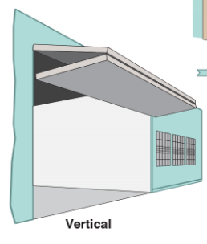
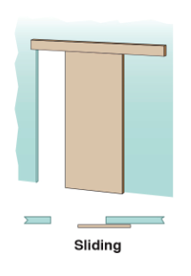
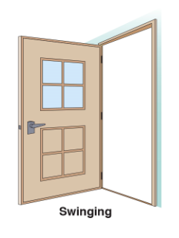
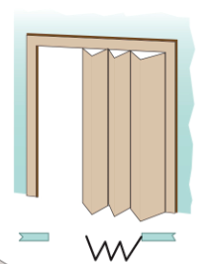
Doors may be classified by the way they operate.
Folding
(Cont.)

Slide 56
Doors may be classified by the way they operate.
Rotates around a vertical axis on hinges secured to the side jambs
May also operate on pivot posts supported at the top and bottom
Can be either single or double leaf
May be single acting or double acting
Generally, exit doors in a means of egress must be swinging doors
(Cont.)

Slide 57
Doors may be classified by the way they operate.
Suspended from an overhead track
May use steel or nylon rollers
Floor guides or tracks prevent the door from swinging laterally
Can be designed as surface sliding, pocket sliding, or bypass sliding
Main advantage: eliminates a door swing that might interfere with the use of interior space
Used for elevators, storefront entrances, and fire doors to protect openings that are not a part of the means of egress
(Cont.)

Slide 58
Doors may be classified by the way they operate.
Hung from an overhead track with rollers or glides similar to those used by a sliding door
Can be bifolding or multifolding
As horizontal fire doors they must meet specific requirements; must be tested and listed for use in a means of egress
Used in residential occupancies
Used in places of assembly to divide large conference areas
Folding
(Cont.)

Slide 59
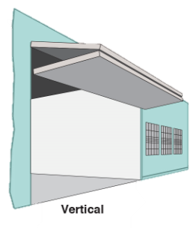
Doors may be classified by the way they operate.
Opens in a vertical plane; used in industrial occupancies
Many consist of interlocking metal slats
Usually has a counterbalance mechanism to help overcome the weight of the door
Can be a single leaf that is raised in vertical guides along the edge of the doorway; or two or more horizontal panels
Can be raised manually, mechanically via chain hoist, power-operated
Swinging door can be installed in large doors as a means of egress; must meet the requirements of the locally adopted code
(Cont.)

Slide 60
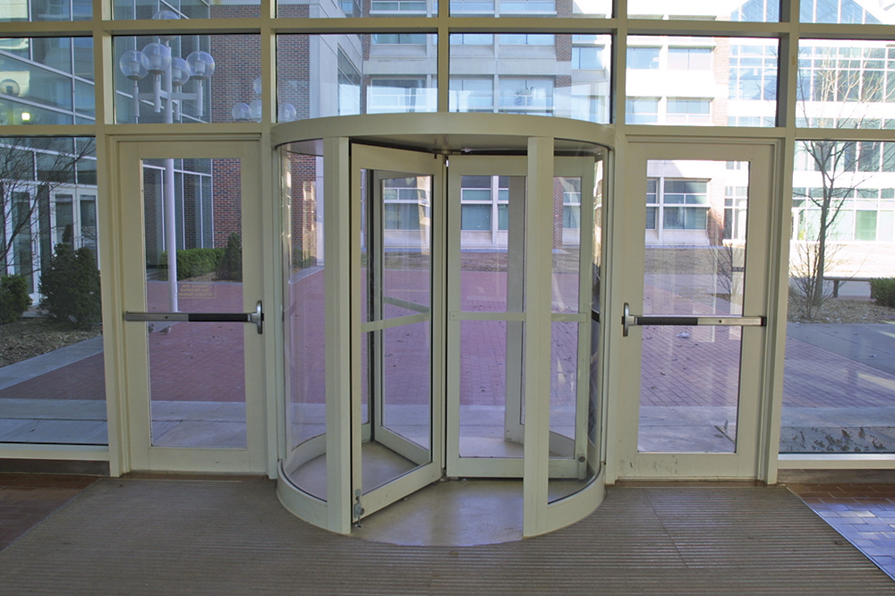
Doors may be classified by the way they operate.
Revolving doors are constructed with three or four sections or wings that rotate in a circular frame
Designed to reduce heat or cooling losses by minimizing flow of air
Prevents the movement of hose or equipment into a building
People attempting to flee during an emergency cannot move through a revolving door as quickly
Wings of the door must be collapsible; codes also limit the amount of force required to collapse the wings
(Cont.)

Slide 61
Doors may be classified by the way they operate.
In revolving doors, several types of mechanisms hold the wings in place: simple chain, spring-loaded, cam-in-groove, or bullet-detent hardware
Most models employ a collapsing mechanism
Revolving doors restrict means of egress; a swinging door must be located within 10 feet (3 m) of the revolving door

Slide 62
Understand the characteristics of fire-rated door assemblies.
Manufactured, assembled, and installed in accordance with specific requirements that have been tested and listed by an independent testing laboratory such as Underwriters Laboratories (UL)

Slide 63
Inspectors should be familiar with the common types of doors.
Wood panel
Flush
Glass
Metal

Slide 64
Inspectors should be familiar with the characteristics of wood panel and flush doors.
Wood panel
Common type of swinging door
Consists of vertical and horizontal members that frame a rectangular area
Thin panels of wood, glass, or louvers placed within the framed area
Flush door
Also called a slab door
Consists of flat face panels that are the full height and width of the door
Panels are attached to a solid or hollow core

Slide 65
Inspectors should be familiar with the characteristics of glass doors.
Used for both exterior and interior applications
Frameless: Consists of a single sheet of glass to which door hardware is attached
Code requirements
Most commonly used in office and mercantile buildings
Can be either framed or frameless
Framed: Glass is surrounded by a metal or wood frame; hardware attached to the frame
Security
Glass doors to be made of tempered glass that resists breakage
Various nonglass components are often used in the framed door to provide additional security

Slide 66
Inspectors should be familiar with the characteristics of metal doors.
Common type
Hollow metal doors can be either panel or flush
Flush doors consist of smooth sheet metal face panels
Vertical sheet metal ribs within the door separate the face panels of a steel door from one another
Hollow metal door made from steel or aluminum

Slide 67
REVIEW QUESTION
How do door operations impact fire risk?

Slide 68
Learning Objective 7
Differentiate among fire doors based on construction and operation.

Slide 69
Inspectors should be familiar with the characteristics of fire doors.
Protect the egress pathways leading through fire-rated walls
Effective at limiting spread of fire and total fire damage
Differ from ordinary doors in construction, hardware, and extent to which they may be required to automatically close
During normal daily operations, many fire doors may be held open; easy to open to allow for ordinary movement of building occupants
When a fire occurs, fire doors must be closed

Slide 70
Fire doors can be either automatic or self-closing.
An automatic door is normally held open and closes when an operating device is activated
In order to activate the closing device and shut a fire door, a detection device must be installed

Slide 71
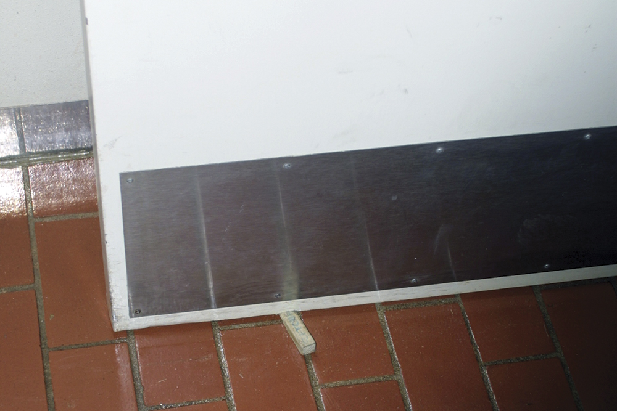
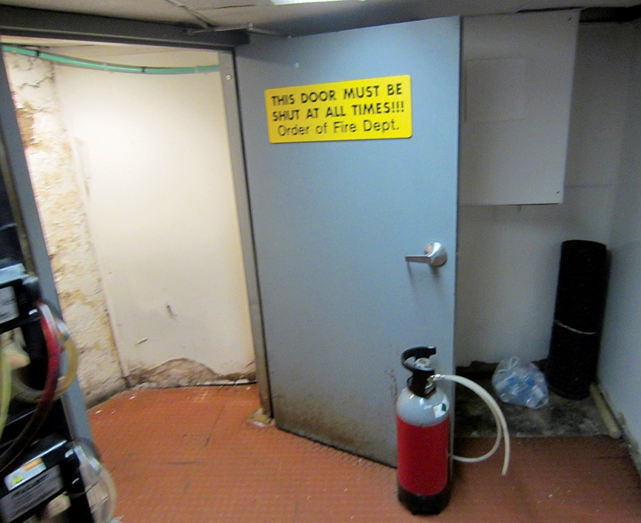
NOTE
Courtesy of Rich Mahaney
The inspector will commonly find fire doors propped open or equipped with kick-down door stops. The inspector must require the removal of these devices and educate the building owner or occupant about the importance of these doors remaining closed. Only approved devices, such as magnetic hold-open devices that release on fire alarm activation, are permitted.

Slide 72
Know the characteristics of fusible links.
Characteristics
Relatively rugged
Easy to maintain
Disadvantages
Oldest and simplest detection device
Detects the heat from an approaching fire and melts, allowing the door to close
Advantages
Inexpensive
Slower to operate than detection devices that react to smoke or temperature rise

Slide 73
Smoke detectors can result in faster fire door release.
May cost more
Requires periodic cleaning
Permits easy testing of the fire door
Must be properly positioned

Slide 74
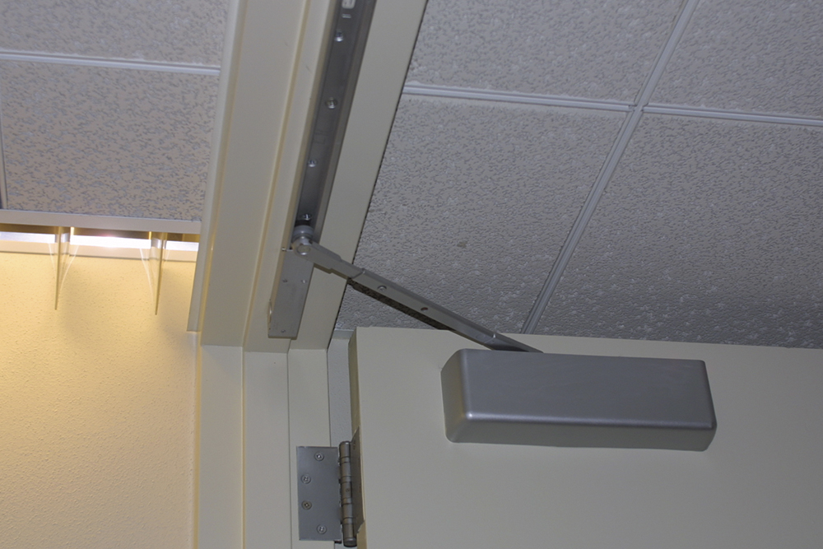
Know the different types of fire door closure devices.
Fire door closers
Used for overhead rolling, sliding, or swinging fire doors; can incorporate a hold-open device or be self-closing
Self-closing fire door closers are commonly used for stairwell doors, hotel room doors
One commonly used self-closer uses a spring hinge
(Cont.)

Slide 75
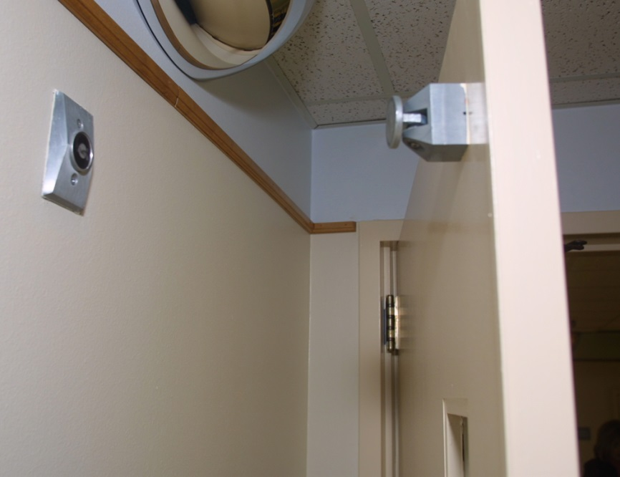
Know the different types of fire door closure devices.
Electromagnetic door holders
Can be used with swinging, sliding, or rolling fire doors
Intended to be used with a suitable door closer and a sensitive smoke detector
Prevents the practice of blocking the doors open
Useful in areas with lots of traffic
Often used for corridor doors in health care occupancies

Slide 76
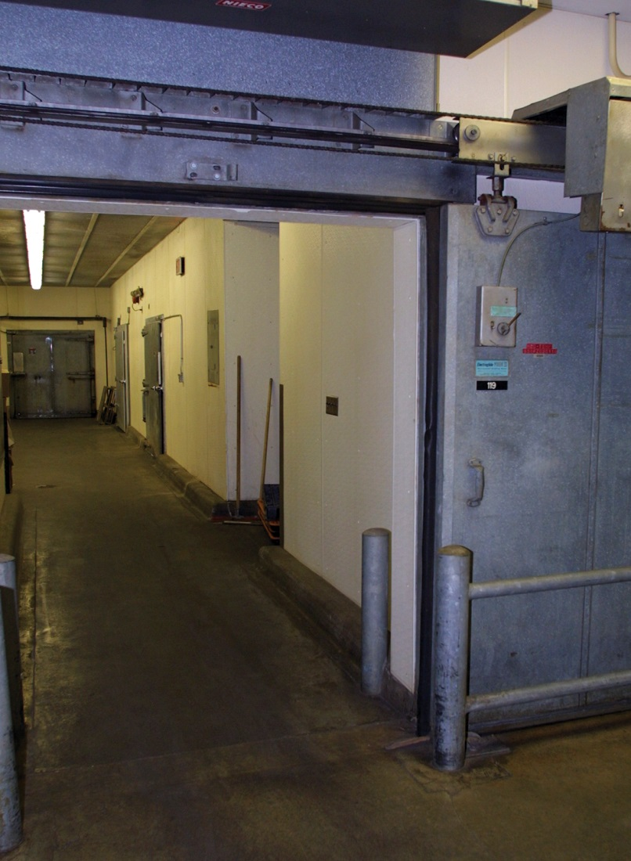
Know the different types of fire door operating devices.
Consists of an electric motor that opens and closes the door for normal usage
Fusible link disconnects the door during a fire
Closes by spring-powered door closer or suspended weights
Door operating devices
Intended for use with sliding fire doors mounted on tracks

Slide 77
Know the methods used to classify fire doors.
Hourly fire protection rating
Indicates length of time the door will resist fire before it is breached
Alphabetical letter designation
Indicates type of opening to be protected based on the location and required level of protection
No longer used
Will encounter fire doors that use this designation
Combination of hour and letter
Indicates fire protection rating and type of opening for which the door assembly has been tested and certified
May be found on existing fire doors
System is no longer used

Slide 78
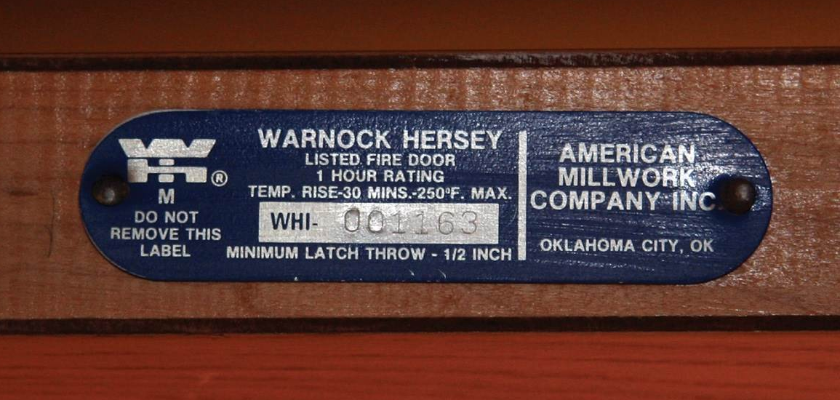
Inspectors need to know about fire door labels.
Door type and hourly rating
Logo of the testing laboratory
Painted over labels are void and require door recertification

Slide 79
Fire door hardware and frame must withstand the stresses and pressures of fire exposure.
Testing includes frames and hardware
Fire door is part of an assembly that must be rated
Assembly is certified as a single unit for a specified time
Third-party agency testing required for
Door
Hardware (hinges, latches, locks)
Door seal
Frame
Glass panels in fire doors must achieve the same test results as the rest of the assembly

Slide 80
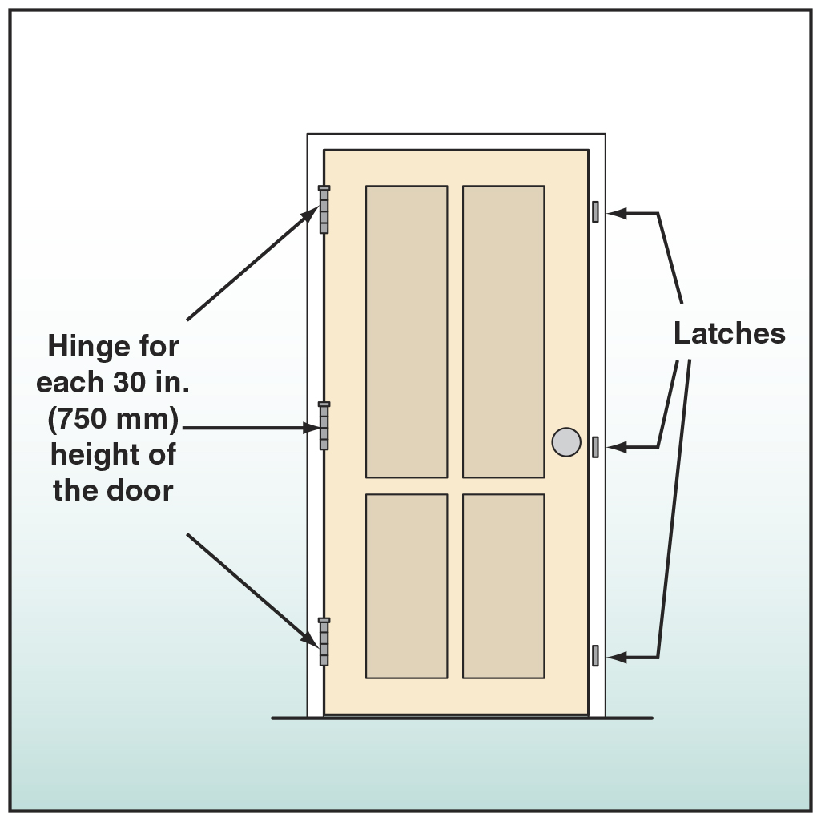
Hardware used on fire doors is referred to as either builder’s hardware or fire door hardware.
Uses
Hardware includes
Locks
Latches
Bolts
Closers
Modifications
Hinges
Can result in loss of listing for that door
Field inspection from the listing organization
Both sliding and swinging fire doors
Normally shipped with the fire doors

Slide 81
Several items impact the construction and operation of fire doors.
Type of occupancy
Amount of space around the door opening
Required fire protection rating for the door

Slide 82
Inspectors need to know the uses of overhead rolling steel fire doors.
To protect an opening in a fire wall in an industrial occupancy
To protect an opening in a wall separating buildings into fire areas
May be used on one or both sides of a wall opening
Cannot be used on any part of the means of egress

Slide 83
Inspectors need to know the components of overhead rolling steel fire doors.
Constructed of interlocking steel slats
Releasing devices
Governors
Counterbalance mechanisms
Wall guides

Slide 84
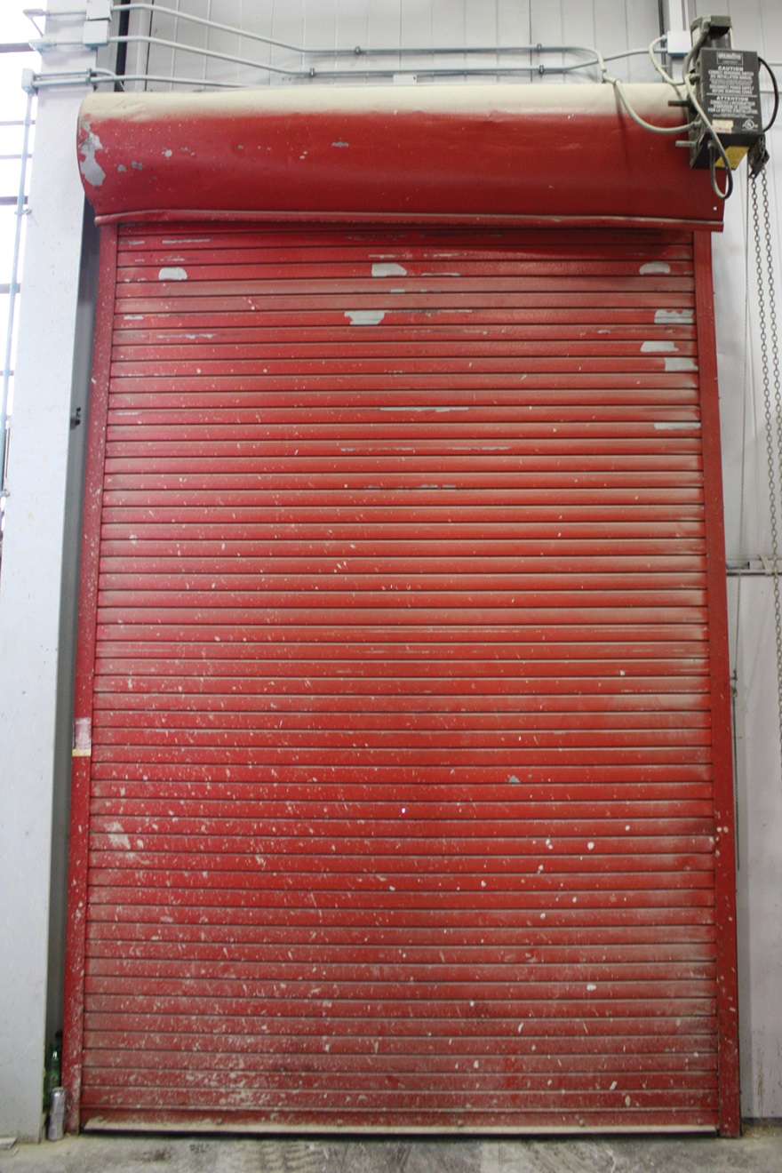
Know the characteristics of rolling steel fire doors.
Ordinarily closes under the force of gravity when a fusible link melts
Without a conventional swinging door at the location, the overhead rolling fire door may create a dangerous dead-end
Motor-driven doors are available that are activated by smoke detection

Slide 85
NOTE
In some schools, the inspector will also encounter security rolling doors that are tied to the detection/alarm systems. These doors roll up on activation of the system and need to be tested during an inspection.

Slide 86
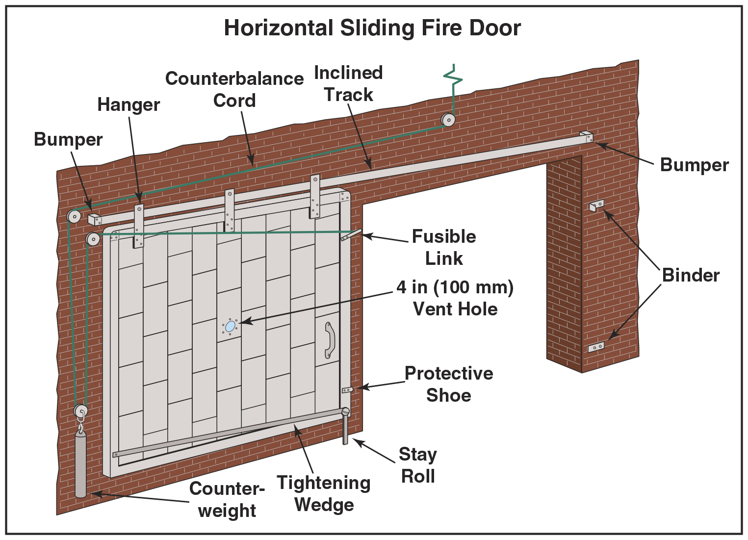
Know the characteristics of horizontal sliding fire doors.
Often found in old industrial buildings
Slide into position along a track either by gravity or by the force of a counterweight
Usually held open by a fusible link
(Cont.)

Slide 87
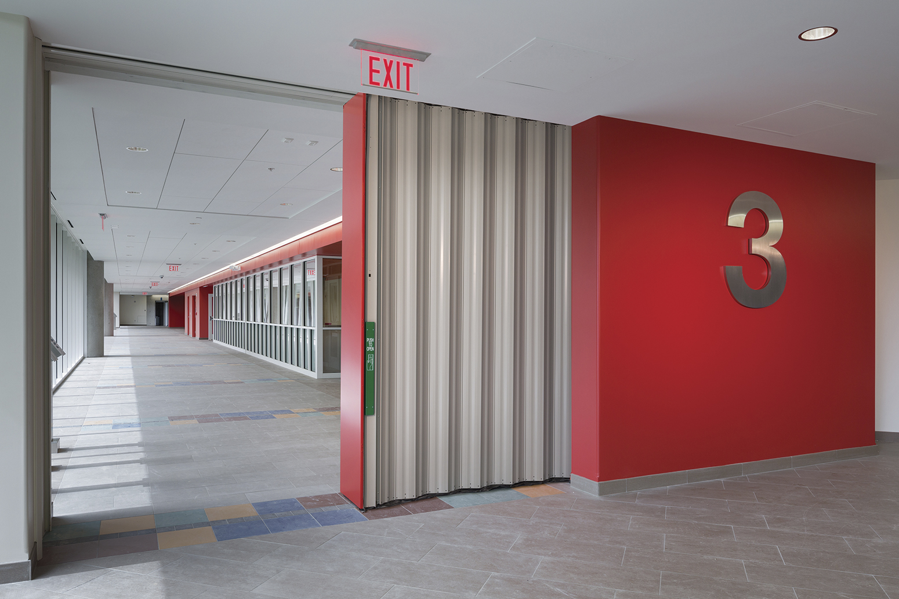
Know the characteristics of horizontal sliding fire doors.
If certified, can be used to protect openings in walls that are parts of a means of egress
Used to separate large areas
Connected to fire alarm system that closes automatically upon activation of a fire alarm
Courtesy of WonDoor Corporation

Slide 88
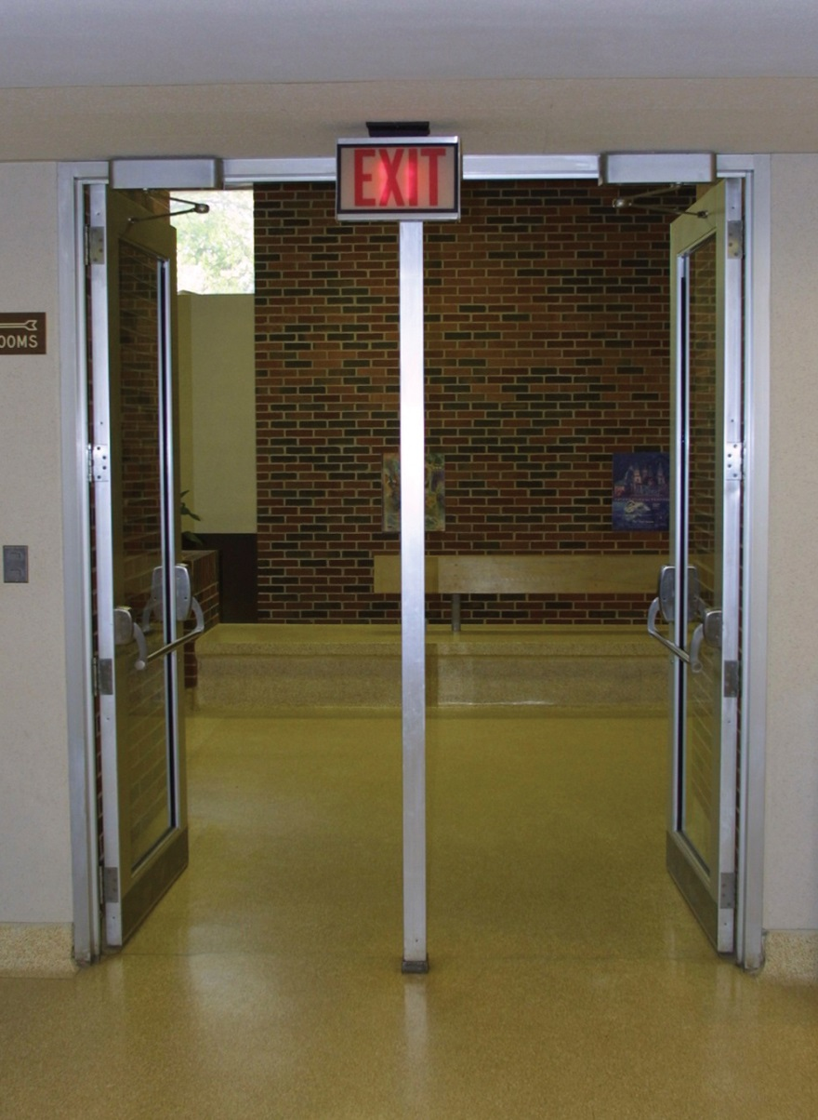
Know the characteristics of swinging fire doors.
When fire doors are needed on either side of a wall, the swing of the doors may impede an exit path through the doors
Both doors required to swing in the direction of egress travel
Fire-resistive-constructed vestibule between the doors provides space needed for the doors to swing in the same direction

Slide 89
Inspectors need to know the special types of fire doors available.
Freight and passenger elevators
Service counter openings
Security (bullet-resisting) doors
Dumbwaiters
Chute openings

Slide 90
Inspectors need to know the characteristics of a horizontal-folding fire door.
Frequently used if a fire-rated partition is required and the designer does not wish to provide a fixed wall to create an unobstructed floor plan
Signal from a smoke detector or fire alarm system initiates the door’s closing
Battery powers the motor if the regular power supply is interrupted

Slide 91
Inspectors need to know the characteristics of glass panels and louvers in fire doors.
A fire door often contains glass vision panels to enhance safety and security
Any glazing material must be fire-rated
Restrictions on the allowable area of glass
Testing laboratories list the louvers separately
Occasionally, it is desirable to install louvers to permit ventilation
Louvers must close during a fire; usually accomplished by means of a fusible link

Slide 92
REVIEW QUESTION
What types of door closure components are used on fire doors?

Slide 93
Learning Objective 8
Describe different types of windows and how they operate.

Slide 94
Windows have long been relied upon for means of light, ventilation, access, and rescue.
Older buildings used openable windows for light and ventilation
Installing fixed windows enhances energy efficiency because it reduces air infiltration around windows
Modern buildings often rely on heating and air conditioning systems and artificial lighting

Slide 95
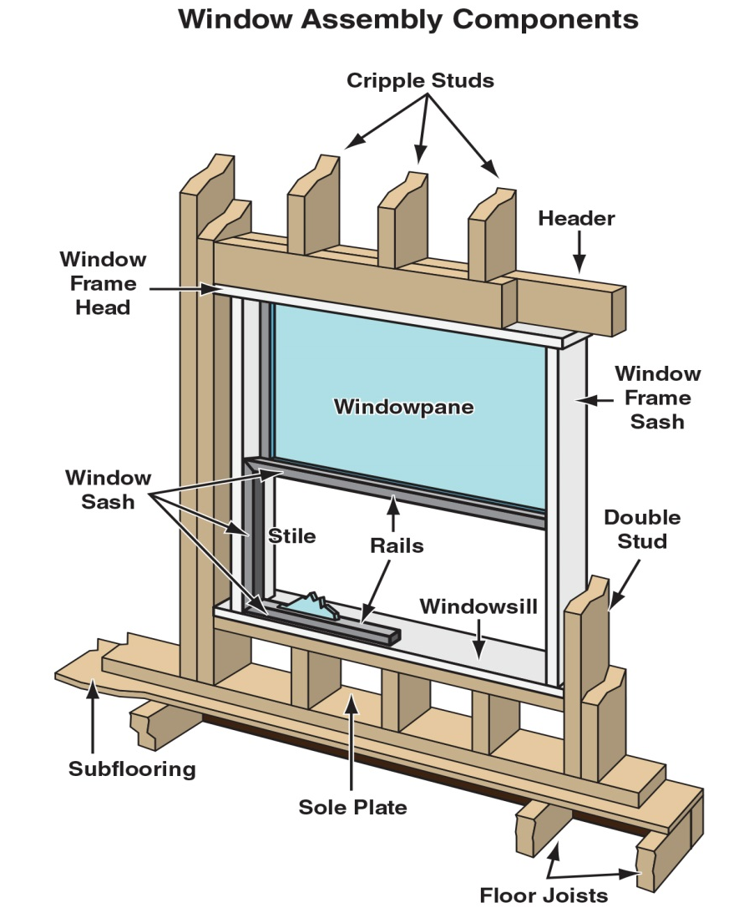
Inspectors should know the components of windows.
Consists of a frame, one or more sashes, and necessary hardware
Frame includes the members that form the perimeter of a window; fixed to the surrounding wall or other supports

Slide 96
There are generally two classifications of windows.
Fixed
Movable

Slide 97
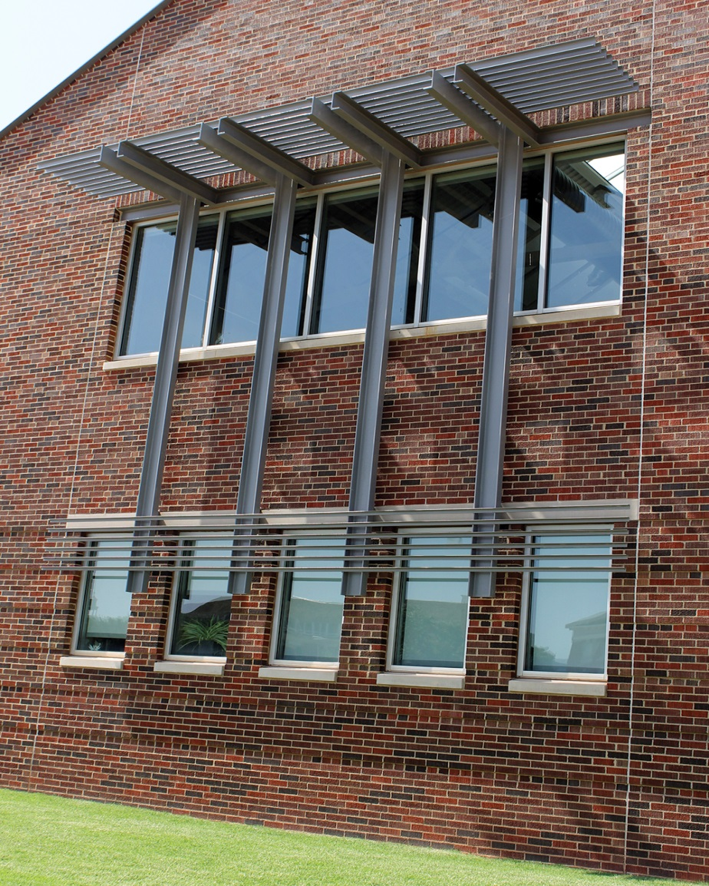
Know the characteristics of fixed windows.
Consists only of a frame and a glazed stationary sash
Can be used alone or in combination with movable windows
Common examples include large windows found in mercantile occupancies and high-rise office buildings

Slide 98
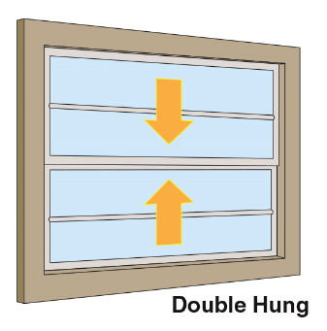
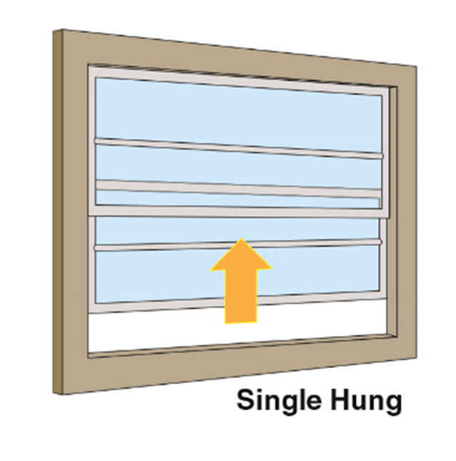
Know the common configurations of movable windows.
Has two sashes that can move past each other in a vertical plane
Has only the lower sash capable of being opened
(Cont.)

Slide 99
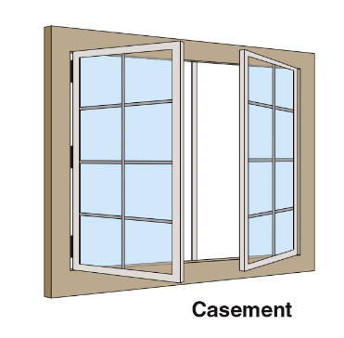
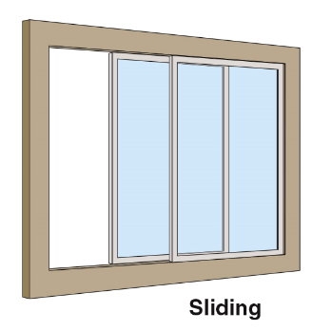
Know the common configurations of movable windows.
Has a side-hinged sash that is usually installed to swing outward
Has two or more sashes of which at least one moves horizontally within the window frame
(Cont.)

Slide 100
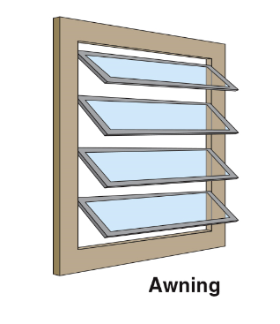
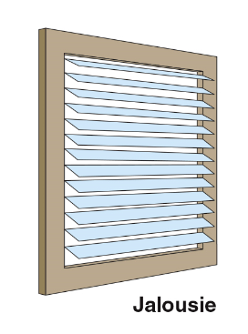
Know the common configurations of movable windows.
Has one or more top-hinged, outward-swinging sashes
Includes a large number of narrow overlapping glass sections swinging outward
(Cont.)

Slide 101
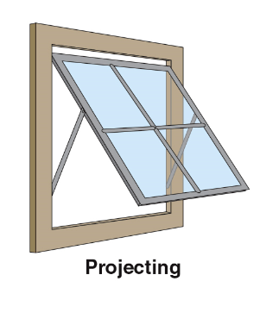
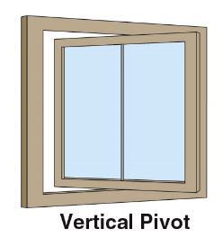
Know the common configurations of movable windows.
Swings outward at the top or bottom and slides upward or downward in grooves
Has a sash that pivots vertically about a central axis

Slide 102
Know the characteristics of security windows.
Metal bars and screens
Used to provide additional security
Embedded in masonry
Mounted on hinges and locked
Movable sashes and fixed bars
Concerns
Prevent the escape of trapped occupants and firefighters
Slow access time for emergency responders
Fastened to the building
Construction types

Slide 103
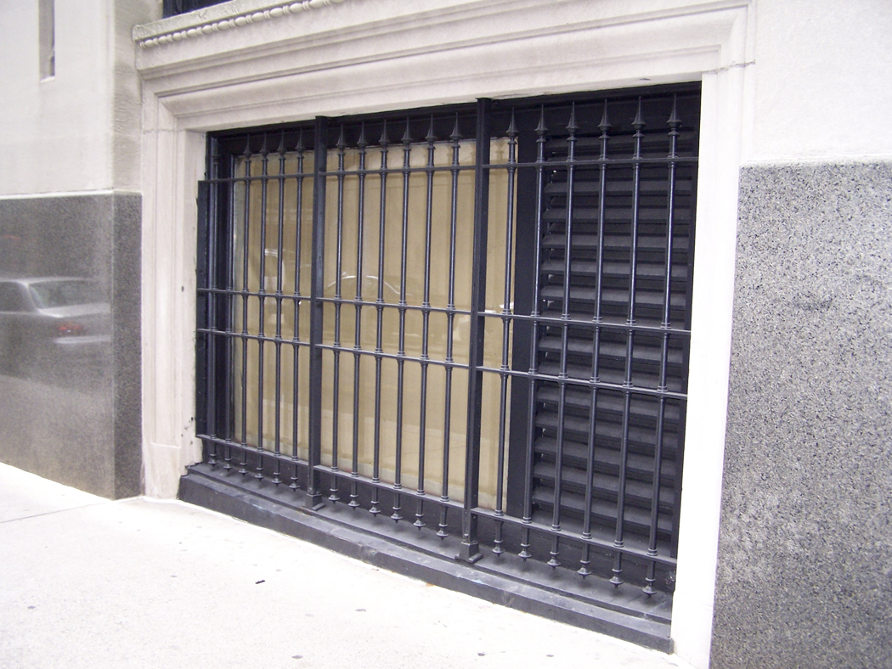
Know the inspection requirements for security windows.
Inspector concerns
Be aware of restrictions placed on the installation of security bars and grilles
If operable, they should be operated during an inspection
Know locally adopted codes

Slide 104
REVIEW QUESTION
Describe the common window configurations and operations.

Slide 105
Learning Objective 9
Describe how interior finishes can contribute to fire spread.

Slide 106
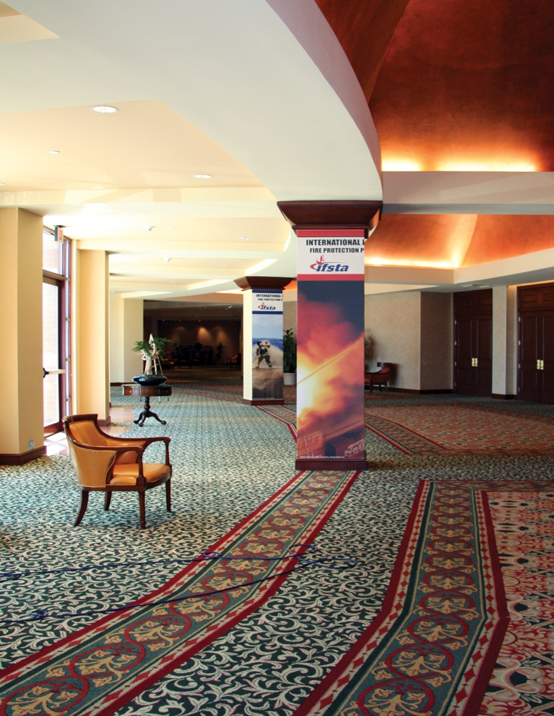
Inspectors need to know about interior finishes.
Materials used for exposed surfaces of the walls and ceilings of a building
Be alert to materials used as interior finish that have not been approved for that application
Courtesy of Tara Gladden

Slide 107
Be aware of typical types of approved interior finishes.
Plaster
Gypsum wallboard
Wood paneling
Ceiling tiles
Plastic
Fiberboard
Fabric
Other wall coverings

Slide 108
Combustibility of an interior finish has been shown to contribute to fire behavior in at least four ways.
Contributes to fire extension by flame spread over its surface
Affects rate of fire growth to flashover
Adds to intensity of a fire because it contributes fuel
Produces smoke and toxic gases that can contribute to the life hazard

Slide 109
Be aware of how interior finishes are addressed in local buildings codes.
May define doors, door and window frames, chair railings, and wainscotings as interior finishes
Hanging fabrics, such as draperies and curtains, are not treated as interior finishes unless applied to a ceiling or wall
Usually exclude surface treatments such as paint

Slide 110
Interior finishes may be part of the building structural materials.
Wood paneling applied over a concrete block wall is considered an interior finish
A masonry wall left exposed as part of the decor of a restaurant is part of the interior finish and part of the structural components

Slide 111
REVIEW QUESTION
What are the four ways in which interior coverings contribute to fire behavior?

Slide 112
Learning Objective 10
Explain the fire and life safety aspects of building services.

Slide 113
Building services and subsystems provide safety, comfort, and convenience to occupants.
Subsystems must be appropriately installed, inspected, tested, and maintained in order to positively affect overall building system safety
Conversely, a defective subsystem will have detrimental effects on the entire system
Inspector’s may be required to verify that the owner/occupant is maintaining building services

Slide 114
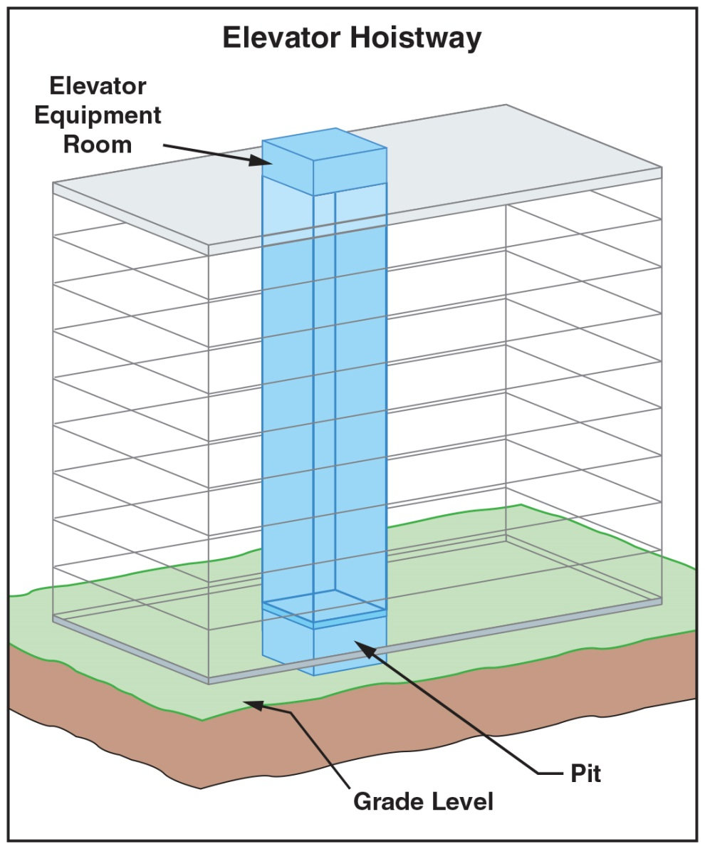
An elevator hoistway is the vertical shaft in which the elevator car travels.
Constructed of fire-resistive materials
Penetrations must be done with an appropriately rated assembly
Equipped with fire-rated door assemblies
No wiring, ductwork, or piping should be run within the hoistway unless it is required for the elevator itself

Slide 115
Utility chases can be used for a variety of items.
Plumbing
Electrical raceways
Telecommunications
Data cables
Ductwork for HVAC and grease

Slide 116
Know the difference between a utility chase and a vertical shaft.
Utility Chases
Unoccupied
Vertical shafts
May be occupied

Slide 117
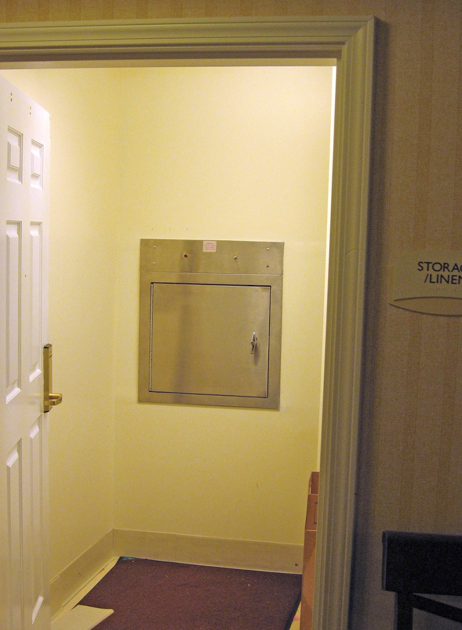
Know the characteristics of refuse and linen chutes.
Large vertical chute that extends through a building
Terminates at grade level or in a basement where the material is collected
Required to be constructed of fire-resistive construction
Openings on each floor for depositing trash or soiled linens
May require sprinkler protection

Slide 118
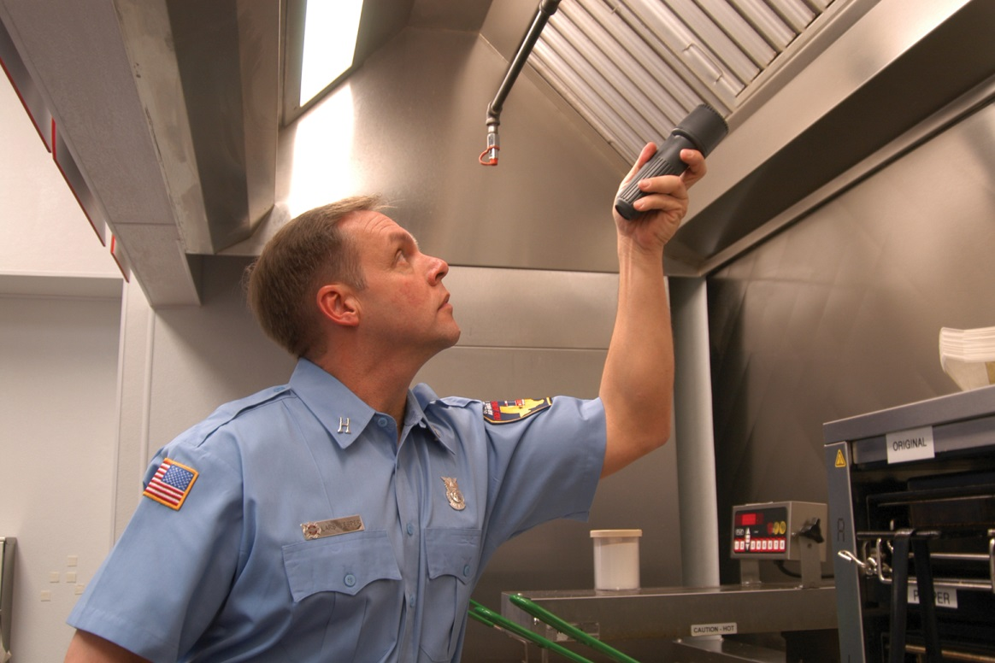
Know the characteristics of grease ducts.
Typically installed over cooking appliances that produce grease-laden vapors
Carry grease vapors to the outside of a building
Proper installation has no areas, such as dips or horizontal runs, where grease may become trapped
Application, design, and protection are specified in codes
Examine the duct to see that it is clean and free from grease buildup
(Cont.)

Slide 119
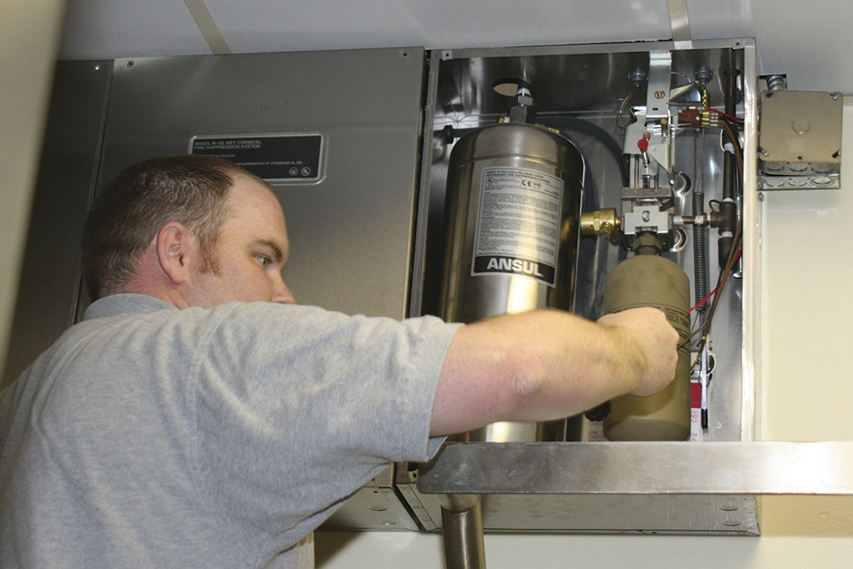
Know the characteristics of grease ducts.
Single-exhaust ducts only serve one exhaust hood; typically has one fire suppression system
Venting systems may require automatic fire suppression equipment
Grease exhaust ducts always require 1-hour fire-resistive separation; usually accomplished with use of fire-resistive-rated duct wrap system
Designed to withstand a fire inside the duct
Use noncombustible duct materials, liquid-tight welds and connections, and minimum clearances from combustible building components

Slide 120
REVIEW QUESTION
What are some of the fire risks associated with building services?

Slide 121
Summary
Components that make a building habitable are incorporated into a building’s structural system.
Exterior walls, roofs, and floors enclose the structural components to define a building’s limits.
(Cont.)

Slide 122
Summary
Within these components, interior walls, floors, and ceilings further divide the space to create individual work and living compartments or rooms.
Stairs, doors, and windows provide access to a structure and between the individual spaces.
(Cont.)

Slide 123
Summary
Walls, floors, and ceilings are finished with interior finishes that may or may not contribute to fire spread by increasing or limiting the fuel load of the compartment.
(Cont.)

Slide 124
Summary
Building services include elevators, HVAC systems, and others that may also increase or decrease the inherent fire hazards within a building.

