Slide 1
Fire Inspection and Code Enforcement
8th Edition Inspector I
Chapter 14 — Fire Detection and Alarm Systems

Slide 2
Learning Objective 1
Identify fire alarm system components.

Slide 3
Be familiar with fire alarm system characteristics.
Modern detection and signaling systems vary in complexity
Systems typically designed and installed by qualified individuals
Design, installation, and approval may also require acceptance testing
Design and installation should conform to applicable provisions of NFPA® standards and local codes

Slide 4
Be familiar with fire alarm control units.
Formerly called fire alarm control panel (FACP)
Basically serves as the brain for the alarm system
Receives signals, processes them, and produces signals that activate alarms
Can transmit signals to off-site monitoring station
Power and fire alarm circuits are connected directly
Remote auxiliary panels are considered to be part of the fire alarm system

Slide 5
The FACU can perform several other functions.
Provide two-way firefighter communication
Provide remote annunciator integration
Controls elevators, HVAC, fire doors, dampers, locks, or other fire protection features
Can provide public address messages and mass notifications alerts

Slide 6
NOTE
Some fire alarm control units are designed for both security and fire protection. In these types of systems, fire protection is engineered into the system to assume the highest priority.

Slide 7
The primary power supply can come from different locations.
Utility company
Trained operator must be on duty 24 hours a day or the system must contain multiple units
Must always be set for automatic starting
FACU must supervise the primary power supply; signal if the power is interrupted
Where the power usually comes from
Engine-driven generators
Rare

Slide 8
Inspectors need to understand secondary power supplies.
All fire alarm systems must have one
Must be capable of providing normal, standby conditions capacity; power to fully operate an alarm condition
Time period requirements for operation capabilities vary
Can consist of batteries with chargers or engine-driven generators; one must be set for automatic starting
Courtesy of Ron Moore, McKinney (TX) Fire Department

Slide 9
REVIEW QUESTION
What is the basic function of the fire alarm control unit (FACU)?

Slide 10
Inspectors need to understand initiating devices.
Includes manual and automatic alarm-initiating devices
Activated by the presence of fire, smoke, flame, or heat
Devices then send a signal to the FACU
Examples
Manual pull stations
Smoke detectors
Flame detectors
Heat detectors
Combination detectors
Waterflow devices

Slide 11
Audible notification signaling appliances are the most common type of alarm-signaling system.
Bells
Buzzers
Horns
Speakers
Strobe lights
Other warning appliances

Slide 12
Know the different categories of notification appliances.
Audible
Visual
(Cont.)

Slide 13
Know the different categories of notification appliances.
Textual
Tactile
Visual text or symbols indicating a fire or emergency condition
Indication of fire or emergency condition through sense of touch or vibration

Slide 14
Fire detection and alarm system can be designed to initiate several actions.
Turn off the HVAC system
Close smoke dampers and/or fire doors
Pressurize stairwells and/or operate smoke control systems
Unlock doors along the path of egress
(Cont.)

Slide 15
Fire detection and alarm system can be designed to initiate several actions.
Provide elevator recall to the designated floor; prevent normal operations
Operate heat and smoke vents
Activate special fire suppression systems

Slide 16
REVIEW QUESTION
List types of notification devices.

Slide 17
Learning Objective 2
Explain types of alarm-signaling systems.

Slide 18
Fire detection and alarm systems are equipped with three types of signals.
Alarm signal
Activation of extinguishing systems are all initiating devices that send fire alarm signals
Warning of fire emergency or dangerous condition
May notify the responding fire department
Supervisory signal
Indicates an off-normal condition
Includes a returned-to-normal signal
Used to monitor the integrity of the system
Trouble signal
Each signal must be audibly and visually displayed at the FACU
Indicates a problem with the system or power supply
Includes loss of primary power or failure or removal of an initiating device

Slide 19
NOTE
A trouble signal indicates a problem with the fire detection and alarm system. A supervisory alarm indicates a problem with an accessory of the fire alarm system.

Slide 20
Know the difference in simple and complex fire alarm systems.
Simple fire alarm system
More complex system may
Sound a local alarm
Activate building services
Notify fire and security agencies to respond
May only sound a local evacuation alarm

Slide 21
Know what factors determine the type of system required.
Level of life safety hazard
Structural features of the building
Hazard level presented by the contents of the building
Availability of fire suppression resources
State and local code requirements

Slide 22
Inspectors should be able to recognize each type of system.
Protected premises (local)
Supervising station alarm systems
Public emergency alarm reporting system
Emergency communications systems

Slide 23
Protected premises systems provide notification to building occupants in the immediate premises.
No provisions for automatic off-site reporting
Activated by manual means or by automatic devices
May be capable of annunciating a supervisory or trouble condition

Slide 24
Understand the characteristics of conventional alarm systems.
Simplest type of protected premises alarm system
When an alarm-initiating device sends a signal all of the alarm-signaling devices operate simultaneously
Signaling devices usually operate continuously until the FACU is reset
FACU is incapable of identifying which initiating device triggered the alarm
Only practical in small occupancies
Found in occupancies that use the alarm signals for other purposes
FACU serves the premises as a local control unit

Slide 25
Zoned conventional alarm systems allow responders to identify the general location of device activation.
Annunciator panel, FACU, or a printout visibly indicates the building, floor, fire zone, or other area that coincides with the location of an operating alarm-initiating device
(Cont.)

Slide 26
Zoned conventional alarm systems allow responders to identify the general location of device activation.
Annunciator panel may be located remotely from the FACU
Usually has a map of the complex coordinated to the zone indicator lamps
Another type of annunciator panel may be found in the lobby area of a building; it will have a graphic display of the involved area
May be found at the driveway approach to a large residential complex

Slide 27
Addressable alarm systems display the location of each initiating device.
Displays on the FACU and an annunciator panel if provided
Enables emergency responders to pinpoint the specific device that has been activated
Reduces amount of time it takes to respond to emergency situations
Allows repair personnel to quickly locate and correct malfunctions in the system

Slide 28
A supervising station is a facility that receives signals from a protected premises fire alarm system.
Central
Proprietary
Remote
Independent business that is also listed by a nationally recognized testing laboratory
Station under the same ownership as the buildings protected by the fire alarm systems
Not listed and operates as business
Recognized as the most reliable type of supervising station
Personnel are constantly in attendance to supervise and investigate signals
Personnel are in attendance at all times to supervise and investigate signals

Slide 29
A listed supervising station monitors the status of protected premises alarm systems.
Provides inspection, testing, and maintenance through contracted services
Typically, a company that sells its services to many customers
(Cont.)

Slide 30
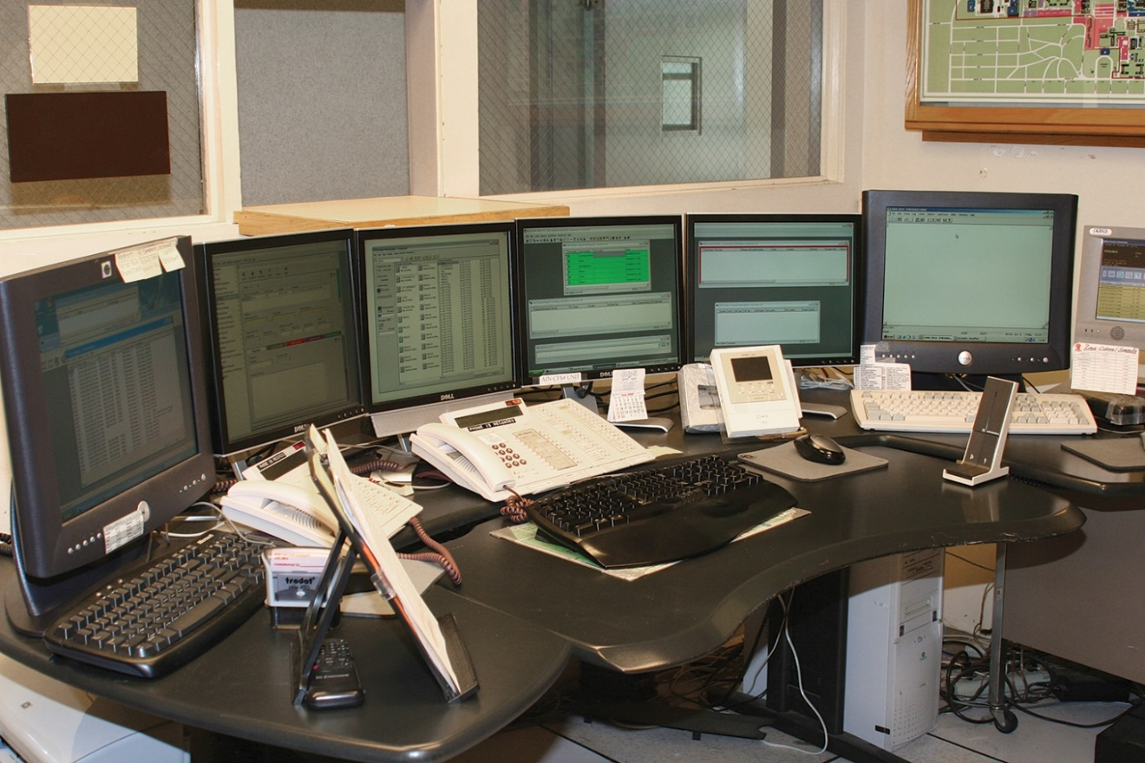
A listed supervising station monitors the status of protected premises alarm systems.
When alarm is activated at a client’s location, central station employees receive it; contact the fire department and representatives of the occupancy
Primary difference between a central station system and a proprietary system is that the receiving point for alarms in a central station system is located outside the protected premises; monitored by a contracted service
Systems and station are most commonly connected by dedicated telephone lines

Slide 31
Proprietary systems are used to protect large complexes in single or multiple locations.
Includes large commercial and industrial buildings, high-rise structures, and groups of commonly owned facilities
Each building or area has its own system that is wired into a common receiving point that the facility owner owns and operates
(Cont.)

Slide 32
Proprietary systems are used to protect large complexes in single or multiple locations.
Receiving point must be in a separate structure or a part of a structure that is remote from any hazardous operations
Receiving station of a proprietary system is continuously staffed by trained personnel
Operator should be able to automatically summon a fire department response
Many proprietary systems and receiving points are used to monitor security functions too

Slide 33
Modern systems can be complex and have a wide range of capabilities.
Coded-alarm and trouble signal indications
Building utility controls
Elevator controls
Fire and smoke damper controls

Slide 34
A remote receiving station is a contracted service that monitors protected premise alarm systems.
Do not provide inspection, testing, or maintenance services
Depending on local requirements, the fire department may approve other organizations to monitor the remote system

Slide 35
In some communities, fire alarm signals are sent directly to the fire department.
Public emergency alarm reporting system
Local energy system
Connected by another means; usually a leased telephone line
Radio signal over a dedicated fire department radio frequency may also be used
Has its own power source
Initiating devices can be activated even when the power supply to the municipal system is interrupted

Slide 36
Understand how shunt systems work.
Electrically connected to an integral part of the municipal fire alarm system
During power failure, an alarm indication is sent to the fire department communications center
NFPA 72® allows only manual pull stations and waterflow detection devices to be used on shunt systems
Fire detection devices are not permitted on a shunt system
Depends on municipal system’s source of electric power

Slide 37
Be familiar with the purpose of emergency communications systems.
Supplementary system
Provides a reliable communication system for occupants and firefighters
May either be stand-alone or integrated directly into the overall fire detection and alarm-signaling system
May be provided in facilities in conjunction with detection and alarm signaling systems
System types include voice notification, two-way communication, mass notification

Slide 38
Understand the characteristics of one-way voice notification systems.
What it does
High-rise buildings
Places of assembly
Educational occupancies
Warns building occupants that action is needed
Tells them what action to take
Most common in

Slide 39
Understand the characteristics of two-way notification systems.
Most helpful to fire suppression personnel who are operating in a building; particularly in high-rise structures
Emergency phones are connected in the stairwells and other locations
Most building codes require these systems in high-rise structures
Use either intercom controls or special telephones
Enable firefighters to communicate with the Incident Commander at the Fire Command Center

Slide 40
Understand the characteristics of mass notification systems.
Provide emergency communications to a large number of people on a wide-scale basis
Communication can be to the occupants of a building or even an entire community
May be incorporated into an emergency communications system
(Cont.)

Slide 41
Understand the characteristics of mass notification systems.
Individuals designing this type of system must take into consideration the building being protected as well as the needs of the occupants
When installed, systems may have a higher priority and override the fire alarm based on risk analysis

Slide 42
REVIEW QUESTION
Name types of alarm-signaling systems.

Slide 43
Learning Objective 3
Explain types of automatic alarm-initiating devices.

Slide 44
Automatic alarm-initiating devices, or detectors, monitor the atmosphere of a building, compartment, or area.
Rapid rise in heat
Presence of smoke
Presence of a flame signature

Slide 45
Know the basic types of automatic initiating devices.
Heat
Smoke
Flame
Water flow

Slide 46
Know the characteristics of fixed-temperature heat detectors.
Among the oldest still in service
Relatively inexpensive
Least prone to nuisance alarms
Typically slower to activate than other types
Must be properly placed where heat is expected to accumulate
Must be selected at a temperature rating that will give margin of safety above the normal ceiling temperatures
Must be color-coded and marked with their listed operating temperatures
(Cont.)

Slide 47
Know the characteristics of fixed-temperature heat detectors.

Slide 48
All heat-detection devices operate on one or more of the primary principles of physics.
Heat causes expansion of various materials
Heat causes melting of certain materials
Heated materials have thermoelectric properties that are detectable

Slide 49
Fire alarm systems can use fusible links and frangible bulbs.
Usually associated with automatic suppression systems; also used in fire alarm systems
Operating principles are the same in either type of system; only their application differs

Slide 50
Fusible links are used to hold a spring device open in the detector.
When the melting point of the fusible link is reached, it melts and drops away
Causes the spring to release and touch an electrical contact that completes a circuit; sends an alarm signal
In order to restore the detector, the fusible link must be replaced

Slide 51
Frangible bulbs hold two electrical contacts apart in the detector.
As temperature increases, liquid in the bulb expands
Expanded liquid compresses the air bubble in the glass; the bulb fractures and falls away
Contacts close to complete the circuit and send the alarm
To restore the detector, the frangible bulb or the entire detector must be replaced

Slide 52
Bimetallic heat detectors use two types of metals with different heat-expansion ratios.
When subjected to heat, one metal expands faster than the other and causes the combined strip to arch
Several factors are calculated into the design of the detector
May be positioned with one or both ends secured in the device
Most are the automatic-resetting type; they need to be checked to verify that they have not been damaged

Slide 53
Continuous-line heat detectors can be used to detect conditions over a wide area.
First model
Consists of a conductive metal inner core cable that is sheathed in stainless steel tubing
Inner core and sheath are separated by an electrically insulating semiconductor material
Insulation is designed to lose some of its electrical-resistance capabilities at a predetermined temperature
Restores itself when the level of heat is reduced
(Cont.)

Slide 54
Continuous-line heat detectors can be used to detect conditions over a wide area.
Second model
When the melting temperature of each wire’s insulation is reached, the insulation melts and allows the two wires to touch
Uses two wires that are each insulated and bundled within an outer covering
To restore this continuous-line heat detector, the fused portion of the wires must be removed and replaced

Slide 55
Know the characteristics of rate-of-rise heat detectors.
Operates on the principle that fires rapidly increase the temperature in a given area
Respond at substantially lower temperatures than fixed-temperature detectors
Can occasionally be activated under nonfire conditions
Most are reliable and not subject to nuisance activations
All automatically reset after alarms

Slide 56
Be familiar with different types of rate-of-rise heat detectors.
Pneumatic rate-of-rise line heat detector
Pneumatic rate-of-rise spot heat detector
Rate-compensation heat detector
Electronic spot-type heat detector

Slide 57
Pneumatic rate-of-rise line heat detectors can monitor large areas of a building.
Consist of a system of metal pneumatic tubing arranged over a wide area
A flexible diaphragm responds to the increase in pressure from the tubing
When temperature increases, the air pressure increases and the heat-detection device operates
Tubing acts as a pressurized air chamber that allows the contained air to expand as it heats

Slide 58
Pneumatic rate-of-rise spot heat detectors are self-contained units.
Operates on the same principle as the pneumatic rate-of-rise line heat detector
Monitors a specific location
Alarm wiring extends from the detector back to the FACU

Slide 59
Rate-compensation heat detectors are designed for areas with regular temperature changes.
Contain an outer bimetallic sleeve with a moderate expansion rate
Outer sleeve contains two bowed struts that have a slower expansion rate than the sleeve
When the detector is heated rapidly, the outer sleeve expands lengthwise
Expansion reduces the tension on the inner strips and allows the contacts to meet, sending an alarm signal to the FACU
If the rate of temperature rise is fairly slow, the sleeve expands at a slow rate that maintains tension on the inner strips
Tension prevents unnecessary system activations

Slide 60
Electronic spot-type heat detectors consist of one or more thermistors.
Rate at which thermistors are heated determines amount of current that is generated
Greater changes in temperature result in activation of the alarm system
Can be calibrated to function as rate-of-rise detectors and function at a fixed temperature
Designed to bleed or dissipate small amounts of current

Slide 61
REVIEW QUESTION
List types of heat detectors.

Slide 62
Smoke detectors serve the purpose of early detection, notification, and reaction.
Some are used to activate mechanical or electrical systems such as dampers, doors, and electronic shutdown
Two principle types of devices: one that provides early detection and reports back to an alarm panel to initiate evacuation alarms and one that provides some type of signal to initiate one of the actions discussed above
Smoke detection is the preferred automatic alarm device in such occupancy types as residences and health and institutional care facilities

Slide 63
Know the factors that affect smoke detector performance.
Type and amount of combustibles
Rate of fire growth
Proximity of the detector to the fire
Ventilation within the area involved

Slide 64
All smoke detectors are required to respond to the same fire tests.
Smoke detectors and smoke alarms are tested, certified, and listed based on their performance by third-party testing services
Two basic methods of smoke detection are in use: photoelectric and ionization
Allowable sensitivity ranges for both types of smoke detectors are established by UL

Slide 65
Understand the characteristics of photoelectric smoke detectors.
Works on all types of fires
Consists of a photoelectric cell coupled with a specific light source
Photoelectric cell functions in one of two ways to detect smoke
Projected-beam application (obscuration)
Refractory application (scattered)
Best suited for areas where smoldering fires can occur
Usually responds more quickly to smoldering fires

Slide 66
Projected-beam detectors use a beam of light focused on a monitored area.
Cell constantly converts the beam into current, which keeps a switch open
When smoke interferes with or obscures the light beam, current changes, initiates alarm
Particularly useful in buildings where a large area of coverage is desired
Need to be mounted on a stable stationary surface
Strategically positioned to sound an alarm more quickly

Slide 67
Understand how refractory application detectors operate.
Uses a beam of light from a light-emitting diode (LED) that passes through a small chamber at a point distant from the light source
When smoke particles enter the light beam, light strikes the particles and reflects in random directions onto the photosensitive device, causing the detector to signal

Slide 68
Understand how ionization smoke detectors work.
Contains a sensing chamber with two electrically charged plates and a radioactive source for ionizing the air between the plates
Products of combustion, which are much larger than the ionized air molecules, enter the chamber and collide with the ionized air molecules

Slide 69
Understand how humidity and pressure changes impact ionization smoke detectors.
Can cause an ionization detector to malfunction and initiate a nuisance alarm
To compensate, a dual-chamber ionization detector has been developed
An ionization smoke detector works satisfactorily on all types of fires
Generally responds more quickly to flaming fires than photoelectric smoke detectors; automatically resets

Slide 70
Know what environments are best suited for ionization smoke detectors.
Cooking fat/grease
Flammable liquids
Newspapers
Paint
Cleaning solutions

Slide 71
Air-sampling detectors continuously monitor a small amount of air from a protected area.
Cloud-chamber type
Most common
Moisture condenses on smoke particles in the test chamber, which creates a cloud
Imparts the high humidity to the sample and lowers the pressure in the test chamber
Detector triggers an alarm signal when density of this cloud exceeds a predetermined level
Uses small air pump to draw sample into a high-humidity chamber
(Cont.)

Slide 72
Air-sampling detectors continuously monitor a small amount of air from a protected area.
Pipe system type
System of pipes spread over the ceiling of the protected area
Fan in the detector/controller unit draws air from the building through the pipes
Air is then sampled using a photoelectric sensor

Slide 73
Understand the characteristics of duct smoke detectors.
Installed in the return or supply ducts or plenums of HVAC systems
Upon detection of smoke, the HVAC system will either shut down or transition into a smoke-control mode
No substitute for other types of smoke detectors in open areas
Specifically listed for installation within higher air velocities

Slide 74
Understand the characteristics of video-based smoke detectors.
Operates on the principle of detecting changes in a digital video image from a camera or a series of cameras
Images are transmitted from a closed-circuit television to a computer that looks for changes in the images
Cameras work only in a lighted space
Provide an image to an operator who is monitoring the system
Systems offer advantages in large, open facilities

Slide 75
REVIEW QUESTION
Names types of smoke detectors.

Slide 76
Know the basic types of flame detectors.
UV detectors
Detect light in the ultraviolet wave spectrum
IR detectors
Detect light in the infrared wave spectrum
Combination: Detect light in both UV and IR waves

Slide 77
Infrared detectors are effective for monitoring large areas.
Among the fastest to respond to fires
Must be positioned so that they have an unobstructed view of the protected area
To prevent accidental activation, detector requires the flickering action of a flame
Easily activated by nonfire conditions
Must only be placed in areas where triggers can be avoided or limited

Slide 78
Understand how video-based flame detectors operate.
Work on the same principle as the video-based smoke detectors
Images from the closed-circuit televisions are sent to a computer with software designed to detect the characteristics of a flame
Used in certain chemical or petroleum facilities

Slide 79
Combination detectors use various combinations of detection devices.
Fixed-rate/rate-of-rise detectors
Heat/smoke detectors
Smoke/fire-gas detectors
These combinations give the detector the benefit of both services and increase their responsiveness to fire conditions

Slide 80
Understand sprinkler waterflow alarm-initiating devices.
Designed to activate an audible alarm when water begins to flow through the sprinkler system
Notification appliance is usually located on the exterior of the building near the sprinkler riser
Many alarm systems are connected to fire alarm systems that monitor fire sprinkler water flow through the use of electronic flow switches that notify the FACU
This action may cause the notification and signaling devices to function

Slide 81
REVIEW QUESTION
List types of flame detectors.

Slide 82
Learning Objective 4
Describe manual alarm-initiating devices.

Slide 83
Be familiar with the characteristics and uses of manual pull stations.
Manually actuated fire alarm boxes, commonly called manual pull stations, allow occupants to manually initiate the fire alarm signaling system
May be connected to systems that sound local alarms, off-premise alarm signals, or both
(Cont.)

Slide 84
Be familiar with the characteristics and uses of manual pull stations.
Come in a variety of shapes and sizes
Should only be used for fire-signaling purposes unless it is designed for other uses or to activate a fixed fire suppression system
Usually red with white lettering that specifies what they are; how they are to be used
(Cont.)

Slide 85
Be familiar with the characteristics and uses of manual pull stations.
Should be mounted on walls or columns so that the operable part is not less than 42 inches and not more than 48 inches above the floor
Positioned so that it is in plain sight and unobstructed
Multistory facilities should have at least one pull station on each floor
Travel distances to the manual pull station should not exceed 200 feet (60 m)
(Cont.)

Slide 86
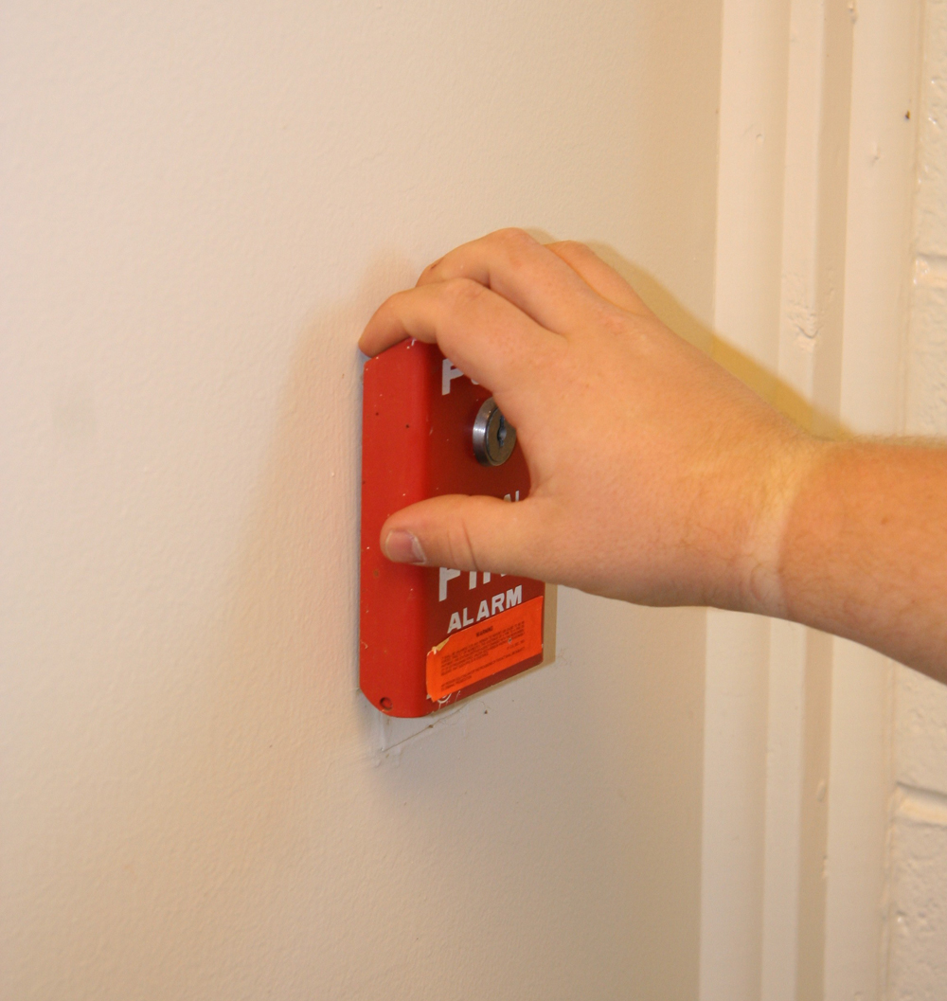
Be familiar with the characteristics and uses of manual pull stations.
Single-action
Operates after a single motion is made by the user
When the lever is pulled, it activates the alarm; sends a signal to the FACU
(Cont.)

Slide 87
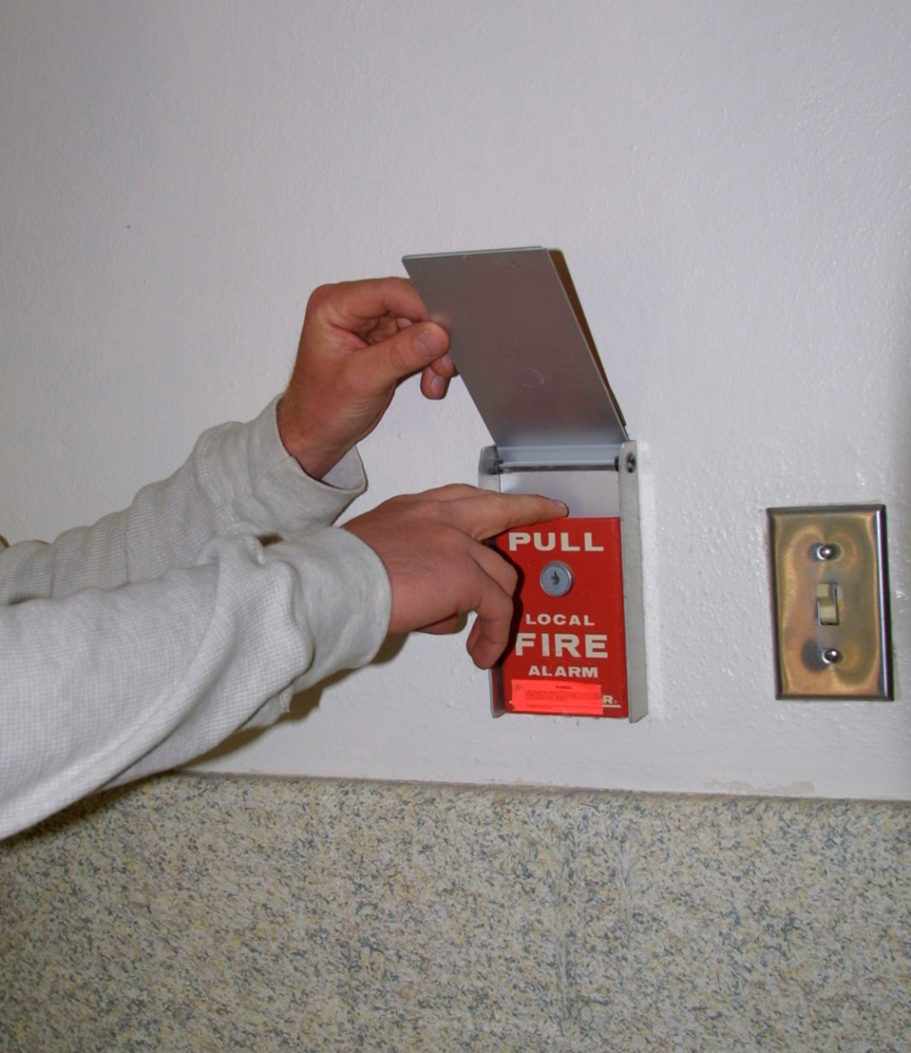
Be familiar with the characteristics and uses of manual pull stations.
Double-action
May be confusing to certain occupant/operators due to the need to perform two separate steps before an alarm is initiated
Requires the operator to perform two steps to initiate an alarm
(Cont.)

Slide 88
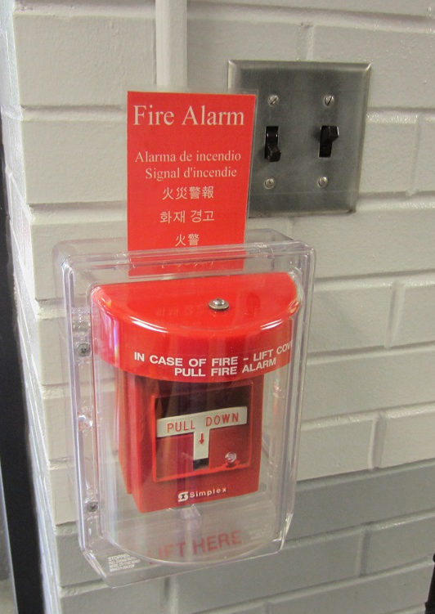
Be familiar with the characteristics and uses of manual pull stations.
Pull station protection
Can only be installed over single-action manual pull stations
Manual pull stations that require the operator to break a small piece of glass with a mallet are no longer recommended
Polycarbonate covers have taken the place of glass
May be protected by a listed protective cover
Some pull stations leave a dye or ultraviolet residue on the activator that will transfer to the fingers of someone pulling the alarm to discourage malicious false alarms
Used in locations where damage or accidental activation is possible

Slide 89
REVIEW QUESTION
What are the placement requirements for manual pull boxes?

Slide 90
Learning Objective 5
Describe service testing and inspection methods for fire detection and alarm systems.

Slide 91
Be familiar with the service testing and inspection requirements for detection and alarm systems.
Verifies operational readiness and proper performance
Periodic testing is often referred to as a service test
Fire detection and alarm signaling systems must be tested when they are installed and on a continuing basis

Slide 92
Be familiar with what to look for during inspections.
Note the functional aspects of the fire detection and alarm systems
Be able to recognize physical and environmental conditions that may negatively affect system operation; render the system inoperative
Recognize conditions that may trigger an unwanted alarm
Recommend corrective action to reduce or eliminate nuisance alarms
(Cont.)

Slide 93
Be familiar with what to look for during inspections.
Have a working knowledge of these systems
Inspectors are generally limited to visual inspections and supervision of system tests
Will not have the authority or responsibility for operating or maintaining these systems

Slide 94
Be familiar with general inspection considerations.
Check for changes to the building, or use of rooms that may result in different requirements
Verify that manual pull stations, audible or visual warning devices, and any other components are not blocked or obstructed in any way
Verify that the monitoring system is operational, if applicable
Verify that all equipment, especially initiating and signaling devices, are free of dust, dirt, paint, and other foreign materials

Slide 95
Be familiar with service testing requirements and issues.
Fire detection and alarm systems must be tested and inspected regularly
Locally adopted fire codes usually mandate that inspectors witness system tests
Periodic tests and inspections are performed on all components of the fire detection and alarm systems
Testing is the responsibility of the owner/occupant or the fire alarm monitoring company

Slide 96
NOTE
Testing and inspection intervals may vary in accordance with local codes and ordinances.

Slide 97
Be familiar with service testing requirements and issues.
It is time-consuming to test fire alarm systems in a jurisdiction
Inspectors should review the inspection/testing carried out by qualified third parties
Review documentation for any deficiencies found or repairs needed, and orders sent for correction of deficiencies
Not always possible for fire department or inspection personnel to witness every test
(Cont.)

Slide 98
Be familiar with inspection considerations for fire alarm control units.
When individual detectors are triggered, the FACU should indicate the proper location and warning lamps should light
All switches should perform their intended functions
All indicators should light or sound when tested
Verify that access to FACUs, recording instruments, and other devices are not obstructed
(Cont.)

Slide 99
Be familiar with inspection considerations for fire alarm control units.
Auxiliary devices
HVAC functions such as air-handling system shutdown controls
Fire dampers
All devices must be restored to proper operation after testing
Receiving signals
Signal impulses should be definite, clear, and evenly spaced
Local evacuation alarms
Proper signal and/or number of signals should be received and recorded
There should be no sticking, binding, or other irregularities
At least one complete round of printed signals should be clearly visible
Time stamp should clearly indicate the time of the signal

Slide 100
Be familiar with inspection considerations for alarm-initiating devices.
May wish to witness the activation of selected devices to verify that the device and the system are operational
Automatic alarm-initiating devices should be checked after installation, after a fire, at scheduled times
Guidelines are found in the locally adopted fire code
Periodic testing procedures are included in NFPA 72® and in the manufacturer’s literature

Slide 101
Be familiar with periodic testing procedures for various devices.
Restorable heat detection device
Different detector should be selected each time
Hair dryers or electric heat guns can be used to test
Combination detectors
Exercise caution to avoid tripping the nonrestorable element
Nonrestorable pneumatic detectors should be tested mechanically
Test one detector on each signal circuit semiannually
Subsequent inspections should include a copy of previous report
Should be checked by following testing procedures described by the manufacturer
Nonrestorable heat detectors must not be tested during field inspections
Some have both restorable and nonrestorable elements
(Cont.)

Slide 102
Be familiar with periodic testing procedures for various devices.
Fusible-link detector with replaceable links
After the test, the fusible link must be reinstalled
Links should be replaced at 5-year intervals
Pneumatic detector
Check semiannually by removing the link and observing whether or not the contacts close
Test semiannually with a heating device or a pressure pump following manufacturer’s instructions
(Cont.)

Slide 103
Be familiar with periodic testing procedures for various devices.
Smoke detector
Testing instruments are usually provided by the manufacturer
Sensitivity testing should be performed after the detector’s first year of service; every two years after that
Flame and gas detection devices
Test semiannually following manufacturer’s recommendations
Require testing by highly trained individuals
Manufacturers usually have specific instructions for testing their detectors
Manufacturers usually have specific instructions for testing their detectors

Slide 104
Know inspection requirements for manual alarm-initiating devices.
Verify that access to the device is unobstructed
Observe that each unit is easy to operate

Slide 105
Understand the conditions that require replacement or testing of all types of detectors.
Restored to service after a period of disuse
Obviously corroded
Painted even if attempts were made to clean them
Mechanically damaged or abused
Subjected to current surges, overvoltages, or lightning strikes
Subjected to foreign substances that might affect operation
Subjected to direct flame, excessive heat, or smoke damage

Slide 106
Understand the records requirements for detector tests.
Test date
Detector type
Location
Type of test
Test results
5-year retention of records

Slide 107
Nonrestorable fixed-temperature detectors cannot be tested periodically.
Testing would destroy the detector
Tests are not required until 15 years after the detector has been installed
Two percent of the detectors must be removed and laboratory tested
If a failure occurs in one of the detectors, additional detectors must be removed and laboratory tested
Require the system to be rendered inoperable until a replacement detector can be located and installed

Slide 108
Know inspection considerations for alarm signaling systems.
Local alarm systems
Central station systems
Check waterflow indicators, automatic fire detection systems, and supervisory equipment bimonthly
Check manual fire alarm devices, water tank level devices, and other automatic sprinkler system supervisory devices semiannually
Facility/building supervisory personnel and central station personnel must be notified before the test to prevent them from evacuating occupants or dispatching fire units
Test in accordance with guidelines established in NFPA 72®; manufacturer’s recommendations
Test signaling equipment on a monthly basis
(Cont.)

Slide 109
Know inspection considerations for alarm signaling systems.
Auxiliary fire alarm systems
Remote station and proprietary systems
Test fire detection system components monthly
Test waterflow indicators semiannually; however, the frequency of testing may depend upon the type of indicator
Occupant should visually inspect and actively test these systems monthly
Test according to testing requirements established by the AHJ
Test noncoded manual fire alarm boxes semiannually
(Cont.)

Slide 110
Know inspection considerations for alarm signaling systems.
Emergency voice/alarm systems
Include selected parts of the system that are likely to be used during an incident
Check all components at least annually
Conduct functional test of the various components in these systems quarterly (by the owner/occupant)

Slide 111
REVIEW QUESTION
Name some of the general inspection considerations for an inspector.

Slide 112
Summary
The inspection of fire detection and alarm-signaling systems is an almost daily activity for the inspector.
This chapter described the fundamental components and operation of these systems.
(Cont.)

Slide 113
Summary
The procedures that must be used while conducting inspections and tests of these systems have also been provided.
Many unique situations may demand a particular type of system or initiating device within the community’s jurisdiction.
(Cont.)

Slide 114
Summary
The fire inspector must be familiar with these conditions and the systems that have been installed.

