Slide 1
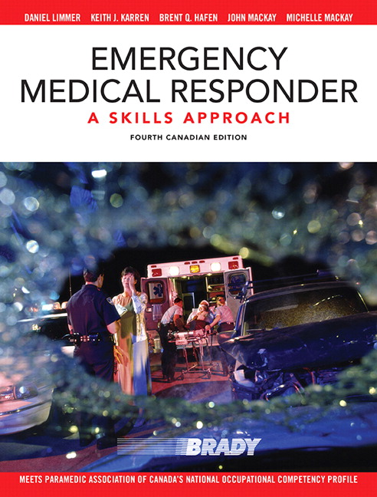
Chapter 1
INTRODUCTION TO THE EMS SYSTEM
Copyright ♥ 2015 Pearson Education Canada

Slide 2
CHAPTER 1 - INTRODUCTION TO THE EMS SYSTEM
Levels of Training
FMR
EMR
PCP/EMT-A
ACP/EMT-P
CCP
Copyright ♥ 2015 Pearson Education Canada
Notes:
FMRs are a program that is newly introduced in Alberta as standard medical training level for firefighters. AHS is acting as an overseeing body, but FMRs are not officially registered or regulated.
EMRs are now the national standard for first response programs.
PCP/EMT-A is considered the entry level for a paramedic on an ambulance.
ACP/EMT-P provide advanced life support on land and in air ambulance programs.
EMR are regulated and registered by the Alberta College of Paramedics and are governed by the Health Disciplines Act
PCP/ACP are regulated and registered by the Alberta College of Paramedics and are governed by the Health Professions Act
CCPs are the least common since the national standards came into place. Few locations have accredited CCP programs. A CCP might be found working during an intensive care air medical transport. Currently Alberta does not recognize CCP but is moving towards it.
Other intermittent levels may be recognized by individual provinces or services but are not recognized nationally.

Slide 3
CHAPTER 1 - INTRODUCTION TO THE EMS SYSTEM
In-Hospital Care System
Specialized facilities to which some patients may be taken include:
Trauma Centre (FMC)
Burn Centre (FMC)
Cardiac Centre (FMC)
Stroke Centre (FMC)
Severe hypothermia (FMC for ECMO)
Paediatric Centre (ACH)
Copyright ♥ 2015 Pearson Education Canada
Notes:
In Kananaskis, minor injuries are generally transported to Canmore General Hospital while paediatrics or anyone requiring a higher level of diagnostics or care are transported to ACH or FMC

Slide 4
CHAPTER 1 - INTRODUCTION TO THE EMS SYSTEM
Who are First Responders?
Firefighters
EMS
Police Officers
KANANASKIS KEYS
Conservation officers
Public Safety Specialists
Ski Patrol
Special event medical standby
Copyright ♥ 2015 Pearson Education Canada
Notes:
Conservation officers double as law enforcement/wildlife control/back country rescue technicians in Kananaskis
Kananaskis Public Safety Specialists often act as incident command in the event of a backcountry rescue. They coordinate removing the patient from the mountain environment and have the ability to provide some medical care. They often utilize helicopter assistance (Alpine Helicopters out of Canmore) for patient extrication. KES fire may be requested for assistance in manual extrication of a patient from the backcountry or assistance with medical care.
Ski patrollers have a diverse level of training. All are at least an FMR equivalent (wilderness first responders) while others may have a higher level of training. They are considered the experts in their environment.
Special event medical standby could be BLS or ALS care covering events such as ski events, running races or movies. These responders often work for a contracted company and will call EMS to respond and transport the patient.

Slide 5
CHAPTER 1 - INTRODUCTION TO THE EMS SYSTEM
KANANASKIS KEYS
One ALS ambulance stationed in Kananaskis (KANA-1) 24hrs a day
Other responding ambulances from surrounding areas commonly include:
-Canmore
-Banff
-Nakoda
-Cochrane
Notes:
The closest ambulance responds to any medical emergency in the province of Alberta
You could have an ambulance responding from as far away as Calgary
There is a possibility you will be caring for a patient for an extended period of time before EMS arrives based on the location they are responding from, current weather conditions, etc.
Find out which ambulance is responding to the call and get in contact with them for ETA or patient updates.

Slide 6
CHAPTER 1 - INTRODUCTION TO THE EMS SYSTEM
Your Role as a First Medical Responder
1. Ensure safety for yourself, crew, patient, and bystanders
2. Gain access to the patient
3. Assess patient for life-threatening problems
4. Alert EMS and additional resources
Copyright ♥ 2015 Pearson Education Canada

Slide 7
CHAPTER 1 - INTRODUCTION TO THE EMS SYSTEM
Your Role as a First Medical Responder
5. Provide care based on assessment findings
6. Assist EMS personnel
7. Participate in record keeping and data collection, as required
8. Act as a liaison for other public safety workers
Copyright ♥ 2015 Pearson Education Canada

Slide 8
CHAPTER 1 - INTRODUCTION TO THE EMS SYSTEM
Your Responsibilities as an FMR
1. Guard your personal health and safety
2. Maintain a caring attitude
3. Maintain your own composure
4. Keep a neat, clean appearance
5. Maintain up-to-date knowledge and skills
6. Maintain current knowledge of local, provincial, and national issues affecting the EMS and First Responder systems
Copyright ♥ 2015 Pearson Education Canada

Slide 9
CHAPTER 1 - INTRODUCTION TO THE EMS SYSTEM
Direct vs. Indirect Medical Control
Direct Medical Director or physician or EMS directs rescuer on emergency care
Indirect Protocols spell out acceptable practice for FMRs in your area
Copyright ♥ 2015 Pearson Education Canada
Notes:
While most services practise through indirect medical control, some permissions for certain procedures may require direct contact with medical control. Cellular phones are often used for these “radio medical orders.” Under the FMR program, it is recommended you contact the incoming EMS crew for medical recommendations and consultation.

Slide 10
CHAPTER 1 - INTRODUCTION TO THE EMS SYSTEM
KANANASKIS KEYS
Poison Control Alberta 1(800)332-1414
PSC (Fire Dispatch) 1(403)264-1022
AHS Dispatch (Transition in progress)
KES Dispatch 1(403)591-7755
Language Line 1(403)261-9611
Notes:
Anyone can contact Poison Control in the event of an overdose. If you suspect an overdose and know the substance that has been taken contact Poison Control for information on what to expect with the patient and/or how to care for them.
Rural EMS in Southern Alberta is transitioning from being dispatched from PSC to AHS dispatch
PSC dispatches KES fire and Calgary metro and surrounding area EMS.
AHS dispatch dispatch (will be taking over dispatching Kananaskis EMS)
KES dispatch dispatches Conservation Officers and Public Safety for backcountry emergencies.
Language Line can be used as a tool when assisting a patient who does not speak english

