Slide 1
Hazardous Materials Technician
1st Edition
Chapter 9 — Decontamination

Slide 2
Learning Objective 1
Explain the process of selecting a method of decontamination.

Slide 3
Select a method of decontamination early in the decision process.
Must be ready before entering the hot zone
Typically determined by product’s chemical properties
Should consult with experts or specialists
Several resources are available

Slide 4
REVIEW QUESTION
What resources may be used in selecting decontamination methods?

Slide 5
Learning Objective 2
Describe various decontamination methods.

Slide 6
Decontamination methods are divided in four ways.
Wet
Physical
Dry
Chemical

Slide 7
REVIEW QUESTION
What are the differences between physical and chemical decontamination methods?

Slide 8
Learning Objective 3
Identify equipment and limitations for various types of technical decontamination.

Slide 9
Technical decontamination is the planned and systematic removal of contaminants.
Courtesy of USAF, photo by Chiakia Iramina

Slide 10
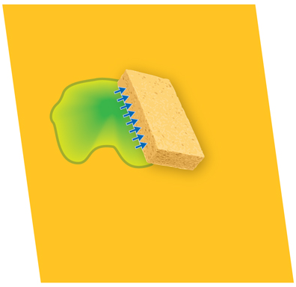
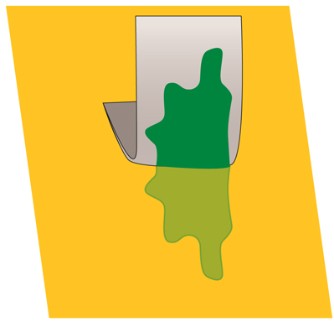
Several processes of technical decon can be used and each have limitations.
Absorption
Process
Required equipment
Limitations
Adsorption
Process
Required equipment
Limitations
(Cont.)

Slide 11
Several processes of technical decon can be used and each have limitations.
Chemical/ biological degradation
Process
Required equipment
Limitations
Dilution
Process
Required equipment
Limitations
(Cont.)

Slide 12
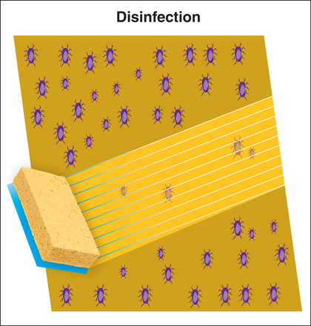
Several processes of technical decon can be used and each have limitations.
Disinfection
Process
Required equipment
Limitations
Evaporation
Process
Required equipment
Limitations
(Cont.)

Slide 13
Several processes of technical decon can be used and each have limitations.
Isolation and disposal
Process
Required equipment
Limitations
Neutralization
Process
Required equipment
Limitations
Solidification
Process
Required equipment
Limitations
(Cont.)

Slide 14
Several processes of technical decon can be used and each have limitations.
Sterilization
Process
Required equipment
Limitations
Vacuuming
Process
Required equipment
Limitations
Washing
Process
Required equipment
Limitations

Slide 15
REVIEW QUESTION
What are the advantages and limitations of each type of technical decontamination?

Slide 16
Learning Objective 4
Compare methods of mass decontamination.

Slide 17
Mass decontamination applies to multiple persons in life-threatening situations.
Steps for chaotic scene
Different methods
Mass decon showers
Can use existing facilities
Communicate and direct victims through process
Provide directions
Mark decon corridors
Victims should remove clothing and dispose of it

Slide 18
Ambulatory victims require different actions than nonambulatory.
Ambulatory
Nonambulatory

Slide 19
REVIEW QUESTION
How is mass decontamination performed differently for ambulatory and nonambulatory victims?

Slide 20
Learning Objective 5
Explain how to assess decontamination effectiveness.

Slide 21
Assessing decon effectiveness begins at the outset and is ongoing.
Courtesy of Steven Baker, New South Wales Fire Brigades

Slide 22
REVIEW QUESTION
What methods should be used to test the effectiveness of the decontamination process?

Slide 23
Learning Objective 6
Describe implementation of decontamination.

Slide 24
Selecting a proper site depends on several factors.
Wind direction
Weather
Accessibility
Terrain and surface material
Lighting and electrical supply
Drain and waterways
Water supply

Slide 25
Decon is also affected by the type of chemicals involved.
Toxic chemicals
Water-soluble chemicals
Water-reactive chemicals

Slide 26
Decon corridor layouts will vary but should have similar characteristics.

Slide 27
Decon corridor layouts may be constructed with several stations.
Gross tool drop
Gross rinse
Wash station 1
Wash station 2
Undressing area
Personal decon shower
Medical monitoring

Slide 28
REVIEW QUESTION
In what order should the decontamination corridor be laid out?

Slide 29
Consider these factors when implementing a decon line.
Identification of decon line
Procedures
Containment
Personnel
Equipment

Slide 30
Other factors must be considered for a decontamination implementation.
Law enforcement and military personnel
Canines
Criminal suspects
(Cont.)

Slide 31
Other factors must be considered for a decontamination implementation.
✓ Are wet methods necessary?
✓ Is wind chill a factor?
✓ Is shelter available afterwards?
✓ If necessary, how can icy conditions be managed?
✓ Is decon available indoors?
✓ If indoors, how will the be transported?
Cold weather decon
(Cont.)

Slide 32
WARNING
Individuals who have been exposed to deadly levels of chemical agents should undergo emergency decon immediately, regardless of ambient temperatures.

Slide 33
Other factors must be considered for a decontamination implementation.
Medical monitoring
Evidence collection and decontamination
Termination

Slide 34
REVIEW QUESTION
What processes should be used to terminate a decontamination incident?

Slide 35
Learning Objective 7
Identify special considerations for decontamination.

Slide 36
Other types of incidents require special considerations.
Radiation
Pesticides
Infectious agents
Decontamination during a terrorist event

Slide 37
REVIEW QUESTION
What special considerations should be taken during decontamination of a terrorist event?

Slide 38
Learning Objectives 8-10
These objectives are measured in Skill Sheets 9-1 – 9-3.
These skill sheets can be found on the curriculum flash drive.
This checklist corresponds with the skill steps beginning on p. 422 of the manual.

Slide 39
Summary
Decontamination is conducted to prevent the spread of contaminants from the hot zone to other areas.
Decontamination is done to reduce the level of contamination to levels that are not harmful.

Slide 40
Summary
Proper decontamination of all personnel and equipment is necessary to ensure the health and well-being of all personnel involved.

