Slide 1
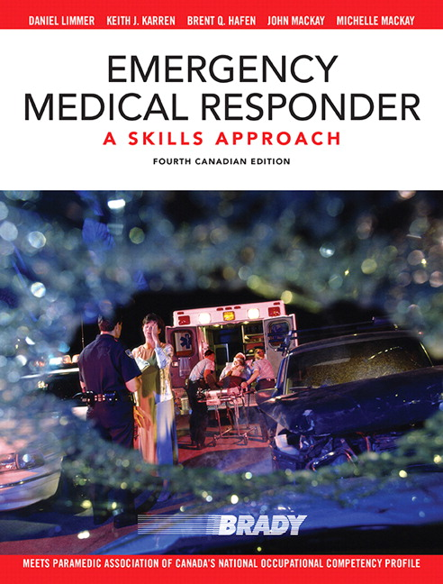
Chapter 2
THE WELL-BEING OF THE EMERGENCY MEDICAL RESPONDER
Copyright ♥ 2015 Pearson Canada Inc.
Notes:
Well-being involves both physical and mental health

Slide 2
CHAPTER 2 - THE WELL-BEING OF THE FIRST RESPONDER EMERGENCY MEDICAL RESPONDER
The Stress of Being a First Responder
shift work
inadequate sustenance
a stressful job environment
dealing with stressful calls
critical incidents
Copyright ♥ 2015 Pearson Canada Inc.
Notes:
Not applicable to Kananaskis :P

Slide 3
CHAPTER 2 - THE WELL-BEING OF THE FIRST RESPONDER EMERGENCY MEDICAL RESPONDER
Recognize the Signs of Stress
Irritability
Anxiety
Inability to make decisions
Loss of interest in sexual activity
Loss of interest in work
Inability to concentrate
Difficulty sleeping
Loss of appetite
Desire to be left alone
Guilt
Copyright ♥ 2015 Pearson Canada Inc.
Notes:
It is imperative that practitioners recognize the symptoms of mental trauma in both themselves and their peers. Trauma can be acute (a singular traumatic call) or cumulative (the compounding effects of a stressful job paired with stressful calls).

Slide 4
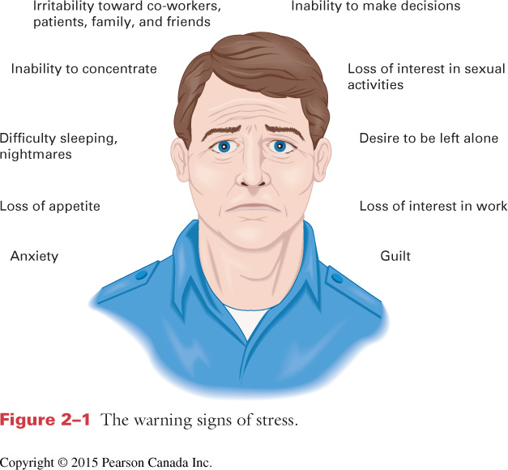
CHAPTER 2 - THE WELL-BEING OF THE FIRST RESPONDER EMERGENCY MEDICAL RESPONDER

Slide 5
CHAPTER 2 - THE WELL-BEING OF THE FIRST RESPONDER EMERGENCY MEDICAL RESPONDER
How to Deal with Stress
Remind yourself that the patient desperately needs you and your skills
Close your eyes and take several long, deep breaths
Hum quietly and sing peaceful songs
Eat properly to maintain your blood sugar
Copyright ♥ 2015 Pearson Canada Inc.
Notes:
Stress is very real on the job.
Someone once said that EMS consists of long periods of boredom, interrupted by short spans of pandemonium. Both can cause stress.
While this slide discusses how to deal with stress on the job, it is important to take time off the job for family, leisure activities, and getting the sleep that is necessary for a healthy lifestyle, as pointed out in the next slide.

Slide 6
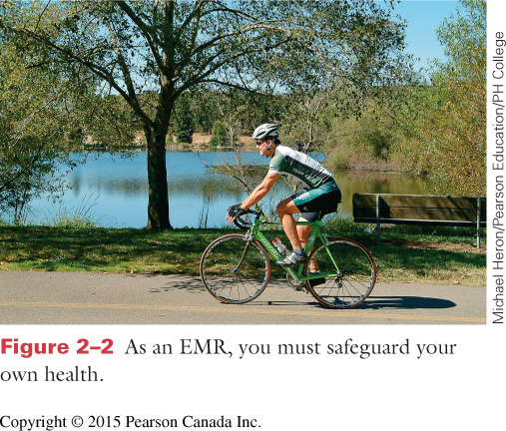
CHAPTER 2 - THE WELL-BEING OF THE FIRST RESPONDER EMERGENCY MEDICAL RESPONDER

Slide 7
CHAPTER 2 - THE WELL-BEING OF THE FIRST RESPONDER EMERGENCY MEDICAL RESPONDER
Lifestyle Changes to Avoid Stress
Cut caffeine, sugar, and alcohol
Avoid fatty foods
Avoid self medicating
Exercise more often
Learn to relax
Spiritual outlets
Maintain balance in your life
Copyright ♥ 2015 Pearson Canada Inc.
Notes:
These items look strangely familiar to the cardiac and stroke risk factors you may remember from a CPR course.

Slide 8
CHAPTER 2 - THE WELL-BEING OF THE FIRST RESPONDER EMERGENCY MEDICAL RESPONDER
Dealing with a Dying Patient
Maintain the patient’s dignity
Show respect to the patient
Communicate
Allow family members to vent
Listen with empathy
Copyright ♥ 2015 Pearson Canada Inc.
Notes:
Despite your best efforts and training, patients will die. CPR and advanced cardiac life support interventions rarely achieve a 15% success rate on cardiac arrest victims. Chapter 3 will look at legal considerations for treatment of terminal patients.

Slide 9
CHAPTER 2 - THE WELL-BEING OF THE FIRST RESPONDER EMERGENCY MEDICAL RESPONDER
Dealing with a Dying Patient
Don’t give false assurances, but allow hope
Use a gentle tone of voice
Assure patient that everything possible is being done
Do what you can to comfort the family
Copyright ♥ 2015 Pearson Canada Inc.
Notes:
Even unconscious patients may be able to hear. Reassure them and remember they may understand what you are saying.

Slide 10
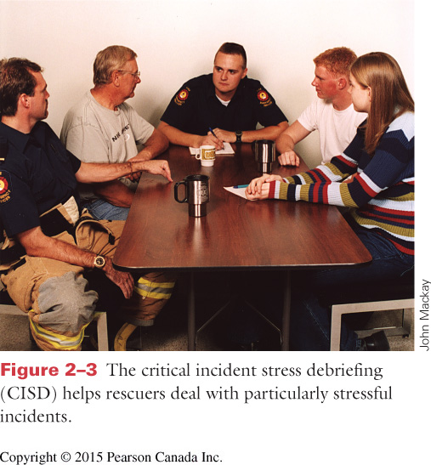
CHAPTER 2 - THE WELL-BEING OF THE FIRST RESPONDER EMERGENCY MEDICAL RESPONDER
Notes:
Unfortunately KES does not have an official CISM team. It is a small department and you need to look after one another and overcome the stigma of having mental and emotional trauma as inflicted by the job.
AHS does have a Peer Support/CISM team. If there is a large scale event involving multiple agencies AHS may host a joint defusing/debriefing for all first responders involved.

Slide 11
CHAPTER 2 - THE WELL-BEING OF THE FIRST RESPONDER EMERGENCY MEDICAL RESPONDER
Strategies for Managing Critical Incident Stress
Pre-incident stress education
On-scene peer support
One-on-one support
Follow-up services
Spouse and Family support
Community outreach programs
Other general health and welfare initiatives
Copyright ♥ 2015 Pearson Canada Inc.
Notes:
What is critical incident stress?
A critical incident is any event that can causes unusually strong emotions that can interfere with your ability to function during or after an incident.

Slide 12
CHAPTER 2 - THE WELL-BEING OF THE FIRST RESPONDER EMERGENCY MEDICAL RESPONDER
Critical Incident Stress Debriefing (CISD)
Defusing
Debriefing
Incidents Potentially Requiring CISD
LODD death or serious injury
Multi-casualty incident
EMS worker suicide
Event attracting media attention
Injury or death of someone you know
Any disaster
Serious calls involving children
Copyright ♥ 2015 Pearson Canada Inc.
Notes:
Line of Duty Death
Defusing is conducted within hours of the incident.
Debriefing is held within 24-72 hours of the incident.
Note that while CISD seems to be more effective employed soon after the incident, there is research that suggests that a person’s attendance at a debriefing should remain optional since there can be a question of the efficacy of demanded attendance and reliving the cause.

Slide 13
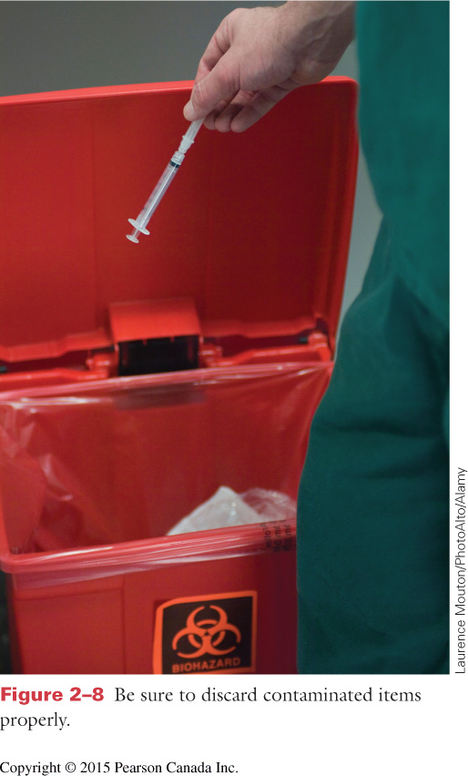
CHAPTER 2 - THE WELL-BEING OF THE FIRST RESPONDER EMERGENCY MEDICAL RESPONDER
Disease Transmission
Direct — blood to blood contact
Open wounds
Exposed tissues
Mucous membranes of eyes or mouth
Indirect —by contaminated objects
Needles
Inhaled airborne droplets
Copyright ♥ 2015 Pearson Canada Inc.
Notes:
This slide compares the 2 modes of transmission and gives examples.
Have students suggest scenarios as examples.

Slide 14
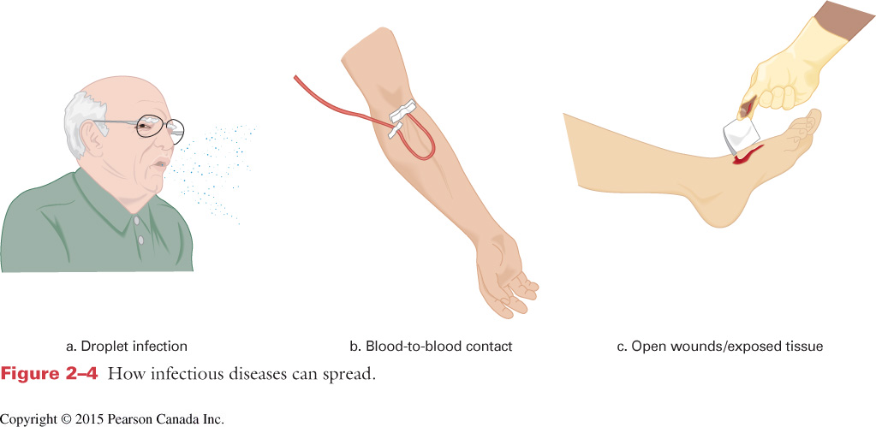
CHAPTER 2 - THE WELL-BEING OF THE FIRST RESPONDER EMERGENCY MEDICAL RESPONDER

Slide 15
CHAPTER 2 - THE WELL-BEING OF THE FIRST RESPONDER EMERGENCY MEDICAL RESPONDER
Diseases of Concern
Hepatitis B & C
Tuberculosis
Acquired Immune Deficiency Syndrome
SARS
H1N1 type influenza
Others?
Copyright ♥ 2015 Pearson Canada Inc.
Notes:
TB has been making a comeback and is alive and well in many Canadian cities.
Others: measles, mumps, rubella, flu, meningitis (GET YOUR VACCINATIONS, these are preventable and a way to protect yourself and your patients from disease transmission)
norovirus

Slide 16
CHAPTER 2 - THE WELL-BEING OF THE FIRST RESPONDER EMERGENCY MEDICAL RESPONDER
Immunizations
Tetanus prophylaxis (every 10 years)
Hepatitis B vaccine
Influenza vaccine
Polio vaccine
Measles, mumps, rubella (MMR) vaccine
Copyright ♥ 2015 Pearson Canada Inc.

Slide 17
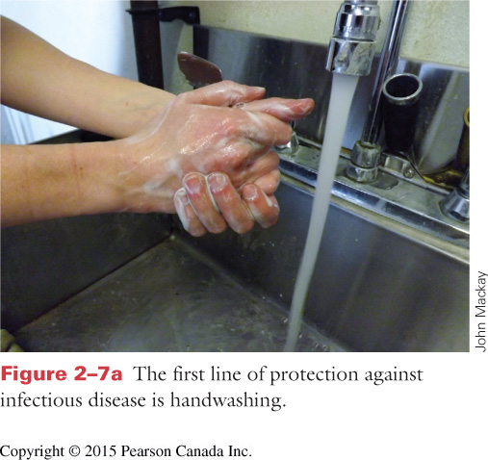
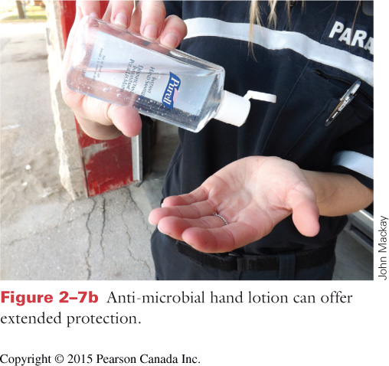
CHAPTER 2 - THE WELL-BEING OF THE FIRST RESPONDER EMERGENCY MEDICAL RESPONDER
Handwashing
Wash your hands well and often.
Keeping clean hands can be your first, last, and best line of defence.
Use alcohol based hand sanitizer if soap and water are not readily available
Copyright ♥ 2015 Pearson Canada Inc.
Notes:
Even after wearing/removing protective gloves.
Current studies show first responders do not wash their hands nearly enough. Although it may seem unrealistic at times, it is the best defence against disease transmission and protecting yourself.
If in doubt, wash your hands!!

Slide 18
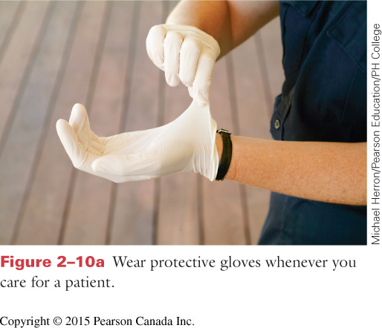
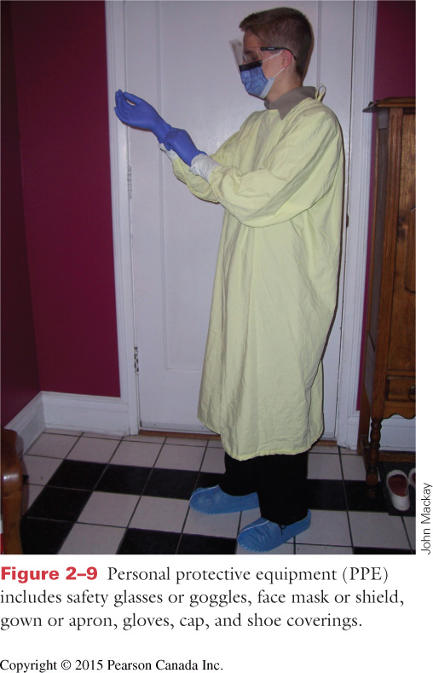
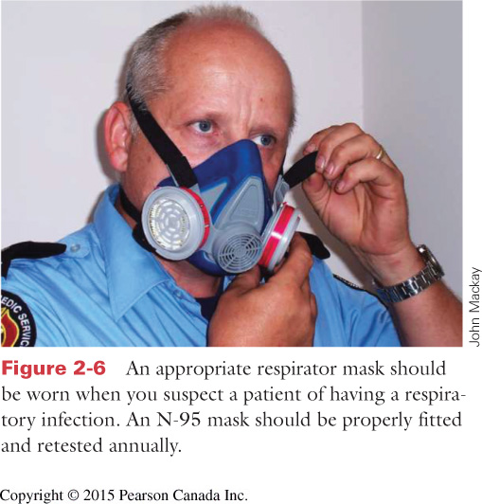
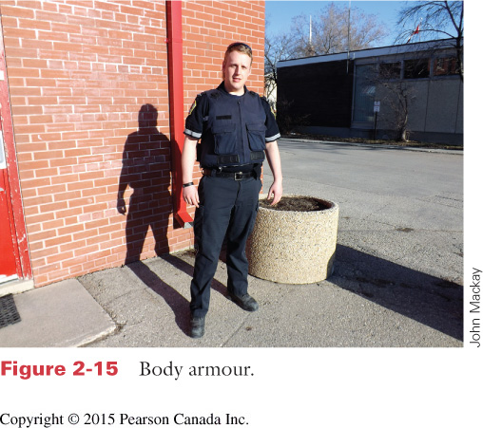
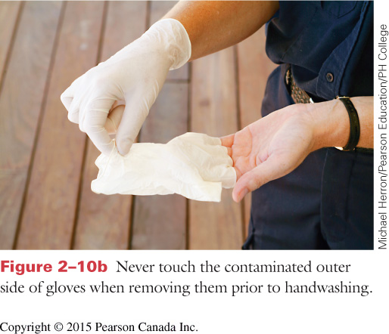
CHAPTER 2 - THE WELL-BEING OF THE FIRST RESPONDER EMERGENCY MEDICAL RESPONDER
Personal Protective Equipment (PPE)
Eye protection
Gloves
Gowns
Procedure masks/N95 masks
Face shields
Copyright ♥ 2015 Pearson Canada Inc.

Slide 19
CHAPTER 2 - THE WELL-BEING OF THE FIRST RESPONDER EMERGENCY MEDICAL RESPONDER
If the scene is unsafe,
make it safe before you enter!
Decide whether the scene is safe to approach the patient.
Look for:
1) MVA or airplane crashes
2) Presence of toxic substances
3) Crime scenes
4) Presence of weapon of any kind
Copyright ♥ 2015 Pearson Canada Inc.

Slide 20
CHAPTER 2 - THE WELL-BEING OF THE FIRST RESPONDER EMERGENCY MEDICAL RESPONDER
If the scene is unsafe,
make it safe before you enter!
Decide whether the scene is safe to approach the patient.
Look for:
5) Possible drug or alcohol use
6) Arguing, threats, violent behaviour, broken glass, overturned furniture
7) Unstable surfaces like water or ice
Copyright ♥ 2015 Pearson Canada Inc.
Notes:
What else can you think to look for when on a scene?
Speeding traffic (do you have adequate traffic control?)
Downed power lines
Aggressive dogs
Environmental hazards
**Remember: It’s not you emergency and if you or your partner get injured you are unable to care for your patients

Slide 21
CHAPTER 2 - THE WELL-BEING OF THE FIRST RESPONDER EMERGENCY MEDICAL RESPONDER

Slide 22
CHAPTER 2 - THE WELL-BEING OF THE FIRST RESPONDER EMERGENCY MEDICAL RESPONDER

Slide 23
CHAPTER 2 - THE WELL-BEING OF THE FIRST RESPONDER EMERGENCY MEDICAL RESPONDER

Slide 24
CHAPTER 2 - THE WELL-BEING OF THE FIRST RESPONDER EMERGENCY MEDICAL RESPONDER
KANANASKIS KEYS
Scene hazards unique to our mountain environment may include:
Avalanche danger zones
Steep slopes with unsteady footing (scree, dirt, snow)
Wildlife (bears, elk, moose, etc.)
Copyright ♥ 2015 Pearson Canada Inc.
Notes:
Who do you contact if there is an avalanche danger? KES dispatch/COs/Public Safety
Who do you contact for steep slopes? KES dispatch/COs/Public Safety for possible high angle rescue
Wildlife? COs or possibly RCMP

