Slide 1
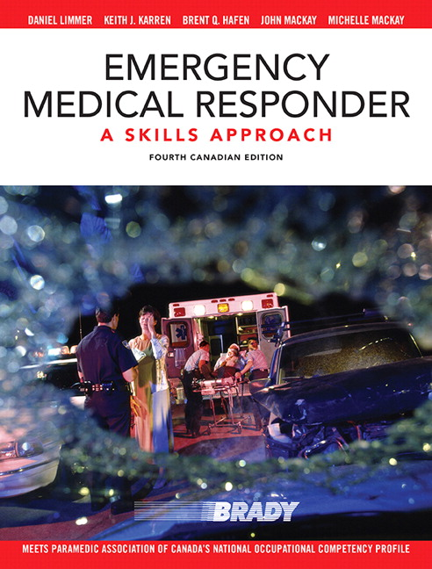
Chapter 3
LEGAL AND ETHICAL ISSUES
Notes:
AHS EMS has developed this set of Medical First Response (MFR), Medical Control Protocols (MCPs). The MCPs contain best standard practice taken from evidence and expert informed care and treatment information that is specifically intended for the use of medical first responders in Alberta and the physicians who provide medical oversight for these agencies. EMS reserves the right at its own discretion to make changes, including the correction of errors and complete revisions to the MCPs.
As part of the MFR program it is expected and required that all care provided is in accordance with the MFR protocols set out by AHS EMS.
AHS EMS protocols are a free download on all platforms. Ie… iphone and android. It is encouraged that you download the app and use.

Slide 2
CHAPTER 3 – LEGAL AND ETHICAL ISSUES
When providing medical care, you should:
Follow standing orders and protocols
Consult medical control or incoming EMS if questions arise about scope of practice or care
Communicate clearly with EMS or medical director
Follow EMS or medical director’s orders
Notes:
The concept of the AHS MFR program is to contact the incoming EMS resource with patient updates and questions. The EMS crew can help direct you to making care decisions and can contact On Line Medical Control if needed (OLMC)

Slide 3
CHAPTER 3 – LEGAL AND ETHICAL ISSUES
Ethical Responsibilities
Make the physical and emotional needs of the patient a priority
Master your skills
Continue your education and take refresher courses
Critically review your performance
Report honestly
Work in harmony with other responders
Notes:
What is the yearly up keep for MFR education?

Slide 4
CHAPTER 3 – LEGAL AND ETHICAL ISSUES
Two Types of Patient Consent
Expressed
Implied
Notes:
Discuss the difference between the two.
A patient must be competent in order to express consent. What deems a patient incompetent is discussed on the next slide.
Consent is implied when a patient is not competent.

Slide 5
CHAPTER 3 – LEGAL AND ETHICAL ISSUES
An incompetent adult…
is under the influence of alcohol or drugs
has an altered mental status
has a serious illness or injury that may affect judgment
has a mental illness or intellectual disability
Notes:
Stress is very real on the job.
Someone once said that EMS consists of long periods of boredom, interrupted by short spans of pandemonium. Both can cause stress.
While this slide discusses how to deal with stress on the job, it is important to take time off the job for family, leisure activities, and getting the sleep that is necessary for a healthy lifestyle, as pointed out in the next slide.

Slide 6
CHAPTER 3 – LEGAL AND ETHICAL ISSUES
A parent or guardian must give
consent before you treat a minor, unless…
a life threatening condition exists
the individual is an emancipated minor
Notes:
Most pediatric patients that we come in contact with in the valley are at Nakiska who are skiing with a school group. The school has authority to make decisions on behalf of the parents. Often EMS or Patrol will attempt to contact the parents directly to gain consent.
If unable to gain parental consent then you assume care of the pediatric until EMS arrives.

Slide 7
CHAPTER 3 – LEGAL AND ETHICAL ISSUES
Advanced Directives or
Do Not Resuscitate Orders (DNRs)
Check whether or not the DNR is:
Physically present
Accompanied by a doctor’s written instructions
Written clearly and concisely and signed by the patient
Notes:
In AHS we have what is referred to as the Green Sleeve. Which is the Goals of Care Directive. The Green Sleeve must be physically present. Do not delay resuscitative efforts to wait for the green sleeve. Generally you will not see the green sleeve in Pre-Hospital scene calls. But at William Watson Lodge it is possible that certain patients or groups may present with a green sleeve.
AHS has a list of goals of Care
R1 Full resc.
R2 Resuscitation without chest compressions
R3 No resc.
M (all) No Resuscitation
C (all) No Resuscitation
http://www.albertahealthservices.ca/frm-103547.pdf
Obvious Death DRIED
Decapitated, Rigor, Incineration, Evisceration, Decomposition
Contact EMS or Medical Direction if questions if resuscitation is needed ie…. Prolonged cold (frozen solid), obvious futility

Slide 8
CHAPTER 3 – LEGAL AND ETHICAL ISSUES
Notes:
The DNR order must be physically present in order to be valid. You have no legal ground to simply take a person’s word that it exists.
Could consider removing

Slide 9
CHAPTER 3 – LEGAL AND ETHICAL ISSUES
Notes:
The DNR order must be physically present in order to be valid. You have no legal ground to simply take a person’s word that it exists.
Consider removing

Slide 10
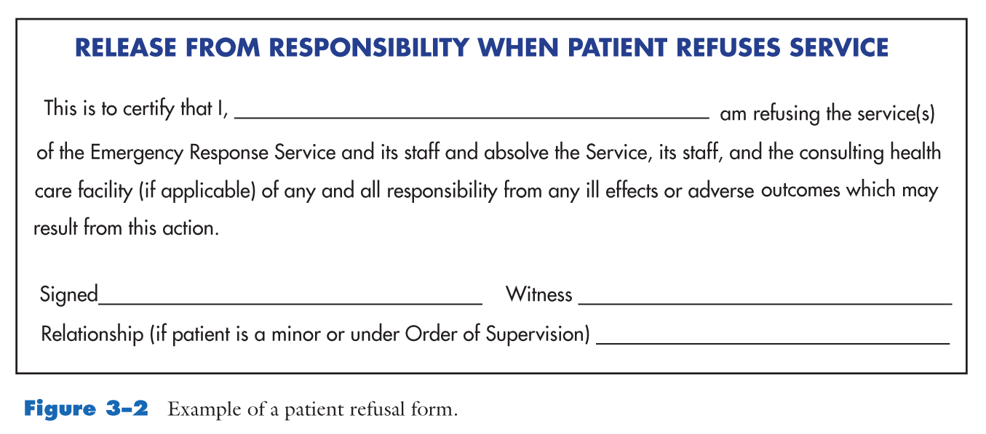
CHAPTER 3 – LEGAL AND ETHICAL ISSUES
Notes:
FMR crews should remain on scene for in coming EMS crews who can deal with any patients who are refusing services. In the event a person is not willing to remain on scene for EMS assessments and they are do not meet implied consent or the mental health act. (Form 10 by RCMP) contact EMS and inform them of the situation. RCMP is always a resource if patients become aggressive or hostile towards FMR responders.

Slide 11
CHAPTER 3 - LEGAL AND ETHICAL ISSUES
Prior to leaving a scene after a patient refusal, you should:
Try again to persuade the patient
Ensure the patient is able to make an informed decision
Have the patient sign the refusal
Encourage the patient to seek help if symptoms persist
Advise the patient to call EMS again if he/she changes their mind
Notes:
This is done by EMS crews.

Slide 12
CHAPTER 3 - LEGAL AND ETHICAL ISSUES
Legal Aspects of Emergency Care
Common Assault – Obtain consent before touching a patient’s clothing or body
Abandonment – Once care is started, you must continue until equally trained or higher-trained personnel take over
Negligence – Your care must adhere to a standard of care

Slide 13
CHAPTER 3 - LEGAL AND ETHICAL ISSUES
Confidentiality
By law, you are allowed to release information without a patient’s, parent’s, or guardian’s consent only if:
Another health care provider needs it
You are required by legal subpoena to provide it in court
Notes:
In Alberta we have the “Alberta Health Information Act”
Purposes of Act
2 The purposes of this Act are
(a) to establish strong and effective mechanisms to protect the privacy of individuals with respect to their health information and to protect the confidentiality of that information,
(b) to enable health information to be shared and accessed, where appropriate, to provide health services and to manage the health system,
Prohibition re disclosure of health information
31 No custodian shall disclose health information except in accordance with this Act.
Disclosure of non-identifying health information
32(1) A custodian may disclose non-identifying health information for any purpose.
(2) If a disclosure under subsection (1) is to a person that is not a custodian, the custodian must inform the person that the person must notify the Commissioner of an intention to use the information for data matching before performing the data matching.
Long story short. You can share Name and dempgraphic information with other agencies on scene. But are not allowed to discuss any medical information. Conditions or treatment. That includes the RCMP if RCMP want medical information they need to ask the patient for it them selves or by a subpoena from a judge to AHS.
You are allowed to share Medical information, ie.. Past medical history, Chief complaint, injuries, medical conditions with other Health care providers. Ie… EMS

Slide 14
CHAPTER 3 - LEGAL AND ETHICAL ISSUES
Volunteer Service Acts
While off duty, you may not be legally required to stop and assist at a scene, but there is a recognized duty to assist according to your level of certification when you do render help.
Notes:
Good Samaritans act. If you do stop to help you then do become responsible for the care you provide

Slide 15
CHAPTER 3 - LEGAL AND ETHICAL ISSUES
Preservation of Evidence
Observe and document anything unusual at the scene
Touch only what you need to
Move only what you need to move to protect the patient and provide emergency care
Don’t use the phone, unless police give you permission

Slide 16
CHAPTER 3 - LEGAL AND ETHICAL ISSUES
Preservation of Evidence
Move patient only if he/she is in danger or to provide emergency care
If possible, don’t cut holes through patient’s clothing
Don’t cut through any knot in a rope or tie
If the crime is rape, do not wash the patient or allow him/her to wash

Slide 17
CHAPTER 3 - LEGAL AND ETHICAL ISSUES
Special Situations
Medical ID Tags
Donor & Organ Harvesting
Notes:
A medical tag can provide valuable information that the patient cannot. Medic alert
Donor and organ harvesting must be validated by a signed donor card which is essentially an advanced health care directive. Back of the health cae card.

