Slide 1
Fire Inspection and Code Enforcement
8th Edition Inspector II
Chapter 16 — Inspection Procedures

Slide 2
Learning Objective 1
Describe what makes a complaint complex.

Slide 3
Complex complaints involve many different topics.
Size of facility
How much research is involved in addressing the issue(s)
Number of codes or standards that need to be addressed
Whether the inspector has experience in the questions asked

Slide 4
Complex complaints do not involve single, straightforward issues.
Example
An existing apartment building where fire, building, electrical, plumbing and/or health issues are present
Inspector may require additional time to conduct research and inspections
May require an interpretation on a particular code and research into additional codes
May require expert assistance or assistance from multiple departments or agencies

Slide 5
Be able to determine which official has the ultimate authority over the questions.
May determine that the complaint is multi-jurisdictional and therefore involves a number of agencies
Complaint resolution will rely on additional technical expertise
Experts may recommend several courses of action to reach a solution

Slide 6
REVIEW QUESTION
What makes a complaint complex?

Slide 7
Learning Objective 2
Describe how to evaluate emergency preparedness plans.

Slide 8
Inspectors are also asked to evaluate emergency planning and preparedness procedures.
Emergency-reporting procedures for facility personnel
Emergency duties and responsibilities of facility personnel
Procedures for conducting emergency fire drills
Information about facility’s fire protection systems
Procedures for personnel to evacuate, relocate, and/or shelter-in-place

Slide 9
Know what to be aware of when evaluating emergency plans.
Occupancy
Hazards

Slide 10
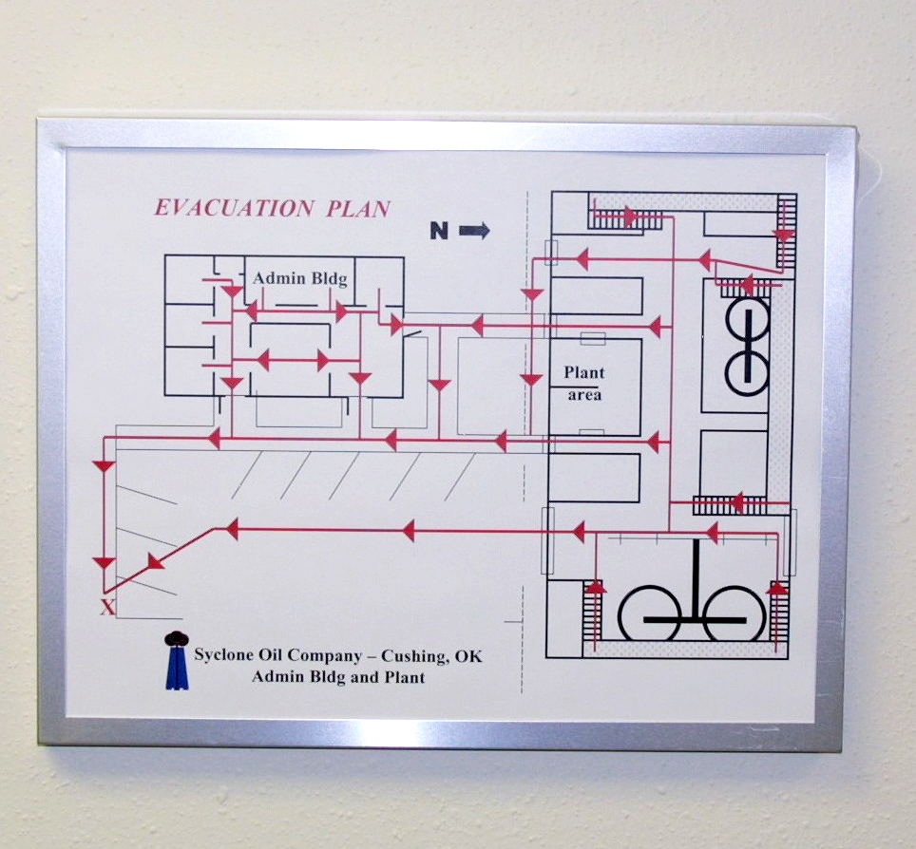
All emergency evacuation plans should have key elements.
Evacuation routes
Maps
Primary and secondary routes of exit from a structure are given for each compartment in an occupancy
Indicate present location of the person reading
Indicate exit routes
Show the location of the meeting point
Should be provided to all employees
Should be posted
(Cont.)

Slide 11
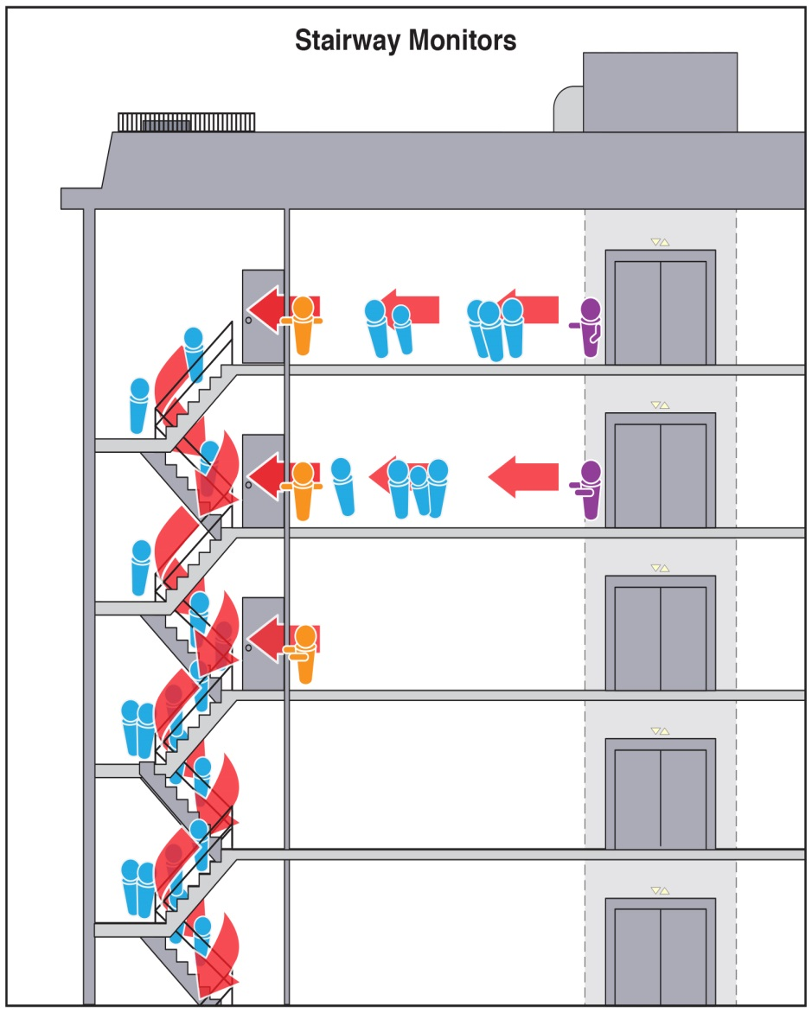
All emergency evacuation plans should have key elements.
Monitors
Seeing that all people in the particular area know the plan; their individual duties
Alternates are appointed
Names of monitors may be listed on maps and in the emergency plan
Each compartment has a primary monitor
Monitor duties
Accounting for the people
Searching the area
(Cont.)

Slide 12
All emergency evacuation plans should have key elements.
Employee occupant duties
Verifying their area is completely evacuated
Turning off equipment
Closing doors and windows
Providing information to responding firefighters
Verify visitors are accounted for

Slide 13
NOTE
Inspection personnel may be requested to assist building administrators and occupants in the development, review, and testing of emergency plans for occupancies within their jurisdictions.

Slide 14
REVIEW QUESTION
What does an Inspector II look for when evaluating an emergency plan?

Slide 15
Summary
The process of conducting an inspection must follow a systematic approach from preparation through the filing of the final reports.
The inspector needs to prepare by researching information about the facility and applicable codes.
(Cont.)

Slide 16
Summary
A successful inspection involves more than research, though. Inspectors need to present a professional appearance, communicate in a respectful manner, and follow up with any issues uncovered during an inspection.

