Slide 1
Fire Inspection and
Code Enforcement
8th Edition
Inspector II
Chapter 14 — Fire Detection and Alarm Systems

Slide 2
Learning Objectives 1 and 2
Explain methods to evaluate fire detection and suppression system equipment for life safety, property conservation, and hazards.
Describe inspection and testing methods for fire detection and suppression system equipment.

Slide 3
Be familiar with the service testing and inspection requirements for several items.
Detection and alarm systems
Initiating appliances
FACUs

Slide 4
An Inspector II may be required to know and do additional items.
Operation of fire detection and alarm systems
Evaluate and approve the design of fire detection and alarm systems during plans review
Building code requirements for their installation, testing, and monitoring

Slide 5
Inspectors need to understand acceptance testing.
Performed soon after the system has been installed and prior to occupancy
Representatives of the building owner/occupant, fire department, and system installer/manufacturer should witness acceptance tests
Ensure it meets design criteria and functions properly
(Cont.)

Slide 6
Inspectors need to understand acceptance testing.
Fire department representative may be a fire inspector, a staff fire protection engineer, or the fire marshal
Some jurisdictions require a record of completion from the system installer/manufacturer
Record prevents the inspector from checking a system that may not have been properly installed

Slide 7
Know what inspectors should witness during acceptance testing.
Inspect all wiring
Inspect conduit for solid connections and proper support
Look for wear, damage, or any other defects
Check batteries in the emergency power source; immediately replace those that fail

Slide 8
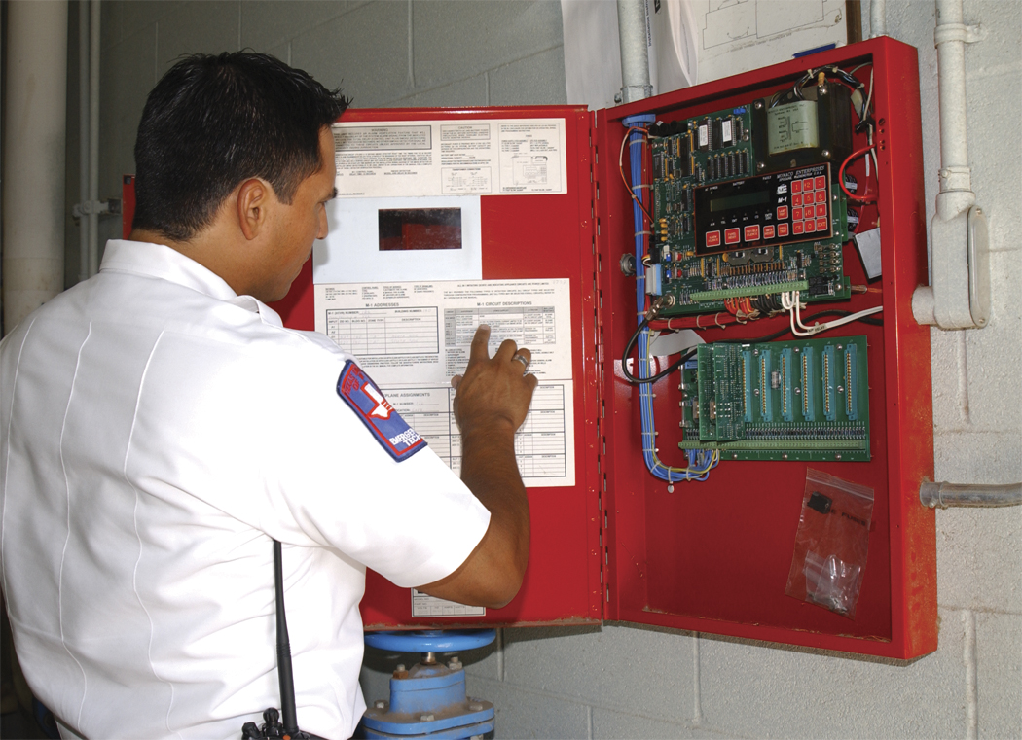
Functions of the fire detection and alarm-signaling system should be operated during acceptance tests.
Alarm, supervisory, and trouble signals
Fire alarm control panel (FACU)
Check actual wiring and circuitry against the system drawing
Operate all interactive controls
Verify that all are connected properly
Verify that they control the system as designed
Inspect thoroughly to verify that the FACU is in proper working order
(Cont.)

Slide 9
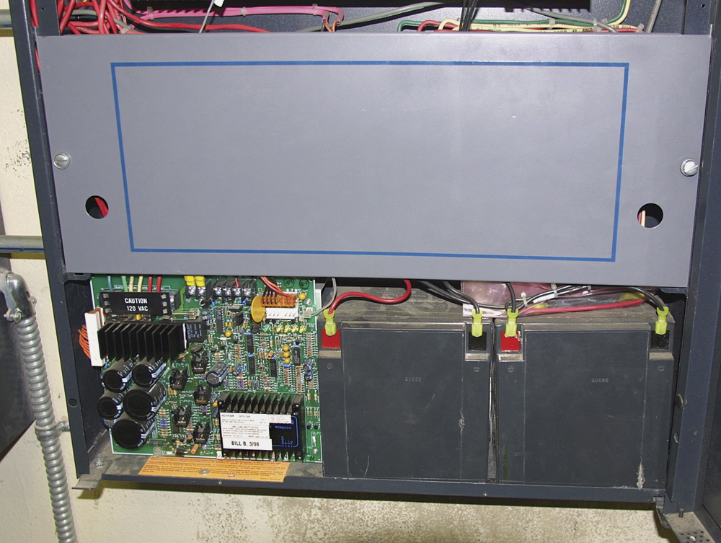
Functions of the fire detection and alarm-signaling system should be operated during acceptance tests.
Alarm-initiating/occupant notification appliances and circuits
Check all items for proper operation
Operate the system on both the primary and secondary power supplies
Test pull stations, detectors, bells, and strobe lights
Test each initiating appliance
Power supplies
(Cont.)

Slide 10
Functions of the fire detection and alarm-signaling system should be operated during acceptance tests.
Check the ability of supervising station services to respond
Results of all tests must be documented to the satisfaction of the AHJ
Verify alarm-receiving capability and response of those involved
Telecommunications facility must receive the request for emergency service
(Cont.)

Slide 11
Functions of the fire detection and alarm-signaling system should be operated during acceptance tests.
All parts of the system have to successfully pass tests before a system certification can be issued
Issuing the alarm system certificate is typically a preliminary step toward the issuance of a certificate of occupancy
NFPA 72® contains complete information on system acceptance tests

Slide 12
REVIEW QUESTION
What should an inspector witness during an acceptance test?

Slide 13
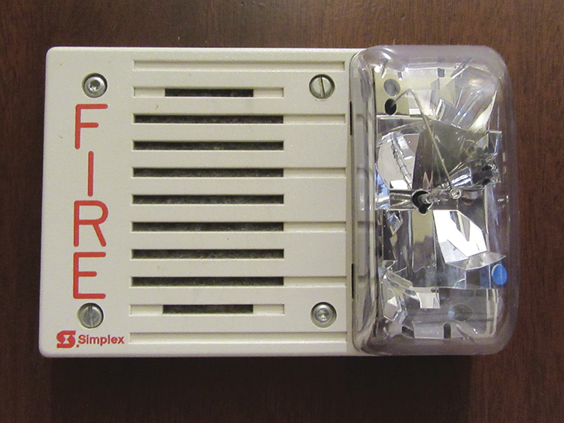
Understand the operation of occupant notification appliances.
Requirements
Voice evacuation systems
Alarm printers
Annunciators
Textual displays
Locally adopted building code
Other governing code or standard
System installation standard
Notification
Used in the occupancy to alert occupants of a fire
Activation of horns, bells, and strobes
Graphic displays
Courtesy of Rich Mahaney

Slide 14
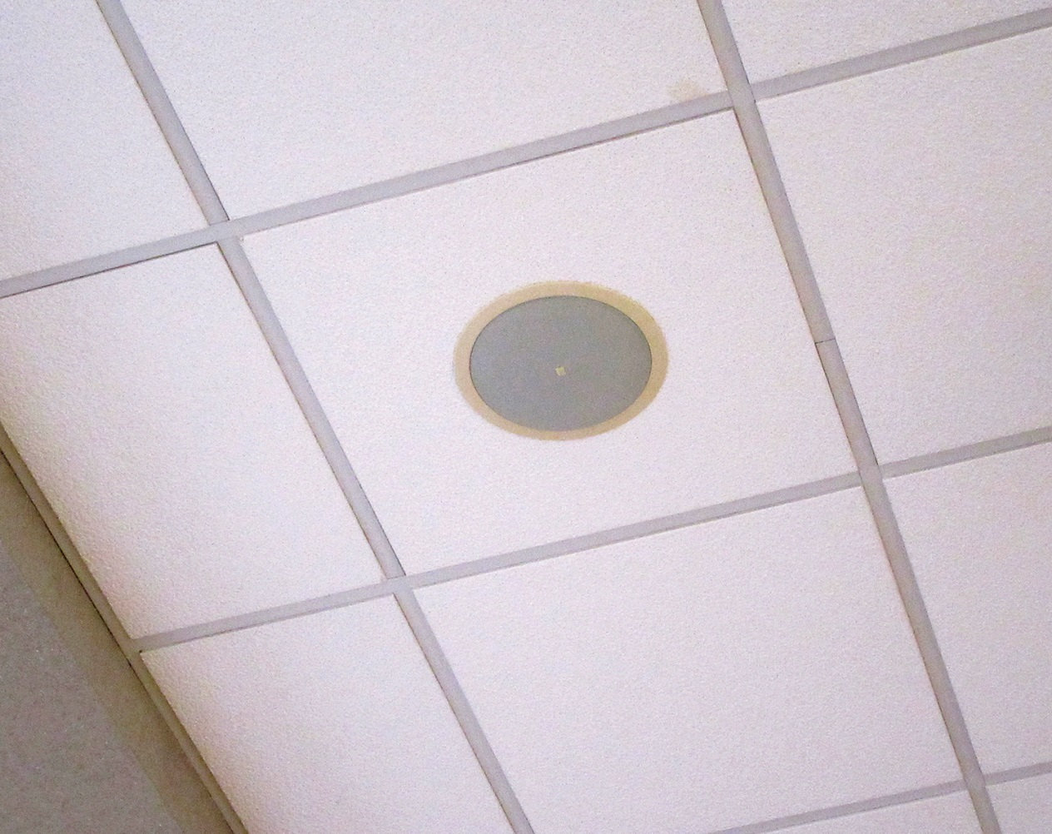
NFPA 72® dictates where and how systems are installed.
Authority
Locally adopted building code specify requirements for the annunciators and graphic displays
Requirements
Graphic displays are located near the front entrance to the building
Provide a complete view of the building with alarm zones and detection points
Remote annunciators will typically be located near the entrance
Courtesy of Rich Mahaney

Slide 15
Building code requirements for disability access will require visual occupant notification appliances.
Visual alarm indicators
A rotating beacon may also be used for outdoor installation or for warning on large complexes
Accomplished through the use of flashing strobe lights
Alarms with integrated audible and visual signals
Accommodate the hearing and visually impaired
For areas where people may be alone
Restrooms, storage areas, offices
Almost all fire detection and alarm system installations require the use of audible signals through horns, bells, or chimes

Slide 16
Inspectors need to understand audible notification.
Provides occupant notification
Level of loudness is a measurement of sound pressure
Appliance must be loud enough to be heard
Measurement is in decibels; expressed as dBA
(Cont.)

Slide 17
Inspectors need to understand audible notification.
NFPA 72® requirements
Level to be at least 15 dBA above the average or normal sound level
Allows audible notification in noisy areas if ambient sound level can be reduced
5 dBA above the maximum sound level that lasts at least one minute
Total sound pressure produced must not exceed 120 dB
If ambient sound in a building is above 105 dB, the building must have visual notification
Measurements
Made at five feet (1.5 m) above the floor
At pillow levels in sleeping areas
Each installation requires specific evaluation

Slide 18
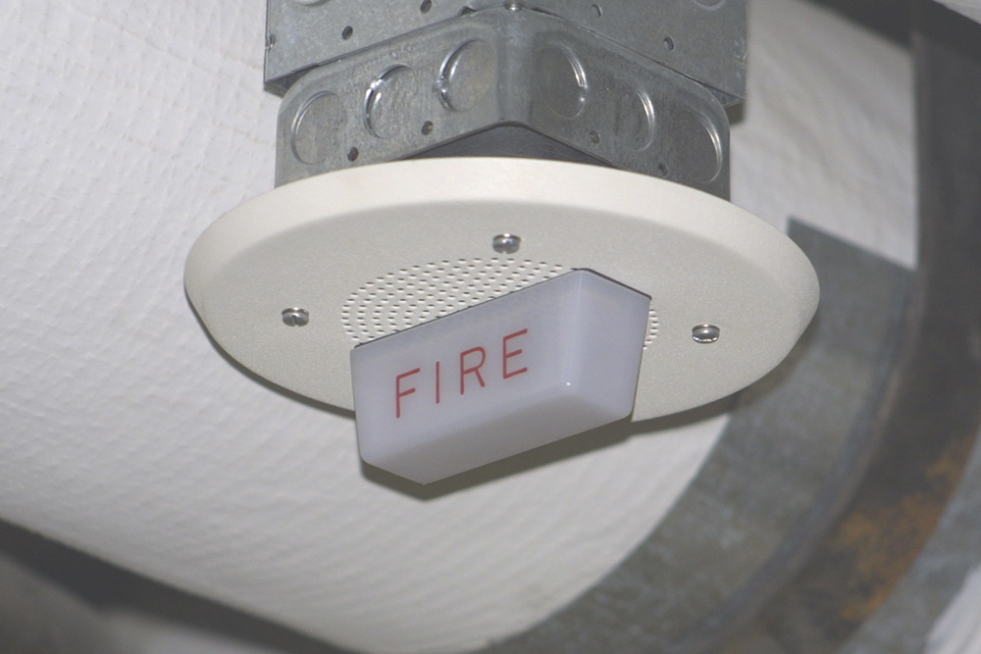
Inspectors need to understand visual notification.
Requirements come from adopted building code
Strobe requirements of the ADA apply to new construction and renovations to portions of buildings
ADA requires appliances in portions of any building accessible to a hearing impaired person
Required in conference rooms, restrooms, hallways, routes of tours, and private offices of those with a hearing disabilities
Location requirements are the same for both the ADA and NFPA 72®

Slide 19
Visual alarm notification appliances are installed in one of two orientations.
Wall mount
Ceiling mount

Slide 20
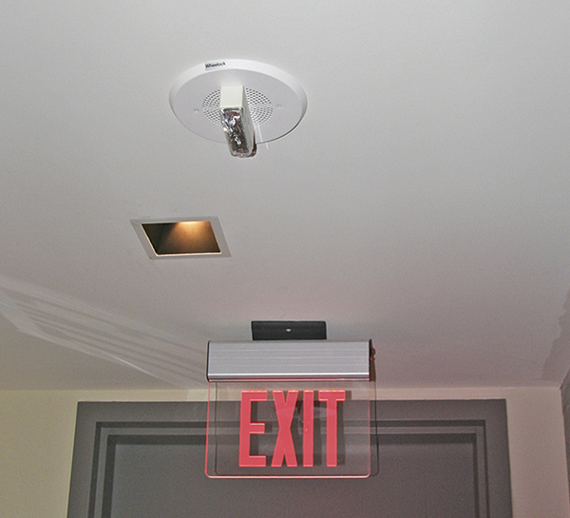
Know the requirements for visual notification appliances.
Must be installed in corridors that are less than 20 feet wide where required
If wider than 20 feet, room spacing requirements apply
Minimum candela rating for appliances mounted in corridors is 15 cd
Must be mounted within 15 feet of the end of the corridor
Must not be spaced more than 100 feet apart on center
(Cont.)

Slide 21
Know the requirements for visual notification appliances.
May be mounted either on the wall or the ceiling; must follow NFPA 72®
Any interruptions in the corridor are viewed as separate areas
Must be observant with installation
Recognize that certain appliances are field adjustable
Verify that the correct candela setting is made; should be shown on the approved plans

Slide 22
Know the requirements for detection and alarm system documentation.
Must be submitted to the local AHJ at installation
Complete plans for fire detection and alarm system should be submitted for review and approval by local authorities
Include building dimensions to scale with partition walls, duct work, and separation barriers
Point-by-point initiating appliance detail should be submitted
(Cont.)

Slide 23
Know the requirements for detection and alarm system documentation.
Manuals and manufacturers’ cut sheets should be also be submitted
When computers are used to program panels, additional design details should be submitted
Design configuration should be given to the building owner and remain on site
System should be completely tested anytime a change in the software is made
Once installed, an “as-built” drawing should also be provided; Record of Completion should be provided to the local authorities

Slide 24
REVIEW QUESTION
List inspection requirements for different types of occupant notification appliances.

Slide 25
Summary
The inspection of fire detection and alarm-signaling systems is an almost daily activity for the inspector.
This chapter described the fundamental components and operation of these systems.
(Cont.)

Slide 26
Summary
The procedures that must be used while conducting inspections and tests of these systems have also been provided.
Many unique situations may demand a particular type of system or initiating appliance within the community’s jurisdiction.
(Cont.)

Slide 27
Summary
The fire inspector must be familiar with these conditions and the systems that have been installed.

