Slide 1
Fire Inspection and Code Enforcement
8th Edition Inspector II
Chapter 13 — Special-Agent Fire Extinguishing Systems and Portable Extinguishers

Slide 2
Learning Objective 1
Identify the appropriate evaluation and testing methods for special-agent fire extinguishing systems.

Slide 3
Know the duties required for inspecting dry-chemical systems.
Evaluate the application methods, agents, components
Evaluate inspection and testing requirements

Slide 4
NFPA® 17 recommends that qualified personnel perform monthly procedures.
Check all parts of the system to verify they are in their proper locations and connected
Inspect manual actuators for obstructions
Inspect tamper indicators and seals to note that they are intact
Check maintenance tag or certificate for proper placement
Examine entire system for any obvious damage
Check pressure gauges to verify they read within their operable ranges

Slide 5
The inspector should be able to review records of inspections and maintenance.
Problems should be corrected immediately
In most cases, this situation requires notification of the organization responsible for the maintenance

Slide 6
Verify that hydrostatic testing is up-to-date for storage containers.
Containers (cylinders) less than 150 pounds (75 kg) must be hydrostatically tested every 12 years
Larger storage cylinders have no hydrostatic test requirements

Slide 7
Inspectors also need to check all auxiliary functions.
Audible/visible alarms
Power shutdowns for process equipment
Functionality of ventilation fans

Slide 8
REVIEW QUESTION
Describe the inspection requirements for dry-chemical systems.

Slide 9
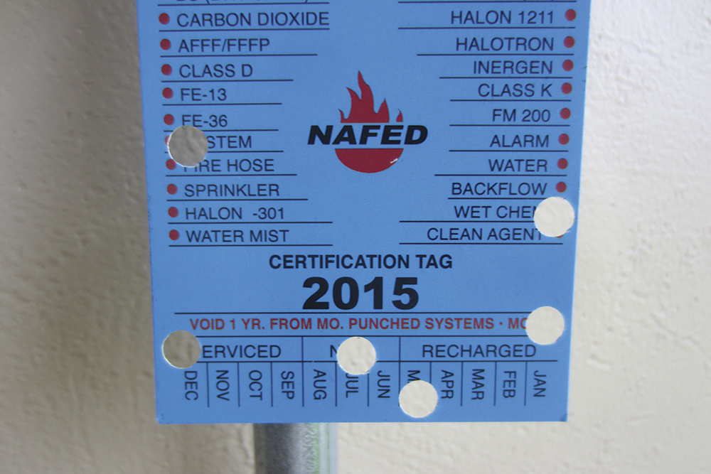
Know the duties required for inspecting wet-chemical systems.
Basically the same as those used for dry-chemical extinguishing systems
NFPA®17A, Standard for Wet Chemical Extinguishing Systems, contains detailed requirements
Verify system maintenance
Verify all manufacturer-required system checks
Courtesy of Rich Mahaney

Slide 10
Review several items when inspecting wet-chemical systems.
System parts are in their correct location
Manual actuators are unobstructed
Tamper indicators and seals are intact
Maintenance tags are in place and up-to-date
Obvious damage is noted
Gauges are within operational limits
Equipment modifications or repairs are noted

Slide 11
REVIEW QUESTION
What is included in an inspection of wet-chemical systems?

Slide 12
Know where to find inspection and testing requirements for clean-agent systems.
NFPA® 2001, Standard on Clean Agent Fire Extinguishing Systems
NFPA® 12A, Standard on Halon 1301 Fire Extinguishing Systems

Slide 13
Become familiar with some of the inspection requirements for clean-agent systems.
Annual inspections by qualified personnel are required for all system components
Quantity and pressure of the clean-agent must be checked semiannually
Records on all tests and inspections must be maintained and available for review
(Cont.)

Slide 14
Become familiar with some of the inspection requirements for clean-agent systems.
Types of agents used in the systems
System components
Inspection and testing requirements

Slide 15
Know inspection requirements for various parts of clean-agent systems.
Containers
Hoses
Protected enclosures
Meet U.S. Department of Transportation (DOT) and Transport Canada (TC) requirements
Be hydrostatically tested every 5 years
For local application must be pressure tested annually
Determine that integrity of the space has not been compromised by penetrations

Slide 16
REVIEW QUESTION
List some of the items an inspector should verify when inspecting clean-agent systems.

Slide 17
Understand the complexities of CO₂ systems.
Only fire suppression system contractors, licensed by the manufacturer, should perform maintenance and testing

Slide 18
Inspectors need to be familiar with the requirements for servicing a CO₂ system.
Physical damage to components
Excessive corrosion
Change in hazard
Enclosure integrity
Up-to-date records
Cylinders checked semiannually
Hydrostatic testing requirements are the same as for clean-agent systems

Slide 19
REVIEW QUESTION
What should inspectors look for when inspecting CO₂ systems?

Slide 20
Foam systems require specially trained personnel for inspections, servicing, and testing.
NFPA® 25, Standard for the Inspection, Testing, and Maintenance of Water-Based Fire Protection Systems
Because some state governments may modify standards, inspectors need to check those regulations as well
Highly complex systems
Procedures described by the manufacturer of the system must be followed

Slide 21
Know what duties an inspector has regarding foam systems.
Concentrate tank
Semiannually
Annually
Check for signs of sludge, damage, or deterioration
Verify that inspections have been performed and documented
Check all valves and alarms attached to the system
Check foam concentrates, foam equipment, and foam proportioning systems
Verify that qualitative tests are performed on the concentrate to certify that no contamination is present

Slide 22
REVIEW QUESTION
What items do inspectors need to verify when inspecting foam fire suppression systems?

Slide 23
Learning Objective 2
Describe proper selection, distribution, inspection, and maintenance of portable fire extinguishers.

Slide 24
Understand the factors that influence proper selection and distribution of fire extinguishers.
Nature of the hazard to be protected
Extinguisher size
Travel distances

Slide 25
Understand additional factors that influence proper selection and distribution of fire extinguishers.
Potential severity (size, intensity, and rate of fire spread) of any resulting fire
Personnel available
Emotional characteristics
Training in extinguisher use
Environmental conditions
Winds
Presence of toxic gases or fumes
Physical abilities
Temperature
(Cont.)

Slide 26
Understand additional factors that influence proper selection and distribution of fire extinguishers.
Any anticipated adverse chemical reactions
Any health and occupational safety concerns
Products of combustion
Extinguishing agent
Inspection and service required to maintain the extinguishers
Between the extinguishing agent and the burning material
Exposure of the extinguisher operator to heat

Slide 27
The nature of hazards dictate the type, size, number and location of fire extinguishers.
Some hazards may require additional extinguishers beyond the distribution required by the locally adopted code
General method for locating or distributing extinguishers
Light (low) hazard
Ordinary (moderate) hazard
Extra (high) hazard
Described in NFPA® 10
Used nationally and consists of classifying occupancies

Slide 28
Inspectors need to know the characteristics of a light-hazard occupancy.
Amount of ordinary combustible material or flammable liquids present is such that a small incipient fire may be expected
Includes classrooms, churches, assembly halls
Some parts of an occupancy that are classified as light hazard may actually be ordinary hazard

Slide 29
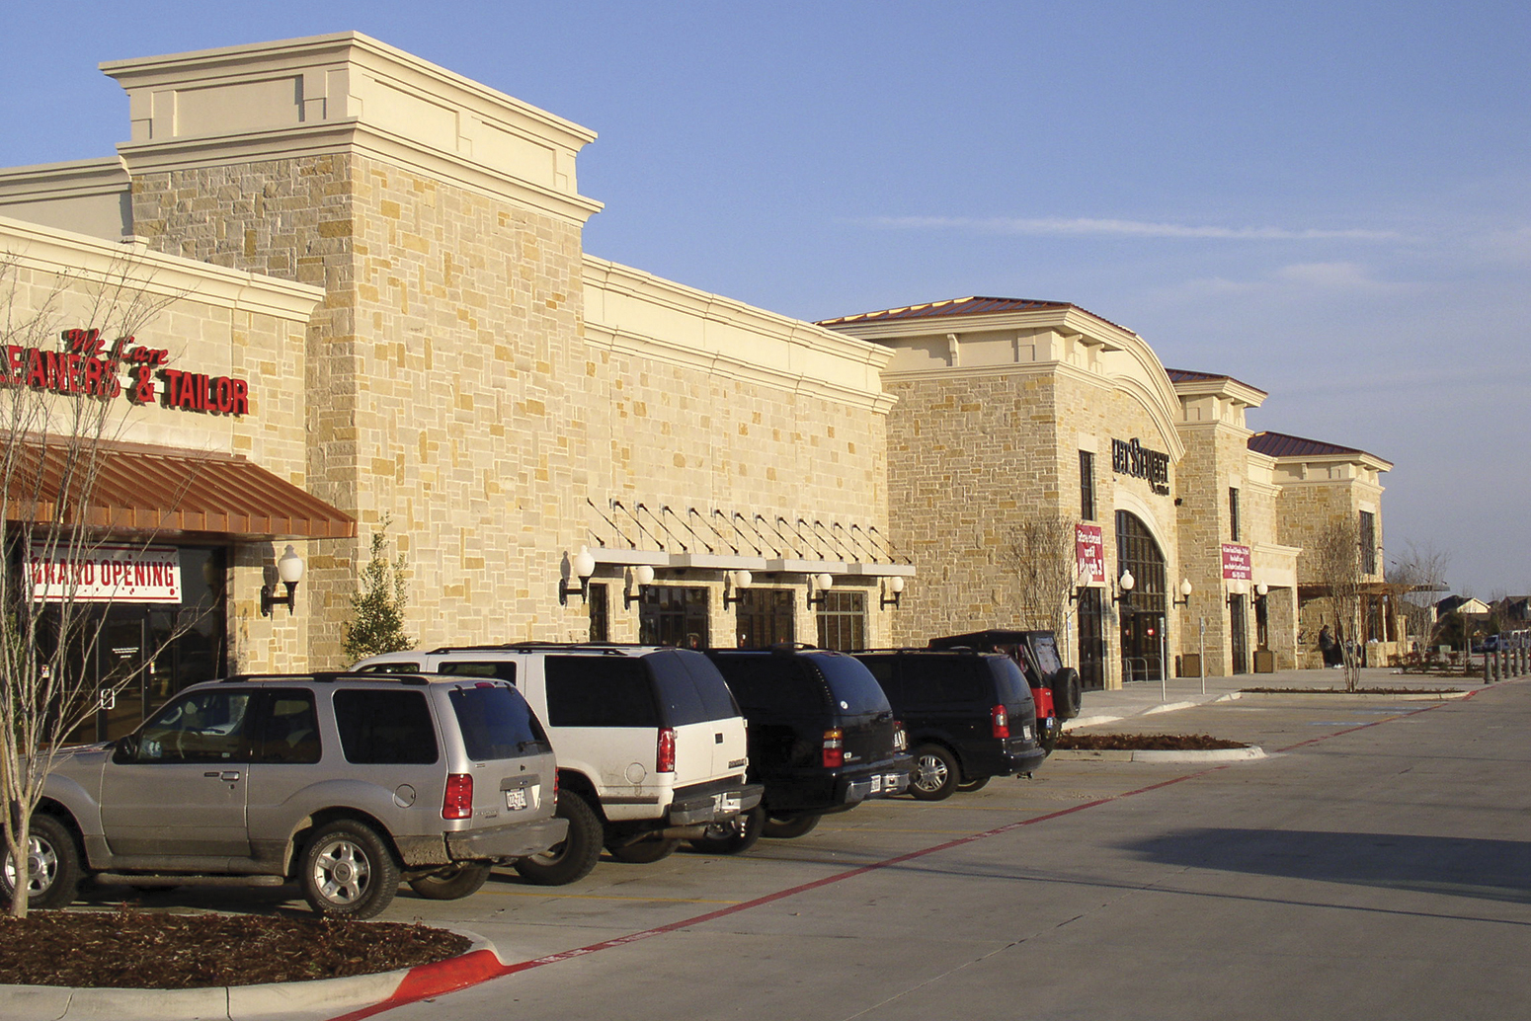
Inspectors need to know the characteristics of an ordinary-hazard occupancy.
Amount of ordinary combustibles and flammable liquids present would likely result in a moderate incipient fire
Includes mercantile storage and display, light manufacturing facilities, parking garages, some warehouses
Fire growth would not be so rapid as to be beyond the control of fire extinguishers if discovered quickly
Courtesy of Ron Moore, McKinney (TX) Fire Department

Slide 30
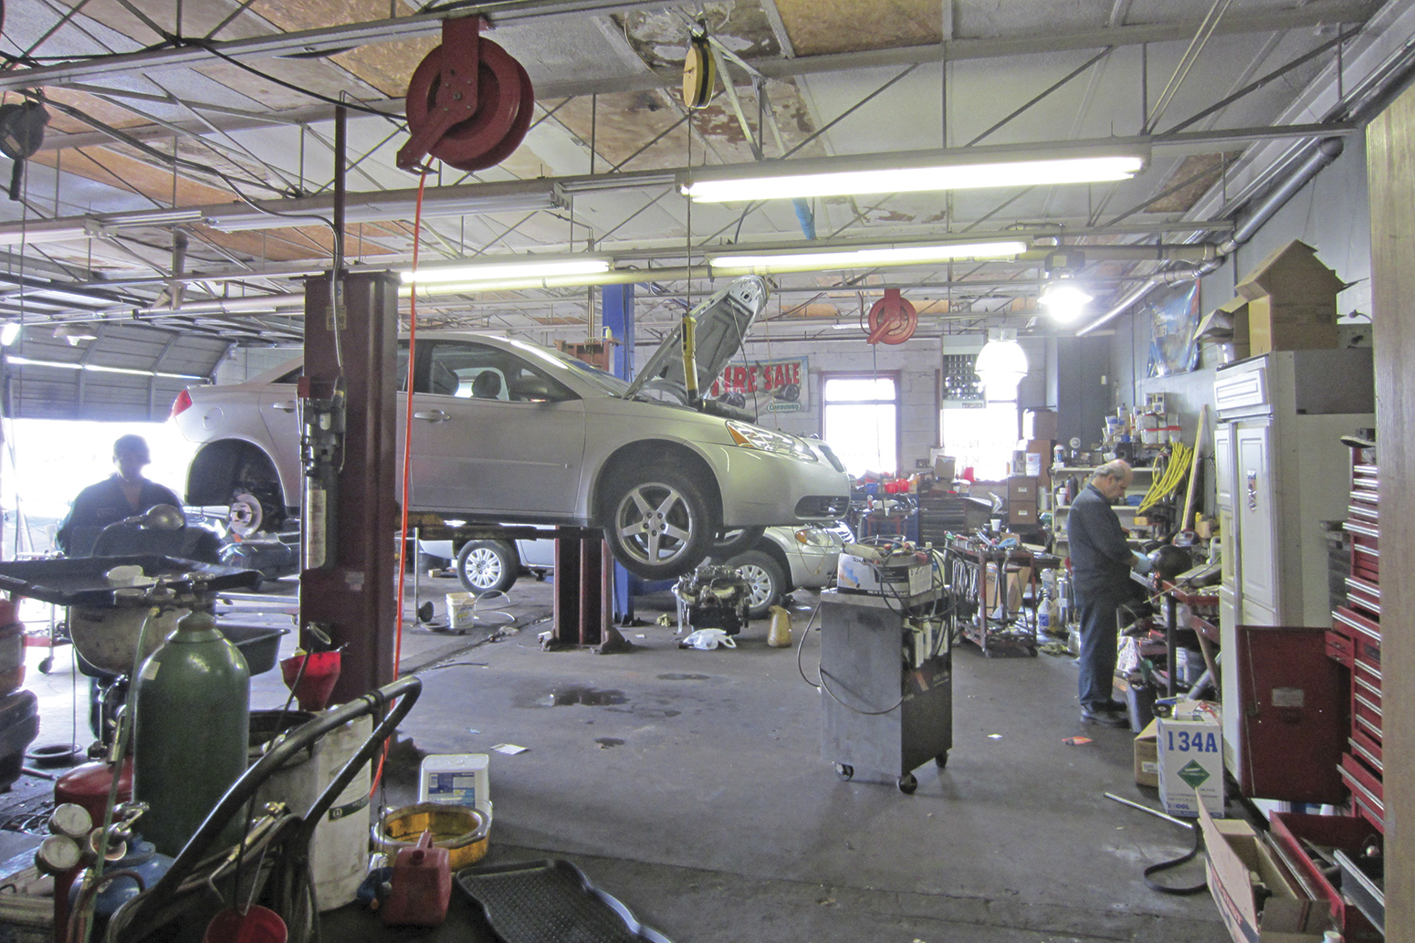
Inspectors need to know the characteristics of an extra-hazard occupancy.
Amount of ordinary combustible materials and flammable liquids present are high and a rapidly spreading fire may develop
Includes automotive repair shops, painting facilities, manufacturing operations that use flammable liquids, restaurants with deep fat fryers, and locations with high-piled storage of combustibles
Courtesy of Rich Mahaney

Slide 31
Understand fire extinguisher size and location requirements for Class A fuels.
Class A fuels
NFPA® 10 recommends minimum size extinguisher needed and maximum floor area to be protected by the extinguisher for Class A fuels
Maximum travel distance to an extinguisher for Class A hazards is 75 feet (25 m)
(Cont.)

Slide 32
Understand fire extinguisher size and location requirements for Class A fuels.

Slide 33
Understand fire extinguisher size and location requirements for Class B fuels.
Class B fuels
Travel distance to the hazard is the most important factor in determining the distribution
Flammable liquid fires develop very rapidly and occur in a variety of situations that are fundamentally different from a fire control standpoint

Slide 34
Understand special considerations for Class B fuels.
Special considerations
Spill fire where the flammable liquid does not have depth
Flammable liquids with depth
Individual hazards involving flammable liquids with depth are often protected by fixed extinguishing systems
These systems lessen the requirements for fire extinguishers; do not eliminate the need
Spill fires that occur beyond the reach of a fixed system require the use of portable extinguishers

Slide 35
Understand fire extinguisher size and location requirements for Class C fuels.
Class C fuels
No special spacing rules are required for Class C hazards because fires involving energized electrical equipment usually involve Class A or Class B fuels

Slide 36
Understand fire extinguisher size and location requirements for Class D fuels.
Class D fuels
Placement and distribution cannot be generalized
Placement analysis
Specific metal
Amount of metal present
Configuration of the metal
Characteristics of the extinguishing agent
NFPA®10 recommends only that the travel distance for Class D extinguishers not exceed 75 feet (25 m)

Slide 37
Understand fire extinguisher size and location requirements for Class K fuels.
Class K fuels
Employees in commercial kitchens are responsible for maintaining appropriate cooking temperatures to ensure safety
NFPA®10 has assigned a more restrictive distance requirement
Maximum travel distance from the hazard to the extinguisher is reduced to 30 feet (10 m)

Slide 38
REVIEW QUESTION
What are the main factors that influence the proper distribution of portable fire extinguishers?

Slide 39
Effectiveness of portable fire extinguishers is limited by the ability of the building occupants to use them.
Inspectors are not responsible for this type of training
Inspectors can recommend that training be given and provide information on who to contact
Inspectors can inquire about how well and how often the occupants are trained
Training is a service that the fire department can provide if no other source is available

Slide 40
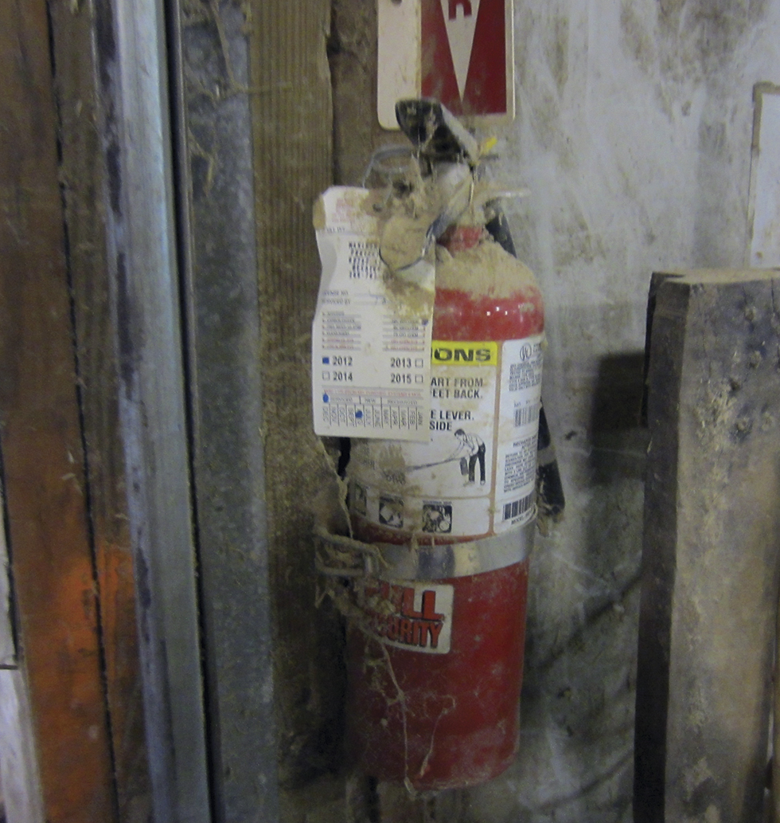
Without regular inspections, fire extinguishers can be rendered useless.
Stolen, misplaced, or obstructed
Damaged as a result of being struck by a vehicle
Low in pressure
Used on a fire and replaced without being recharged
Clogged with solid agent
Courtesy of Rich Mahaney

Slide 41
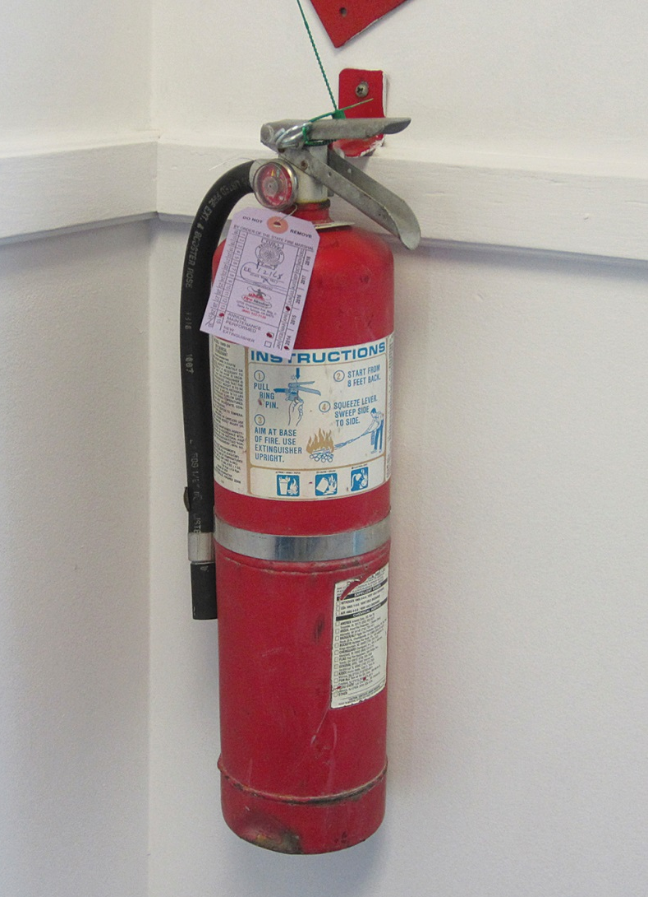
Periodic fire extinguisher inspections are very important to fire and life safety in a facility.
Simply checking to verify that they have not been stolen or vandalized is an important part of industrial plant protection
Usually performed by building or facility personnel but may be performed by fire suppression or inspection personnel
Important to consult local or state licensing/certification requirements for servicing
Courtesy of Rich Mahaney

Slide 42
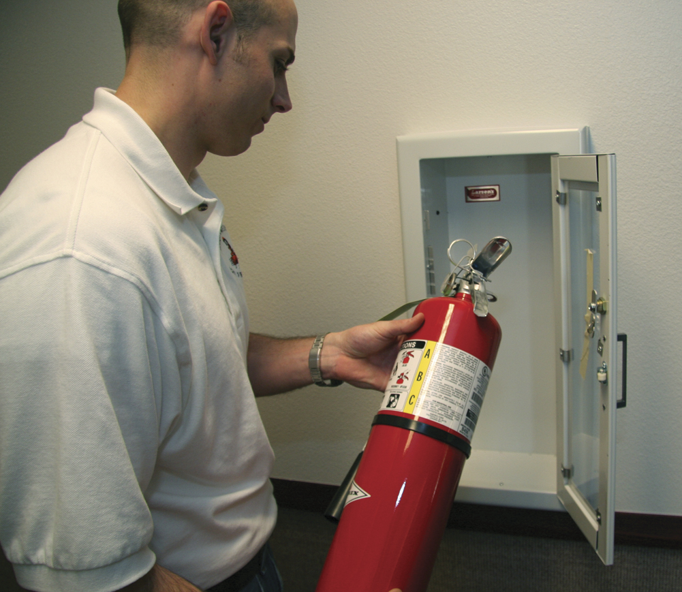
NFPA® 10 recommends monthly fire extinguisher inspections.
Owner/occupant is responsible for keeping accurate records
Bar code readers may be used to record the inspection
Also provides owner/occupant with chronological data to verify compliance with codes and insurance requirements
Extinguisher inspection tag
Should feature inspector’s name or initials

Slide 43
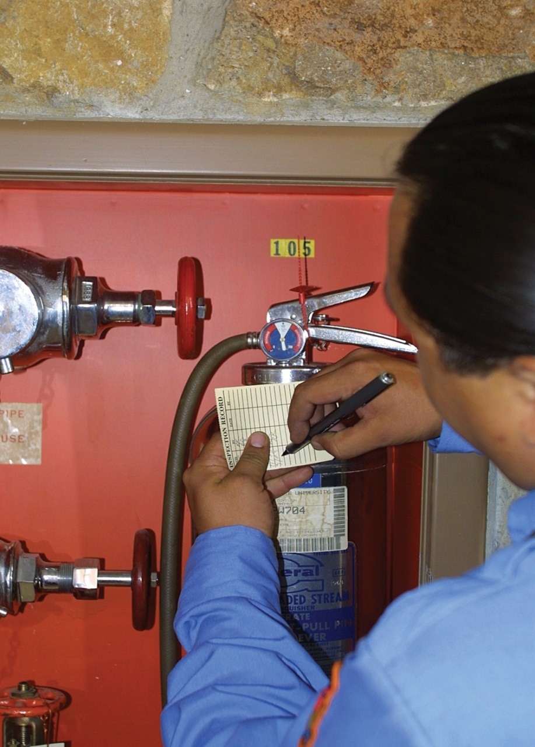
Be sure to check the inspection tag and the service collar tag.
Service collar tag
Purpose is to verify that the extinguisher was actually opened and discharged during maintenance
Will have maintenance data impressed into the plastic for the inspector’s records
Must not be damaged
Made of polyethylene or aluminum
Tightened down against the opening of the extinguisher body
Verify the inspection has occurred

Slide 44
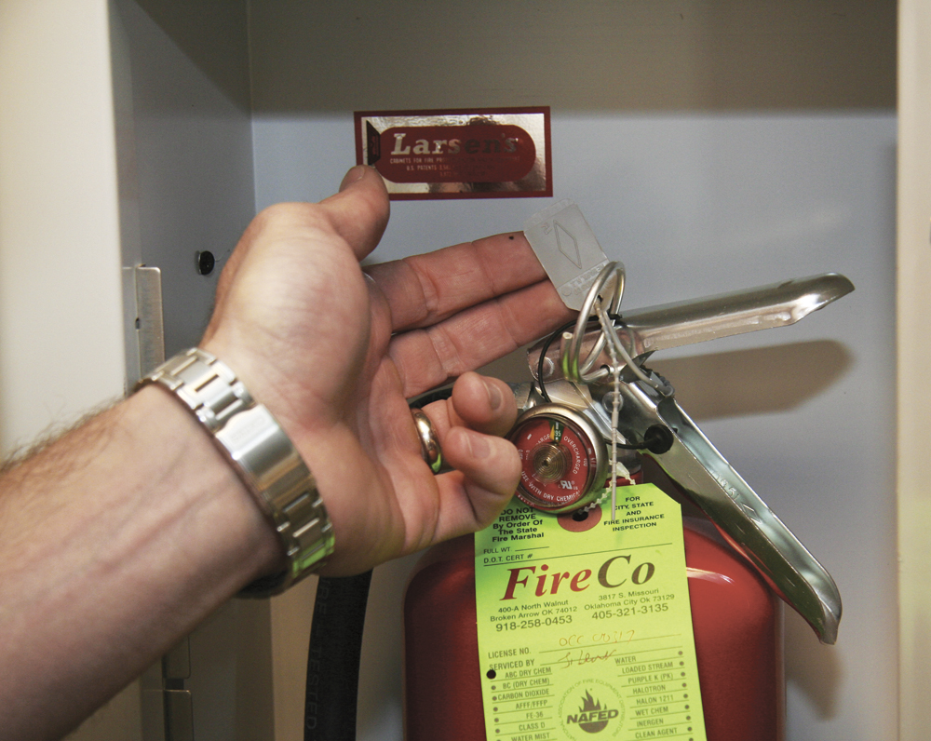
Inspectors need to check the same items the owner/occupant did.
Make sure the extinguisher is properly located
Verify that access is not obstructed
Check the inspection tag to determine if maintenance is due
Examine the nozzle or horn for obstructions
Verify that lock pins or tamper seals are intact
Check that the extinguisher is suitable for the hazard protected
(Cont.)

Slide 45
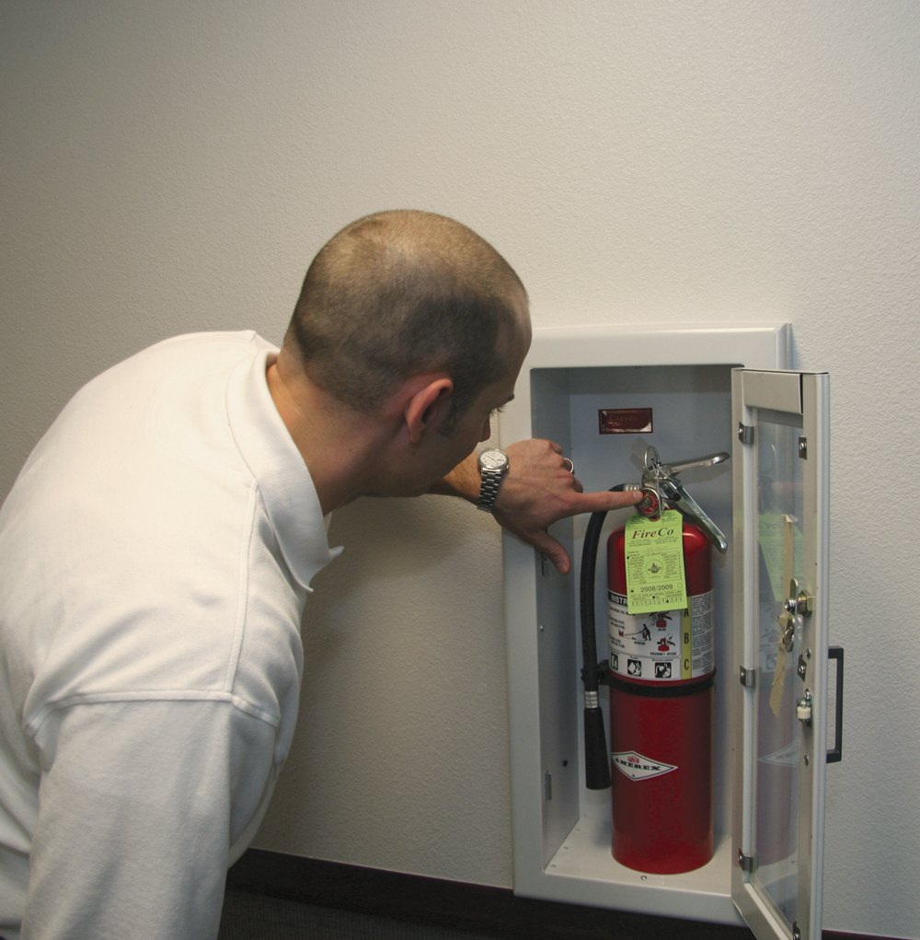
Inspectors need to check the same things the owner/occupant did.
Check for signs of physical damage
Check that the extinguisher is fully charged with expellant and agent
Check that the pressure gauge indicates proper operating pressure
Check collar tag for current information and/or damage
Check that required signage is in place
Check to see if the operating instructions on the extinguisher nameplate are legible

Slide 46
Inspectors need to know when to perform fire extinguisher maintenance and who should do it.
When
Whenever an inspection reveals the need for maintenance
Unit is due for periodic maintenance required by the manufacturer
Who
Personnel who are trained and certified by the extinguisher manufacturer
For more information on maintenance intervals and fire extinguisher inspection, see NFPA®10

Slide 47
REVIEW QUESTION
What should an inspector look for when inspecting portable fire extinguishers?

Slide 48
Summary
Special-agent extinguishing systems and portable fire extinguishers are major components of fire and life safety systems.
(Cont.)

Slide 49
Summary
This chapter provided the fire inspector with an overview of the types of special-agent systems and portable fire extinguishers that might be found during a building or facility fire inspection.
(Cont.)

Slide 50
Summary
The inspector should become familiar with the specific types of special-agent fire extinguishing systems that are found locally as well as the locally adopted codes and standards that govern the distribution and installation of portable fire extinguishers.

