Slide 1
Fire Inspection and Code Enforcement
8th Edition Inspector II
Chapter 12 — Water-Based Fire Suppression Systems

Slide 2
Learning Objective 1
Explain how to evaluate fire protection systems and equipment

Slide 3
Understand the information available in NFPA® 25.
Contains detailed lists of inspection, testing, and maintenance requirements for all types of water-based fire suppression systems
Includes charts indicating the frequency for performing these tasks
Owner/occupant is responsible for seeing that trained and experienced personnel perform these tasks
Owner/occupant may contract with third-party testing and maintenance organizations to perform these tasks
AHJ is responsible for verifying that the required testing and maintenance are complete and required records are in order

Slide 4
Inspectors have four opportunities to review, inspect, and witness tests.
1
During the plans review and approval process
During the construction phase when the equipment is being installed
During the acceptance test
During the life of the system
3
2
4

Slide 5
CAUTION
NEVER personally operate, adjust, manipulate, alter, or handle any fire suppression system devices or equipment during situations other than emergencies or planned training sessions. Always allow facility personnel to operate fire suppression system devices during the inspection and testing of these systems. Inspectors should only witness testing, inspection, and maintenance or accept appropriate documentation that required inspection, testing, and maintenance has been conducted by the owner or owner's representative.

Slide 6
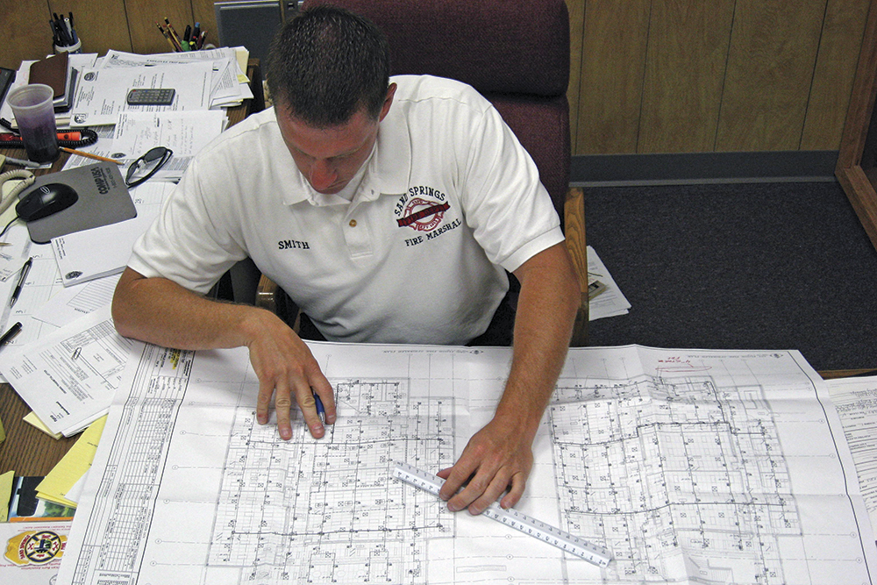
An Inspector II must determine several items about proposed fire suppression systems.
Is it appropriate for the type of occupancy, hazard, and construction type?
Is it correctly designed?
Does it meet NFPA® and adopted fire and building code requirements?
Does it contains all necessary documentation to permit an accurate assessment of the design?

Slide 7
Understand the preacceptance inspection requirements.
Occurs after the inspector reviews and corrects plans for the system and AHJ issues a permit for the installation
Although the contractor should maintain a stamped (certified) copy of the plans on site, bring copies of the plans and other documentation
During installation of all fire protection systems, compare the components of the system to those shown on the plans or listed in the construction documents
Contractor must submit any changes, alterations, or substitutions for review and approval as meeting or exceeding the original design

Slide 8
An inspector should particularly notice pipe hangers.
Hangers must match the requirements shown on the plans and in the documents
Correct hanger spacing is essential to prevent damage to the system during operation

Slide 9
An inspector needs to understand acceptance testing.
Performed on all water-based fire extinguishing systems once installation is complete
Installation contractor or the owner/occupant’s trained maintenance personnel performs acceptance tests
Representatives of building department or fire department may be required to witness the tests

Slide 10
CAUTION
Due to waterflow quantities and pressures, electric voltage required by fire pumps, and high noise levels, inspectors must wear appropriate protective equipment, including gloves, eye and hearing protection, and hard hat or helmet.

Slide 11
Water-based systems must be inspected and tested regularly to verify that they are operational.
Responsibility of owner/operator to have inspections and tests performed; maintain accurate records
Inspector’s responsibility to review records and sometimes witness inspections and tests
Verify that the system is installed and maintained according to the original design and applicable standards
Be aware that modifications in a structure can have an impact system effectiveness

Slide 12
Know what situations require special attention.
Changes in occupancy
Commodity changes
Water supply degradation
Sprinkler changes
Structural modifications such as adding or removing walls

Slide 13
The inspector must consult historical records detailing what the system is designed to protect.
This knowledge will help the inspector determine whether to add additional protection for hazards or occupants, or whether the sprinkler system itself is adequate for the current situation

Slide 14
Know what to do before performing any inspection, witnessing a test, or reviewing records.
Review records of previous inspections
Determine whether the occupancy classification has changed
Review building permits for the site to determine whether any approved alterations have been made to the structure or facility
Identify make, model, and type of equipment, including area protected by the system
(Cont.)

Slide 15
Know what to do before performing any inspection, witnessing a test, or reviewing records.
Wear appropriate clothing for dirty locations; protective clothing may be necessary
Obtain permission from the owner/occupant before performing any inspection
Consult NFPA® 25 for specific inspection and testing requirements
Verify that someone has informed the alarm monitoring company prior to starting or witnessing any test

Slide 16
REVIEW QUESTION
What does an inspector need to do before performing an inspection, witnessing a test, or reviewing records?

Slide 17
Learning Objective 2
Explain inspection and testing of fire suppression systems and components.

Slide 18
Any scheduled building inspection should also include automatic sprinkler systems.
Generally, an inspector begins an inspection in the system riser room
Every sprinkler system is equipped with various water-control valves and operating valves
Valves are used to shut off the water, drain the system, prevent recirculation of water, and serve other needs of the system

Slide 19
Inspectors need to know the inspection requirements for water-based fire suppression systems.
First verify that all valves controlling water supplies to the sprinkler system and within the system (sectional valves) are open at all times
An inspector who finds a valve closed should report the condition to the responsible party and to the fire department
Verify that the indicating control valve is opened fully and secured or otherwise supervised in an approved manner
(Cont.)

Slide 20
Inspectors need to know the inspection requirements for water-based fire suppression systems.
Check the indicating control valve
Used to shut off the water supply to the system when it is necessary to replace sprinklers or for maintenance
Located between sources of the water supply and the sprinkler system
Confirm that it is in operating condition
Confirm it is accessible and undamaged
(Cont.)

Slide 21
NOTE
If there is a permanent ladder to access elevated valves, check to see that it is in good condition.

Slide 22
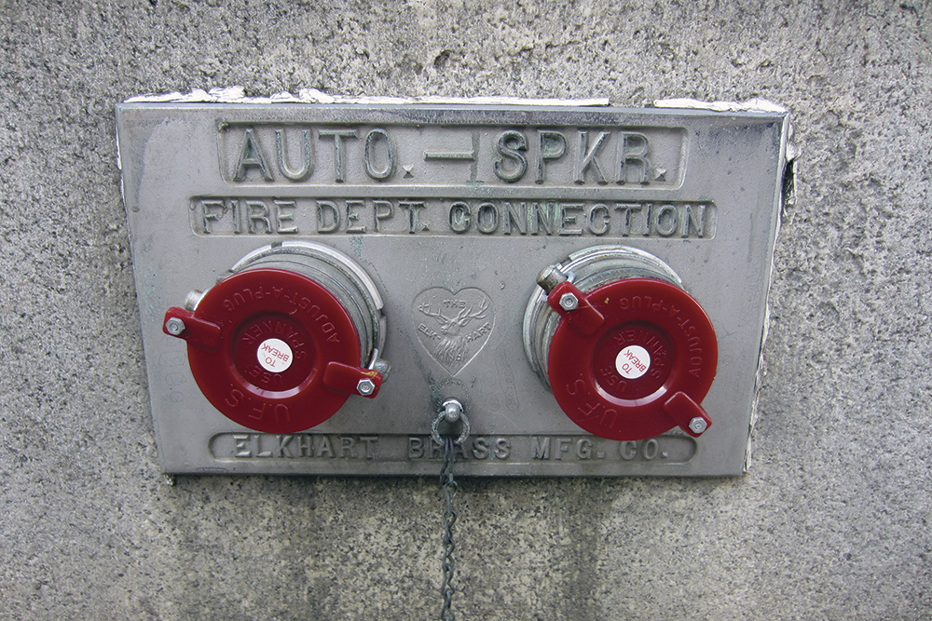
Inspectors need to know the inspection requirements for water-based fire suppression systems.
Verify FDC is not blocked
If locking caps are in place, verify that appropriate keys are provided
Use a fire department male coupling to verify that FDC female threads are compatible
Verify FDC is free of obstruction, the swivels rotate freely, and caps are in place
(Cont.)

Slide 23
Inspectors need to know the inspection requirements for water-based fire suppression systems.
Verify that automatic sprinkler protection is provided throughout the occupied areas or area based on the locally adopted code
Verify that inlet and outlet gauges on the sprinkler riser are indicating that water or water and air pressure are available
For wet-pipe sprinkler systems, verify that piping is protected from freezing
For dry-pipe sprinkler systems, note that the riser room is heated, the air compressor is functional, and the system piping is pressurized
(Cont.)

Slide 24
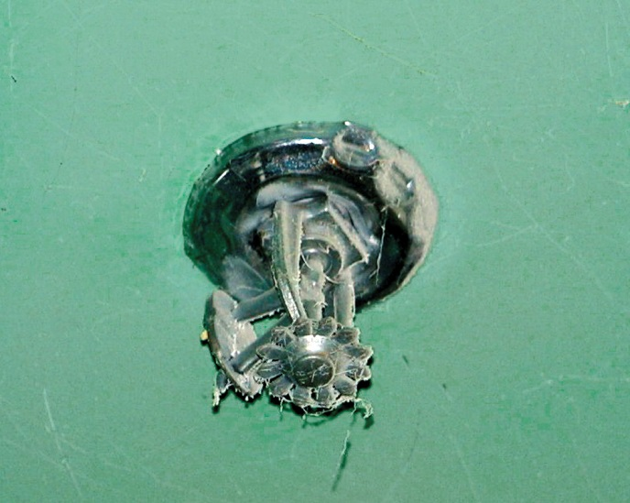
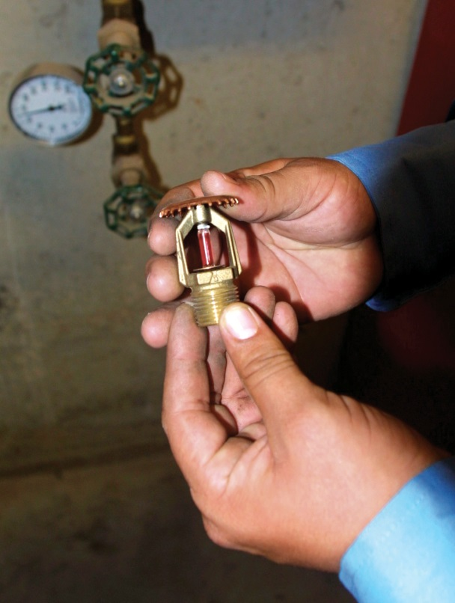
Inspectors need to know the inspection requirements for water-based fire suppression systems.
Verify that sprinklers are free from damage, corrosion, and paint, and are not subject to recall
Review that inspection, testing and maintenance report has been completed in accordance with NFPA® 25
Reports that are incomplete may require re-test of the system or inspection emphasis in certain areas

Slide 25
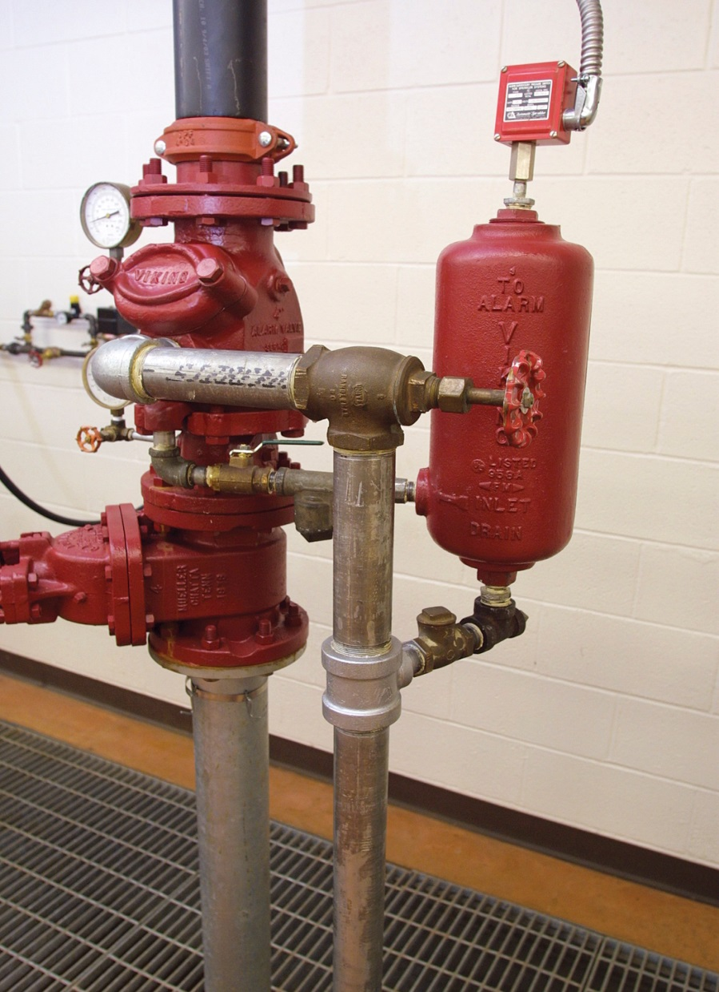
The primary purpose of the main drain is to drain water from the system for maintenance purposes.
Each sprinkler system riser has a main drain
NFPA® 25 mandates quarterly main drain tests
Verify inspection of the system; witness the alarm test in conjunction with the main drain test
System pressure gauge frequently indicates a higher pressure than the supply pressure gauge
Risers that are 4 inches (100 mm) or larger in diameter are equipped with a 2-inch (50 mm) main drain
Main drain test is useful for detecting impairments such as closed valves, obstructions, or gradual deterioration in the water supply

Slide 26
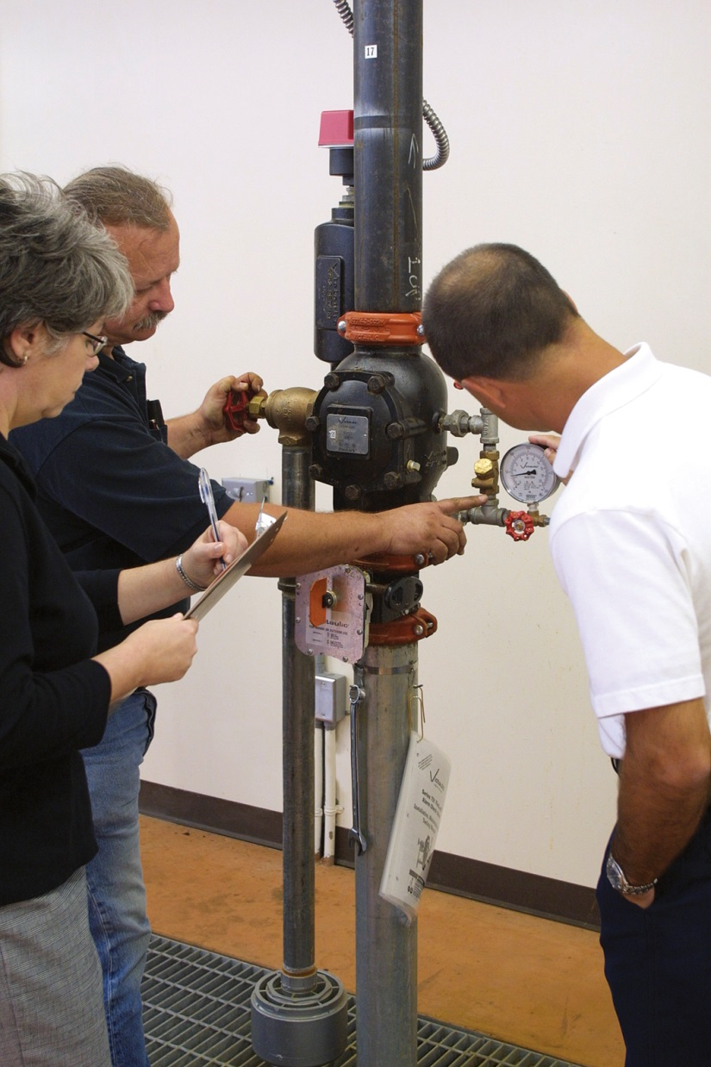
Inspectors need to understand how to perform a main drain test.
1
2
3
4
5
Observe and record pressure on the system side gauge at the system riser
Have building representative fully open the main drain
Observe and record the pressure drop
Have building representative close the 2-inch (50 mm) main drain slowly
Observe and record final static pressure

Slide 27
NOTE
On a system using an alarm check valve, take the pressure readings from the lower gauge because erroneously high static pressures can exist above the valve.

Slide 28
NOTE
The main drain will usually discharge outside the building; check the area to make sure it is clear.

Slide 29
Compare the new readings to previously recorded readings.
If there are significant differences, there may be a partially closed supply valve or an obstruction in the supply line
Another cause can be faulty backflow preventers

Slide 30
Know what to verify when inspecting a dry-pipe sprinkler system.
All indicating control valves are open and properly supervised in the open position
Air-pressure readings correspond to previously recorded readings
Ball drip valve moves freely and allows trapped water to seep out of the FDC
(Cont.)

Slide 31
Know what to verify when inspecting a dry-pipe sprinkler system.
Velocity drip valve located beneath the intermediate chamber is free to move and allow trapped water to seep out
Check this valve by instructing the building representative to lift a push rod that extends through the drip valve opening
Where an automatic drip valve is installed, the velocity drip valve can be checked by moving the push rod located in the valve opening
Any drum drips are drained to eliminate the moisture trapped in the low areas of the system
(Cont.)

Slide 32
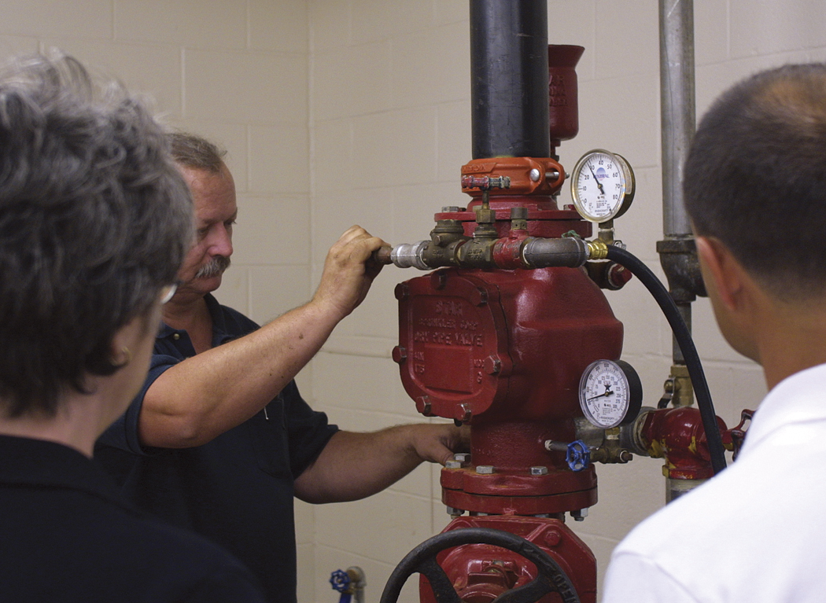
Know what to verify when inspecting a dry-pipe sprinkler system.
Priming water is at the correct level
System’s air pressure is maintained at 15 to 20 psi (105 to 140 kPa) above the trip point
No air leaks are indicated by a rapid or steady air loss
System air compressor is approved for sprinkler system use, well-maintained, operable, and of sufficient size

Slide 33
NOTE
If the system is equipped with a quick-opening device, opening the priming water test line could trip the system.

Slide 34
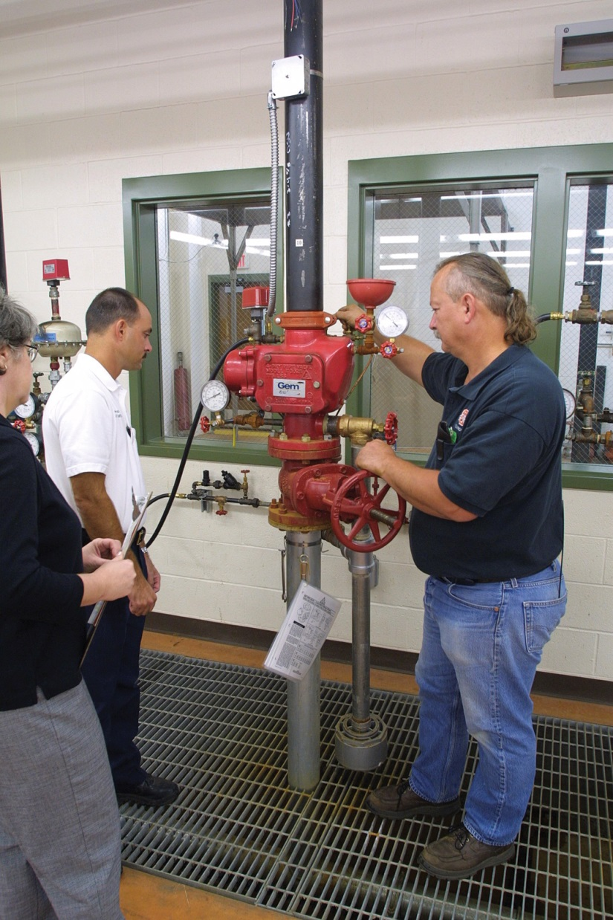
Inspectors need to understand alarm trip tests.
Performed by a representative of the sprinkler company of the owner/occupant
Inspector never performs this test due to liability issues
Alarm trip test on a dry-pipe system can take from two to four hours to complete
Old valves may prove more difficult to reset because of leaking seats or worn parts, and more than one attempt may be necessary

Slide 35
Notify the alarm-monitoring organization before conducting any tests.
With electronically supervised equipment
Another option is to notify the monitoring company after the first portion of the test to verify that the company handles its responsibility
After tests are complete, the alarm-monitoring organization should confirm that the alarm equipment functions properly

Slide 36
Inspectors should also inspect the sprinkler cabinet.
Located near the waterflow control valve
NFPA® sprinkler standards list the appropriate supply of extra sprinklers that the protected premises must keep on hand
Verify that the required number of replacement sprinklers are available
Standards specify a minimum of one sprinkler for each type and temperature rating, as well as a sprinkler wrench

Slide 37
Know what to inspect after the sprinkler system riser room.
Continue through the remainder of the building
Pay particular attention to temporary or permanent changes that could obstruct or alter sprinkler discharge patterns
Note condition and location of sprinklers, hangers, and piping
(Cont.)

Slide 38
Know what to inspect after the sprinkler system riser room.
Are all sprinklers are clean, undamaged, unobstructed, and free of corrosion or paint? If not, they must be replaced
Guards that protect sprinklers may need to be added or repaired
Carefully examine sprinklers in buildings subject to high temperatures
Any sprinkler showing evidence of weakness or damage needs to be replaced with a sprinkler of the same type and temperature
Changes may require installation of different types of rated sprinklers

Slide 39
Inspectors need to understand the cold flow concept.
Creeping or sliding apart of the fusible link (cold flow) or leakage around the sprinkler orifice indicates a weak sprinkler
Cold flow is the distortion of a material caused by the repeated heating of a fusible link to near its operating temperature
Using frangible bulb sprinklers or a higher temperature rated sprinkler will eliminate cold-flow problems

Slide 40
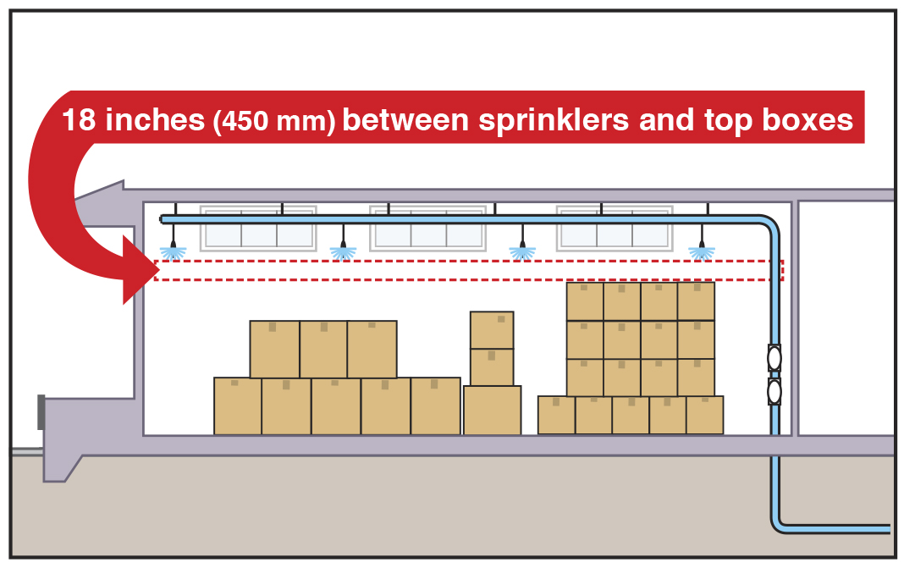
Inspectors need to check for sprinkler obstructions.
Partitions, stock, lights, or other objects should not obstruct the distribution of water discharge from sprinklers, and the discharge area should be free of hanging displays
Minimum clearance of 18 to 36 inches (450 to 900 mm), measured from the deflector, should be maintained under sprinklers, depending on type

Slide 41
Inspect all sprinkler piping and hangers to determine that they are in good condition.
Check for corrosion and physical damage to verify that there are no leaks in the pipes or fittings
Report loose sprinkler hangers
Note whether hangers are at proper intervals and match the original installation plans
Do not permit occupants to use sprinkler piping as a support for ladders, stock, ceiling grids, or other materials

Slide 42
REVIEW QUESTION
Describe the steps involved in inspecting an automatic sprinkler system.

Slide 43
Know the characteristics of residential sprinkler systems.
In sprinkler systems designed for one- and two-family dwellings, the water supply source is generally the same as the domestic water supply
Water supply requirements are substantially less for residential systems
An NFPA® 13D system requires a minimum ten-minute supply of stored water
If structures are less than 2,000 square feet (180 m²) and no more than one story, the minimum quantity of water needed is based on the flow rate of two sprinklers for seven minutes
Structures equipped with an NFPA® 13R system require that four sprinklers operate for thirty minutes
(Cont.)

Slide 44
Know the characteristics of residential sprinkler systems.
Major difference between residential sprinklers and standard sprinklers is their sensitivity or speed of operation
Residential sprinklers operate more quickly
Any type of piping such as steel, copper, and plastic that is listed by an approved testing agency may be used for residential sprinkler systems
Be aware of the design criteria for piping
(Cont.)

Slide 45
Know the characteristics of residential sprinkler systems.
Sprinkler coverage in residential systems is not as extensive as in standard commercial automatic sprinkler systems
Placement and spacing inside a dwelling and sleeping units is based on the sprinkler's listed area of coverage
Single residential sprinkler is permitted to protect its listed area of coverage

Slide 46
In some design standards, sprinklers can be omitted from some areas in one- and two-family dwellings.
Bathrooms not over a certain size
Small closets not over a certain size
Garages
Porches
Carports
Uninhabited attics
Entrance hallways

Slide 47
Be familiar with local amendments to the adopted fire and building codes.
Local codes may be amended to remove some or all sprinkler exemptions
As the area coverage increases, required flow also increases
Area of coverage is dependent on the ceiling being flat or sloped
Area of coverage for any residential sprinklers cannot exceed 400 square feet (35 m²)

Slide 48
REVIEW QUESTION
What are some of the conditions inspectors should check or verify when inspecting residential sprinkler systems?

Slide 49
Know which components and records of water-spray fixed systems require inspection.
Valves
Detection devices
Piping
Nozzles
Strainers
Water supply
Owner/occupant reports

Slide 50
Know what to look for when inspecting piping and fittings.
Mechanical damage
Leaks
Corrosion
Misalignment of parts
Missing components
Damaged or missing pipe hangers

Slide 51
Know the general items an inspector should look for in water-spray fixed systems.
Nozzles
Sprinkler cabinet
Strainers on the mainline
Free from corrosion, paint, or accumulations of dirt
Properly aligned for the protected area
Verify that they are operable
Verify that it contains replacement sprinklers and wrenches
Clean strainers and remove any debris to permit the proper flow of water
(Cont.)

Slide 52
Know the general items an inspector should look for in water-spray fixed systems.
Verify that it is dependable
Fire pumps, tanks, and connections to the public water supply
Verify all waterflow control valves are in the locked and open position
Make sure they are in accordance with the requirements for those types of systems
Water Supply
What to witness
Operational tests to determine that the system’s response time is less than forty seconds
Discharge pattern is correct for the surface being covered

Slide 53
REVIEW QUESTION
Name some of the water-spray fixed system components inspectors need to check during an inspection.

Slide 54
Know what is important to inspections of foam-water systems.
Verify that the control valves are in the appropriate position for the type of proportioner in use
Valves may be in the open or closed position

Slide 55
Understand the inspection requirements for foam proportioners.
Standard pressure proportioner
Bladder tank proportioner
Line proportioner
Verify that ball drip valves are open and operable
No corrosion is present on foam concentrate storage tanks
Check operation of waterflow control valves
Look for corrosion on exterior of the storage tank
Look for presence of foam in the water around the bladder
Inspect strainers to verify that they are not obstructed
Look for corrosion on the exterior of the storage tank
Verify that the pressure vacuum vent is operational
(Cont.)

Slide 56
Understand the inspection requirements for foam proportioners.
Standard and inline balanced-pressure proportioners
Pressure vacuum vent is operational
Gauges are operational
Sensing line valves are open
Power is available to the foam pump
Orifice plate proportioner
Strainers are not obstructed
Same inspection requirements as balanced-pressure proportioners
Exception, check there are no sensing line valves in the system

Slide 57
REVIEW QUESTION
What foam-water system components should be checked during an inspection?

Slide 58
Understand the inspection requirements for standpipes and hose systems.
Building management personnel should make a visual inspection at least once a month
Fire department must also inspect them at regular intervals
Fire protection system contractor or employees should perform testing of standpipes and hose systems
Employees must be trained and certified to perform standpipe tests
(Cont.)

Slide 59
Understand the inspection requirements for standpipes and hose systems.
All water supply valves are sealed (locked) in the open position
Fire pump in operating condition with power available
Individual hose valves are free of paint, corrosion, and other impediments
Individual hose valves are operable
Hose valve threads are not damaged
(Cont.)

Slide 60
Understand the inspection requirements for standpipes and hose systems.
Hose valve wheels are present and not damaged
Hose cabinets are accessible
Hose (when present) is in good condition, is dry, and is properly positioned on the rack or reel
Discharge outlets in dry systems are closed
Dry standpipe is drained of moisture
(Cont.)

Slide 61
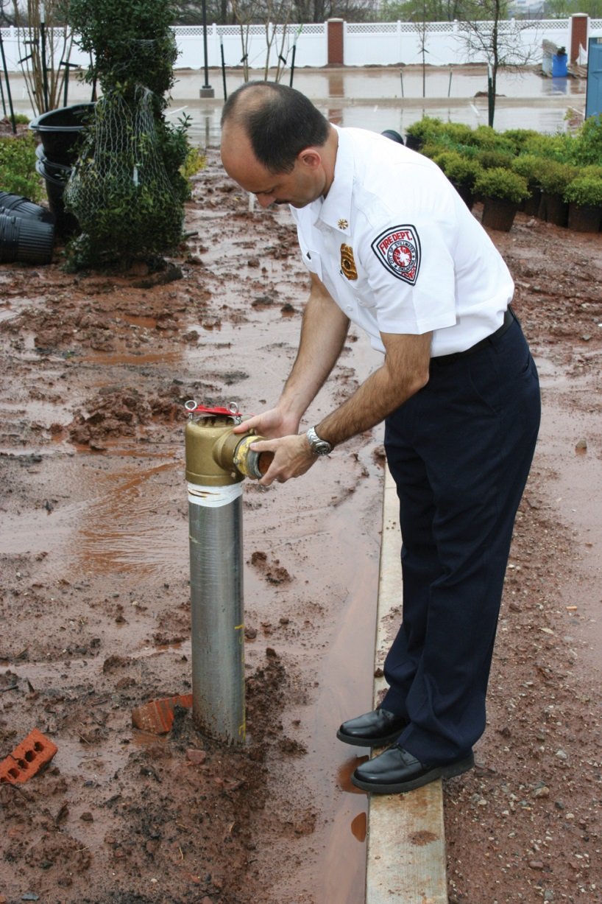
Understand the inspection requirements for standpipes and hose systems.
FDC is not blocked and is free of obstruction, the swivels rotate freely, and caps are in place
If system is equipped with pressure-regulating devices, those devices are tested as the manufacturer requires
Dry-pipe systems are hydrostatically tested every five years
Water supply tanks are filled to the proper level

Slide 62
REVIEW QUESTION
What conditions should inspectors look for in standpipe and hose systems?

Slide 63
Understand the inspection requirements for stationary fire pumps.
Recommended inspection frequency for fire pump operation is weekly
Pumps should be operated from automatic starts and brought to full speed while pumping a substantial stream
Building maintenance personnel or contracted fire protection specialists most commonly perform pump tests
Inspectors may be required to witness the tests on a periodic basis
Evaluate electrical power for electrically driven fire pumps
(Cont.)

Slide 64
Understand the inspection requirements for stationary fire pumps.
Visually check the fire pump control panel to verify that the circuit breaker or disconnect is closed and that the power indicating light is on
Check incoming pressure gauge to verify that water is available
Simply checking the incoming pressure will not disclose an obstruction such as a partially closed valve in the water supply
Flow test is necessary to check for obstructions

Slide 65
REVIEW QUESTION
What are some of the inspection requirements for stationary fire pumps?

Slide 66
Summary
Water-based fire suppression systems have proven their value in controlling, containing, and preventing fires in many types of occupancies.
Statistics show both the life safety and property protection value of these systems.
(Cont.)

Slide 67
Summary
When such systems fail, the cause is generally human error.
To prevent failures, it is up to fire inspectors to determine that water-based fire suppression systems are designed, installed, tested, and inspected properly.
(Cont.)

Slide 68
Summary
While the property owner/occupant is responsible for performing the various tests and inspections that are listed in the NFPA® standards, it is the fire inspector who must verify the performance of the tests and inspections.
(Cont.)

Slide 69
Summary
This verification occurs through report reviews, witnessing tests and inspections, and performing periodic inspections in the presence of owner/occupants.
(Cont.)

Slide 70
Summary
An inspector must be familiar with the types of water-based fire suppression equipment, types of tests required for the equipment, and intervals at which the tests and inspections must occur.

