Slide 1
Fire Inspection and Code Enforcement
8th Edition Inspector II
Chapter 9 — Fire Hazard Recognition

Slide 2
Learning Objective 1
Evaluate hazardous conditions involving building systems.

Slide 3
Building systems present unique challenges inspectors need to research before inspections.
Heating, Ventilating, and Air Conditioning Equipment/Systems
Cooking Equipment
Industrial Furnaces and Ovens
Powered Industrial Trucks
Tents

Slide 4
Be familiar with heating, ventilating, and air conditioning (HVAC) equipment and systems.
Air heating or cooling
Air humidifying or dehumidifying
Air filtering or cleaning

Slide 5
Inspectors are responsible for verifying several HVAC items.
Qualified personnel are properly inspecting and maintaining the HVAC system
Unit clearances are maintained
Operating instructions for the equipment are provided

Slide 6
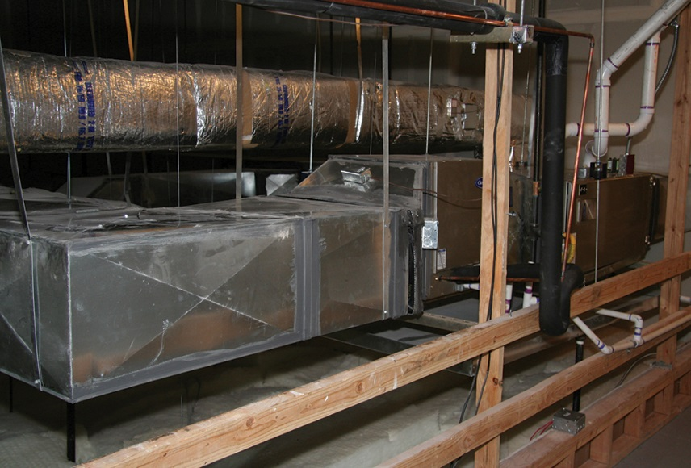
Know the major components of HVAC systems.
Heaters
Air conditioners
Fans
Ducts
Heat exchangers
Thermostatic controls

Slide 7
Know the two primary hazards HVAC systems pose.
Fire hazards from heating appliances (greater hazard)
Spread of fire and products of combustion through the air handling system

Slide 8
Inspectors need to know the common causes of fires related to heating appliances.
Improperly adjusted or worn fan drive belts
Clogged filters
Combustible lint or debris near the burners
Poorly maintained motors

Slide 9
Inspectors should take note of HVAC system rooms or mechanical equipment rooms.
Only authorized personnel should have access
Consult appropriate codes for issues with HVAC system rooms
Type and size of refrigeration or heating equipment will determine the fire separation requirements
Fire-resistive construction and the appropriate protective openings should be used
Look for combustible storage inside the room; generally, this storage is not permitted

Slide 10
Inspectors need to understand furnaces.
Most common
Gravity furnaces
Warm-air furnaces
Considered obsolete
Located in basements of houses
Operate primarily by the circulation of air; no fans
Forced-air furnaces
Units contain plenums and ductwork that may become hot; require the use of appropriate clearances and insulation
Automatic controls turn off the furnace

Slide 11
Know the fire problems presented by warm-air furnaces.
Inadequate clearances
Lack of proper limit control
Heat-exchanger burnouts
Improper installations
Improper maintenance procedures

Slide 12
Most floor furnaces are designed and approved for installation under combustible floors.
Require temperature-limit controls and proper clearances from miscellaneous combustibles
Must have safety controls that turn off the fuel source if the pilot light is extinguished
Must be properly vented so they cannot contribute to carbon monoxide buildup
Mostly found in single-family dwellings built before the 1960s
Some commercial occupancies may use them
Warn individuals with floor furnaces not to cover the register

Slide 13
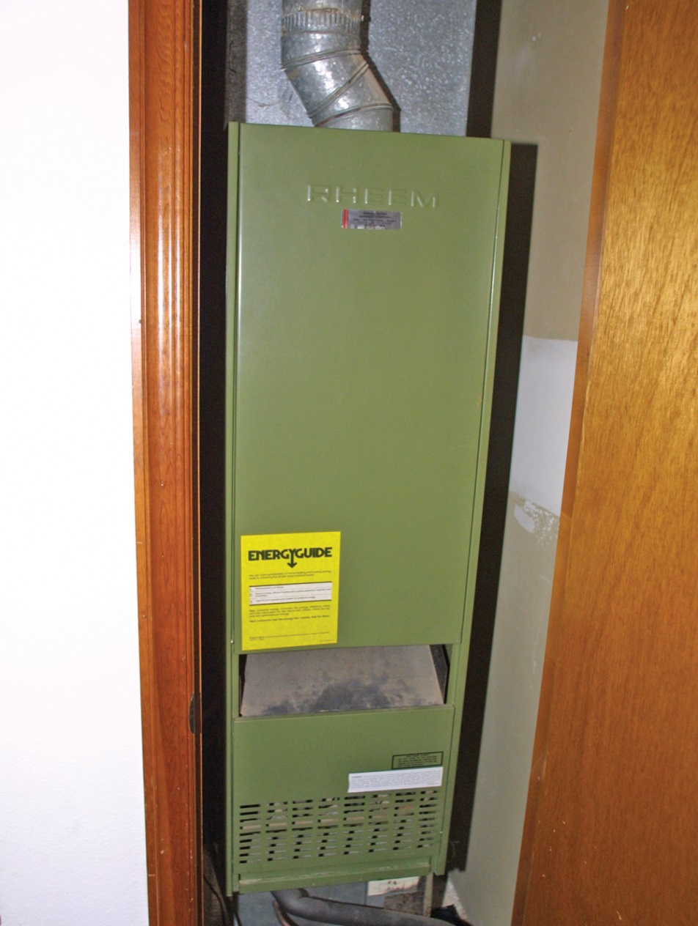
Inspectors should also be aware of wall furnaces.
Gas or oil heaters may have a direct vent to the exterior or be equipped with an indirect vent or chimney
Found in residential occupancies and small office spaces
Self-contained electric, indirect-fired gas, or oil heaters installed within or on a wall

Slide 14
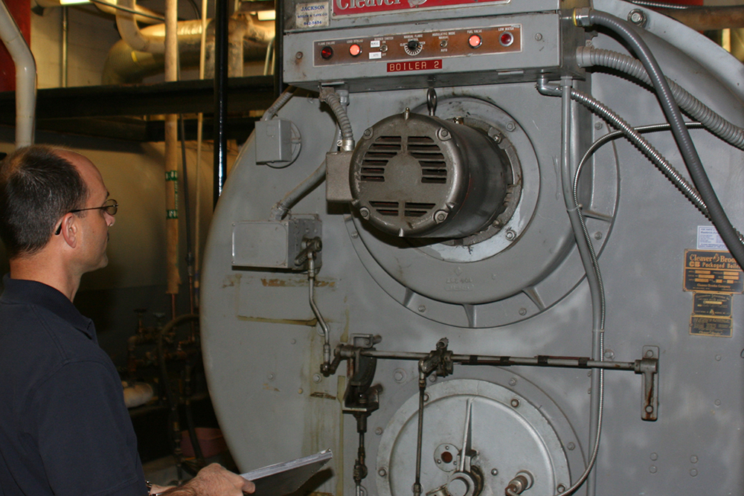
A boiler is a pressure vessel used for a variety of industrial processes.
Generating steam to power machinery
Providing heat required by industrial processes
In nonindustrial applications, boilers provide heating and hot water through a system of radiators
Found in single- and multi-family residences
More prevalent in old structures, newer, more efficient systems are on the market

Slide 15
Manufacturers must strictly adhere to all applicable codes when building boilers.
Many manufacturers use the American Society of Mechanical Engineers (ASME) Boiler and Pressure Vessel Codes
All boilers should meet fire and explosion prevention requirements
Entire system will include interlocks, detectors, alarms, sensors to turn off fuel

Slide 16
Know what to verify when inspecting boilers for compliance.
Check for ASME nameplate
Verify inspection history via an up-to-date inspection tag or certificate
Note the pressure relief device

Slide 17
Inspectors need to know the two common type of boilers.
Fire-tube boilers
Water-tube boiler
Combustion gases pass through tubes that are immersed in circulating water
Steam-generating unit in which steam and water circulate through a series of small drums and tubes
Converts to steam
Combustion gases pass over the outside of these steam- and water-containing elements

Slide 18
NOTE
Most large boilers are of the water-tube type.

Slide 19
Know what fuels are usually used in boilers.
Natural gas
Coal
Oil
Either supplied to the burner premixed or externally mixed
Units deliver air and pulverized coal to the burners for combustion
Atomized at the burner, which causes it to mix with air and burn most efficiently
In a premix, the air and fuel are mixed before they reach the burner

Slide 20
Understand the hazards associated with boilers.
Depend on a number of fuel and malfunction possibilities
Coal-fired boilers present hazards when debris is mixed with coal
Gases can build in the system and ignite
Main hazard in natural-gas-fired boilers is the leaking of gas and the buildup of fuel-rich mixtures if a burner fails
(Cont.)

Slide 21
Understand the hazards associated with boilers.
Oil-fired hazards come from the fuels, oil leaks, or interruptions in the oil flow caused by water or sludge in the fuel
Coal dust accumulation in areas adjacent to the unit’s fire box
Failure of the vessel
Deterioration or modification of unit exhaust

Slide 22
Operator training is an important part of any hazard reduction plan.
Workers who are educated in the process and function of the equipment around them will be better able to eliminate a potential hazardous situation
In some circumstances, workers are more knowledgeable than inspectors regarding the boilers
Together, workers and inspectors can identify and report hazardous issues as well as promote solutions
Workers can provide inspectors with useful information during an inspection

Slide 23
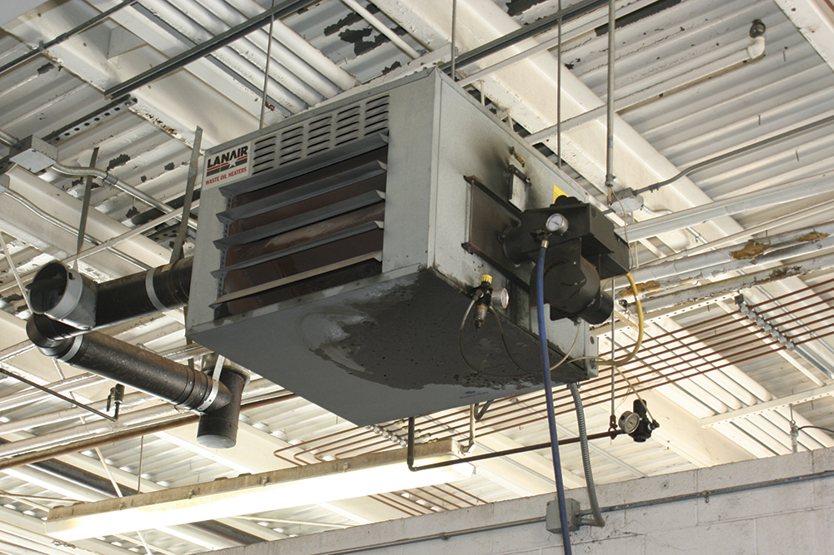
Unit heaters are self-contained devices that are thermostatically controlled.
May be mounted on the floor or suspended from a wall or ceiling
Consult guidelines in NFPA® 1 Fire Code and the International Fire Code (IFC)
Model fire codes regulate the type and amount of fuel to operate the heaters
Can use propane, natural gas, kerosene, or electricity

Slide 24
NOTE
The heating element and fan are enclosed in a common operating unit. The inspector should verify that heaters are located with appropriate clearances from combustibles. An inspector should also look for proper storage and handling of the fuel source.

Slide 25
Room heaters are self-contained units designed to heat the immediate surrounding area.
Use the circulation of radiant heat as the heating medium
Usually incorporate manual or thermostatically controlled drafts
Require that nearby floors and walls be properly protected

Slide 26
Be familiar with different types of room heaters.
Wood and coal stoves
Electric and gas logs
Electric baseboard heaters
Open-front heaters

Slide 27
Understand the hazards of room heaters.
Overfiring the device
Careless handling of fuel and ashes
Inadequate clearances from fuel cans or other combustible materials
Accumulation of creosote in flues and chimneys as applicable
Use of insufficient extension cords with electric heaters
Refueling with the wrong fuel

Slide 28
Solid-fuel room heaters are free-standing appliances that vent to the exterior.
Primarily found in single-family dwellings
May also be found in restaurants, apartment clubhouses, or bars where a living-room atmosphere is desired

Slide 29
Know what to look for when inspecting room heaters.
Solid fuels for wood or coal stoves stored a safe distance from the stoves
Provisions made for safely removing and storing ashes and cinders
Chimneys and flues are kept clear of excessive creosote
Combustibles are stored a safe distance from heating units
Heating appliances have proper industry approvals; labeled accordingly
Heating sources are vented and provided with adequate ventilation according to manufacturer’s instructions

Slide 30
Portable heating equipment can be found in nearly every type of occupancy.
Kerosene
Electricity
Propane
Also includes natural gas and oil

Slide 31
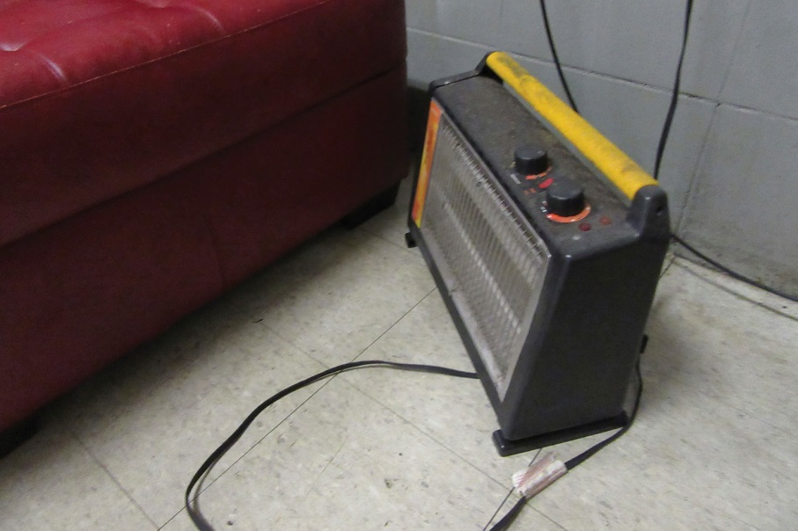
Understand the hazards related to portable heaters.
Easily misused, placed in poor locations, damaged, poorly maintained
Heaters placed close to combustibles
Lack of adequate ventilation
Many communities have enacted laws regulating or prohibiting certain types of heaters in certain occupancies
Be familiar with locally adopted code requirements
Be familiar with manufacturers’ requirements
If prohibited, it must be removed from service and taken from the premises

Slide 32
NOTE
The 2012 edition of the International Fire Code® (IFC) and the International Building Code® (IBC) contain requirements for the installation of CO detection in new and existing Group-R and Group-I occupancies. These would include hotels, dormitories, apartment buildings, hospitals, and nursing homes. These alarms must be installed and maintained in accordance with NFPA® 720, Standard for the Installation of Carbon Monoxide (CO) Detection and Warning Equipment® as well as the manufacturer’s instructions. The inspector must be familiar with these requirements and exceptions.

Slide 33
Know what to verify when portable heaters are permitted and in use.
Heater is well maintained; in safe working condition
Equipped with safety switches that turn the heating element off if the heater tips over
Appropriate fuel, if applicable, is used for the heater
(Cont.)

Slide 34
Know what to verify when portable heaters are permitted and in use.
Electric heaters are only plugged into an electrical receptacle/circuit that is designed to carry the current required to operate the heater
Located away from the route of egress from the structure
Placed a safe distance from any flammable or combustible materials
Fuel for kerosene heaters is stored outside the structure; heater is refilled outside the structure

Slide 35
Understand the hazards related to air conditioners.
Most commercial refrigerants have a classified level of toxicity and flammability as defined in American National Standards Institute (ANSI) and the American Society of Heating, Refrigeration, and Air-Conditioning Engineers (ASHRAE)
Refrigerants are assigned to one of two toxicity classes (A or B) based on what would be a permissible exposure
Remember that they may be dealing with a refrigerant that is not very flammable but is very toxic
ANSI/ASHRAE Standard 34, Designation and Safety Classification of Refrigerants

Slide 36
Ventilation systems are mechanical air-moving or air-distribution systems.
These systems are tied into both the heating appliance and the air conditioning equipment
Quality and characteristics of the air remain unchanged
Primary fire safety concern is the potential for the transmission of fire, smoke, and products of combustion through the air distribution system
No cooling or heating of the air occurs within the system

Slide 37
NOTE
An inspector must recognize the difference between an air conditioning system and a ventilation system.

Slide 38
Know the types of filters used in HVAC systems and the hazards they pose.
Fibrous media filters/renewable media filters
Electronic air cleaners
May become filled with trapped particulates
Particulates can generate large quantities of smoke if they become ignited
Can develop an electrical malfunction that ignites the filters or particulate matter inside the HVAC system

Slide 39
Understand the classification systems for filters.
Basis
Class 1
When clean, will burn moderately
UL classification
Smoke development
Class 2
When clean, will not contribute fuel to a fire
Emit very small quantities of smoke when flames strike them
Emit moderate quantities of smoke
Flame propagation

Slide 40
REVIEW QUESTION
Identify fire and life safety hazards presented by heating, ventilation, and air conditioning systems.

Slide 41
Facilities with cooking equipment represent a large percentage of occupancies inspectors will enter.
Inspection focus
Type I hoods
Type II hoods
Ventilation hood
Exhaust
Fire protection systems installed above the cooking area
Systems should meet locally adopted code
Placed over grease-producing equipment
Over such equipment as dishwashers and ovens

Slide 42
Recognize hazards associated with cooking equipment.
Cleanliness and functionality
No grease accumulation
Proper provisions for grease removal; regularly scheduled cleaning
Clearance of at least 18 inches (450 mm) from any combustible material
Fire extinguishers should be accessible and personnel should have been trained
Extinguishers should be compatible with the suppression system

Slide 43
Know what to look for when inspecting ventilation-hood systems.
Verify general cleanliness and maintenance of the cooking area and ductwork
Examine the system for any obvious damage, including mechanical damage
Verify that nozzles are properly oriented toward the protected hazard
(Cont.)

Slide 44
Know what to look for when inspecting ventilation-hood systems.
Verify all parts of the system to confirm that they are in their proper locations and connected
Inspect manual actuators for obstructions
Inspect tamper indicators and seals to verify that they are intact
Check maintenance tag or certificate for proper placement
(Cont.)

Slide 45
Know what to look for when inspecting ventilation-hood systems.
Verify that a detector or fusible link is provided for each protected cooking appliance located under the hood
Fusible links that control the activation of the fire extinguishing system should be replaced at least annually
Fusible links that appear to be distorted from frequent exposure to heat may need to be replaced more often

Slide 46
Know safety requirements for solid-fuel cooking equipment like grills and smokers.
Becoming very common in many restaurants
Includes wood-fired brick ovens and meat grilling or smoking equipment
Must be installed on combustible floors that extend 3 feet (900 mm) from the outside of the appliance in every direction
Requires grease removal devices
Requires a ventilation hood system to exhaust smoke and gases; spark arrestors must be located inside the hoods ahead of the filter system
(Cont.)

Slide 47
Know safety requirements for solid-fuel cooking equipment like grills and smokers.
Only a one-day supply of solid fuel is allowed in the same room as the appliance
Ashes must be removed from the firebox regularly so that the buildup of ashes does not interfere with the draft
Ashes must be disposed of in an approved container separate from containers containing other combustible waste

Slide 48
NOTE
Restaurants that operate open-air patios may also have propane or butane heaters or wood-burning fireplaces. These heaters or fireplaces may be in contact with or near awnings or other combustible materials, creating an exposure hazard through radiant heat or burning embers.

Slide 49
Understand items for to look for in fire suppression systems.
A vital part of commercial cooking equipment
Be familiar with the systems in use in jurisdiction
Make sure cooking appliances protected by the system have not been changed or switched out
Verify system has been maintained per NFPA® standards
Verify an instruction sign for manual system operation is present
Verify employees have been trained to perform manual operations
Courtesy of George Apple, Cosumnes Fire Department

Slide 50
Many commercial cooking establishments utilize wet-chemical systems.
Must meet the requirements in NFPA® 17A, Standard for Wet Chemical Extinguishing Systems
Requirements for these systems are also contained in UL Standard 300, Fire Testing of Fire Extinguishing Systems for Protection of Restaurant Cooking Areas

Slide 51
NOTE
An inspector should be aware that changes in the type of cooking oil used in fryers can require that a dry-chemical system be replaced by a wet-chemical system that is designed to control Class K fires. The adopted code may allow the continued use of the dry-chemical system as long as the system can be serviced and maintained.

Slide 52
REVIEW QUESTION
List some of the conditions inspectors must look for when inspecting cooking equipment like ventilation hoods.

Slide 53
There are several reasons industrial furnaces and ovens fail.
Inadequately trained operators
Lack of proper maintenance
Improper application of equipment

Slide 54
Know how industrial ovens and furnaces are classified.
Class A
Class B
Operates at approximately atmospheric pressure
Operates at approximately atmospheric pressure where no flammable volatiles or combustible materials are being heated
Has a potential for explosion or fire hazard when flammable volatiles or combustible materials are processed or heated
(Cont.)

Slide 55
Know how industrial ovens and furnaces are classified.
Class C
Class D
Potential hazard due to a flammable material being used or if a special atmosphere is present
Operates at temperatures from above ambient to over 5,000°F (2 750°C)
Includes a special atmosphere supply system
Includes integral quench furnaces and molten salt bath furnaces
Operates at pressures normally below atmospheric using any type of heating system
Can include the use of special processing atmospheres
Can use any type of heating system

Slide 56
Understand the fire and explosion hazards of industrial furnaces and ovens.
Failing to maintain required clearances
Ventilation systems, including makeup air and exhaust systems
Heat, gas, and smoke removal systems
Temperatures required for operation
Material handling equipment

Slide 57
Be familiar with proper housekeeping techniques that reduce hazards in industrial furnaces and ovens.
Remove combustible items from the area around the oven or furnace
Remove general dirt and debris on a regular basis
Maintain required clearances
Check/verify all automated controls and alarms

Slide 58
Be familiar with components commonly found on safety controls.
Switches
Valves
Relays
Controllers
Detectors
Interlocks

Slide 59
NOTE
It is important to check the schedule and the extent of the inspection, testing, and maintenance programs.

Slide 60
Understand the importance of interlocking systems.
It is important to interlock the entire system so that in the event of a malfunction, the equipment will deactivate and remove the remaining fuel from the system
Deactivation of the heating system by any safety feature or safety device requires that an operator manually intervene to reestablish normal system operation

Slide 61
REVIEW QUESTION
Name some of the special considerations inspectors need to be aware of when it comes to industrial furnaces and ovens.

Slide 62
Be familiar with different types of powered industrial trucks.
Personnel transportation vehicles
Special material handling vehicles
Emergency response vehicles

Slide 63
Be familiar with fuels used in powered industrial trucks.
Diesel
Gasoline
Liquefied petroleum gas (LPG) (Most common)
Compressed natural gas (CNG)
Electric batteries (Most common)
Dual fuels (gasoline/LPG)

Slide 64
Be familiar with fuels used in powered industrial trucks.
Powered vehicles are found at industrial settings, malls, schools, and golf courses
Numerous age-restricted communities are encouraging vehicle use of this type
Power lifts can be found in convention centers, in hotels, and on construction sites
Requirements for powered industrial trucks are contained in most model fire codes

Slide 65
Know what conditions to watch for during inspections.
Chargers
Charging areas should not be accessible to the public
Charging area should be vented to prevent an accumulation of hydrogen gas
Liquid- or gas-fueled vehicles
Should be kept at least 5 feet (1.5 m) from combustible materials
Should only be fueled outside buildings
Fuel storage should be in compliance with locally adopted fire codes
(Cont.)

Slide 66
Know what conditions to watch for during inspections.
Repairs
Should be performed in areas designated for that function
Industrial trucks
Should only be used in the atmosphere for which it is specified
Should be marked with signs indicating the class of truck and any operational restrictions
Must be maintained in accordance with manufacturer’s instructions

Slide 67
REVIEW QUESTION
What conditions should an inspector be alert to when inspecting facilities that use industrial trucks?

Slide 68
Understand what to look for when inspecting tents.
Tents must be made of flame-resistant materials that are approved and tagged as such

Slide 69
Inspectors need to know specifics about tent requirements.
Materials that go inside the tent or on the tent such as banners or decorations must be treated with or made of flame-retardant material
Adopted building code includes permanent tents
Temporary tents fall under the jurisdiction of the adopted fire code
(Cont.)

Slide 70
NOTE
While 180 days within a 12-month period is a typical time for a tent to be considered to be temporary; local policy or practice may differ.

Slide 71
Inspectors need to know specifics about tent requirements.
All tents must meet the requirements of the large-scale test contained in NFPA® 701, Standard Methods of Fire Tests for Flame Propagation of Textiles and Films
Tents must be tagged or certified that they meet the requirements
Inspectors should not attempt to test the flammability of materials on their own
Tents must be located according to the requirements of the adopted fire and building codes
(Cont.)

Slide 72
Inspectors need to know specifics about tent requirements.
Specified distances from property lines, vehicles, and other tents
Means of egress requirements as contained in the locally adopted building and fire codes
Storage and handling of flammable or combustible liquids in accordance with fire code requirements
Electrical installments in accordance with locally adopted codes (including extension cords)
Pyrotechnics and open flames are prohibited in any tents or temporary membrane structures
Access for emergency vehicles
(Cont.)

Slide 73
NOTE
When multiple tents are put together, the increased area under consideration may involve additional safety requirements and permits.

Slide 74
Inspectors need to know specifics about tent requirements.
Combustible vegetation must be cleared both inside the tent and up to 10 feet (3 m) around the outside of the tent
Inspecting authority agrees if vegetation has been removed properly
Hay, straw, and shavings may require treatment with fire-retardant chemicals or limited to amounts sufficient for daily care and feeding of animals
Sawdust may need to be treated with fire-retardant chemicals or kept damp, depending on code requirements

Slide 75
REVIEW QUESTION
Name some of the provisions required for tents.

Slide 76
Learning Objective 2
Distinguish among hazardous processes that contribute to increased fire risk.

Slide 77
There are a number of potential hazardous processes an inspector may encounter.
Welding
Dry cleaning operations
Dust hazards
Dipping and quenching operations
Application of flammable finishes

Slide 78
Numerous locations may house multiple hazardous processes.
Manufacturing facilities
Auto repair and painting shops
Fabrication businesses
Furniture repair shops
Dry cleaning operations
Semiconductor/electronic manufacturing
Distilleries
Construction/ demolition sites
Commercial operations

Slide 79
Some operations can generate ignition sources or hazardous atmospheres.
Welding
Cutting
Grinding
Painting
Replacing roof coverings

Slide 80
Inspectors should be aware of these processes and their potential locations.
Some will be contained at specific facilities designed for their operations
There are locations where these hazardous processes may exist only during the use of the process; require a permit to perform
Be familiar with code requirements for these processes
Others may be present during inspections of other types of occupancies
Recognize any code infractions when they are encountered

Slide 81
REVIEW QUESTION
What are some of the operations that can create hazardous atmospheres?

Slide 82
Inspectors should be aware of hazardous processes in welding and thermal cutting operations.
Also known as hot work
Processes used to join or sever materials
May use a variety of energy sources, including a gas flame or an electric arc
Significant cause of fires in commercial and industrial occupancies and on construction sites

Slide 83
Welding and thermal cutting operations use two processes.
Process One
Process Two
Uses electrical arc as a heat source
Uses combination of oxygen and fuel gas
Acetylene is commonly used
Both processes generate temperatures in excess of the melting point of the metals

Slide 84
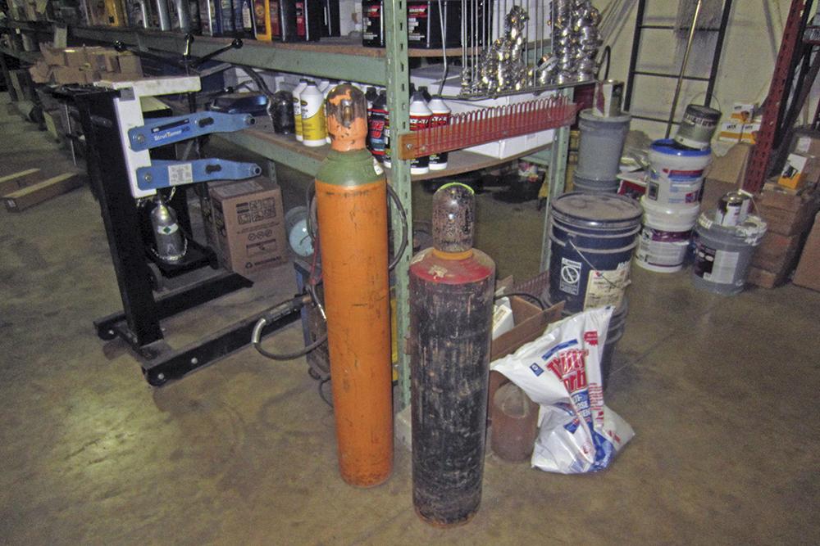
Inspectors should primarily be concerned with hot work fire safety issues.
Equipment maintained
Equipment in working order
Equipment stored properly
Combustible materials kept well away from hot work operations
Oxygen and fuel gases in cylinders are stored properly
Gas regulators maintained at their proper settings
Courtesy of Rich Mahaney

Slide 85
NOTE
Electric welding and thermal cutting equipment should be maintained according to the manufacturer’s instructions and adopted electrical codes.

Slide 86
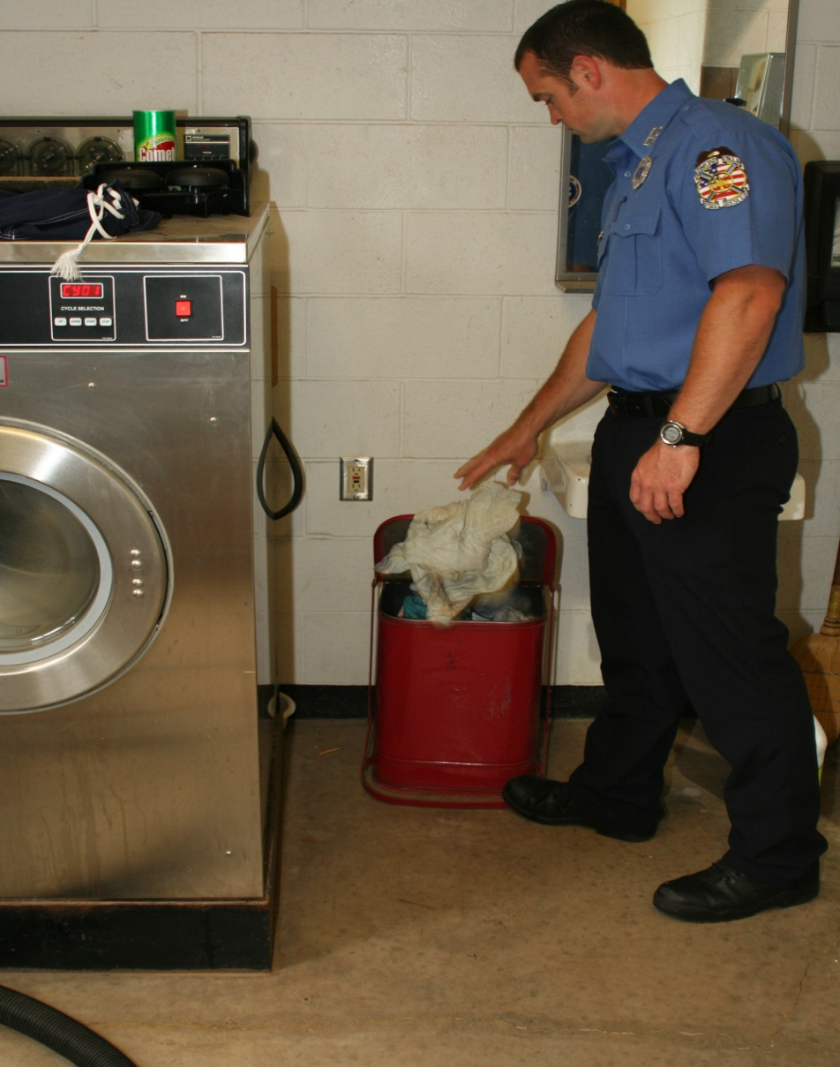
Thermal cutting operations and some arc welding operations produce several ignition sources.
Examples: sparks and hot slag, a glass-like residue that the process creates
Verify that sparks or slag cannot come in contact with combustible materials
Combustible materials should not be stored in the welding or cutting areas
Shop rags or towels should be kept in approved metal containers with lids at all times

Slide 87
Welding and cutting should never be allowed in some situations.
Inside buildings when automatic sprinkler systems are not in operation
In the presence of explosive atmospheres
On drums, tanks, or other containers that have previously held flammable liquids
Near large quantities of exposed combustible materials

Slide 88
Understand the requirements when paper clippings, wood shavings, or textile fibers are on the floor.
An area with a radius of at least 35 feet (10.7 m) must be cleared
When it is impractical to create this size radius, the materials must be covered with approved fire-resistant guards or curtains

Slide 89
Know where to find more information on these types of operations.
NFPA® 51, Standard for the Design and Installation of Oxygen-Fuel Gas Systems for Welding, Cutting, and Allied Processes
NFPA® 51B, Standard for Fire Prevention During Welding, Cutting, and Other Hot Work
FM Global Loss Prevention Data Sheets

Slide 90
Know local requirements for hazard reduction practices.
Fire watches
Issuance of permits
Development of hot-work programs

Slide 91
Understand the requirements for hot-work programs.
Written plan
Establishes procedures to prevent fires resulting from temporary operations
Approved by the AHJ
Involves operations that use an open flame or produces heat, sparks, or hot slag

Slide 92
Hot-work programs can be used for several hazardous processes.
Welding
Brazing
Cutting
Grinding
Soldering
Thawing pipes
Applying roofing with a torch

Slide 93
Know permit requirements for thermal cutting and welding operations.
Local municipal jurisdictions
Should consider annual permits to conduct operations in fixed locations
Developing the hot-work program
Establishing a written policy for hot work
Applying for the permit
Inspection
Note all hazards in the area
Discuss emergency procedures with applicant
May have requirements for as-needed welding and cutting operations
Owner/occupant responsibility
Area where the work is to be performed before a work permit is issued

Slide 94
Permits should contain several types of information.
Date
Work to be performed
Period for which the permit is valid
Location of the job
Type of fire suppression equipment available
Inspection of area before work begins
Authorization signature of individual in charge
Notification of when a fire watch is assigned
Final signature of the individual after the work has been completed

Slide 95
A 30-minute fire watch is most critical in certain situations.
Combustible contents are closer than 35 feet (11.7 m) from the point of operation
Adjacent areas having wall or floor openings are within a 35-foot (11.7 m) radius
Exposed combustible materials are in adjacent areas, especially concealed spaces, walls, and floors
Anytime a fire could spread due to conduction or radiation
See NFPA® 1, Fire Code, NFPA® 51b, Standard for Fire Prevention During Welding, Cutting, and Other Hot Work and IFC for other requirements

Slide 96
Inspectors should know the training requirements for fire watch personnel.
Use of required fire extinguishers appropriate for the level of hazard
Procedures to warn occupants
Procedures to summon the fire department in the event of a fire

Slide 97
REVIEW QUESTION
Name the hot work fire safety issues inspectors should primarily be concerned with.

Slide 98
Understand different types of common flammable finishing methods.
Spray finishing
Creates an aerosol
Powder coating
Hazard in this process is flash fire or dust explosion
Primary hazard comes from pressurizing a flammable or combustible liquid and discharging it through a small orifice
Easily ignited
Involves suspension of electrically charged combustible powders like polyester resin
(Cont.)

Slide 99
Understand different types of common flammable finishing methods.
Immersion coating
Involves placement of a suspended article into an open dip tank of flammable or combustible liquids
Constant vapor production as the liquid evaporates increases the risk of fire

Slide 100
Model codes require controls to reduce ignition and protect occupants in case ignition occurs.
Use of mechanical ventilation
Administrative controls limiting fuel amounts/other ignition sources
Interlocks to stop the flammable finishing process if mechanical ventilation is lost or the automatic fire extinguishing system activates
Installation of noncombustible equipment or noncombustible enclosures
Specification of hazardous electrical location boundaries in and around the spray finishing process
Automatic fire extinguishing system in and around the flammable finishing process

Slide 101
Inspectors need to know what conditions are exempt.
Application of water-based coatings
Use of coatings supplied from disposable aerosol containers
Manual application of flammable liquids over small areas using brushes or rollers

Slide 102
The most common flammable finishing operation is spray finishing.
Utilizes compressed air or hydraulic energy to atomize flammable or combustible liquids into small droplets
Hydraulic systems are termed airless spray finishing because it does not utilize compressed air

Slide 103
Model fire codes require the use of spray booths or rooms, which are classified as appliances.
Noncombustible enclosure constructed of carbon, galvanized, or stainless steel panels with a plenum
Plenum is connected to a noncombustible exhaust duct that discharges outside

Slide 104
Understand mechanical ventilation requirements for spray booths and rooms.
Must be designed to maintain the atmosphere inside at an atmosphere less than 25 percent of the lower flammable limit for the most volatile flammable liquid
Confirm this air exhaust rate
Mechanical inspectors commonly require an air balance test to confirm the exhaust fan is properly sized and functioning correctly
Generally, acetone is used because of its high evaporation rate
Generally speaking, a conventional spray booth designed for a passenger automobile is designed to exhaust at a rate of 8-11,000 cubic feet/minute
Test confirms that the system meets manufacturer’s specified flow rate

Slide 105
Verify that the appropriate electrical equipment is installed inside the spray booth or room.
Must be designed for hazardous (classified) locations
Interior space of spray rooms or booths is illuminated with electric lamps
Fire codes and NFPA® 33, Standard for Spray Application Using Flammable or Combustible Material, require that these lamps be listed for use in Class I, Division 1 atmosphere, a National Electrical Code® classification

Slide 106
Almost all spray booths or rooms require some form of automatic fire extinguishing system.
Acceptable methods include automatic sprinkler protection and dry chemical fire extinguishing systems
Another key fire protection feature is the interlock
NFPA® 33, Standard for Spray Application Using Flammable or Combustible Material, and model fire codes require the mechanical ventilation system be interlocked

Slide 107
REVIEW QUESTION
Name some of the controls model fire codes require for flammable finishing processes.

Slide 108
Powder coating is a process in which metal parts are coated with a powdered polyester resin.
Powder is ionized with positive electrons so it will adhere to the metal
After coating, the powder is backed to form a durable finish on the material surface
Powder is applied in a ventilated enclosure, which can be a spray booth or a spray room
Primary hazard of powder coating is the ignition of the combustible powder inside the room or space where it is applied

Slide 109
Recognize the hazards presented by powder coating and certify proper controls are in place.
Verify equipment is listed for combustible powders
Powdered polyester resin is a combustible resin
Equipment must be listed for hazardous locations under the jurisdiction’s electrical code
Powder collection system
Can be an independent device that is ducted to a dust collector
Automatic fire extinguishing system
Booth is constructed using noncombustible materials
Powder application equipment
Collector may be part of the booth
In the spray space

Slide 110
Recognize the hazards presented by immersion coating.
Combustible liquids
Equipment
Conveyor pumps
Heaters and heat exchangers
Agitators
Ventilation and exhaust equipment
Flammable liquid storage tanks

Slide 111
Know how to reduce potential incidents involving immersion coating.
Should be located away from other process areas
Never located near an egress area
Dip tanks and reservoirs should be contained in 1-hour fire-rated construction
Ignition sources identified and removed if possible
Production and safety components in place
(Cont.)

Slide 112
Know how to reduce potential incidents involving immersion coating.
Use suspended nonflammable curtains to shield an operation
Explosion-venting construction can be used
Ventilation and exhaust of the areas
Housekeeping
Maintenance
Regular inspections

Slide 113
REVIEW QUESTION
What are the three types of flammable finishing operations for which model fire codes specify requirements?

Slide 114
Understand the components used in quenching operations.
Elevators
Conveyors
Hoists
Cranes

Slide 115
Understand the requirements for quenching operations.
Medium must remain fluid and stable; minerals oils are commonly used
Two types of quenching: heated and unheated
Located in fire-resistive buildings away from the main production areas
Ventilation system
Designed where conveyor systems automatically stop in the event of a fire
All portions of the process should be interlocked
Automatic sprinkler system

Slide 116
NOTE
All aspects of the quenching process should be electrically grounded in accordance with NFPA® 77, Recommended Practice on Static Electricity.

Slide 117
Understand how to reduce hazards around a quenching operation.
Eliminate
Open flames
Spark-producing equipment or processes
Equipment whose exposed surfaces exceed the autoignition temperature of the quenching medium
Enclose hazards
Train workers
Control overflow risk

Slide 118
Inspectors should be mindful of a number of tank-related considerations.
Should be located at grade level
Should be designed with enough freeboard to keep the tank from overflowing
All tanks should have drains
Should be built within dikes with drains capable of containing the contents of the tank or moving it into specialized holding tanks
Installation of drain boards and automatic-closing covers
Fire extinguishers of several types must be available

Slide 119
REVIEW QUESTION
How can hazards around quenching processes be reduced?

Slide 120
Understand the characteristics of dry cleaning operations.
The process removes dirt, grease, and stains from clothing or other textiles by using solvents
Classified as a business occupancy
Facilities with onsite cleaning may be classified differently, such as a hazardous occupancy
Presents numerous chemical, fire, and environmental hazards
Presence of all elements necessary for uncontrolled fires

Slide 121
Inspectors need to know about solvents used in dry cleaning.
Types
Newer solvents in common use today have fewer environmental concerns but greater flammability hazards
Perchlorethylene reduced fire hazards but introduced environmental concerns
Dry cleaning plants are classified by the type of solvents used in the process
Type I plants are prohibited
Small quantities of Class I solvents may be stored and used in the other classifications of plants
Classifications

Slide 122
Know what to look for during plans review and inspections.
Plans review
Inspections
Establish that the fire protection requirements of the locally adopted code are met
Quantity of Class I solvents is limited and properly stored
Dry cleaning plant type and solvent used match
Routine maintenance is performed
All containers with flammable or combustible petroleum-based solvents are properly stored, transported, and used
A No Smoking policy is in place, enforced, and signs are posted
Correct size and number of portable fire extinguishers are available
All fire protection equipment is operational
Personnel trained in extinguisher use

Slide 123
REVIEW QUESTION
What are some of the items an inspector must verify when inspecting dry cleaning operations?

Slide 124
Dust hazards consist of suspended particulates in the air.
Given the correct mixture of oxygen and an ignition source, a dust hazard in sufficient quantity can create a fire, conflagration, or explosion
Dust explosion can be severe enough to destroy an entire facility
U.S. Chemical Safety and Hazard Investigation Board (CSB) identified 281 combustible dust incidents between 1980 and 2005
Even materials that do not burn in larger pieces can form combustible or explosive dust

Slide 125
Materials that can form combustible dusts are used in a wide variety of industries and processes.
Agriculture
Chemical manufacturing
Pharmaceutical production
Furniture
Textiles
Fossil fuel power generation
Recycling operations
Metal working/processing

Slide 126
Know what conditions must be present for a dust explosion to occur.
Combustible dust must be suspended in air
Particle concentration must be within its explosive range
Ignition source must be present
Dust must be in a confined space
Oxygen content must be capable of supporting combustion

Slide 127
Understand that dust explosions occur in a series.
First explosion usually is not as severe as subsequent explosions
First explosion stirs dust that has settled on ledges, walls, equipment, or in areas of low travel
Second introduction of particles to the air generally results in larger and stronger explosions

Slide 128
Inspectors need to know where to find requirements for safe dust collections systems.
NFPA® 654, Standard for the Prevention of Fire and Dust Explosions from the Manufacturing, Processing, and Handling of Combustible Particulate Solids
Can assist the inspector as a reference when preparing to conduct inspections
Locally adopted codes
All-encompassing standard on how to design a safe dust collection system
Requires that process hazard analysis be conducted for processes handling powders and bulk solids that present a fire or explosion hazard

Slide 129
Process hazard analysis, conducted by a qualified testing agency, determines many things about combustible dusts.
Particle size (surface area-to-mass ratio)
Moisture content as received and dried
Minimum dust concentration to ignite
Available oxygen in atmosphere
Minimum energy required for ignition
Maximum rate of pressure rise at various concentrations
Minimum dust layer ignition temperature
Maximum explosion pressure at optimum concentration

Slide 130
Know requirements for employers who use materials or processes capable of producing combustible dusts.
Basics
Provide required safety and handling information to employees
Evaluate operations and tasks where dusts are present or may be generated
Control measures
Appropriate engineering controls
Work practices
Personal protective equipment
Include that information on the SDS

Slide 131
Understand the groupings of combustible dusts.
Group E
Group F
Materials include coal, carbon black, charcoal, and coke dusts present in manufacturing and power production facilities
Metal dusts including aluminum, magnesium, their commercial alloys, and other dusts whose particle size, abrasiveness and conductivity present hazards in the use of electrical equipment
Volatile dusts containing more than 8 percent carbonaceous materials
(Cont.)

Slide 132
Understand the groupings of combustible dusts.
Group G
Dust atmospheres produced in flour, grain, wood, plastic, and chemical processing operations

Slide 133
Understand the classifications of combustible dusts.
Class II, Division 1
Mechanical failure or abnormal operation of machinery might cause such an ignitable mixture
Dust accumulations are greater than 1/8 inch (3 mm) thick under normal conditions
Combustible dust is in the air under normal operating conditions; in sufficient quantities to produce an explosive or ignitable mixture
Group E combustible dusts are in quantities sufficient to be hazardous
(Cont.)

Slide 134
Understand the classifications of combustible dusts.
Class II, Division 2
Dust accumulations have occurred but are normally insufficient to interfere with normal operation of electrical equipment
Accumulation of combustible dust on or in the vicinity of electrical equipment could lead to its ignition by abnormal operation or failure of the electrical equipment
Combustible dust is produced due to an abnormal operation; present in quantities to produce explosive or ignitable mixtures

Slide 135
Facilities with dust hazards must employ some type of dust control.
Passive
Include providing enclosures for conveyor belts
Active
Air material separators
Reducing the speeds at which materials are moved through the facility on conveyor belts or through chutes
Usually mechanical dust-collection systems capable of collecting 99.5 percent of the dust and storing it in bins outside the facility

Slide 136
Preventive measures taken for dust collection and reduction must be constantly monitored.
Cleaning programs must be performed daily or as needed
Dust continually picked up by manual sweeping, vacuuming, or other means; placed in appropriate storage bins or containers
Metal of all types collected and separated
Courtesy of Rich Mahaney
(Cont.)

Slide 137
Preventive measures taken for dust collection and reduction must be constantly monitored.
Electrical equipment in the plant needs to be compliant with NFPA 70®, National Electrical Code and listed for this environment and use
All equipment grounded to minimize static electricity
Smoking restricted to designated areas
Fire protection equipment as required by the locally adopted fire and building codes and the referenced NFPA® standards
Motors may need to be nonsparking and intrinsically safe
Courtesy of Rich Mahaney

Slide 138
NOTE
Large facilities may have their own dust control programs that the inspector should review.

Slide 139
Understand fire protection requirements for process industries.
Basics
Building should have fire extinguishers in accordance with NFPA® 10
Person designated to notify emergency responders
Facility layout drawings
Emergency telephone number(s)
Emergency response duties for occupants
Comply with locally adopted codes
Written emergency action plan
Means of notification for occupants
Preplanned evacuation assembly area
Location of safety data sheets (SDSs) or material safety data sheets (MSDSs)

Slide 140
Know the keys to preventing fires in materials-handling facilities.
Control the dust and the ignition sources
Courtesy of Rich Mahaney

Slide 141
Understand the requirements for grain facilities.
It is important that dust-collecting systems be located outside the grain elevator
Buildings should be built in accordance with the building code used in the jurisdiction as well as NFPA® 61
Life safety issues for a grain-handling facility should comply with the appropriate locally adopted fire and building codes
Courtesy of Rich Mahaney

Slide 142
There are several places where prevention methods must be provided.
Belt loaders
Belt discharge or transfer points
Trippers
Turnheads
Distributors
Unfiltered vents
Courtesy of Rich Mahaney

Slide 143
Know the most common place for fires at woodworking and processing facilities.
Dust hogger
Small pieces of metal, called tramp, wear off the machine during the milling operation; accumulate in the hog trap
Trap can become hot enough to ignite wood on contact
Fire can then spread into other portions of the machinery, including the dust collection system
These fires are often hard to control
Machine that turns scrap wood into splinters or chips
Fires also may be located within an elaborate system of ducts, storage bins, and other associated equipment

Slide 144
Know the requirements for machine shops and manufacturing facilities.
Fine metal dust has an enormous explosive potential
Review company’s policies on smoking and open flames
No smoking, open flames, electric- or gas-cutting or welding equipment, or spark-producing operations should be allowed
(Cont.)

Slide 145
Know the requirements for machine shops and manufacturing facilities.
Employers need to enforce strict rules that employees may not carry lighters, matches, and smoking materials
Employees working in a metal dust processing or handling area should wear flame resistant personal protective clothing
Imperative that workers be trained in emergency procedures
Workers need to be familiar with the emergency PPE they must use

Slide 146
There are several items to confirm during an inspection.
Warning signs must be posted for areas containing inert fire protection systems and explosion protection systems
Spark-producing portable power tools and propellant-actuated tools should not be used where combustible dust is present
All equipment, floors, and walls must be carefully cleaned; all dust accumulations in the area removed
(Cont.)

Slide 147
There are several items to confirm during an inspection.
Machinery
Inspection must be conducted at the end of the job
Verify that any spark-producing tools or debris that could enter equipment are removed
Packaging
Miscellaneous storage
If it causes vibrations, it should be turned off until work is completed
Work areas
All work areas must be kept clean and uncluttered
Sacks, boxes, uninstalled machinery or parts, or other supplies are stored away from areas where the only other combustible material is the agricultural commodity being stored
Must be placed so it does not impede facility housekeeping or fire suppression operations

Slide 148
REVIEW QUESTION
What are the five conditions that must be present for a dust explosion to occur?

Slide 149
Know what roofing contractors must tell their employees.
Never torch directly to combustible decks or materials
Never torch to areas that cannot be seen fully
Do not use torches near vents or air intakes
Never use a torch to heat a propane tank that begins to frost on the outside
Have appropriate fire extinguishers within easy reach at all times
Whenever working with torch-applied roofing materials, fire-watch inspections must be conducted for at least two hours after the work has been completed and the last torch has been turned off

Slide 150
Know the characteristics of asphalt tar kettles.
Typically trailer-mounted devices
If the hot contents spill, they can ignite other fuels and spread fire rapidly as a mass of flaming liquid
Adopted fire code will provide requirements
Heated using an LPG burner or similar heating device

Slide 151
Inspectors must be aware of fire protection and safety procedures associated with kettles.
Should have limit controls, tight-fitting lids, and other safety devices to prevent fire or spills
Must never be operated inside a building or on its roof
Area of operation should be identified by traffic cones, barriers, and other suitable means as described in the adopted code
At least one employee knowledgeable about the operation should constantly attend the kettle and be in a reasonable distance with the kettle in sight
Appropriate portable fire extinguisher must be located within 25 feet (7.5 m)
(Cont.)

Slide 152
Inspectors must be aware of fire protection and safety procedures associated with kettles.
LPG cylinders must be secured; regulators are required
All kettles must have an approved, functional, and visible temperature gauge that indicates the temperature of the material being heated
Must also have a lid over the product tank that should be closed in the event of a fire
At no point should water be used to extinguish these types of fires
LPG containers for roofing kettles must not be used inside any building

Slide 153
Be aware of the hazards associated with distilleries.
Primary hazards are fire and explosion
Fire can occur when vapors from flammable organic compounds are released from leaks in tanks, casks, and equipment
Vapor explosion can occur if enough vapors are released in an enclosed space with ignition sources
Dust from processing grain and combustion from wood floors, casks, and racks can also cause fires or explosions
Courtesy of Rich Mahaney

Slide 154
Be aware of the ignition sources in distilleries.
Open flames
Torch cutting and welding
Sparks (static, electrical, and mechanical)
Hot surfaces
Heat from friction
Radiant heat
Combustible dust

Slide 155
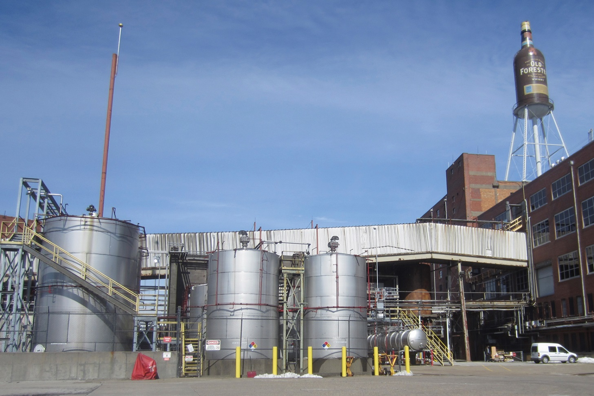
Inspectors need to be familiar with requirements for distilleries.
Locally adopted code
Hazmat requirements in fire codes may not apply to distilleries, but the hazmat requirements in the building codes may apply
Occupancy that exceeds the maximum allowable quantities (MAQs) for storage may become a hazardous occupancy

Slide 156
The best way to prevent distillery fires is to control flammable vapors.
Note venting processes
Check for proper ground and bonding technique when pouring ethanol from the storage container to the still container and when decanting large amounts of finished product or byproduct
Note that heaters and natural gas appliances that use pilot lights at least 10 feet away from the pouring and distilling areas
Verify that fire sprinkler systems meet the fire jurisdiction’s requirements
Make sure the electrical system in rooms where distilling or blending flammable liquids is done conforms to the National Electrical Code Class I Division 1 Hazardous Location for Group D Flammable Liquids

Slide 157
REVIEW QUESTION
What are some of the conditions an inspector should be aware of in a distillery?

Slide 158
Summary
Inspectors are expected to immediately recognize common fire hazards in their communities.
(Cont.)

Slide 159
Summary
Although there are numerous individual hazards that can cause a fire or contribute to a higher risk of a fire event, categorizing some hazards into general groups can help an inspector learn what to observe and note.
(Cont.)

Slide 160
Summary
Although a single community may not have all or even most of the categories included in this chapter, an inspector must have a familiarity with each.
(Cont.)

Slide 161
Summary
The most effective approach for an inspector is to research the types of occupancies in the community, the types of processes that occur there, and the building and fire code requirements for each facility before performing inspections.
(Cont.)

Slide 162
Summary
In addition, inspectors must be familiar with the types of permits that are locally required before facilities can engage in hazardous processes.
These permits determine the fire safety requirements that must be present at the site where the process occurs.

