Slide 1
Fire Inspection and Code Enforcement
8th Edition Inspector II
Chapter 3 — Fire Behavior

Slide 2
Learning Objective 1
Describe how the fire tetrahedron model can be used to control or extinguish a fire.

Slide 3
Inspectors need to understand fire control.
Fire is controlled and extinguished by limiting or interrupting one or more of the essential elements in the combustion process depicted by the fire tetrahedron model

Slide 4
Understand how firefighters influence fire behavior.
Reducing temperature
Eliminating fuel
Separating the fire from the available fuel
Changing the oxygen concentration
Interrupting the self-sustained chemical chain reaction

Slide 5
Inspectors also have tasks in regard to fire control.
Verify extinguishing systems are ready to
Act to cool a fire
Interrupt its chemical chain reaction
Exclude oxygen, in some cases
Check installation and maintenance of standpipe and hose systems
Used to disrupt combustion in elevated stories or large facilities
(Cont.)

Slide 6
Inspectors also have tasks in regard to fire control.
Monitoring and regulating hazardous conditions
Fire load and interior finishes
Helps reduce the potential for fire growth
Verify proper placement and maintenance of fire extinguishers
Enables occupants the opportunity to suppress incipient fires

Slide 7
Cooling with water is one of the most common methods of fire control and extinguishment.
Reduces temperature of the fuel
Solid fuels and liquid fuels with high flash points can be extinguished
Most effective method of extinguishing smoldering fires

Slide 8
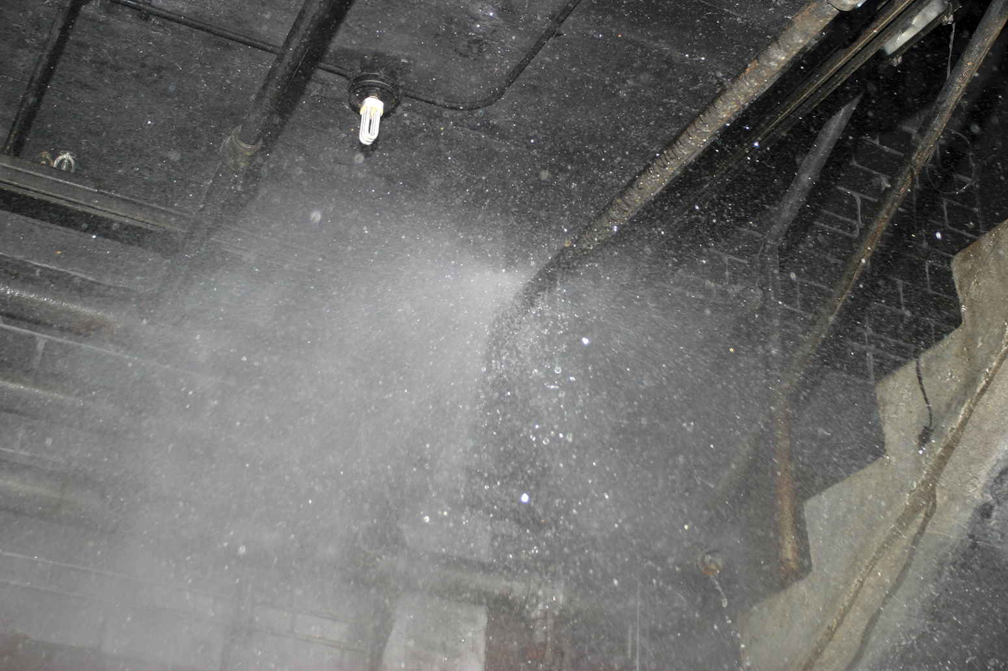
Cooling with water is accomplished through installed sprinkler systems.
Designed to extinguish by reducing temperature
Enough water must be applied to absorb the heat
Cannot sufficiently reduce vapor production to extinguish fuels with low flash points

Slide 9
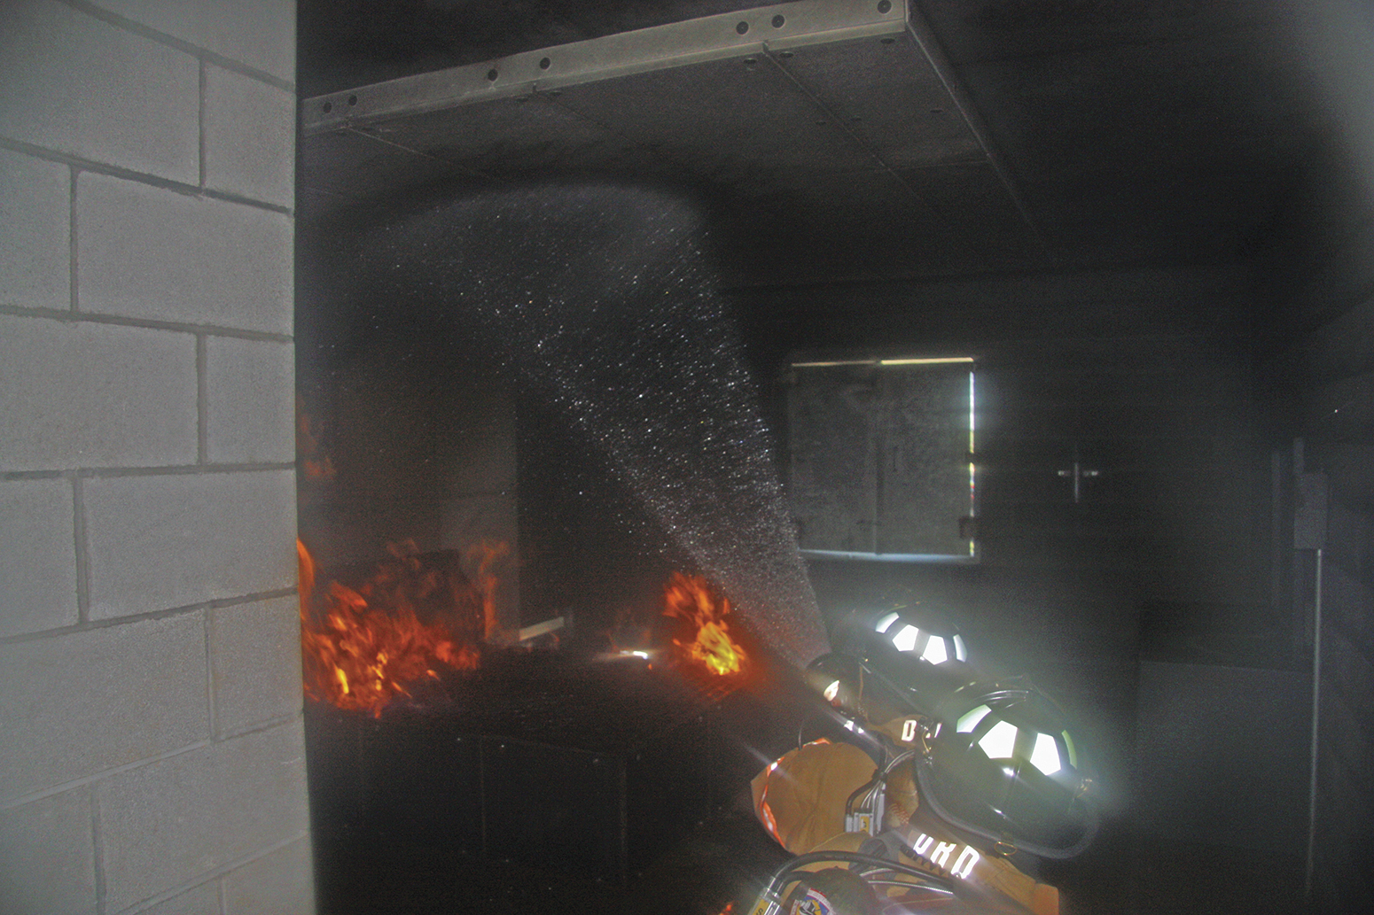
Water can also be used to control burning gases and reduce the temperature in the upper layer.
Reduces the temperature of hot products of combustion
Slows the pyrolysis process
Reduces heat flux and potential for flashover
Water has its greatest effect when it is vaporized into steam
When converted to steam, water expands 1,700 times

Slide 10
Removing the fuel is one way to avoid or extinguish a fire.
Not possible in
Buildings constructed from combustible materials
Occupancies where combustibles are stored or displayed
Building codes commonly require use of fire-resistive construction
Isolates certain fire hazards and materials that have a higher heat of combustion or burning rate
Reduces likelihood of ignition
If ignition occurs, combustibles are compartmentalized
Limits spread beyond the room

Slide 11
Reducing available oxygen reduces fire growth.
Reducing oxygen available to the combustion process
Reduces fire growth
May extinguish it over time
Flooding an area with an inert gas
Displaces oxygen
Disrupts the combustion process
Foam also separates oxygen from fuel
Neither gas, nor foam works on oxygen-enhanced fires
Those involving oxidizers

Slide 12
Chemical flame inhibition is also a method of controlling fire.
Extinguishing agents
Dry chemicals
Halogenated agents (Halons)
Halon-replacement agents
Interrupt the combustion reaction, stop flame production
Effective on gas and liquid fuels
Do not easily extinguish nonflaming combustion
No chemical chain reaction to inhibit
Requires high agent concentrations, extended periods
Makes them impractical

Slide 13
REVIEW QUESTION
What are the four components of the fire tetrahedron model?

Slide 14
Summary
The inspector’s job is to reduce risk. To this end, the inspector needs to understand the combustion process and how fire behaves in different materials and environments.
Understanding fire behavior will help the inspector evaluate fire protection systems that are designed to prevent fire or fire spread.
(Cont.)

Slide 15
Summary
The inspector must also be able to recognize how building design, construction materials, fuel loads, and combustible furnishings affect fire behavior and fire spread.
The inspector needs to understand that a solid working knowledge of fire behavior will help reduce the loss of life and property from fire and help businesses to operate more safely and provide for business continuance.

