Slide 1
Fire Inspection and Code Enforcement
8th Edition Inspector I
Chapter 10 — Hazardous Materials

Slide 2
Learning Objective 1
Explain the application of hazardous materials regulations.

Slide 3
Understand why hazardous materials present a challenge for fire inspectors.
Physical hazard materials burn, accelerate burning, and either detonate or deflagrate
Release of a health hazard material can injure or incapacitate the public or emergency responders
(Cont.)

Slide 4
Understand why hazardous materials present a challenge for fire inspectors.
Over half of the IFC and NFPA®1 are focused on hazardous materials or processes
IFC Chapters 50 through 67 and NFPA® 400 focus on preventing and minimizing incidents
Courtesy of Scott Stookey, International Code Council, Washington, D.C
(Cont.)

Slide 5
Understand why hazardous materials present a challenge for fire inspectors.
Regulations emphasize reporting storage and use of hazardous materials above certain quantities
Model codes mandate permit applicant to submit a properly prepared Hazardous Materials Management Plan or Hazardous Materials Inventory Statement
Hazardous waste materials can be chemical compounds that are mixtures of used industrial products; complicates classifications
Businesses that fail to report storage of hazardous materials are violating the jurisdiction’s fire code
(Cont.)

Slide 6
Understand why hazardous materials present a challenge for fire inspectors.
Hazardous materials responses generally require that responding personnel be specially trained and equipped to manage a chemical release
Such incidents may also require additional time to mitigate
IFC and NFPA® 400 both require that a business designate a fire department liaison or emergency response coordinator

Slide 7
Be vigilant of small changes in containment and piping.
Ask how the stored material will affect the tank, piping, or the valves that contact the solid, liquid, or gas considered to be hazardous
Courtesy of Scott Stookey, International Code Council, Washington D.C

Slide 8
Pressure relief is an important element in any hazmat system.
Stored hazardous materials are always assumed to be capable of being exposed to fire
Pressure relief can be heat-activated or respond to an increase in pressure
Can also be a design where the container safely vents under controlled fire exposure
Courtesy of Scott Stookey, International Code Council, Washington D.C

Slide 9
Many hazardous materials present flammable or reactivity hazards.
Protection can include locating the materials in fire-resistant enclosures
Fire-resistive construction may be required to separate rooms or areas where hazardous materials are stored or used
Model codes require that an automatic sprinkler system protect the building or area
Courtesy of Scott Stookey, International Code Council, Washington D.C
(Cont.)

Slide 10
Many hazardous materials present flammable or reactivity hazards.
Goal of codes is to protect the stored material from a fire; limit the risk of its involvement
Inspector will need to rely on a particular NFPA® standard for a given class of hazardous materials to determine if the sprinkler discharge density and design area are correct for the stored materials

Slide 11
Know which hazmat activities and processes may be exempt from regulation.
Hazardous materials transportation
Pesticides, fungicides, and rodenticides
Certain building systems

Slide 12
Hazmat transportation is outside the scope of the IFC and NFPA® 400.
DOT Pipeline and Hazardous Materials Safety Administration (PHMSA) regulate hazardous material transportation and its pipeline in the U.S.
IFC and NFPA® 400 regulate facilities that store, package, or use hazardous materials
Courtesy of Scott Stookey, International Code Council, Washington D.C

Slide 13
Another exemption is the application of pesticides, fungicides, and rodenticides.
The EPA under the Federal Insecticide, Fungicide, and Rodenticide Act (FIFRA), approves the use of these materials in the U.S.
Exemption does not limit the inspector’s authority to apply the fire code to the storage or manufacturing of these materials

Slide 14
Certain building systems that store or use hazardous materials can be exempt.
In the IFC, mechanical refrigeration, fuel oil storage, and stationary storage battery systems are generally exempt from the hazardous materials provisions
Courtesy of Scott Stookey, International Code Council, Washington D.C

Slide 15
Be familiar with local codes and the standards applicable to hazmat storage, use, and handling.
The IFC and NFPA® 400 adopt a number of standards by reference
Standards reflect minimum requirements for design and construction of containers, cylinders, tanks and piping systems
Address proper marking and identification of cylinders and hazardous materials piping
Other standards provide guidance to the inspector in ensuring proper classification of gases

Slide 16
REVIEW QUESTION
Name some of the ways in which hazardous materials regulations are applied.

Slide 17
Learning Objective 2
Identify some of the applicable codes and standards that apply to hazardous materials.

Slide 18
Be able to identify some of the applicable codes and standards that apply to hazmat.
ICC
International Fire Code (IFC)
International Building Code (IBC)
International Mechanical Code (IMC)
NFPA®
NFPA® 1, Fire Code
NFPA® 30 and 30A, Flammable & Combustible Liquid Code, Motor Vehicle Fuel Dispensing and Repair Garages Code
NFPA® 55, Compressed Gases and Cryogenic Fluids Code
NFPA® 58, Liquefied Petroleum Gas Code
NFPA® 91, Standard for Exhaust Systems for Air Conveying of Vapors, Gases, Mists, and Noncombustible Particulate Solids
NFPA® 400, Hazardous Materials Code
(Cont.)

Slide 19
Be able to identify some of the applicable codes and standards that apply to hazmat.
API (American Petroleum Institute)
API 620 Design and Construction of Large, Welded, Low-Pressure Storage Tanks
API 650 Welded Steel Tanks for Oil Storage
API 653 Tank Inspection, Repair, Alteration and Reconstruction
ASME (American Society of Mechanical Engineers)
B31.3 Process Piping
Boiler and Pressure Vessel Code, Section VIII, Division 1 and 2
ASTM (American Society of Testing and Materials)
Include flash point tests
(Cont.)

Slide 20
Be able to identify some of the applicable codes and standards that apply to hazmat.
CGA (Compressed Gas Association)
CGA C-7, Guide to Preparation of Precautionary Labeling and Marking of Compressed Gas Containers
CGA S-1.1, S-1.2, S-1.3, Pressure Relief Devices — Parts 1-3
CGA P-18, Standard for Bulk Inert Gas Systems
CGA P-20, Standard for Classification of Toxic Gas Mixtures
CGA P-23, Standard for Categorizing Gas Mixtures Containing Flammable & Nonflammable Components
Underwriters Laboratories (UL)
UL 58 Steel Underground Storage Tanks for Flammable and Combustible Liquids
UL 142 Steel Aboveground Storage Tanks for Flammable and Combustible Liquids
UL 1316, Glass-Fiber-Reinforced Plastic USTs for Petroleum Products, Alcohols and Alcohol-Gasoline Mixtures
UL 2080 Fire-Resistant Aboveground Storage Tanks
UL 2085 Protected Aboveground Storage Tanks
UL 2245 Vaulted Storage Tank Systems

Slide 21
REVIEW QUESTION
List some of the codes and standards that apply to hazardous materials.

Slide 22
Learning Objective 3
Explain the classification system used for hazardous materials.

Slide 23
Understand the classification of hazardous materials.
Verifying proper chemical classification is similar to inspecting an existing building
Generally, the inspector will review any property or permit information
One information source is the building’s Certificate of Occupancy, which may indicate
Occupancy classification
Type of construction
Building area
Whether it is protected by an automatic sprinkler system
(Cont.)

Slide 24
Understand the classification of hazardous materials.
Classification is the first step in regulating hazardous materials
SDS do not always provide enough information
NFPA® 1 and IFC give inspectors the authority to require more information
Single compound or hazardous material may have multiple hazards
When a material presents multiple hazards, fire codes require all hazards be addressed
Courtesy of Rich Mahaney

Slide 25
NOTE
Inspectors are commonly asked to assist in classification because it may be faster and easier than trying to correct errors. They should exercise caution to avoid giving incomplete or inaccurate information.

Slide 26
Know what classification resources are available to inspectors.
Hazardous Materials Expert Assistant software
Appendix E in the IFC
Wireless Information System For Emergency Responders (WISER)
Free internet-based search engine developed by the National Library of Medicine
Compilation of number of databases developed by several U.S. agencies
Database contains about 8,000 hazardous materials and compounds
Allows user to search by chemical name, synonym, or Chemical Abstract Service number
Contains examples of hazardous materials classified using the code’s criteria
Section E103 offers guidance on steps to take to evaluate hazards of a material

Slide 27
Hazardous materials are broadly classified into two major categories.
Physical hazard materials
Health hazard materials

Slide 28
REVIEW QUESTION
What are some of the resources available to assist inspectors in determining hazardous material classifications?

Slide 29
Learning Objective 4
Describe the classification and properties of physical hazard materials.

Slide 30
Physical hazardous materials are those that burn, accelerate burning, detonation, or deflagration.
Characteristics
Inspectors should understand that these subcategories will make a major difference in how the applicable code provisions are applied
Subcategories will also dictate the building’s occupancy classification in the IBC and NFPA® 400
There are ten classes of physical hazard materials and within them a number of subcategories

Slide 31
Inspectors need to be familiar with physical hazard materials.
Flammable and Combustible Liquids
Compressed and Liquefied Compressed Gases
Flammable Solids or Gases
Organic Peroxides
Oxidizers and Oxidizing Gases
Pyrophorics
Unstable (Reactive) Materials
Water-Reactive Materials
Cryogenic Fluids
Explosives and Blasting Agents

Slide 32
Flammable and combustible liquids are the most common class of hazardous material an inspector will encounter.
Classified as flammable or combustible liquid when it contains carbon and hydrogen
Classified as flammable or combustible based on flash point and boiling point temperatures
Flash point must be evaluated and considered in assessing overall flammability hazard of a liquid
(Cont.)

Slide 33
Flammable and combustible liquids are the most common class of hazardous material an inspector will encounter.
Do not burn: the vapor they release can be ignited and burn
These liquids exhibit much higher heat release rates than ordinary combustibles
When a container or other vessel leaks, the liquid will begin to evaporate, depending on the atmospheric temperature
Occupants should store flammable and combustible liquids such that their Lower Flammable Limit (LFL) is never exceeded
Fires involving these materials are far more difficult to control

Slide 34
Know how flammable and combustible liquids are used.
Motor vehicle fuels
Creating plastics
Coatings
Semiconductor fabrication
Lubricants
Food preparation
Wide availability is one reason why this class of hazardous materials is the most misused and has contributed to numerous injuries and deaths

Slide 35
REVIEW QUESTION
What makes flammable and combustible liquids the most "misused"?

Slide 36
Know the two major concerns for compressed and liquefied gases.
Physical and health hazards of the stored gas
Design, construction, and protection of the compressed gas container or cylinder

Slide 37
Know the three categories of compressed and liquefied gases.
Nonliquefied compressed gases
Examples of such gases include oxygen, helium, methane, and nitrogen
Compressed gases do not liquefy at normal temperature and pressure and under pressures as high as 10,000 PSIG
Compressed gases can be liquid if they are cooled below their boiling point temperature, which converts them to cryogenic fluids
Dissolved gases
Acetylene is assigned to this category
Acetylene is supplied and stored dissolved in acetone, which renders it safe to transport and use with proper precautions
Placed in a solution with another chemical to stabilize it
(Cont.)

Slide 38
Know the three categories of compressed and liquefied gases.
Liquefied compressed gases
Elements or compounds that have boiling points relatively near atmospheric temperatures
Rules limit maximum amount that can be put into a container to allow space for liquid expansion
Gases that become liquids at ordinary temperatures and pressures from 25 to 600 PSIG
Become solid at the low temperatures used for cryogenic fluids
Examples of include anhydrous ammonia, propane, and carbon dioxide
Courtesy of Scott Stookey, International Code Council, Washington D.C

Slide 39
REVIEW QUESTION
Describe the three categories of gases.

Slide 40
Know the characteristics of cryogenic fluids.
Process of converting gases into liquid form through refrigeration is known as cryogenics
Cryogenic liquids, or cryogens, have a boiling point of -130°F (-90°C)
Also known as refrigerated liquids, especially while they are in transit

Slide 41
Inspectors need to know common cryogenic fluids.
Nitrogen
Oxygen
Hydrogen
Helium
Argon
Neon
Krypton
Xenon
Liquefied natural gas (LNG)/methane
Carbon monoxide

Slide 42
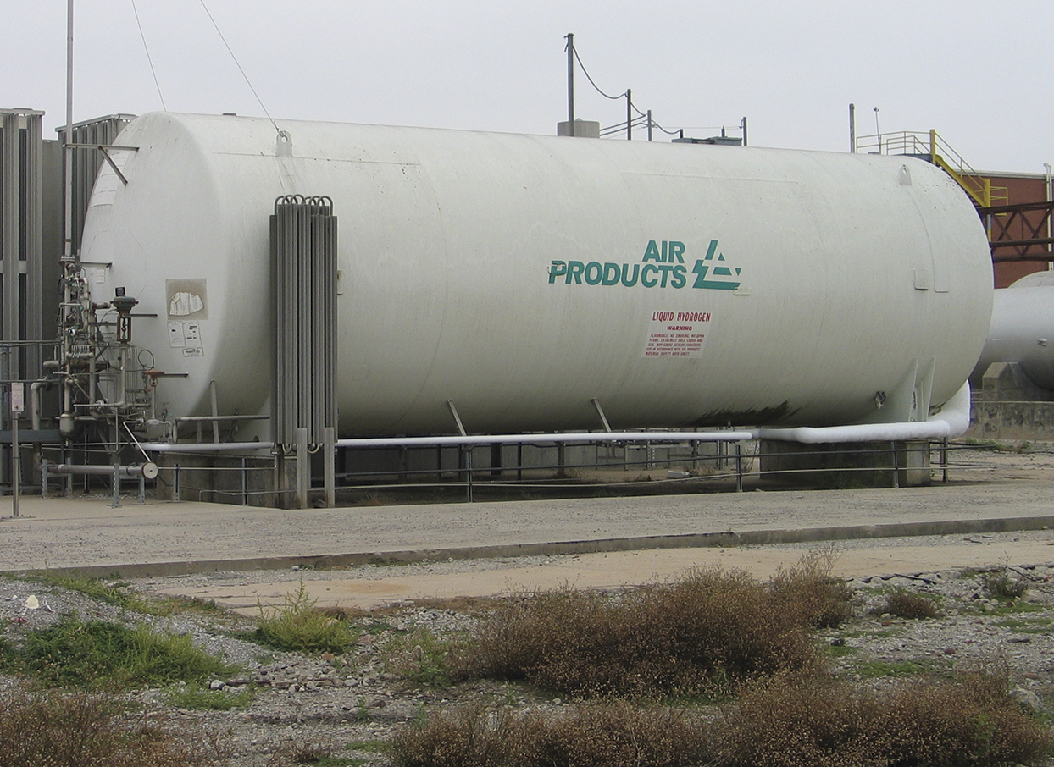
Inspectors need to know advantages of cryogenic fluids.
Ability to modify a material's liquid-to-gas volume ratio
Cryogenic cylinder of liquid oxygen can hold 12 times more gas than a pressurized cylinder of oxygen
Valuable because they are extremely cold
Courtesy of Rich Mahaney

Slide 43
Inspectors need to know the hazards associated with cryogenic fluids.
Inherent hazard of the particular gas, which may be intensified when it is in liquid form
High liquid-to-vapor ratio
Extremely low temperatures

Slide 44
WARNING
All cryogenic liquids (except oxygen) are either asphyxiants or toxic.

Slide 45
Cryogenic liquids and gases create a flammability hazard because they can burn or explode.
Hydrogen is very easily ignited and particularly hazardous
Pressure-relief device should be installed on every length of pipe between two shutoff valves
All pipes carrying cryogenic liquids must be designed so that they slope up from the container
If cryogenic liquids are trapped within a confining space such as a pipe or other container without adequate venting, the liquid will vaporize, expand, and cause a violent pressure explosion of the confining vessel

Slide 46
Know what materials pipes and fittings should be made of to handle cryogenic material.
Stainless steel
Aluminum
Copper
Monel® nickel-copper alloy

Slide 47
Know the physical dangers cryogenic materials can pose to inspectors.
Can inflict severe burns upon contact with exposed skin
Inhaling gases can severely damage the respiratory tract
Inspector must wear appropriate personal protective equipment (PPE)
When released into the atmosphere, they will refrigerate any moisture in the air and create a visible fog
Vapors can damage the eyes by causing the water in the eyes to freeze

Slide 48
REVIEW QUESTION
What hazards are associated with cryogenic liquids?

Slide 49
Inspectors need to be familiar with flammable solids and gases.
Flammable solids have an ignition temperature of less than 212ºF (100ºC)
According to the IFC, flammable solids are any solids other than explosives that are capable of causing a fire through the following actions
Friction
Absorption of moisture
Spontaneous chemical reaction
Retained heat
(Cont.)

Slide 50
Inspectors need to be familiar with flammable solids and gases.
Variety of materials are loosely categorized as flammable solids
Metal powders
Readily combustible solids that ignite by friction
Self-reactive materials that undergo a strong exothermic decomposition
Explosives that are wetted to suppress their explosive properties

Slide 51
Inspectors need to be familiar with spontaneously combustible materials.
Pyrophoric materials
Self-heating materials
Liquids, solids, or gaseous materials that, even in small quantities and without external ignition sources, can ignite within 5 minutes after coming into contact with air
Materials that have the potential to self-heat when they come in contact with air

Slide 52
Understand dangerous-when-wet materials.
When they come in contact with water, they are likely to become spontaneously flammable or produce flammable or toxic gas
Magnesium phosphide is an example of a dangerous-when-wet material
Must not be stored in locations or in a manner where they can become combustible or dangerous

Slide 53
Flammable solids that are metals require a Class D extinguisher nearby.
NFPA® 10, Standard for Portable Fire Extinguishers, includes requirements on extinguisher sizes and travel distances
Inspector should consult the SDS to determine the appropriate fire extinguishing agent according to the manufacturer’s specifications

Slide 54
Know flammable gases that can be compressed, liquefied compressed, or dissolved.
Ethane
Hydrogen
Isobutane
Propane

Slide 55
Know what conditions result in gases being classified as “flammable”.
Ignitable at atmospheric pressure when in a mixture of 13 percent or less by volume in air
Flammable range of at least 12 percent in air at atmospheric pressure, regardless of its lower limit

Slide 56
REVIEW QUESTION
What actions can make flammable solids capable of causing a fire?

Slide 57
Inspectors need to be familiar with organic peroxides.
Only exist as solids or liquids
Release energy in the form of heat
Present fire and reactivity hazards
Degree of the hazard depends on their classification
Used to introduce energy into chemical reactions so more useful compounds can be created

Slide 58
All organic peroxides have a limited shelf life.
Shelf life can be reduced if recommended temperature limits are not maintained
Once shelf life is reached, the material should be disposed of in accordance with the manufacturer’s recommendations
Expired organic peroxide can become unstable

Slide 59
Model fire codes assign hazard classes for organic peroxides.
The lower the Roman numeral classification, the greater the decomposition, reactivity, and burning rate hazards the organic peroxide presents

Slide 60
REVIEW QUESTION
Explain the hazard classifications of organic peroxides.

Slide 61
Know the characteristics of oxidizers and oxidizing gases.
Solid and liquid oxidizers and oxidizing gases do not burn
Oxidizer yields oxygen or other chemical compounds that promote or initiate combustion
If oxidizer is heated or contaminated, it can initiate a self-sustained reaction and can result in an explosion or violent decomposition
Unstable (reactive)
Water reactive
Toxic (in some cases)
They accelerate the rate of burning
Other oxidizers can be
Corrosive

Slide 62
Fire code-compliant storage and use of oxidizers is designed to separate them from incompatible hazardous materials.
Oxidizers should never have contact with any petroleum-based materials because the reaction will be immediate and violent

Slide 63
Understand the naming convention of oxidizers.
How it works
Hydrogen peroxide
Calcium hypochlorite
Potassium perchlorate
Ammonium nitrate
Perchloric acids
Ends in the letters ate or ite
If it begins with the letters per
Examples include

Slide 64
Know the hazard categories for solid and liquid oxidizers.
Based on ability to accelerate burning, rate of decomposition, and if their decomposition can ignite combustible (Class A) materials
The higher the Arabic numeral rating, the greater the hazard the solid or liquid oxidizer presents

Slide 65
Oxidizing gases can support and accelerate combustion more than air.
Can exist as compressed or liquefied gases
Cryogenic oxygen is commonly used for respiratory therapy and can be found in home health care liquid oxygen containers
Oxygen can be converted into an oxidizing cryogenic fluid

Slide 66
REVIEW QUESTION
What are the hazard categories of solid and liquid oxidizers based upon?

Slide 67
Inspectors need to understand pyrophorics.
Category of solid, liquid, or gaseous hazardous materials that are a significant physical hazard
Material is classified as pyrophoric when it autoignites in air at temperatures of 130°F (55°C) or less
Do not require an ignition source
Some are also water reactive
Because air contains moisture, pyrophorics ignite upon release in air
(Cont.)

Slide 68
Inspectors need to understand pyrophorics.
Commonly present other physical and health hazards
Some isotopes of plutonium and uranium are pyrophoric
Some pyrophoric gases and liquids exist
Most materials are solid metals
(Cont.)

Slide 69
Inspectors need to understand pyrophorics.
Model codes require automatic sprinkler protection in buildings housing pyrophoric materials
Requirements for pyrophoric gases are found in NFPA® 55 and NFPA® 318, Standard for the Protection of Semiconductor Fabrication Facilities
Model fire codes also reference Compressed Gas Association Standard G-13, Storage and Handling of Silane and Silane Mixtures

Slide 70
REVIEW QUESTION
Name some examples of pyrophoric materials.

Slide 71
Inspectors need to understand unstable (reactive) materials.
Solids, liquids, or gases that can react adversely due to changes in temperature, pressure, mechanical, thermal shock
Most oxidizers and organic peroxides are also classified as unstable (reactive) materials
Blowing agents that create foam plastics are commonly classified as unstable (reactive)
Can be found in the manufacturing of plastics, including expanded foams and urethane compounds
(Cont.)

Slide 72
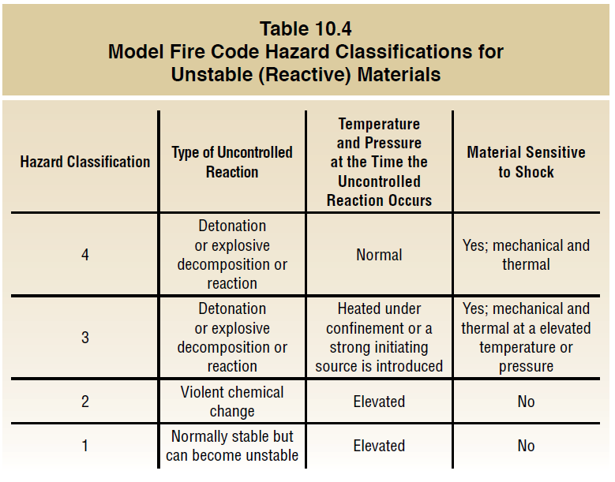
Inspectors need to understand unstable (reactive) materials.
Classified based on
How the reaction can be initiated by changes in temperature or pressure
Type of uncontrolled reaction they are capable of producing

Slide 73
REVIEW QUESTION
What do unstable materials react to?

Slide 74
Inspectors need to understand water-reactive materials.
Can react violently or explosively if in contact with moisture or water
Model fire codes regulate water-reactive solids and liquids
No water-reactive gases
Many pyrophoric metals are also water reactive

Slide 75
Inspectors need to understand explosives and blasting agents.
Capable of producing a sudden, violent expansion of gases that may be accompanied by a shock or pressure wave
Explosives exist in solid or liquid states
Explosives classification system in the IFC and NFPA® 495 is based on the UNDMGC and US DOT regulations
All explosive materials that meet the UNDMGC criteria are designated as Hazard Class 1 materials
Further categorized based on type of hazard they present

Slide 76
REVIEW QUESTION
List the states in which explosives and blasting agents exist.

Slide 77
Learning Objective 5
Explain the classification of health hazard materials.

Slide 78
Toxicity limits in model fire codes are lower than DOT and TC regulations.
Health hazard materials include items where a single brief exposure to the hazardous material can result in death, injury, or incapacitation
Under DOT and TC rules it is a toxic inhalation hazard (TIH)
This illustrates why a DOT label or placard cannot always be used as a basis for classifying hazardous materials in fire codes

Slide 79
Highly toxic and toxic materials are capable of producing serious illness or death once they enter the bloodstream.
It is imperative that inspectors become aware of the possible toxic effects of a material and ensure that they are wearing appropriate PPE

Slide 80
WARNING
During inspections of facilities where toxic materials are being manufactured, stored, or shipped, an inspector must have appropriate personal protective equipment (PPE) and training in its use when there is any possibility of being exposed to these products.

Slide 81
Inspectors need to be familiar with hazardous material toxicity data.
LD₅₀
LC₅₀
Refers to ingested dose of a given substance that was lethal to 50 percent or more of the test population when they swallowed or ate the substance
Refers to concentration in the air of a given substance that killed 50 percent or more of the test population when they inhaled or absorbed the vapors, fumes, or mists of the substance
(Cont.)

Slide 82
Inspectors need to be familiar with hazardous material toxicity data.
Resources
Sax’s Dangerous Properties of Industrial Materials
Highly Toxic materials include
Fluorine
Hydrogen cyanide
Methyl ethyl isocyanic acid
White phosphorus
Toxic materials include
Chlorine
Aniline
Sulfuric acid
Chromium trioxide
Registry of Toxic Effects of Chemical Substances (RTECS)

Slide 83
REVIEW QUESTION
How are highly toxic and toxic materials classified?

Slide 84
Corrosives exist in all three physical states.
Used in water and wastewater treatment; metal finishing; extraction and processing of minerals
Classification in model fire codes is assigned when the material causes irreversible alteration or visible destruction to human skin
At higher concentrations, corrosives are a health hazard because contact on skin or eyes can cause burns
Classification criteria used in fire codes is the same as the UNDMGC criteria
Material classified as corrosive by DOT or TC has the same classification in the fire codes
Courtesy of Scott Stookey, International Code Council, Washington, D.C

Slide 85
WARNING
Avoid contact with corrosives or corrosive spills. These materials rapidly dehydrate water from the skin while simultaneously reacting with proteins to inflict burns. Materials like sodium hydroxide attack and destroy proteins in the skin and are absorbed into the bloodstream, causing injury to the central nervous and circulatory systems.

Slide 86
REVIEW QUESTION
How are corrosives classified in fire codes?

Slide 87
A mixture is a substance that contains two or more materials that are not chemically combined.
Mixing chemicals can change their chemical and physical properties like their boiling or melting point
Can also change the hazard classification of a material
Mixing two chemicals can create a new compound with its own unique hazards

Slide 88
REVIEW QUESTION
How does mixing two or more materials impact hazard classification?

Slide 89
Inspectors need to know the characteristics of incompatible materials.
Definition
Heat
Fumes
Gases
Byproducts that are hazardous to life or property
Two materials that are mixed and cause a reaction
Reaction
Uncontrolled pressures in containers or tanks
Identifying incompatible storage
Knowing the hazard classification of the two materials
Reviewing each product’s SDS
Comparing reactivity information to determine chemical compatibility

Slide 90
Inspectors need to know what to do when incompatible storage is found.
Considered separated if
Separated by a distance of 20 feet (6 m) or more
One of the materials is stored in an approved storage cabinet, exhausted enclosure, or gas cabinet
Separated by a noncombustible line-of-sight barrier
Exemptions
Packages weighing less than 5 pounds (2.5 kg) or with a volume of 0.5 gallons (2 L) or less

Slide 91
REVIEW QUESTION
What is required to identify the appropriate storage classification of incompatible materials?

Slide 92
Learning Objective 6
Describe the code requirements for the marking of hazardous materials for identification by emergency responders.

Slide 93
Inspectors need to understand markings and resource guides.
Markings
SDSs
Placards and material numbering systems used by
DOT
Transport Canada (TC)
Mexican Secretariat for Communications and Transport (SCT)
International governing bodies
Other agencies
Assist in determining proper storage or handling procedures during inspections
Must be present where hazardous materials are stored, used, or transported
(Cont.)

Slide 94
Inspectors need to understand markings and resource guides.
Inspectors must be familiar with
UN classification system
DOT placard and markings system
Know how to use
Emergency Response Guidebook (ERG)
National Institute for Occupational Safety and Health (NIOSH) Pocket Guide to Chemical Hazards
Hazardous Materials Guide for First Responders from the U.S. Fire Academy (USFA)

Slide 95
Become familiar with safety data sheets (SDS).
Formerly known as material safety data sheet (MSDS)
Detailed information bulletin prepared by manufacturer or importer of a chemical to describe hazards
Inspectors can acquire an SDS from several sources
Used worldwide and must include the sixteen sections
May still see some SDSs that were developed to ANSI standards, OSHA standards, or Canadian standards

Slide 96
REVIEW QUESTION
List some of the resources inspectors must be familiar with and know how to use in order to identify hazardous materials.

Slide 97
Understand the history of transportation placards, labels, and markings.
Result of the North American Free Trade Agreement (NAFTA) of 1994 and other agreements
To help regulate movement of vehicles and materials, adopted the UN Recommendations regarding transportation placards, labels, and markings for identifying hazardous materials or dangerous goods
Majority of the placards, labels, and markings used to identify these materials are very similar in each country
These recommendations enhance safety
Trucks carrying products that include hazardous materials move freely among the U.S., Canada, and Mexico

Slide 98
The UN system enables an inspector to readily categorize hazardous materials based on the risks they pose.
Class 1
Class 2
Class 3
Class 4
Flammable and Combustible Liquids
Explosives
Gases
Flammable Solids, Spontaneously Combustible Materials, and Dangerous-When-Wet Materials
(Cont.)

Slide 99
The UN system enables an inspector to readily categorize hazardous materials based on the risks they pose.
Class 6
Class 7
Class 8
Class 9
Class 5
Oxidizers and Organic Peroxides
Poison (Toxic) and Poison Inhalation Hazard
Radioactive Materials
Corrosive Materials
Miscellaneous Dangerous Goods

Slide 100
Each class has a specific placard that indicates a material’s hazard class by number or name.
Number must be displayed in the lower corner of placards corresponding to the primary hazard class of a material

Slide 101
The UN also has a system used in conjunction with illustrated placards in the North America.
Each hazardous material is assigned a unique four-digit number
This number is often displayed on placards, labels, orange panels, and/or white diamonds
(Cont.)

Slide 102
The UN also has a system used in conjunction with illustrated placards in the North America.
On orange panels, letters “UN” may precede the number
Yellow-bordered pages section in the ERG provides a key to the four-digit identification numbers
Number also appears on shipping papers; should match the numbers displayed
Use the number and the ERG to determine appropriate response information
Courtesy of Rich Mahaney

Slide 103
Know which container packages in North America display UN numbers.
Rail tank cars
Cargo tank cars
Portable tank cars
Bulk packages
Vehicle containers containing large quantities (at least 8,820 lbs or 4 400 kg) of hazardous materials
Certain nonbulk packages (for example, poisonous gases in specified amounts)

Slide 104
DOT regulations address some additional categories of substances.
Other regulated materials (ORM-Ds)
Materials of trade (MOTs)
Fumigated loads

Slide 105
Understand why knowledge of DOT information is important.
Must record information about these substances during an evaluation of a facility or industrial location
Basic understanding of the UN system enables an inspector to quickly recognize most hazardous materials or dangerous goods
Knowledge of the standard systems used in the U.S. is important in order to accurately recognize these hazards

Slide 106
Inspectors need to be able to read DOT placards.
Description
Where they are seen
Rail tank cars
Cargo tank vehicles
Portable tanks
Unit loading devices containing hazardous materials over 640 cubic feet (18 m³) in capacity
Certain nonbulk containers
Diamond-shaped
Color-coded
Bulk packages

Slide 107
There are important facts to remember regarding placards.
Shippers required to provide placards
Drivers may not know what they are carrying
Exemptions
Shipments of infectious substances
ORM-Ds
MOTs
Limited quantities
Small-quantity packages
Radioactive materials
Combustible liquids in nonbulk packaging
(Cont.)

Slide 108
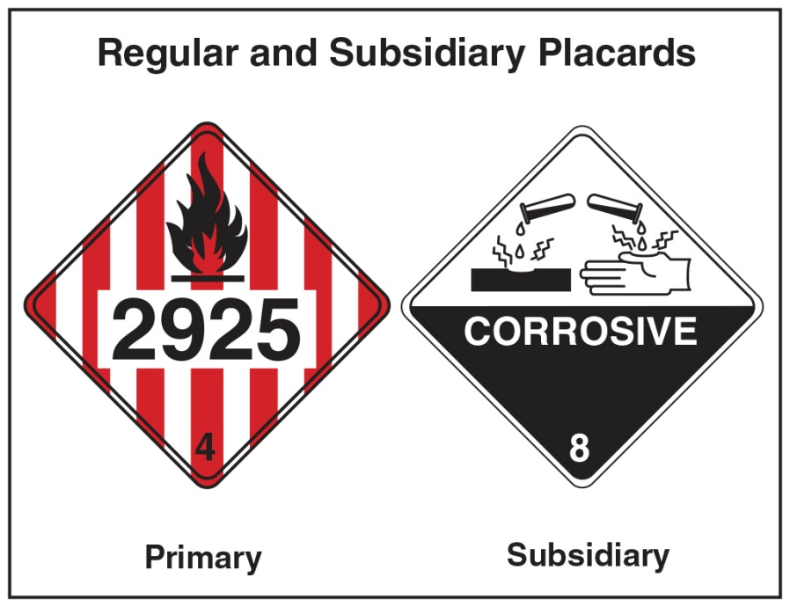
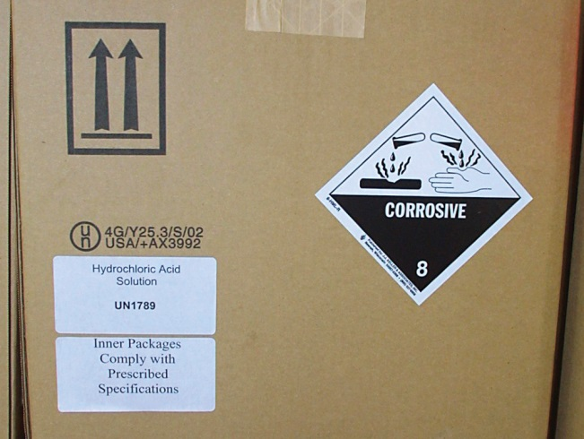
There are important facts to remember regarding placards.
Some private agriculture and military vehicles may not have placards
Other than the Class 7 or DANGEROUS placard, text indicating a hazard is not required; text may be omitted from the oxygen placard only if the specific ID number is displayed
Hazard class or division number corresponding to the primary or subsidiary hazard class of a material must be displayed in the lower corner of a placard

Slide 109
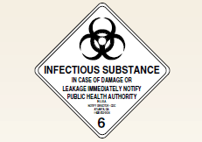
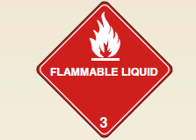
Inspectors need to be able to read DOT labels.
Description
Packaging contains a primary label for materials that meet the definition of more than one hazard class
Printed matter on 3.9-inch (100 mm), square-on-point diamond
May or may not have written text
Communicates hazards posed by the material
Each class is assigned a pictogram as well as a division number
Provide information similar to vehicle placards
(Cont.)

Slide 110
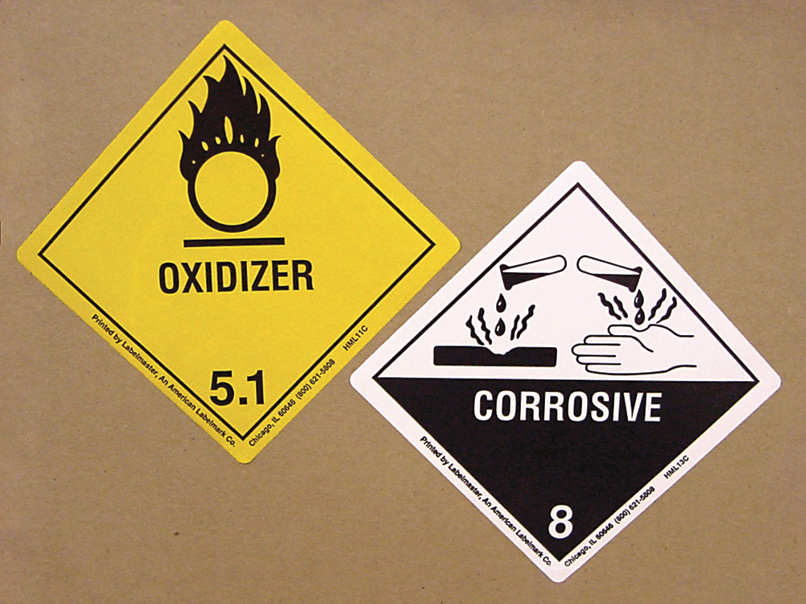
Inspectors need to be able to read DOT labels.
Where they are seen
Subsidiary labels
Nonbulk packaging such as drums, boxes, bags, and other small containers
Package may have several labels placed side by side, with primary hazard label located on the left and secondary or subsidiary class label on the right
DOT regulations require they display class numbers

Slide 111
Inspectors need to be able to read DOT markings.
Description
Descriptive name
Identification number
Weight
Instructions, cautions, or UN marks
Required on outer packaging
Inspector duties
Pay attention in receiving areas to verify items are marked, stored correctly
Verify exterior markings on structures are current and reflect the hazards present

Slide 112
REVIEW QUESTION
Compare and contrast DOT placards, labels, and markings.

Slide 113
Be familiar with OSHA identification requirements for the workplace.
OSHA’s Hazard Communications Standard (HCS) requires employers to identify hazards in the workplace; train employees how to recognize them
Requires employers to certify that all hazardous material containers are labeled, tagged, or marked correctly
Does not specify what identification system to use
Emergency responders and inspectors may encounter a variety of different labeling and marking systems

Slide 114
Be familiar with other identification marking requirements.
Chemical manufacturers and importers
Manufacturer’s contact information
Precautionary hazard warnings
Directions for use and handling
Names of active ingredients
First aid instructions
Other pertinent information
Required under OSHA HCS to provide appropriate labels on their product containers
Name of the product
(Cont.)

Slide 115
Be familiar with other identification marking requirements.
Military services (U.S. and Canada)
Pipeline companies
NFPA® 704 System
Provide own marking systems for hazardous materials and chemicals in addition to DOT and TC markings on transports
Must provide markers where pipelines cross under (or over) roads, railroads, and waterways
Provides number ratings for rapidly identifying the presence of hazardous materials and their potential severity based on health, flammability, instability, and related hazards

Slide 116
Know the requirements for manufacturers’ warnings.
CAUTION
DANGER
POISON
May have minor health effects
Moderate hazards that have significant health effects or flammability
Highest degree of hazard
Use in addition to DANGER on labels of highly toxic materials
WARNING
Used on products that explode when exposed to heat

Slide 117
Know how to recognize military markings.
Used on fixed facilities
May also be on military vehicles (although not required)
Not necessarily uniform
Some buildings and areas that store hazardous materials may not be marked due to security reasons

Slide 118
CAUTION
The military ships some hazardous materials and chemicals by common carrier. In these instances, materials are not required to be marked with U.S. Department of Transportation (DOT) or Transport Canada (TC) markings.

Slide 119
Know how to recognize pipeline markings.
Markers must be in sufficient numbers along a pipeline to identify pipe’s location
Do not always mark exact pipeline location
In the U.S. and Canada include the signal words CAUTION, WARNING, or DANGER
Contain information describing transported commodity and the name and emergency telephone number of the carrier

Slide 120
Inspectors need to understand the NFPA® 704 system.
Provides widely recognized method for indicating the presence of hazardous materials at commercial, manufacturing, institutional, and other fixed-storage facilities
Commonly required by local ordinances for all occupancies that contain hazardous materials
Designed to alert emergency responders to health, flammability, instability, and related hazards

Slide 121
Know what the NFPA® 704 system does NOT cover.
Transportation
Nonemergency occupational exposures
Explosives and blasting agents
Etiologic agents and other similar hazards
General public use
Chronic health hazards

Slide 122
The NFPA® 704 system uses a rating system of numbers from 0 to 4.
Number 0 indicates a minimal hazard
Rating is assigned to three categories: health, flammability, and instability
Number 4 indicates a severe hazard

Slide 123
Know how to read NFPA® 704 system markings.
(Cont.)

Slide 124
Know how to read NFPA® 704 system markings.
Special hazards are located in the six o’clock position and have no specified background color; however, white is most commonly used
Only two special-hazard symbols are presently authorized for use in this position by NFPA®
Inspectors may see other symbols in the white quadrant on old placards, including the trefoil radiation symbol
If more than one special hazard is present, multiple symbols may be seen

Slide 125
REVIEW QUESTION
What are some of the other types of markings inspectors might encounter?

Slide 126
Several references are widely used to identify hazardous materials.
Emergency Response Guidebook (ERG)
NIOSH Pocket Guide to Chemical Hazards (NPG)
Hazardous Materials Guide for First Responders from the U.S. Fire Administration
Hazardous Materials Information Resource System (HMIRS) is available for inspectors who deal with U.S. government facilities

Slide 127
The ERG is primarily a guide to aid emergency responders.
Developed jointly by TC, DOT, and Secretaría de Comunicaciones y Transportes (SCT) of Mexico
Used to quickly identify thazards of materials involved in an emergency incident
Knowledge helps protect them and the general public
Useful resource for inspectors

Slide 128
NOTE
The ERG does not address all circumstances that may be associated with hazardous materials/dangerous goods. It is primarily designed for use at hazardous materials/dangerous goods incidents occurring on highways or railroads.

Slide 129
Inspectors can use the ERG in several ways.
Identify four-digit UN identification number on a placard or on shipping papers and then find the appropriate guide in the yellow-bordered pages of the guidebook
Find the name of the material involved (if known) in the blue-bordered pages section of the guidebook
Use three-digit guide code associated with the placard in the Table of Placards and Initial Response Guide to Use On-Scene located in the front of the ERG

Slide 130
The NPG is a reference source of general industrial hygiene information.
Provides key information and data in abbreviated or tabular form for over 600 chemicals or groups of chemicals
Can provide a quick reference for inspectors
Designed for occupational safety personnel, employers, and employees
(Cont.)

Slide 131
The NPG is a reference source of general industrial hygiene information.
Chemical names, synonyms, trade names, conversion factors, Chemical Abstract Service (CAS) number, Registry of Toxic Effects of Chemical Substances® (RTECS®), and DOT numbers
NIOSH recommended exposure limits (RELs)
OSHA permissible exposure limits (PELs)
NIOSH immediately dangerous to life or health (IDLH) values
(Cont.)

Slide 132
The NPG is a reference source of general industrial hygiene information.
Physical description of the agent with chemical and physical properties
Measurement methods
Personal protection and sanitation recommendations
Respirator recommendations
Information on health hazards including route, symptoms, first aid, and target organ information

Slide 133
Be familiar with the Hazardous Materials Guide for First Responders.
Section 1
Section 2
Section 3
Indexes; Alphabetical Material Name Index and a UN/NA Number Index
Specific Material Guides: specific recommendations for 430 commonly encountered materials
Materials Summary Response Table; summary information for 1,422 less commonly encountered materials
(Cont.)

Slide 134
Be familiar with the Hazardous Materials Guide for First Responders.
Section 4
Section 5
Section 6
Section 7
DOT Placards; Chart 10
Silhouettes of Rail Cars, Tank Trucks, and Chemical Tanks
General Approach to a Hazardous Materials Incident
Glossary of Terms and Abbreviations

Slide 135
Inspectors should be familiar with the HMIRS.
U.S. Department of Defense (DoD) automated system the Defense Logistics Agency developed
Central repository for SDSs for U.S. Government military services and civil agencies
Contains other valuable information including hazard communications (HAZCOM) warning labels and transportation information
Includes data for hazardous materials that the federal government purchased through the DoD and civilian agencies

Slide 136
REVIEW QUESTION
List some of the references used to identify hazardous materials.

Slide 137
Inspectors should be familiar with the Canadian Dangerous Goods System.
Federal or provincial government regulates a number of products designated as dangerous goods
Municipal inspectors are not normally empowered to enforce these regulations
Be aware of and familiar with other regulations to avoid conflicts between federal, provincial, and local laws
Be prepared to notify the proper agency to address a hazard or dangerous commodity when they encounter one

Slide 138
NOTE
Inspectors can obtain federal and provincial legislation from government web sites. Federal legislation can be found at the Department of Justice Canada web site. The provincial Queen’s Printer web site usually contains provincial legislation.

Slide 139
Inspectors should be familiar with WHMIS.
Workplace Hazardous Materials Information System (WHMIS)
Designed to reduce the risk from hazardous products in the workplace
Health Canada and provincial agencies administer WHMIS
Provincial agency responsible for occupational health and safety (OHS) normally regulates WHMIS within each province
Inspectors may not have authority to apply these regulations on their own
WHMIS is applicable to federal government employees

Slide 140
Inspectors should be familiar with WHMIS requirements for employers.
Controlled products used, stored, handled, or disposed of in the workplace are properly labeled
SDS are readily available to workers
Workers receive education and training in the safe storage, handling, usage, and disposal of controlled products in the workplace

Slide 141
Be familiar with what WHMIS considers a controlled product.
Burn readily
Explode
Produce toxic reactions, allergies, infectious diseases, or dangerous reactions

Slide 142
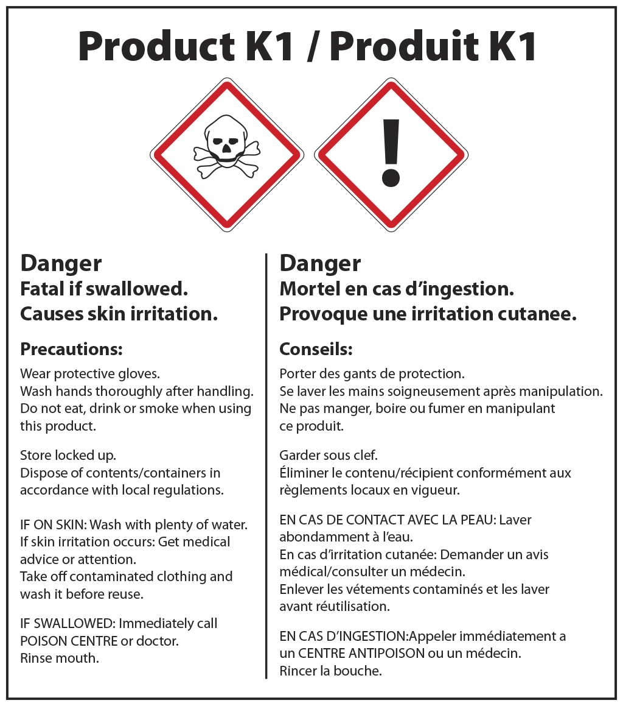
Inspectors need to be familiar with other WHMIS characteristics.
Requires all containers holding a controlled product to display a WHMIS label
When moved to another unmarked container for use at a worksite, new container must be labeled with a Workplace Label
Suppliers of controlled products must label all containers with a Supplier Label
Critical component of WHMIS is that an SDS must be available on site for each controlled product

Slide 143
NOTE
The Workplace Label does not require the distinctive crosshatch border that is required on the Supplier Label.

Slide 144
Inspectors need to be familiar with WHMIS labels.
Supplier Label
Hazard symbols
Statement that an MSDS/SDS is available
Must show all text in English and French
Have a WHMIS-hatched border
Product identifier
Supplier identifier
Statement that an MSDS/SDS is available
Risk phrases
Precautionary measures
First aid measures
Workplace Label
Product identifier
Information on safe handling

Slide 145
REVIEW QUESTION
Why is it important for inspectors to be aware of different aspects of the Canadian Dangerous Goods System?

Slide 146
Inspectors need to be familiar with the Mexican Hazard Communication System.
Normas Oficiales Mexicanas (NOMs) augment the Mexican Regulation for the Land Transport of Hazardous Materials and Wastes
Mexican SCT is responsible for publishing and maintaining the NOMs
Mexico’s equivalent to the Hazard Communication Standard (HCS) is NOM-018-STPS-2000
Requires employers to see that hazardous chemical substances in the workplace are labeled
Essentially an adoption of the NFPA® 704 marking system and HMIG
Remember that employers in Mexico may use any alternative system that complies with the objectives of the standard
(Cont.)

Slide 147
Inspectors need to be familiar with the Mexican Hazard Communication System.
NOM-026-STPS-1998 authorizes the use of some International Organization for Standardization (ISO) safety symbols from ISO-3864
General caution symbols in Mexico are triangular rather than round like those in Canada or rectangular as in the U.S.
(Cont.)

Slide 148
Inspectors need to be familiar with the Mexican Hazard Communication System.
Transportation placards, labels, and markings are based on the UN Recommendations
Placards and labels in Mexico will have text in Spanish
Information provided on markings will also be written in Spanish
Uses same hazard classes and divisions

Slide 149
Inspectors need to be familiar with a few Spanish hazard warnings.
Peligro (danger)
Gases Flamables (flammable gas)
Radioactivo (radioactive)
Liquido Criogenico (cryogenic liquid)

Slide 150
Know some of the differences between Mexican transportation regulations and U.S. HMR.
Official Mexican regulations do not authorize the use of DANGEROUS placards
Package markings are consistent except that the proper shipping name is provided in Spanish in addition to English
HOT mark used for elevated temperature in the U.S. is not authorized in Mexico
Mexican standard regarding the classification of flammable liquids does not incorporate provisions for combustible liquids; combustible liquid requirements only apply in the U.S.

Slide 151
REVIEW QUESTION
What are some of the differences between markings in the Mexican Hazard Communication System and those found in the U.S. and Canada?

Slide 152
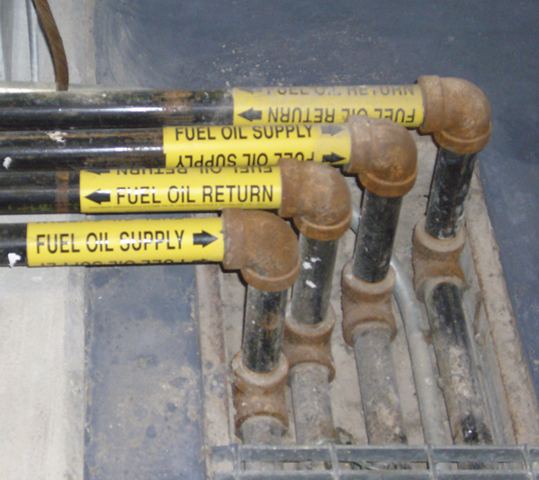
Inspectors should understand piping identifications.
Model fire codes require identification of the piping that conveys hazardous materials
Enables plant personnel to trace piping in event of a leak or a spill
Labels are required at
Maximum spacing of 25 feet (7.5 m)
Each change of piping direction
Both sides of floor or ceiling penetrations
Pipe labels must identify contents and direction of flow
Courtesy of Scott Stookey, International Code Council, Washington, D.C

Slide 153
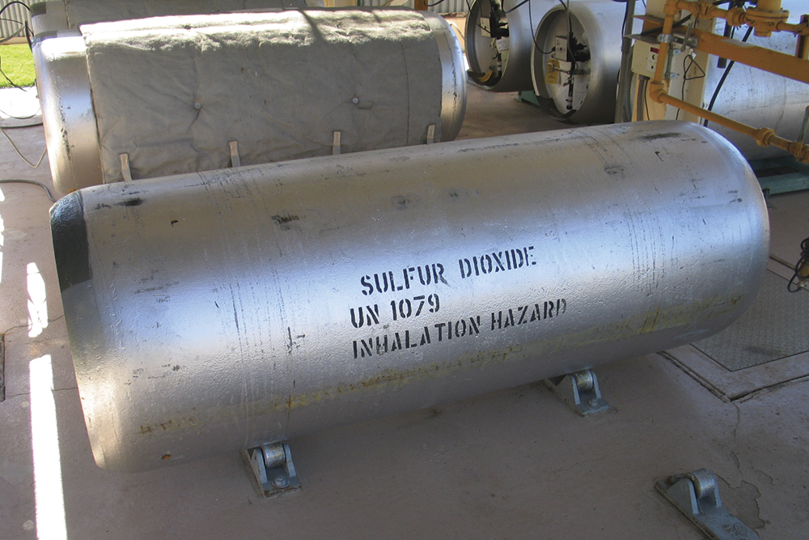
Inspectors should understand cylinder markings.
Cylinder color does not indicate which gas it may store
Only way to identify cylinder’s contents is by labeling or marking the cylinder
Require markings in accordance with Compressed Gas Association (CGA) Standard C-7
C-7 requires the marking contain several items
Labels located on shoulder or wall of the cylinder
If compressed gas is inhalation hazard, warning statements about this hazard are required
Courtesy of Ron Moore, McKinney (TX) Fire Department

Slide 154
REVIEW QUESTION
Describe the requirements for marking piping and cylinders.

Slide 155
Learning Objective 7
Describe code considerations for determining the permissible amount of hazardous materials within a building.

Slide 156
Know the three possible storage situations for hazardous materials.
Storage
Use — Closed system
Use — Open system

Slide 157
Inspectors need to know the definition of storage.
Material in a package that is static and not moving is defined as storage
Hazardous materials storage can present its own hazards
Loss of container integrity will result in release of a hazardous material
Containers of compressed gases and cryogenic fluids contain materials that are stored at high pressures and create stored kinetic energy
Courtesy of Scott Stookey, International Code Council, Washington, D.C

Slide 158
When a hazardous material is moved from its original container, it is use.
Use-closed system
Does not allow for release of hazardous particulates or vapor
Courtesy of Scott Stookey, International Code Council, Washington, D.C
(Cont.)

Slide 159
When a hazardous material is moved from its original container, it is use.
Use-open systems
Vapors or dusts are liberated to the atmosphere
Much higher potential for unintended consequences
Include liquids dispensed from a container or intermediate bulk containers
Courtesy of Scott Stookey, International Code Council, Washington, D.C

Slide 160
Model fire codes set limits for the amount of hazardous materials allowed inside a building.
Maximum allowable quantity (MAQ) definition
Determinations
Building’s occupancy classification
Material’s physical state
Material’s situation
Classification of the hazardous material
MAQ per control area is the largest amount of a particular class of hazardous materials permitted inside a building without changing the occupancy to a High Hazard use

Slide 161
Know what a code official must have to determine the MAQ of an occupancy.
Material hazard classification
Physical state
Amount of material that is in storage and use

Slide 162
Understand the importance of the footnotes in the MAQ tables.
When the MAQ is exceeded, the tables in the model fire codes will stipulate the Hazardous (High Hazard) occupancy classification that is required
Establish certain requirements or conditions that allow an increase of hazardous materials inside buildings without requiring a change of occupancy
Set forth limitations or prohibitions for certain classes of hazardous materials

Slide 163
Know requirements for materials isolated by noncombustible enclosures.
Most buildings are not protected by automatic sprinkler systems
These enclosures offer increased resistance to fire
Model fire codes allow an MAQ increase when materials are isolated by noncombustible enclosures

Slide 164
Adding individual protection features can safely increase the MAQ.
In the case of a fire in a sprinklered building, it is expected that the sprinkler system will control the fire
Courtesy of Scott Stookey, International Code Council, Washington, D.C

Slide 165
Know which materials are too high risk to be allowed in unprotected buildings.
Class 4 Oxidizers
Detonable Unstable (Reactive) materials
Explosives (excluding Division 1.4G consumer fireworks)
Pyrophoric materials

Slide 166
Most standards have specific sprinkler design requirements for hazmat.
Review their adopted fire code
Most NFPA® standards governing hazardous materials have requirements that exceed the minimum requirements in NFPA® 13
Verify that the required discharge density and design area is selected
Courtesy of Scott Stookey, International Code Council, Washington, D.C

Slide 167
REVIEW QUESTION
What must a code official have to determine the MAQ?

Slide 168
A control area is a physical boundary inside a building where hazmat can be stored.
Used as long as the MAQ is not exceeded
For the purposes of applying hazardous material regulations, all buildings are considered a single control area
Area bounded by the floor
Exterior walls
Roof of a building
Areas of a building separated by fire-resistant rated construction
Number of control areas inside a building and their MAQ is influenced by building’s occupancy
Control areas can be

Slide 169
Know the characteristics of control areas.
Model codes have established MAQs based on the loss history of certain hazardous materials in certain occupancies
MAQs are also based on concerns for occupant and firefighter safety
Construction requirements for control areas are in the jurisdiction’s adopted building code
Requirements for control areas are deferred to the building code

Slide 170
REVIEW QUESTION
Describe examples of control areas.

Slide 171
Learning Objective 8
Explain the requirements for storage and use of nonbulk and bulk packaging.

Slide 172
Inspectors need to know the two DOT and TC categories of packaging for hazmat.
Nonbulk
Bulk

Slide 173
Inspectors need to know the IFC categories of packaging for hazmat.
Containers
Cylinders
Portable containers
Stationary tanks

Slide 174
Know the characteristics of nonbulk packaging.
Designed to hold:
119 gallons (475 L) or less of liquids
882 pounds (440 kg) or less of solids
Compressed gas cylinders with a water capacity of 1,000 pounds (500 kg) or less
(Cont.)

Slide 175
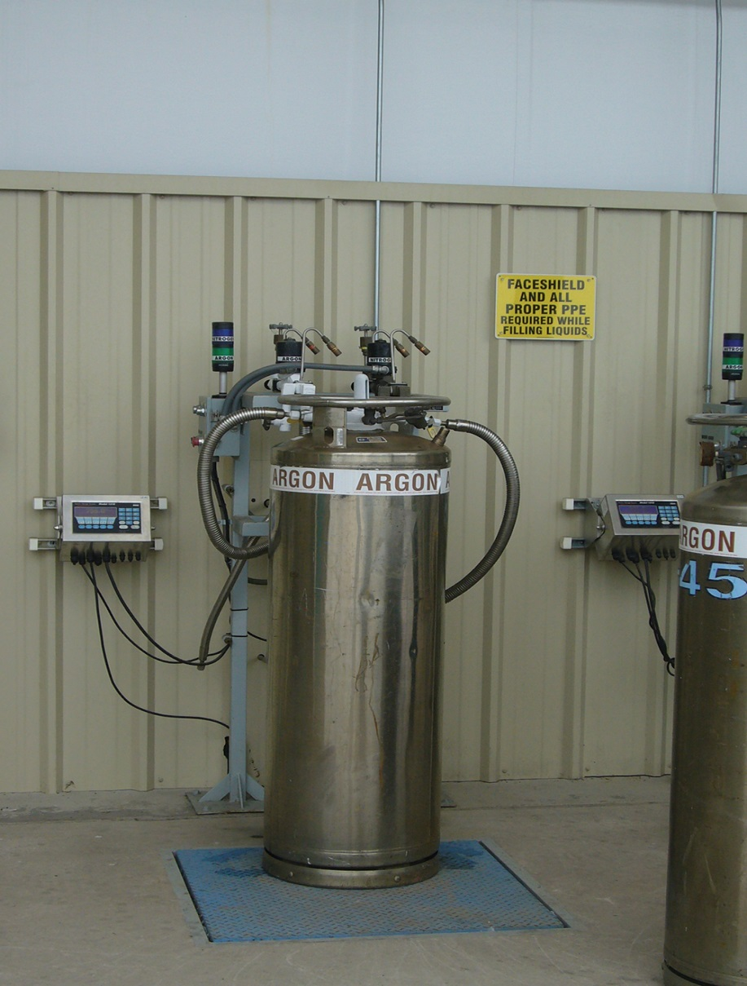
Know the characteristics of nonbulk packaging.
Water capacity (w.c.) is the accepted measurement of the available volume of compressed gas cylinders
Reason for expressing available volume in this manner is that gases have different densities based on their molecular weight
Gas cylinders are generally filled by weight
Cylinder’s empty (termed tare) weight is combined with the density of the packaged gas to prevent overfilling of cylinders
(Cont.)

Slide 176
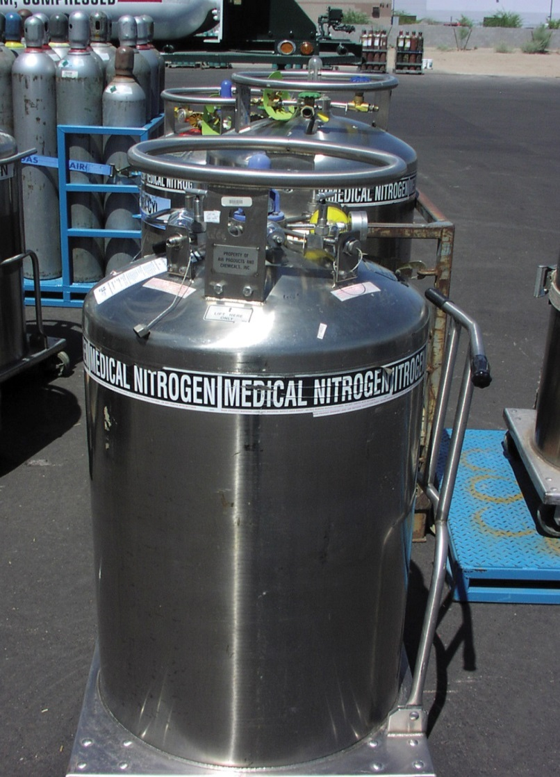
Know the characteristics of nonbulk packaging.
Nonbulk packages containing liquefied compressed gases, cryogenic fluids, or liquids with a high vapor pressure must contain a means of venting
Vented products cannot create a flammable mixture in air or a poisonous or asphyxiating atmosphere
Same for flammable liquids stored in portable tanks
Courtesy of Scott Stookey, International Code Council, Washington, D.C

Slide 177
Code requirements for containers address packaging of flammable and combustible liquids.
NFPA® 30 has specific limits
Additional requirements for containers and their construction are also established based on the building’s occupancy
All model fire codes exempt liquid fuels stored in motor vehicle fuel tanks from regulation; storage of distilled spirits in containers if their volume does not exceed certain limits

Slide 178
Safety cans are the safest containers approved for storing small amounts.
Inspector most often encounters flammable or combustible liquids stored in containers that are a maximum of 5 gallons (20 L) or less in size
Constructed to reduce the chance of leakage or container failure
Designed to virtually eliminate vapor release from the container under normal conditions
Uses self-closing lids with vapor seals
Self-closing lid also acts as a pressure-relief device when the can is heated

Slide 179
Know the characteristics of intermediate bulk containers (IBCs).
Also known as totes
Designed for volumes between 119 to 793 gallons (475 L to 3 150 L)
Common form of DOT authorized nonbulk packaging for liquids or solids
Made of carbon or stainless steel, aluminum, high-density polyethylene, or multiple-layer fiberboard and plastic
(Cont.)

Slide 180
Know the characteristics of intermediate bulk containers (IBCs).
Multiple-layer fiberboard IBCs, only allowed for single trips
Rigid plastic IBCs cannot be used for storage and dispensing of Class I flammable liquids
All others are subject to requalification every 30 months
(Cont.)

Slide 181
Know the characteristics of intermediate bulk containers (IBCs).
Designed for gravity dispensing
For the remaining classes of flammable and combustible liquids an automatic-closing valve is provided
Require a means of pressure relief
Design is based on the classification of the stored hazardous material
NFPA® 30 has specific requirements for the design of pressure relief devices installed on IBCs for flammable and combustible liquids
Generally required to have a means of spill control; this method is not allowed for Class I-A flammable liquids and Highly Toxic liquids
(Cont.)

Slide 182
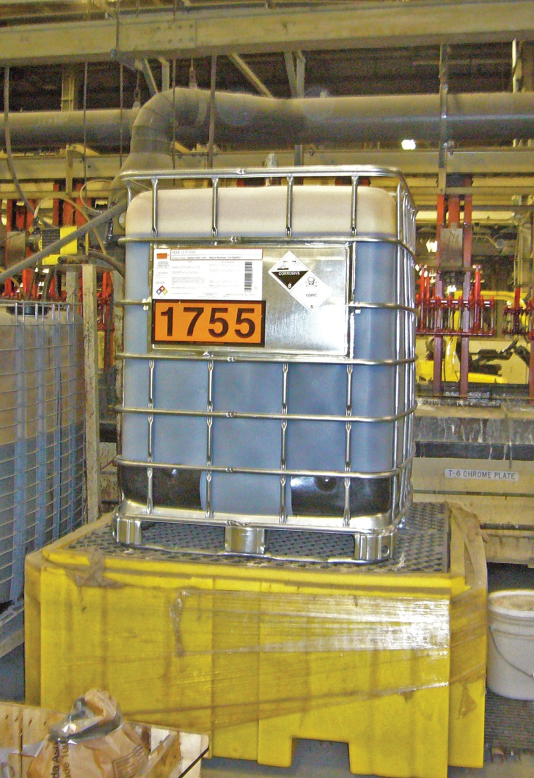
Know the characteristics of intermediate bulk containers (IBCs).
Inspectors duties
Storage of certain liquids will automatically change the building to a High-Hazard or Hazardous occupancy
Be aware of IBCs inside buildings
Courtesy of Scott Stookey, International Code Council, Washington, D.C

Slide 183
Inspectors need to be familiar with the characteristics of cylinders.
Compressed gas container is a pressure containment vessel
Container must be properly engineered to safely store and dispense the gas based on its physical or health hazards
Compressed gas cylinders are designed and constructed in accordance with US DOT requirements and approved standards
Unless disposable, compressed gas containers are subject to periodic testing and examination
Stationary pressure vessels must be constructed in accordance with the Boiler and Pressure Vessel Code (BPVC) requirements for unfired pressure vessels
(Cont.)

Slide 184
Inspectors need to be familiar with the characteristics of cylinders.
Size of a cylinder or container is limited
Cylinders, containers, and tanks always have a circular cross-sectional area
Not constructed using other geometric shapes because of the imposed forces in the corners of rectangular-shaped containers
Designed to operate at pressures above 25 PSIG
Volume of gas that can be stored is directly proportional to the density of the gas molecules
(Cont.)

Slide 185
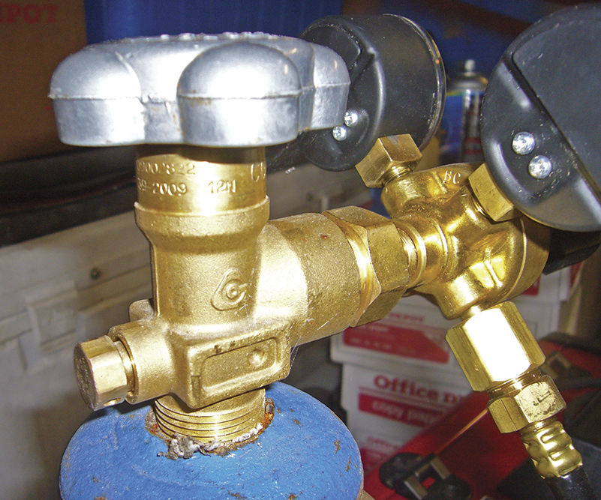
Inspectors need to be familiar with the characteristics of cylinders.
Proper storage and use of compressed gas containers is dependent on the material contained within, construction, and intended use
Cylinders are designed for either a vertical or horizontal orientation
Almost all compressed gas containers are equipped with a pressure relief device
Valve fittings are manufactured with unique, material-specific connections
Cylinders require markings
Courtesy of Scott Stookey, International Code Council, Washington, D.C

Slide 186
REVIEW QUESTION
List examples of containers used for nonbulk and bulk packaging.

Slide 187
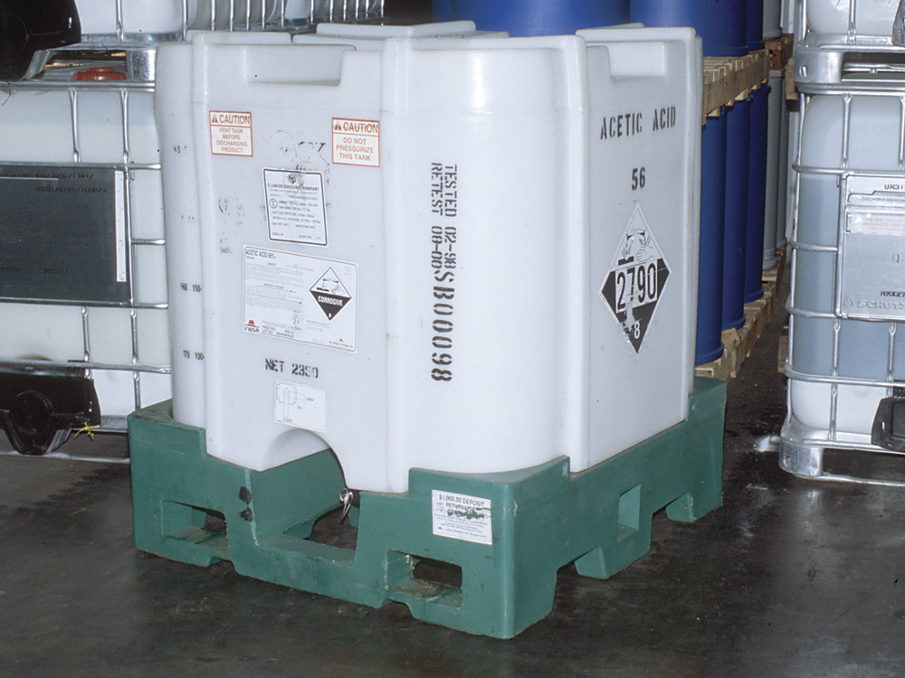
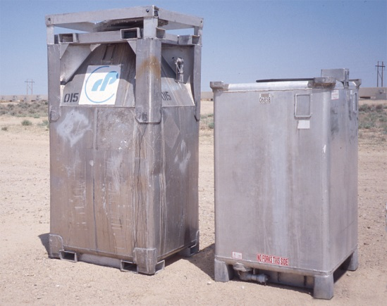
Inspectors need to know the characteristics of bulk packaging.
Refers to a packaging, other than that on a ship or barge, in which materials are loaded with no intermediate form of containment
Includes a transport vehicle or freight container such as a cargo tank, railcar, or portable tank
Also includes stationary tanks
Courtesy of Rich Mahaney

Slide 188
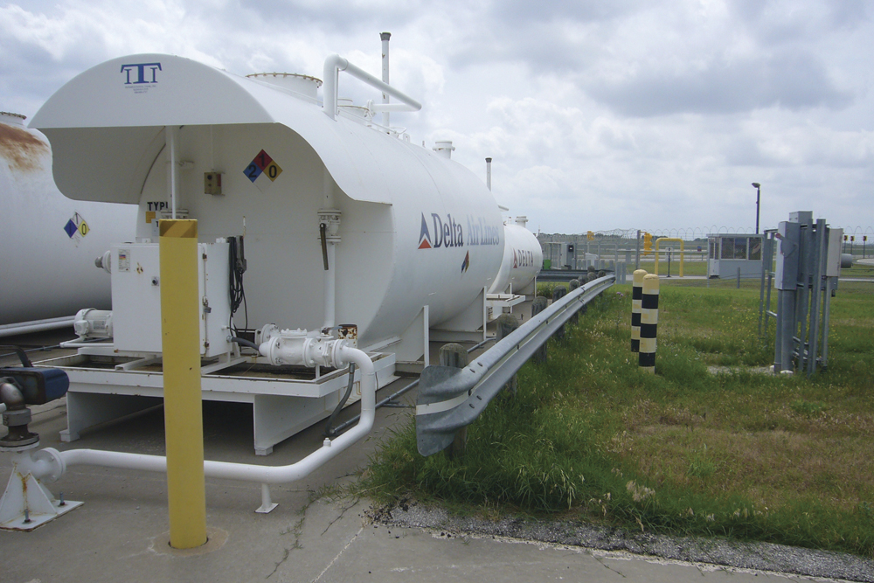
Inspectors need to know the characteristics of stationary tanks.
Stationary tanks used to store hazardous materials are permanently installed underground or aboveground
Depending on design, stationary tanks are listed by a nationally recognized testing laboratory or must be approved by the fire official
Most common stationary tanks are used for storing flammable and combustible liquids
Either shop fabricated or field erected
Courtesy of Scott Stookey, International Code Council, Washington, D.C
(Cont.)

Slide 189
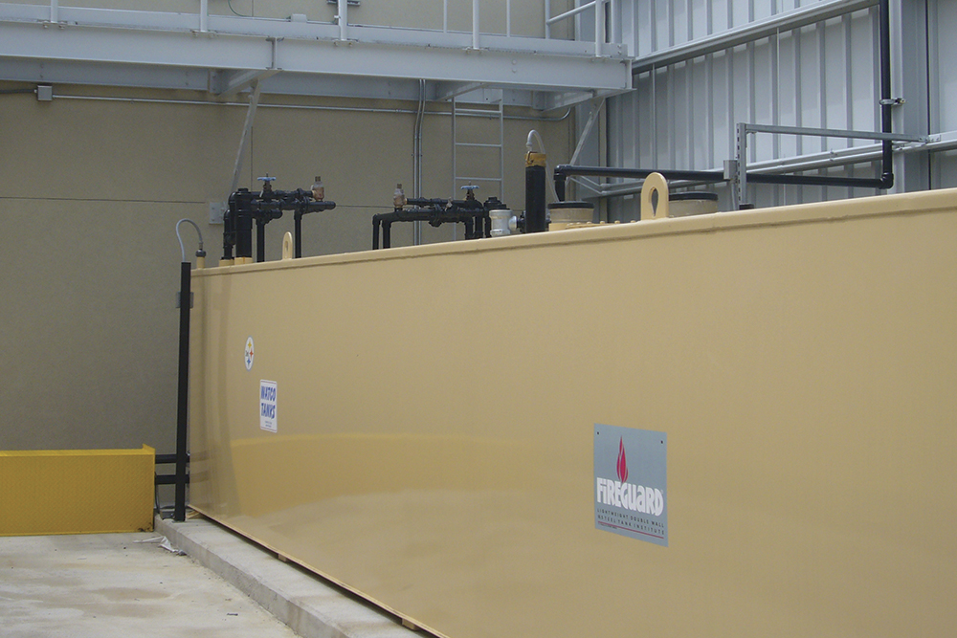
Inspectors need to know the characteristics of stationary tanks.
Shop-fabricated tanks
All underground storage tanks and most aboveground storage tanks are shop-fabricated tanks
Model fire codes require shop-fabricated tanks for storing flammable and combustible liquids to be listed
Assembled from metallic or nonmetallic materials, tested, factory certified, and shipped to the installer
Courtesy of Scott Stookey, International Code Council, Washington, D.C
(Cont.)

Slide 190
Inspectors need to know the characteristics of stationary tanks.
Field-erected tanks
Engineered specifically for the product they will store and for the site conditions
Not limited in diameter or height
Always installed aboveground and are usually approved by the fire official
Very common for tanks to hold ten to hundreds of millions of gallons (liters) of product
Commonly found in refineries and petroleum terminals and other places
(Cont.)

Slide 191
Inspectors need to know the characteristics of stationary tanks.
Stationary tanks are also categorized by their design pressure
The applicable engineering standard used as the basis for design and approval governs its design pressure
Standards prohibit installing an underground storage tank aboveground and aboveground storage tanks being installed underground
(Cont.)

Slide 192
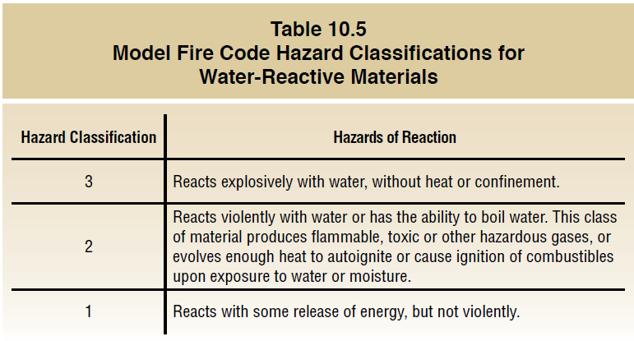
Inspectors need to know the characteristics of stationary tanks.

Slide 193
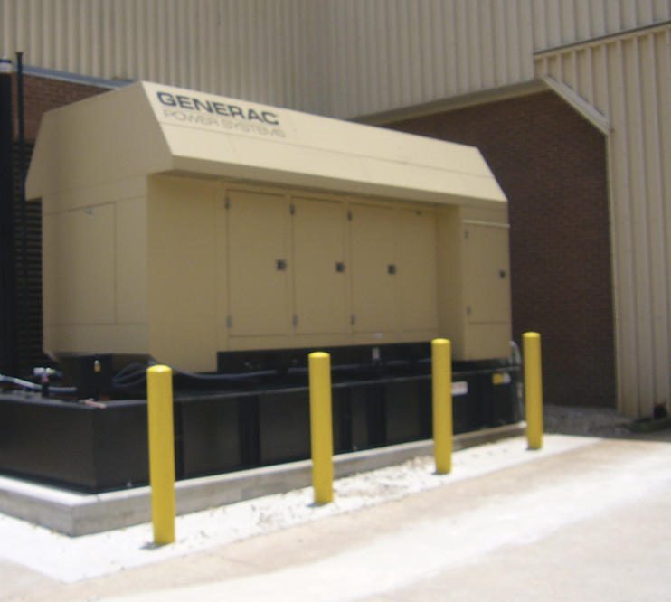
Inspectors need to know the characteristics of shop-fabricated aboveground tanks.
Inspectors commonly encounter atmospheric aboveground storage tanks (ASTs)
ASTs can range in volume from 60 to 60,000 gallons (240 L to 240 000 L)
Variety of installations use ASTs
ASTs for flammable and combustible liquids are required by NFPA® 30 and the IFC to be listed
Standard considered universal by tank manufacturers and AHJs is UL 142
Courtesy of Scott Stookey, International Code Council, Washington, D.C
(Cont.)

Slide 194
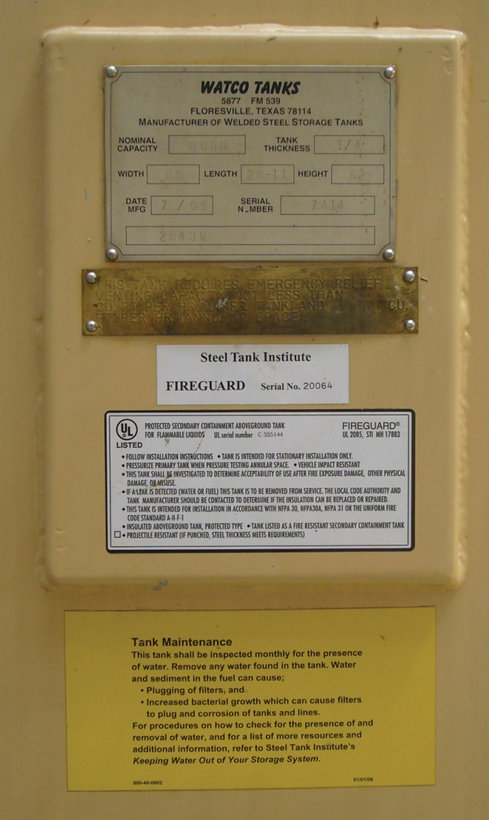
Inspectors need to know the characteristics of shop-fabricated aboveground tanks.
UL 142 nameplates
Indicates application that the tank is designed for
Stipulates required flow rate for tanks equipped with emergency vents
UL 142 construction requirements
Requires any shop-fabricated AST storing flammable or combustible liquids have a permanent nameplate
Indicates standard the tank was constructed to
Carbon or stainless steel
Aluminum is not allowed
Courtesy of Scott Stookey, International Code Council, Washington, D.C
(Cont.)

Slide 195
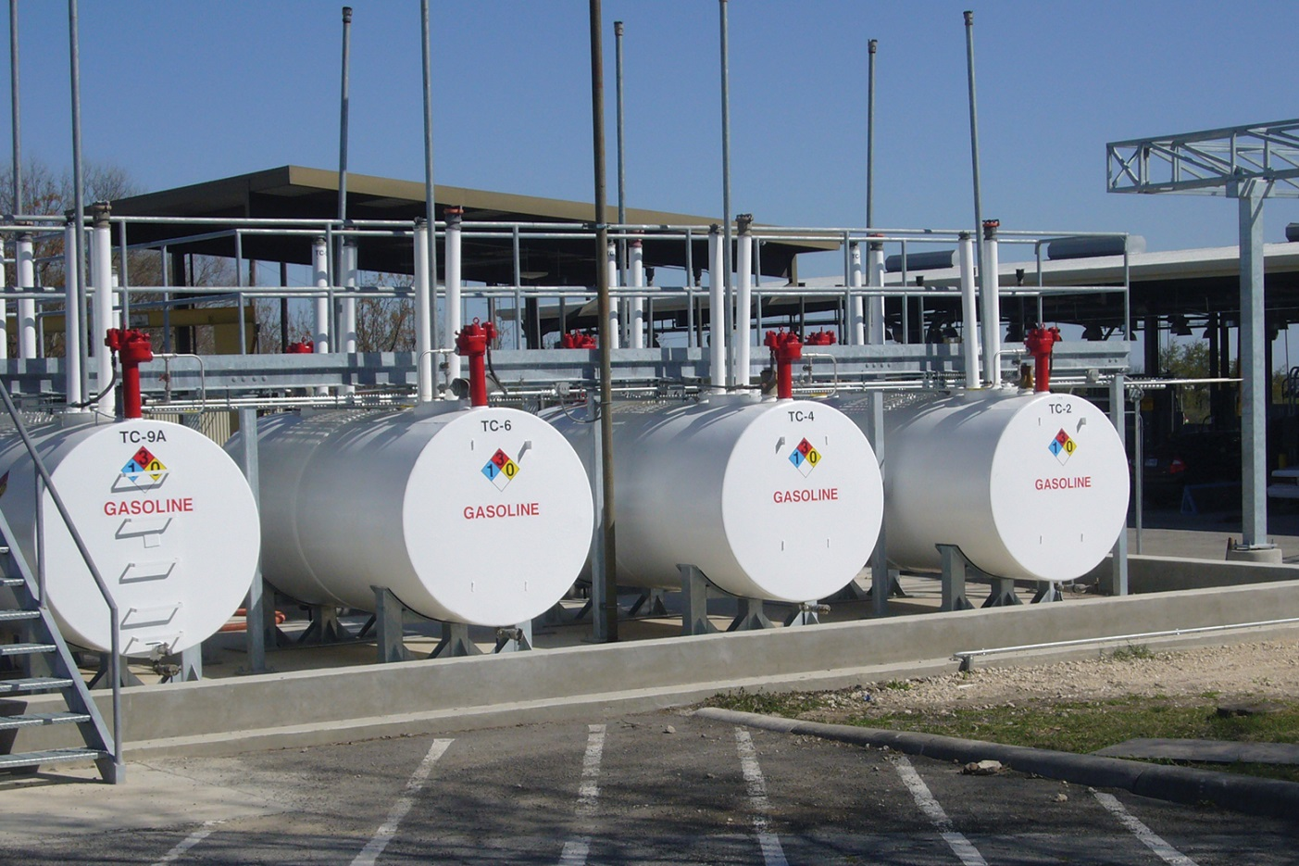
Inspectors need to know the characteristics of shop-fabricated aboveground tanks.
ASTs are constructed with a normal and an emergency vent
Vent openings provided to protect the tank from excessive vacuum or positive pressure
Courtesy of Scott Stookey, International Code Council, Washington, D.C
(Cont.)

Slide 196
Inspectors need to know the characteristics of shop-fabricated aboveground tanks.
Normal vents
Air is not introduced into storage tank unless product is being removed
Flammable vapors remain inside tank unless it is being filled
PV vent must terminate at least 12 feet (3.5 m) above grade, and 5 feet (1.5 m) from lot lines that can be built upon
Normal vent protects tank from collapse or overpressurization
Normal vent is required for all underground storage tanks
NFPA® 30 and IFC require that the normal vent on tanks storing Class I flammable liquids have a pressure/vacuum (PV) vent designed so that
Courtesy of Scott Stookey,
International Code Council, Washington, D.C
(Cont.)

Slide 197
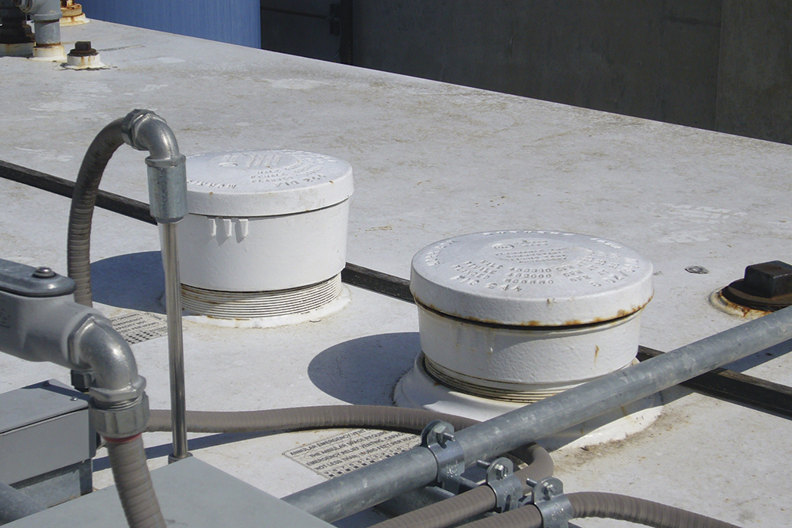
Inspectors need to know the characteristics of shop-fabricated aboveground tanks.
Emergency vents
Most important safety feature on any AST
Serves as pressure relief
Not required for underground storage tanks
Designed to open when subjected to a few ounces of pressure
Designs vary based on whether AST is shop-fabricated or field-erected
Designed to prevent tank from exploding
Courtesy of Scott Stookey, International Code Council, Washington, D.C
(Cont.)

Slide 198
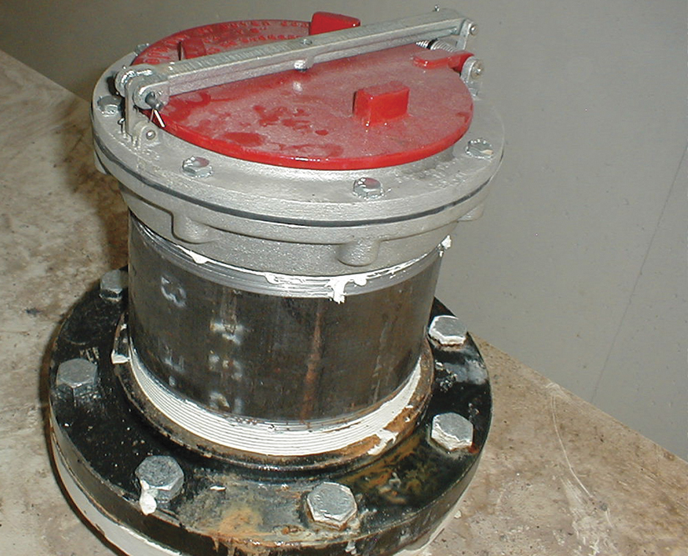
Inspectors need to know the characteristics of shop-fabricated aboveground tanks.
Inspector concerns
Is the tank equipped with an emergency vent?
Is the vent operational?
Is it properly sized?
Has the vent been modified or obstructed so it is no longer functional?
Sizing of emergency vents is performed by the tank designer
Emergency vents are sized based on the surface area of the tank, its orientation, and its geometry
Courtesy of Scott Stookey, International Code Council, Washington, D.C

Slide 199
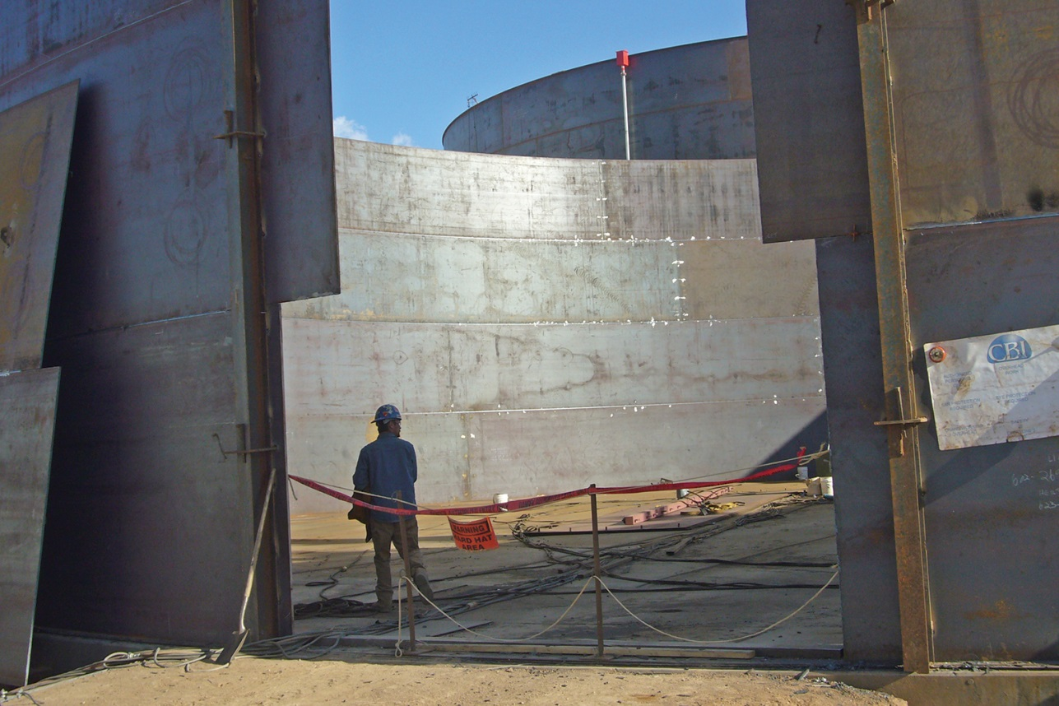
Inspectors need to know the characteristics of field-erected aboveground tanks.
Fabricated from plate carbon steel and stainless steel
Model codes do not limit diameter or height of field erected ASTs
Steel sheets are erected into a structurally safe tank onsite
Courtesy of Scott Stookey, International Code Council, Washington, D.C
(Cont.)

Slide 200
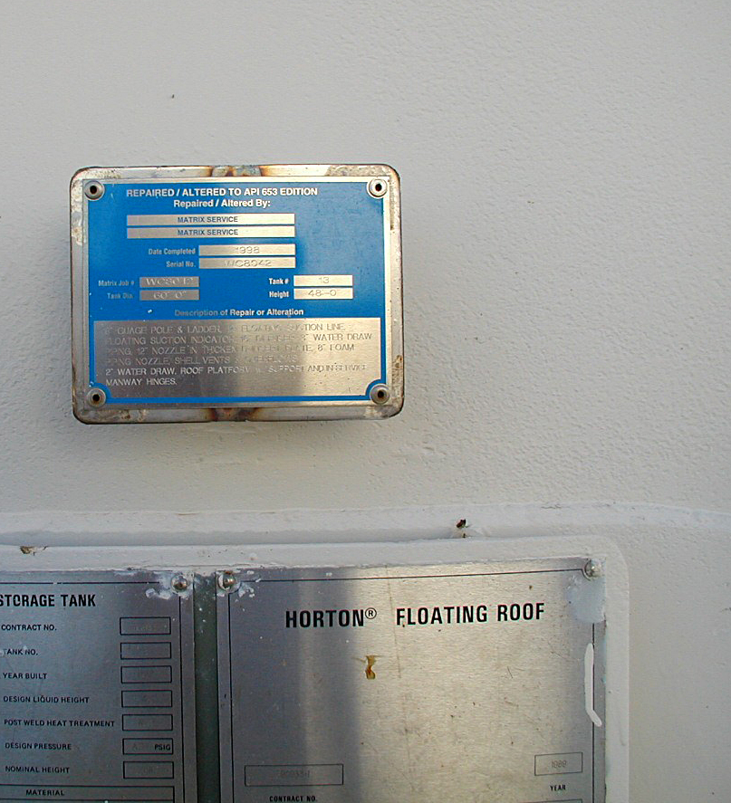
Inspectors need to know the characteristics of field-erected aboveground tanks.
Tanks designed to operate at atmospheric pressure are designed to API 650
Tanks that operate at a pressure between 2-15 PSIG or that store liquids at temperatures above 200°F (93°C) are classified as low pressure field-erected ASTs
Inspectors will need to review manufacturer’s nameplate affixed to the tank to determine the standard of construction that was used
API Standard 653 requires that major modifications or repairs to field-erected ASTs be noted on a permanent repair nameplate affixed to the storage tank
Courtesy of Scott Stookey, International Code Council, Washington, D.C
(Cont.)

Slide 201
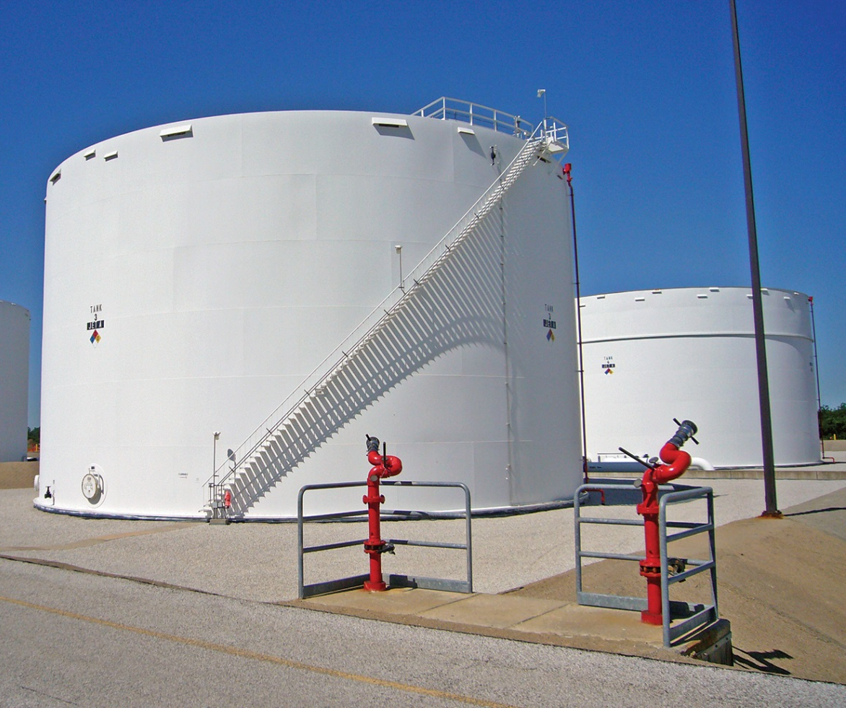
Inspectors need to know the characteristics of field-erected aboveground tanks.
Constructed to American Petroleum Institute (API) standards
Constructed as cone roof, open floating roof, or internal floating roof tanks
New tanks utilize welded construction and are liquid- and vapor-tight
Older tanks may be of riveted or bolted construction and may not be vapor-tight
Type of roof selected is based on the petroleum product the tank will store
Courtesy of Scott Stookey, International Code Council, Washington, D.C
(Cont.)

Slide 202
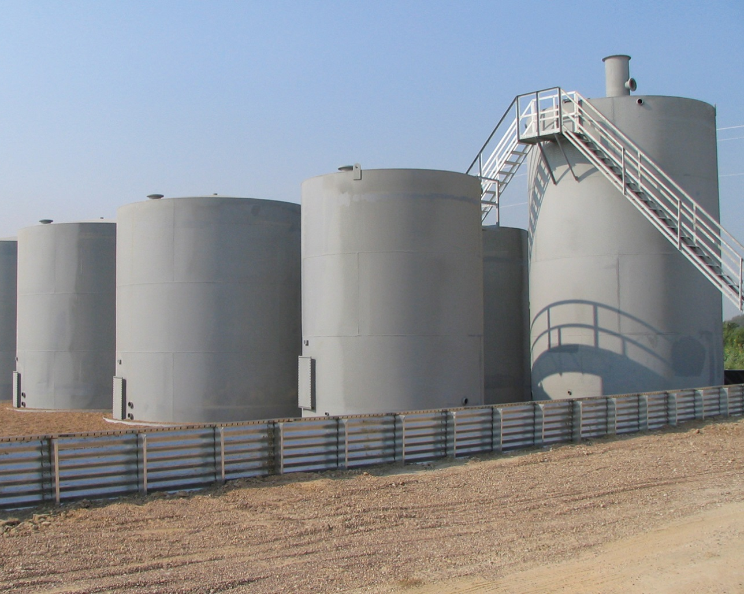
Inspectors need to know the characteristics of field-erected aboveground tanks.
Fire protection
Requirements will vary based on tank’s volume, contents, and design
Need also influenced by tank’s location and capabilities of fire department
Review locally adopted codes to determine when fire protection for field-erected ASTs is required
Courtesy of Scott Stookey, International Code Council, Washington, D.C
(Cont.)

Slide 203
Inspectors need to know the characteristics of field-erected aboveground tanks.
Tank owners/representatives are required to perform a monthly visual inspection of the exterior of each field-erected AST
At an interval no greater than 20 years, the tank must be removed from service and internally inspected
Authorized inspector certified to API 653 must perform an external examination every five years

Slide 204
Inspectors need to know the characteristics of underground storage tanks (USTs).
Designed to operate at atmospheric pressure
Offer highest degree of fire safety
Model fire code-compliant USTs are listed
Constructed of carbon steel or glass-fiber reinforced plastic
With exception of lightning strikes, USTs are safe from most fire exposures
Violation of model fire codes to attempt to install an aboveground tank underground
Designed to resist the dead load of water-saturated soil
(Cont.)

Slide 205
Inspectors need to know the characteristics of underground storage tanks (USTs).
Designed to store
Gasoline
Diesel
Bio-fuels
Alcohol-blended fuels
Courtesy of Scott Stookey, International Code Council, Washington, D.C
(Cont.)

Slide 206
Inspectors need to know the characteristics of underground storage tanks (USTs).
Openings are located on top of the tank and are prohibited below the tank’s liquid level
Require openings for a normal vent, filling the tank with liquid, and openings to accommodate pumps to supply dispensers
(Cont.)

Slide 207
Inspectors need to know the characteristics of underground storage tanks (USTs).
Product reconciliation
Compares measurement of the product that comes into the UST from the tanker and compares it to amount of petroleum fuel sent to consumers via the dispensers
If measurements deviate beyond a set limit, an audible alarm activates at the control panel
Reconciliation is required daily
Requires electronic monitoring
One method used for verifying liquid-tightness of the UST
Courtesy of Scott Stookey, International Code Council, Washington, D.C
(Cont.)

Slide 208
Inspectors need to know the characteristics of underground storage tanks (USTs).
Model fire codes do not require USTs to have secondary containment
May be required by state environmental laws; along with electronic monitoring
Model codes require overfill protection and spill control for all USTs
Review applicable state environmental laws to determine any special UST design or installation requirements

Slide 209
Inspectors need to know the characteristics of pressure vessels.
Engineered stationary containers designed to store liquids, cryogenic fluids, or gases at pressures of 15 PSIG or greater
Can be constructed for horizontal or vertical orientation
Design, construction, and examination requirements are contained in Section VIII, Division 1 of BPVC
Courtesy of Scott Stookey, International Code Council, Washington, D.C
(Cont.)

Slide 210
Inspectors need to know the characteristics of pressure vessels.
Required markings
Manufacturer’s name preceded with the words “certified by”
Maximum allowable working pressure (MAWP), expressed in PSIG at the design temperature, expressed in degrees Fahrenheit (°F)
Minimum design metal temperature (MDMT) expressed in °F at a given pressure (PSIG)
Manufacturer’s serial number for the pressure vessel
Year of construction
Required abbreviations specified by the BPVC
Official code symbol for all pressure vessels is a shamrock with the letter “U” inside it
(Cont.)

Slide 211
Inspectors need to know the characteristics of pressure vessels.
Pressure relief device
Required by BPVC
Open at a predetermined pressure below the design pressure of the vessel
Burst discs cannot close upon operation and are replaced after activation
Operating pressure of the relief device generally does not exceed the MAWP of the pressure vessel
Close automatically when the pressure falls below the opening pressure
Either safety relief valves or non-reclosing relief devices such as burst discs

Slide 212
REVIEW QUESTION
List types of stationary tanks that may be used for nonbulk and bulk packaging.

Slide 213
Learning Objective 9
Describe the code requirements for testing, maintenance and operation of equipment, containers and tanks.

Slide 214
Know inspector duties regarding testing, maintenance, and operations.
Inspectors evaluating hazardous materials will encounter processes and equipment used to facilitate their safe storage and handling
Important that mechanical integrity and tightness of the system are maintained
Must have a good understanding of the hazards involved and how the model fire codes regulate use
(Cont.)

Slide 215
Know inspector duties regarding testing, maintenance, and operations.
Verify tank vents are operational; tanks and piping are free of any leaks
Damaged or nonfunctional tank or piping components should be repaired or replaced with approved components
Tanks with integral secondary containment that cannot be visually monitored require electronic leak detection, which requires periodic testing
Courtesy of Scott Stookey, International Code Council, Washington, D.C
(Cont.)

Slide 216
Know inspector duties regarding testing, maintenance, and operations.
Gravity dispensing
Occurs when liquids are flowed from containers or IBCs using the weight of the stored liquid to flow from the container when a valve is opened
For gravity dispensing to be safely accomplished, the arrangement of the dispensing system must anticipate small liquid losses
Before dispensing can occur, a self-closing automatic valve that requires an operator is required
Receiving container must comply with jurisdiction’s fire code
Means of spill control required
Common use of hazardous materials

Slide 217
REVIEW QUESTION
What are some of the things inspectors need to verify when inspecting hazardous materials storage?

Slide 218
Summary
The ability to distinguish hazardous materials or dangerous goods by their properties and identify the materials or goods by the markings on the containers is basic to an inspector’s duties.
(Cont.)

Slide 219
Summary
This chapter provided information that will help an inspector apply the requirements contained in the model building and fire codes for storing, handling, transporting, dispensing, and using the materials or goods.
(Cont.)

Slide 220
Summary
Information was also given for federal markings used to identify the materials or goods while in transit.
This information can be used to generate an inventory of the type and size of the hazards present in the community.
(Cont.)

Slide 221
Summary
An inspector must be proficient in reading the placards, markings, and labels of all types of hazardous materials or dangerous goods and using reference guidebooks.
(Cont.)

Slide 222
Summary
During the course of an inspection, an inspector may encounter materials that may individually or in combination pose a risk or hazard.
(Cont.)

Slide 223
Summary
It is essential for an inspector to recognize these potential hazards and have them removed, modify the way hazardous materials are stored, or provide for measures that reduce risks to acceptable levels.
(Cont.)

Slide 224
Summary
The inspector must also be familiar with the maximum allowable quantities of hazardous materials that are permitted based on occupancy type and the materials themselves.
(Cont.)

Slide 225
Summary
Hazardous and High-hazard occupancies require special attention because of the materials involved and potential for a catastrophic event.
(Cont.)

Slide 226
Summary
This chapter provided information on the types of storage containers and packaging used to store hazardous materials and dangerous goods in North America.

