Slide 1
Fire Inspection and Code Enforcement
8th Edition Inspector I
Chapter 8 — Site Access

Slide 2
Learning Objective 1
Describe types of fire lanes and fire apparatus access roads.

Slide 3
Know the purpose of fire lanes and fire apparatus access roads
Fire Lanes
Means of access
Access Roads
Can be any street or highway
NFPA® and IFC® codes contain requirements
Parking for fire apparatus
Designated and identified by AHJ
NFPA® and IFC® codes contain requirements

Slide 4
NOTE
Parking and materials storage on designated fire apparatus access roads and in fire lanes is prohibited.

Slide 5
Inspectors should know the size requirements for fire lanes and fire apparatus access roads.
Fire lanes and fire apparatus access roads must be appropriately sized to allow emergency apparatus unimpeded passage to and around a facility
Most nationally developed fire codes contain specifications

Slide 6
Understand the requirements for road extensions.
Must extend to within 150 feet (45 m) of all portions of a building, although local codes may require otherwise

Slide 7
Understand other requirements for fire lanes and access roads.
Vertical clearance
Vertical clearance over a fire lane or fire apparatus access road must be minimum of 13 feet, 6 inches (4 m)
Width
Width requirements intended to allow a vehicle to pass a parked apparatus, including an aerial device with outriggers deployed
Measurement does not include parking widths
Must be minimum width of 20 feet (6 m)
Capacity
Designed and maintained to support expected load of emergency vehicles

Slide 8
NOTE
These specifications can include lanes over underground structures, bridges, or ditches.

Slide 9
Inspectors need to know certain things when inspecting or designating fire lanes and access roads.
Turning radius requirements
Weight specifications of departments' heaviest apparatus
Safety margin
Should be included for future design changes in weight of new apparatus
(Cont.)

Slide 10
Inspectors need to know certain things when inspecting or designating fire lanes and access roads.
Angle of approach and departure
Generally, an angle of no more than 8 degrees is necessary to allow apparatus to drive onto the lane
Inspector should determine if the angle meets fire code requirements

Slide 11
Inspectors need to be familiar with the different types of dead-end access roads.
Wherever possible, fire lanes or fire apparatus access roads should encircle a structure
According to model fire codes, dead-end fire lanes and access roads are those that extend farther than 150 feet (45 m) from a public street or road
Those that do not circle around a structure or return to a public street or road must provide a method for emergency vehicles to turn around
(Cont.)

Slide 12
Inspectors need to be familiar with the different types of dead-end access roads.
Short section of roadway that lies perpendicular to the end of a dead-end street with equal sections on each side of the dead-end
(Cont.)

Slide 13
NOTE
The “T” or hammerhead turnaround may also be arranged in the form of a Y.

Slide 14
Inspectors need to be familiar with the different types of dead-end access roads.
Street closed at one end designed to the minimum dimensions as required by the municipality
(Cont.)

Slide 15
Inspectors need to be familiar with the different types of dead-end access roads.
Configuration that allows a vehicle to back into a space and turn around
(Cont.)

Slide 16
Inspectors need to be familiar with the different types of dead-end access roads.
Inspectors will need to review and approve the designs of these dead-end access roads
Once the AHJ approves the access road, the property owner/occupant is responsible for properly marking and maintaining these turnarounds

Slide 17
Know how fire lanes and fire apparatus access roads are marked.
Local jurisdiction generally establishes requirements for markings
Indicate to emergency responders areas designed to support the weight of the apparatus and provide the most effective access
Indicate to the public the areas that must remain clear at all times
Inspectors may be involved in recommending location, as well as offering guidance on parking restrictions based on need for site access
(Cont.)

Slide 18
Know how fire lanes and fire apparatus access roads are marked.
Markings take two general forms: painted curbs and posted signs
Curbs generally painted red or red with white lettering
Signs conform to local or state design for information signs
Generally a reflective white background with red lettering
May feature the words No Parking Fire Lane or No Stopping Fire Lane
In some locations, fire lane designations are painted in large letters on the road surface
(Cont.)

Slide 19
Know how fire lanes and fire apparatus access roads are marked.
AHJ should locate signs at the entry and exit points
Verify that the markings are in the correct location and unobscured by vegetation
Emergency responders should be able to recognize the edge of the roadway to prevent the apparatus from getting stuck in the soft soil next to it
Reflective markings or other indicators placed along the edge of the subsurface construction indicate the area designed to support the weight of an apparatus
(Cont.)

Slide 20
Know how fire lanes and fire apparatus access roads are marked.
In some multistory structures, parking garages or plazas surround the grade-level entrance to the building
When this situation occurs, the AHJ usually requires that a portion of the parking garage or plaza is designed to support fire apparatus
Verify that the fire lanes are accurately indicated and that these markings are maintained

Slide 21
REVIEW QUESTION
What fire lane and access road characteristics are important for inspectors to verify?

Slide 22
Learning Objective 2
Explain site access considerations for construction and demolition sites.

Slide 23
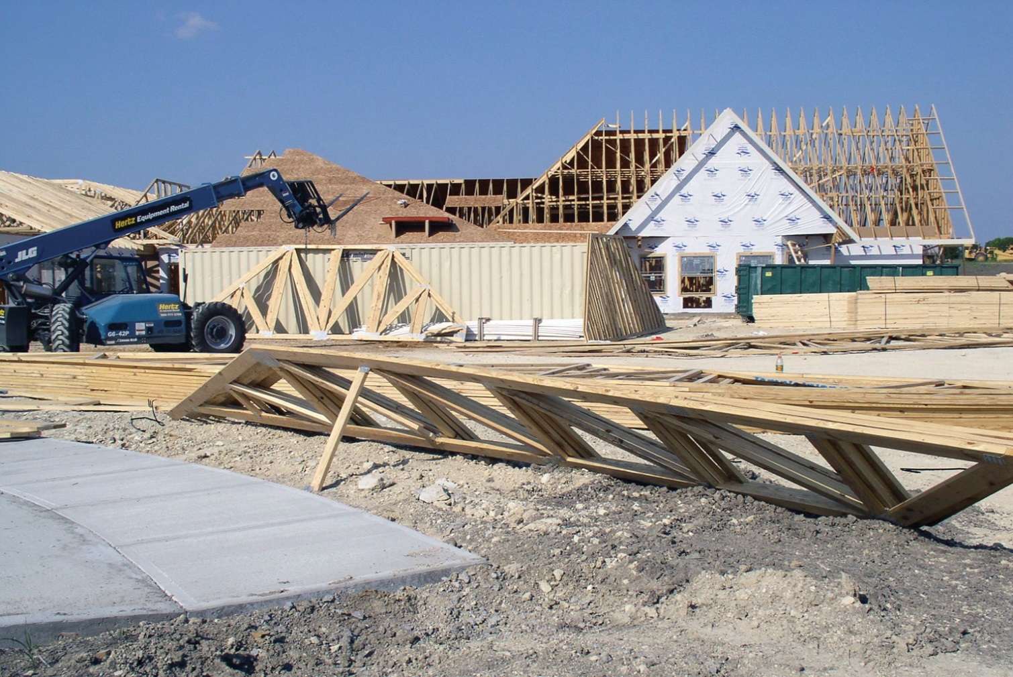
Know items in NFPA® 241, Standard for Safeguarding Construction, Alteration, and Demolition Operations.
Designating a Command Post
Accessibility of portable fire extinguishing equipment
Lock boxes at construction and demolition sites
Courtesy of Ron Moore, McKinney (TX) Fire Department

Slide 24
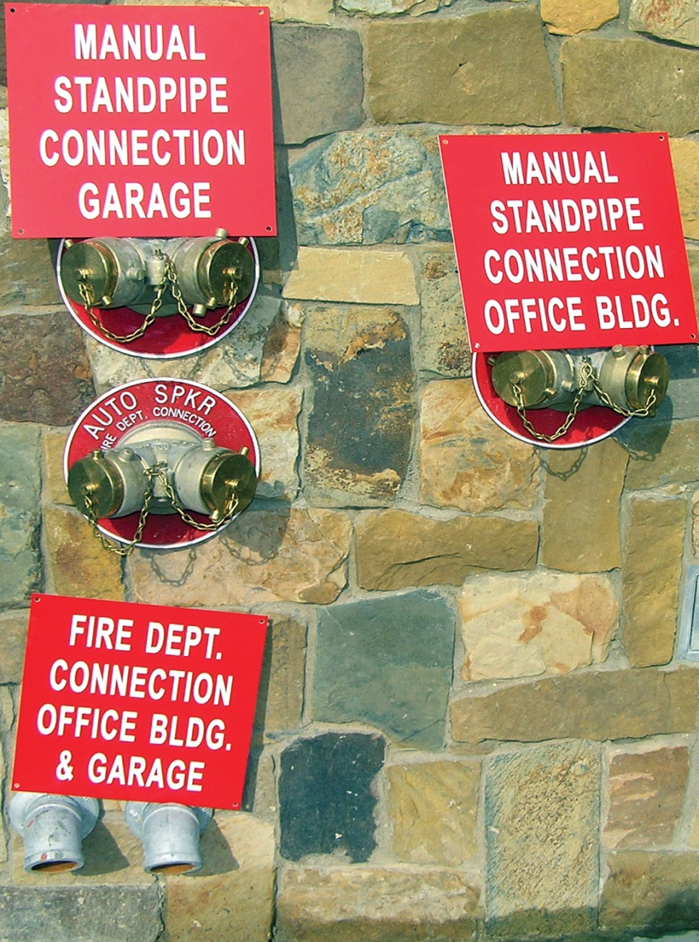
Know what to monitor at construction and demolition sites.
Means to call for help
Posted emergency numbers
Command Post
Fire protection systems
Fire extinguishers
Flammable, combustible liquids
Asphalt/tar kettles
Portable heating devices
Trash disposal
Courtesy of Ron Moore, McKinney (TX) Fire Department

Slide 25
Be familiar with common problems with access roads.
Realignment of a travel surface that limits access to the structure
Roadway not maintained in a serviceable condition
Access to fire department water supplies and fire department connections (FDCs) not maintained
Roadways narrowed below the minimum width required by the code

Slide 26
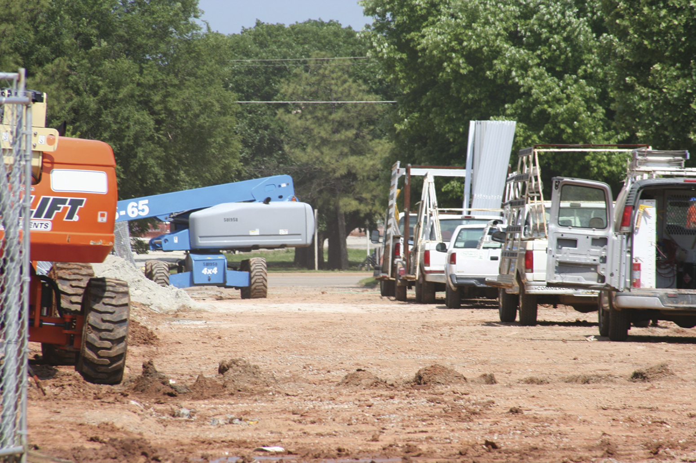
Verify that all designated access roads are unobstructed and maintained in serviceable condition.
No ditches dug across temporary roadways without alternate routes
No temporary gates, fences, or walls that block site access, fire lanes, or access roads
No demolition debris or large trash receptacles located along or in designated fire lanes or access roads
No workers using a fire lane as a parking

Slide 27
Know what to do when access roads are obstructed.
Immediately notify the general contractor
Inspector and contractor should review required access road design
Contractors or demolition operators may be reluctant to comply
Make sure that the road is returned to the approved design
Inspector may need to resort to more rigorous enforcement procedures
As a last resort, an inspector may decide to close the site until the contractor complies

Slide 28
REVIEW QUESTION
What are some of the practices an inspector must verify are in place at construction and demolition sites?

Slide 29
Learning Objective 3
Identify structure access barriers.

Slide 30
Know the two types of structure access barriers and their hazards.
Exterior access barriers
Interior access barriers
Be aware of a facility’s structure access barriers and the possibility of these conditions changing over the life of the facility

Slide 31
REVIEW QUESTION
What are the two types of structure access barriers emergency responders may encounter?

Slide 32
Inspectors are responsible for verifying that buildings are accessible and not impeded.
Driveways
Parking lots
Gates
Overhangs
Vegetation
Setbacks
Security barriers
Awnings
Overhead obstructions
Temporary fencing around construction sites

Slide 33
NOTE
Gates across fire access lanes must open to provide a minimum clearance of 20 feet (6 m) unless the AHJ approves another distance.

Slide 34
The AHJ should take into account the weight, height, length, and width of the largest fire apparatus.
Performance-based driveway design is more effective than simply following a minimum radius for the turn stated in the code
AHJ should specify these requirements to ensure exterior access from a public street or road is not obstructed
AHJ should designate the driveway as a fire lane or fire apparatus access road
Apply those criteria to its design, maintenance, and markings

Slide 35
Know other items that may cause issues with exterior access.
Weight requirements
Illegal parking
Overhead obstructions
Landscape issues
Topographical conditions
Season climate conditions
Courtesy of Dennis Marx

Slide 36
Municipality must develop minimum weight requirements for fire lanes and fire apparatus access roads.
Usually these requirements are in a collection of standard designs that the local highway/transportation engineer has approved and the locally adopted codes enforces
Roads should be designed to bear the weight of the jurisdiction’s heaviest fire apparatus

Slide 37
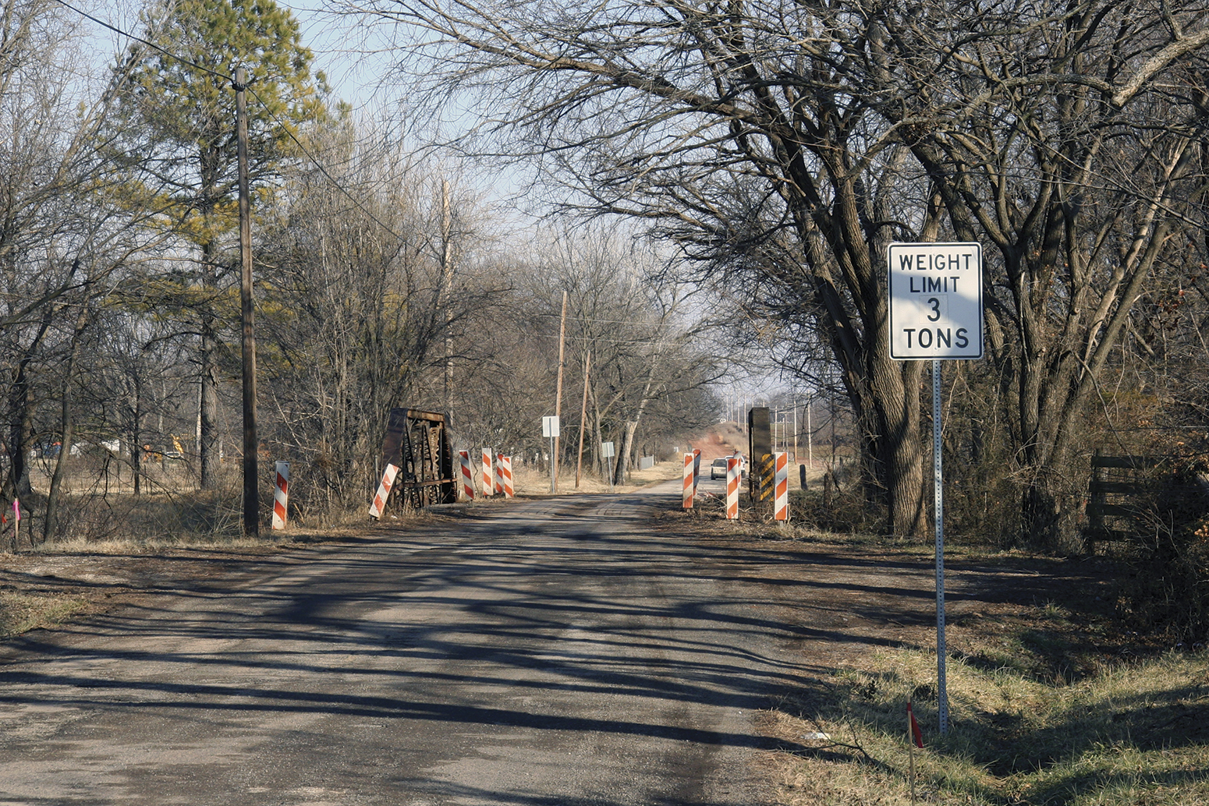
Private bridges and driveways over culverts must also adhere to the minimum size requirements.
AHJ may require labels designating a bridge’s capacity to prevent personnel from attempting to cross bridges that will not support the weight of fire apparatus
Inspectors may encounter places that were constructed before adoption of the fire code or that have been modified since their construction

Slide 38
Private driveways and parking lots present more concerns than public streets or roads.
Surfaces may not be designed or constructed to support the weight of a fully loaded fire apparatus
Condition may not prevent apparatus from access, but could affect the operation of aerial apparatus
Inspectors can rarely mandate changes unless the AHJ requires that existing privately owned driveways and parking lots adhere to current weight requirements

Slide 39
Understand the hazards presented due to illegal parking.
Fire lane areas may subject to illegal parking after hours
Work with law enforcement and property owners to correct these conditions and provide required fire department access at all times
May also occur where a large number of attendees may exceed the number of available parking spaces

Slide 40
When inspecting a facility, inspectors should look for overhead obstructions.
Block apparatus access
Obstruct aerial device operations
Hinder use of ground ladders
Courtesy of Ron Jeffers

Slide 41
Many potential overhead obstructions can impede minimum unobstructed height requirements.
Electrical lines or utility poles
Trees, vines, and other vegetation
Parking lot lights or streetlights
Building canopies, marquees, or overhangs
Flagpoles
Signs
Satellite dishes
Overhead pipes in industrial complexes

Slide 42
Understand how to handle overhead obstructions.
Properly applying locally adopted codes during the plans review, construction, and initial inspection process should control overhead obstructions
Inspector may still need to document these conditions during annual inspections so that owners can make corrections

Slide 43
Landscaping can create exterior access barriers in several ways.
Overgrown vegetation may block fire hydrants from view
Decorative boulders may hide utility control valves
Fences may obstruct electric shutoff switches
Some locally adopted codes require access to these services to be clear and marked
Property owners have been known to purposely design their landscapes to minimize the visibility
Be aware of changes in building’s landscape design
Evaluate and mitigate situations that potentially interfere with emergency responders’ access
Courtesy of Dennis Marx

Slide 44
Topographical conditions may limit or prohibit access.
Railroad tracks
Drainage ditches, streams, rivers, canals, ponds, or lakes
Steep slopes, cliffs, or variations in topographical grades
Unstable terrain (sand, loose or soggy soil)
Narrow alleys or passageways between structures
Retaining walls
Courtesy of Ron Jeffers

Slide 45
Seasonal climate conditions may prevent access to structures.
Examples and responsibility
Snow
May be the responsibility of the street department or contractor
Location of access roads must be visible following snowfalls
Snow piles should not block access roads, hydrants, or FDCs
On private property, the owner/occupant is responsible for keeping access free of snow and ice
Snow, rain, and drought
Responsibility for mitigating climate-related obstructions may belong to the owner/occupant or the AHJ
Prolonged and deep accumulations of snow require inspectors to work with outside agencies for removal
(Cont.)

Slide 46
Seasonal climate conditions may prevent access to structures.
Periods of heavy rain can overwhelm runoff systems, causing street flooding
Accumulated water can create problems for emergency responders
Nonhard-surface roads can become saturated and impassible
Access lanes that use subsurface materials can cease to support their designed weight limit
Be aware of potential problems caused by heavy rains
Work with owners/occupants and building officials to correct them before they occur
Courtesy of Dennis Marx

Slide 47
Droughts also have an effect on site access.
Access roads not constructed of asphalt or concrete can become dry
Creates a potential source for dust that can obscure view
Creates a potential for grass fires around facilities
Building owners/occupants may be required to clear all dead or dry vegetation away from structure and fences

Slide 48
REVIEW QUESTION
Name some of the exterior access hindrances that can block emergency access to structures.

Slide 49
Pay attention to items that may prevent access to the interior of a structure.
Inspectors share applicable information with emergency responders
Type of wall construction, door locks, windows, and other interior access barriers will help firefighters perform their duties
(Cont.)

Slide 50
Pay attention to items that may prevent access to the interior of a structure.
Lock boxes containing keys to the facility or structure may be located near doors into the structure
Security fences and gates may have lock boxes located near an entry point
Structures that have 24-hour security on site may not be required to have lock boxes
Note location, key, or access codes to lock boxes and provide this information to the department’s operations section

Slide 51
Firefighters may utilize fire escapes, roof access doors, and other openings to gain access.
When doors and windows fail to provide access to a building
Inspectors must consider the feature’s condition, location, and operation
Inspectors should examine roof access doors, hatches, skylights, and other openings as well
Evaluate access to below-grade floors through doors, stairs, or windows
Courtesy of Rich Mahaney

Slide 52
Some buildings that were constructed before national building codes existed may have insufficient access.
Inspectors should inform the owner/occupant of these hazards and recommend alternatives
Inspectors should notify emergency response personnel
Inspectors should recommend that fire personnel perform a site survey to list factors that limit access

Slide 53
Windowless buildings and underground structures pose a special issue.
Lack interior access points
Most codes require installation of an automatic sprinkler system; this requirement should be identified during the plans review process
Over the life of old brick buildings, windows and doors are often closed and sealed
When it is not technically or economically possible to install a sprinkler system the inspector must be able to determine acceptable alternatives

Slide 54
Know the other building features that create interior access problems.
Shell of a building
Sunscreens
Security bars on doors and windows
Grilles
Hurricane shutters
False fronts
Blank and ornamental walls
Courtesy of Rich Mahaney

Slide 55
REVIEW QUESTION
List the interior access hindrances that can block emergency access to structures.

Slide 56
Summary
Fire and life safety inspections are critical to maintaining site access for fire apparatus and emergency responders.
An inspector should note the current access condition and identify any obstructions to fire lanes and fire apparatus access roads.
(Cont.)

Slide 57
Summary
In addition, an inspector should monitor site access to construction and demolition sites and recognize the potential structural access barriers.
(Cont.)

Slide 58
Summary
Whenever inspectors discover a circumstance that affects fire and emergency responders’ ability to access a structure, they should immediately implement appropriate corrective actions.
(Cont.)

Slide 59
Summary
If this situation proves to be a permanent access obstruction, the inspector should inform the fire department operations section of the details.

