Slide 1
Fire Inspection and Code Enforcement
8th Edition Inspector I
Chapter 5 — Building Construction

Slide 2
Learning Objective 1
Identify accepted types of construction building materials and the fire risks associated with them.

Slide 3
Be familiar with the most commonly used construction materials.
Wood
Masonry
Concrete
Steel

Slide 4
Become familiar with materials used in nonload-carrying capacities.
Metals
Aluminum
Cast iron
Copper
Zinc
Glass
Gypsum board
Plastics
Fabric

Slide 5
Inspectors need to be familiar with several aspects of physical properties.
Combustibility
Thermal conductivity
Variation of strength with temperature
As temperature increases, materials weaken and strength is compromised
Behavior of building materials affected by
Chemical and physical properties
Method of fabrication

Slide 6
REVIEW QUESTION
What are the materials most commonly used for construction?

Slide 7
Some terms sound similar, but have unique applications.
Fire protection rating
Assigned to an opening in a fire wall
Indicates length of time a protective assembly (door, window) can withstand fire conditions
May use lower rating than the surrounding fire-resistant barriers
Fire-resistant materials
Wall assemblies
Rated through laboratory testing to determine ability to withstand fire conditions over a set amount of time
Assumed that the fire load will not be close to assemblies
(Cont.)

Slide 8
Some terms sound similar, but have unique applications.
Fire-retardant coatings
Applied to the surface of combustible materials
Ignition-resistant construction
Materials used to decrease vulnerability of structures
Suppress, reduce, or delay the flame-spread rating
Behave in unique ways
Features include fire-resistance roof coverings

Slide 9
Wood structural members provide a large amount of fuel for combustion.
Buildings constructed of wood can be destroyed by fire
Voids result in many square feet (square meters) of combustible surface area surrounded by large volumes of air
Different properties of wood affect its use in construction
Strength of wood varies significantly, the IBC® requires lumber be graded (labeled) to denote its strength
Primarily used in construction as solid lumber and as engineered wood products

Slide 10
Solid lumber includes dimensional lumber, boards, and timbers.
Standard measurements of dimensional lumber match the stated measurements
Dimensional lumber is available in lengths from 8 to 24 feet (2.5 to 7 m) in 2-foot (600 mm) increments
Courtesy of NIST

Slide 11
Engineered wood products are prefabricated from different components.
Dimensional lumber
Panels
Adhesives
Metal fasteners

Slide 12
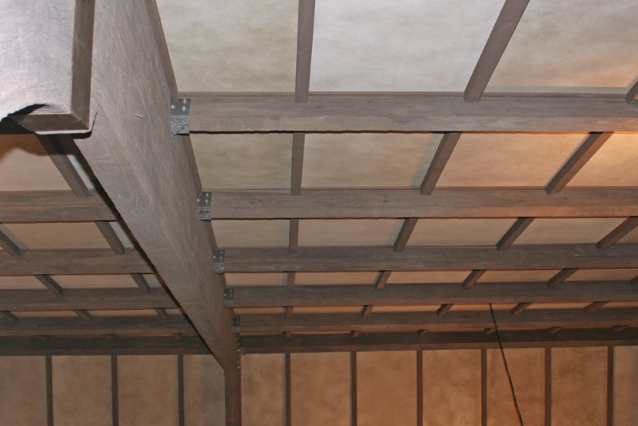
Manufactured members can include many building materials.
Trusses
Box beams
I-beams
Panel components
Courtesy of Dave Coombs; Ron Moore and McKinney (TX) Fire Department

Slide 13
Laminated members are produced by joining smaller pieces of wood with glue.
Beams produced are called glued-laminated beams
Advantage: sizes and shapes not available in solid wood like curves and varying cross-sections

Slide 14
Scarf joints or finger joints are used in constructing laminated members.
Provide additional surface area for the glue
Allow transmission of a greater amount of force than a typical butt joint
Inspectors need to know that these joints hold laminated members together

Slide 15
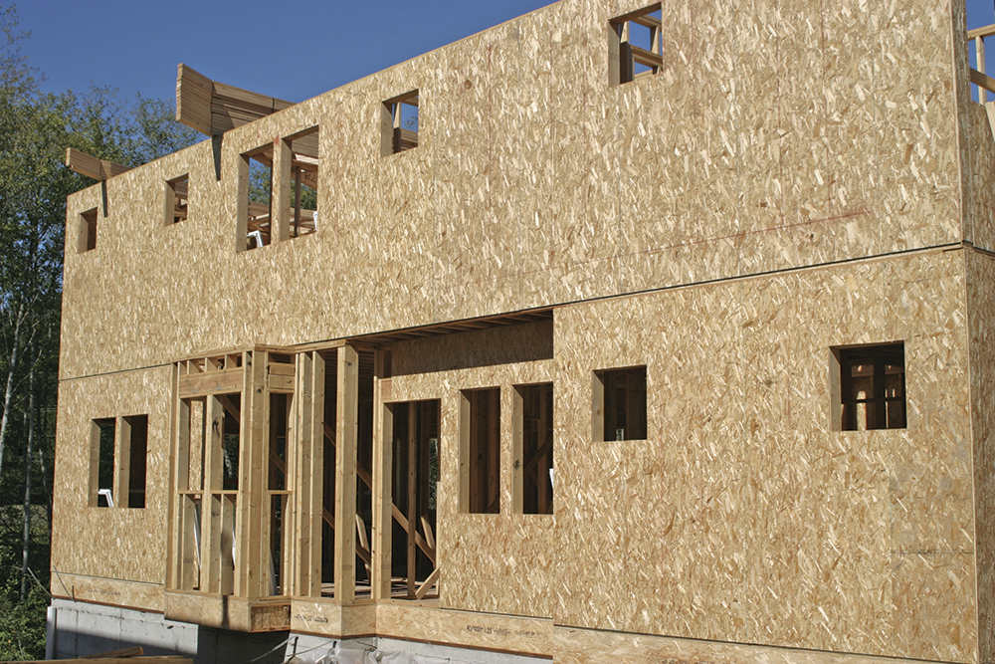
Wood panel products include plywood, oriented strand board (OSB), and nonveneered panels.
Possess several advantages from a construction standpoint
Widely used for roofs, subflooring, and siding
Panel products are more equal in strength along their two major axes
Graded for their structural use and exposure durability
Grade stamp on the back indicates intended application and suitability for exposure to water
Courtesy of Greg Havel

Slide 16
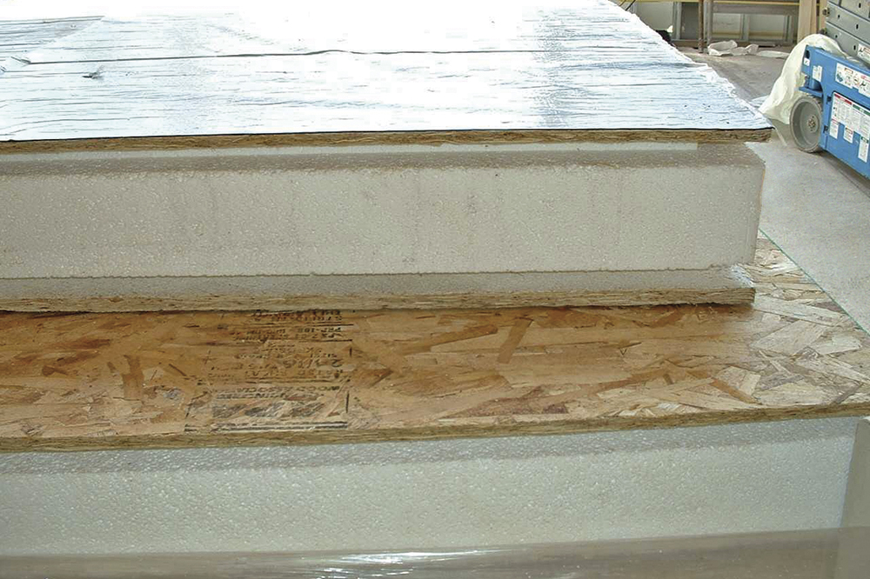
OSB has replaced plywood and planking in many construction applications.
Stressed skin panels consist of an interior frame or plastic foam core
Skin of plywood or OSB is attached to the core
Commonly used in modular buildings
OSB used in roof decks, walls, and subfloors
Courtesy of Greg Havel

Slide 17
Inspectors need to be familiar with fire-retardant treated wood.
Wood can be chemically altered with a fire retardant to reduce its susceptibility to ignition
Building codes permit the use of fire-retardant-treated wood for certain applications
Should not be confused with materials that are noncombustible or fire resistive
Two main methods of fire-retardant treatment of wood include pressure impregnation and surface coating
(Cont.)

Slide 18
Inspectors need to be familiar with fire-retardant treated wood.
Only these treatments can produce wood that is listed as fire-retardant-treated wood
Surface coating is used primarily to reduce the surface burning and flame spread characteristics of wood
Fire-retardant chemicals used in the pressurization process are proprietary products
The most commonly used fire-retardant treatments are combinations of inorganic or organic salts

Slide 19
Know the disadvantages and limitations of fire-retardant treated wood.
Water solubility and structural strength
Some treatments use chemicals that are water soluble, prohibiting their use for exterior applications
Others can be used in interior applications where high humidity does not exist
May adversely affect structural strength of wood as a result of elevated temperature and humidity
Intumescent coatings
Coatings are often painted over or not maintained
Look for missing coating
Can be applied to wood to make its surface fire-resistant

Slide 20
Become familiar with materials used on exterior walls.
Provide resistance to environmental and pest infiltration
Sidings are often chosen for aesthetic reasons; underlayers chosen for compatibility with sidings
Sheathing
Installed outside the studs to provide structural stability, insulation, and an underlayer for the siding
Most common are plywood, OSB, particle board, or exterior gypsum sheathing
(Cont.)

Slide 21
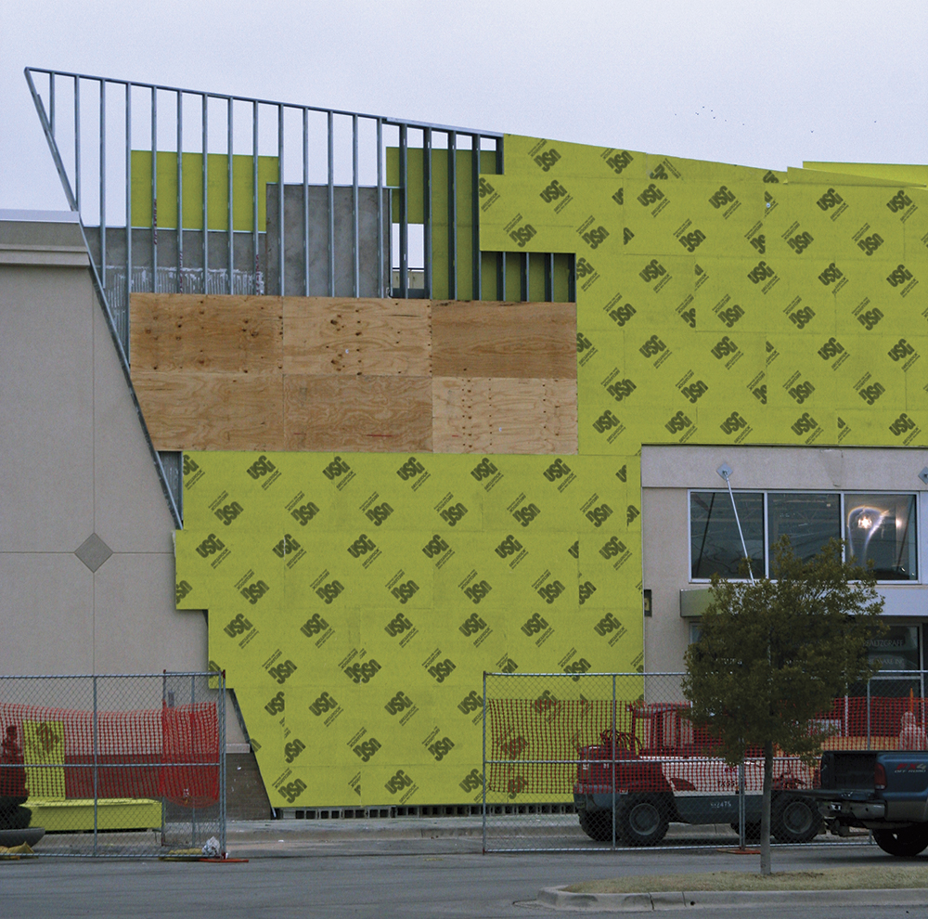
Become familiar with materials used on exterior walls.
Building wrap
Put between sheathing and siding; acts as vapor barrier
Reduces infiltration of moisture and air
Modern synthetic wraps are much more fire-resistant than the felt or tar paper used in older installations

Slide 22
Know the characteristics of foam insulation.
Combustible insulation does somewhat increase the possibility of a fire starting within the wall
Extent to which foam insulation will increase fire spread within a wood-framed wall depends on the existence of air space
Air space will contribute to rapid fire development within the wall space
If the space is completely filled, the fire has to burn upward through the material and will progress much more slowly

Slide 23
Know the noncombustible materials used for insulation.
Glass wool and rock wool in the form of batts or blankets with combustible paper or foil coverings
Fiberglass

Slide 24
NOTE
Some older vermiculite and batt insulation also contains asbestos.

Slide 25
Know the other materials that can also be used in insulation.
Loose-fill
Mineral wool/glass wool blown into or manually packed into studs
Cellulose fiber/shredded wood treated with water-soluble salts to reduce combustibility
Granulated rock wool
Solid-fill
Soft foam insulation that hardens after application
Foam is treated with flame retardants before application
Style of insulation is gaining popularity and is referred to as “building icing” because of its appearance
Two types: polyurethane foam and urea formaldehyde foam

Slide 26
Siding provides the exterior cladding of a wood-frame building.
Provides weather protection
Can contribute to the appearance of a building
Some materials are noncombustible
Some materials are combustible
Combustibility of a siding material can affect fire behavior
New siding is frequently applied over existing siding
(Cont.)

Slide 27
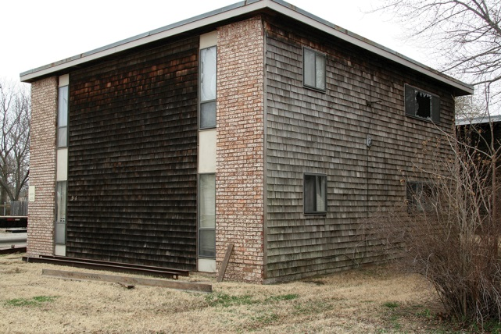
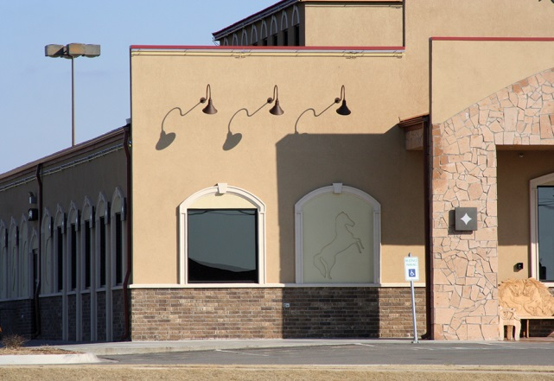
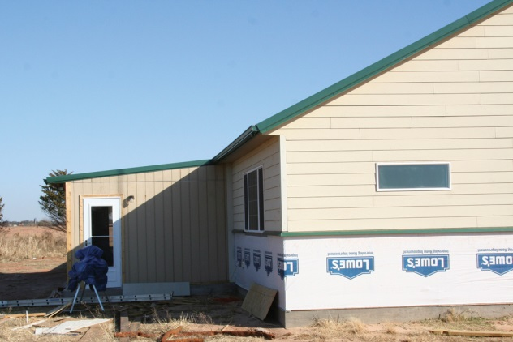
Siding materials provide the exterior cladding of a wood-frame building.
Aluminum
Asphalt siding/shingles
Cement board
Plywood
Stone
Stucco
Wood boards
Wood shingles
Vinyl

Slide 28
REVIEW QUESTION
What are types of wood structural members?

Slide 29
SAFETY ALERT: ASBESTOS COMPONENTS
Asbestos can be found in a wide variety of building products including:
• Siding
• Insulation
• Construction adhesives
• Dry wall compound
• Electrical equipment
• Heating equipment
• Floor tile
• Ceiling tile
Asbestos is no longer used as a building material because it is known to cause respiratory ailments. However, it was commonly used in the U.S. from the 1930’s until the 1970’s and is still found in many older buildings. Asbestos siding may be covered with another siding material, or, in some cases, still be exposed.
(Cont.)

Slide 30
SAFETY ALERT: ASBESTOS COMPONENTS
The inspector needs to be aware of the health hazards associated with asbestos, and take care not to disturb asbestos materials when conducting inspections. Exercise caution while in proximity to components that may potentially contain asbestos. Any activity near or affecting asbestos products must include proper PPE and decontamination procedures.
In addition to respiratory hazards, asbestos fibers are also difficult to remove from contaminated clothing and other resources. The AHJ may require contaminated resources to be discarded after use. For additional information, refer to NFPA® 1851, Standard of Selection, Care and Maintenance of Protective Ensembles, Structural Firefighting and Proximity Firefighting.

Slide 31
REVIEW QUESTION
Why is it important to know where asbestos can be found?

Slide 32
Understand the use of masonry in construction.
One of the oldest and simplest building materials
Can be used for fencing or stone work trim
Inspector’s chief interest is masonry’s use for wall construction
Fundamental construction technique consists of stacking masonry units on top of one another and bonding them into a solid mass
Masonry caution
Masonry units are inherently fire-resistive, however, mortar joints may deteriorate over time or when exposed to fire and result in weakening of the structure

Slide 33
Masonry units can be made of several materials.
Brick
Concrete block
Stone
Clay tile block
Gypsum block

Slide 34
Become familiar with the characteristics of brick.
Produced from a variety of locally available clay and shale
Manufactured by placing clay in molds, removing the molded clay, and drying
Fired in a kiln subjected to temperatures as high as 2,400°F (1 300°C)
Intense heat converts them to a ceramic material

Slide 35
Become familiar with the characteristics of concrete block.
Also known as concrete masonry units (CMUs)
Most commonly used concrete block is the hollow concrete block, sometimes referred to as cinder block
Can also be produced as bricks or as solid blocks

Slide 36
Become familiar with the characteristics of stone.
Consists of pieces of rock that have been removed from a quarry and cut to the size and shape desired
Principal types: granite, limestone, sandstone, slate, marble
Used in two ways: laid with mortar to form walls or used as exterior veneer attached by supports to the structural frame
Courtesy of Ed Prendergast

Slide 37
Become familiar with the characteristics of clay tile block and gypsum block.
Used for foundations and walls in areas where clay is available
Blocks are hollow, providing a space for fill material
Blocks do deteriorate over time
Blocks are susceptible to damage from water and freezing temperatures
Gypsum block is not used often in modern practice
Once widely used for construction of interior partitions
Structural glazed tile is still frequently used

Slide 38
REVIEW QUESTION
What are the different types of masonry?

Slide 39
Concrete is used in many construction components.
Pavement
Foundations
Columns
Floors
Walls
Concrete masonry units

Slide 40
Inspectors need to know the characteristics of concrete.
Does not burn
Resists insects
Resists effects of contact with soil
Can be placed in forms to create a variety of architectural shapes
Concrete types include ordinary and lightweight
Cannot be used alone where significant tensile forces occur in a structure

Slide 41
NOTE
Concrete is poured and then allowed to harden; masonry is not.

Slide 42
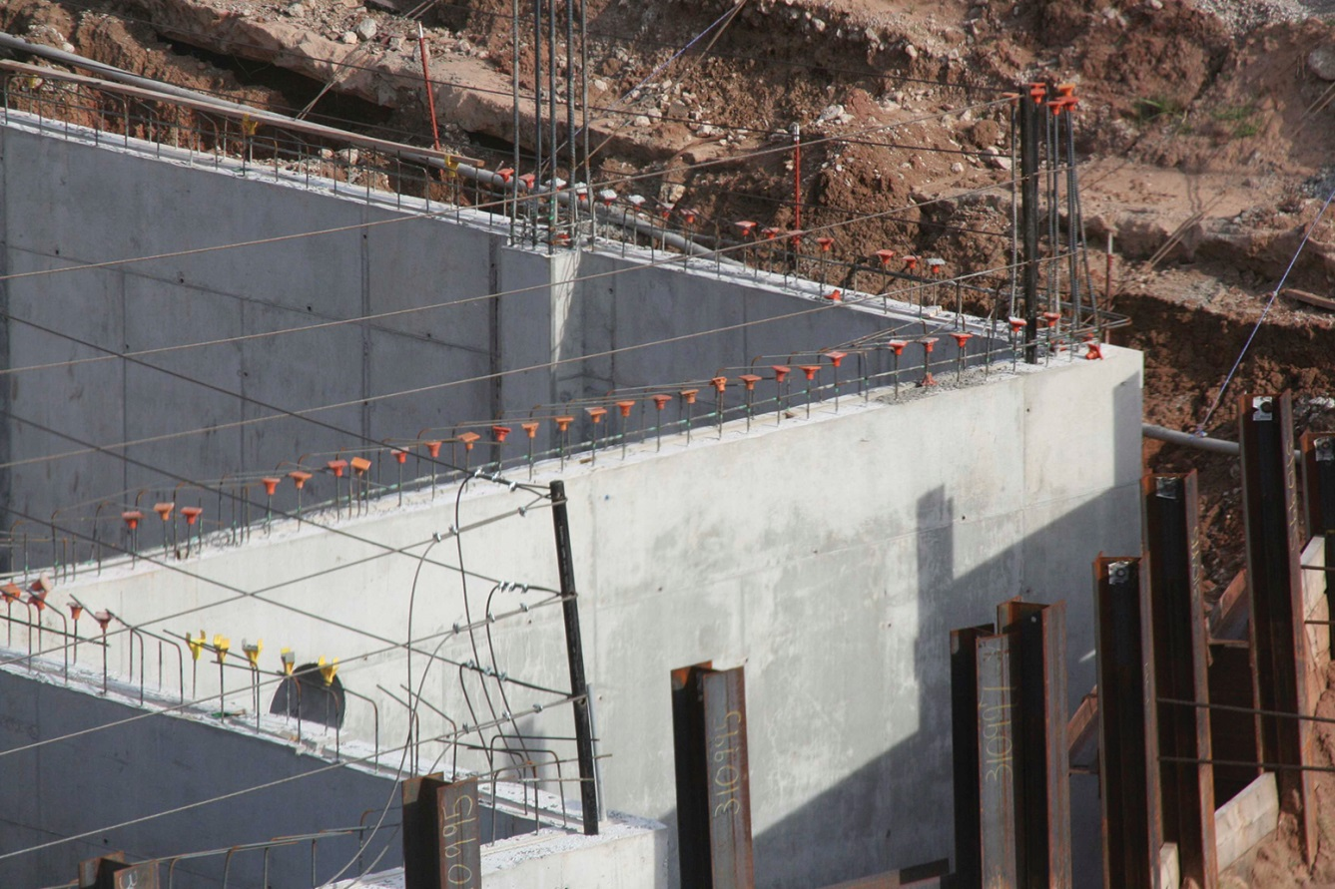
Concrete is weak in tension and cannot be used alone where significant tensile forces occur.
Courtesy of Ed Prendergast
Concrete is reinforced through use of steel bars (rebar) or cables placed within the concrete

Slide 43
REVIEW QUESTION
What is concrete used for in building construction?

Slide 44
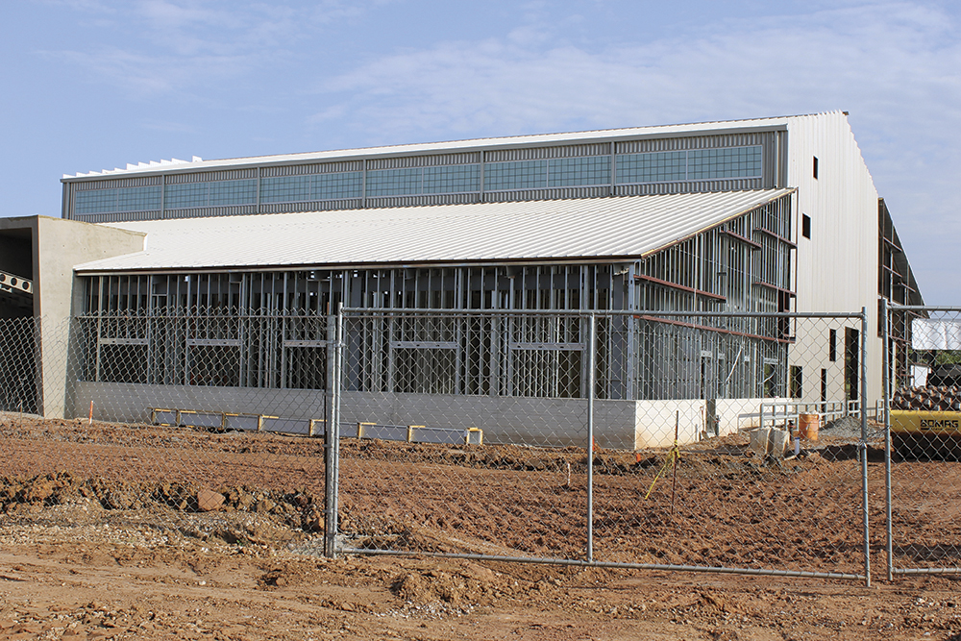
Inspectors need to know the characteristics of steel.
Basically an alloy of iron and carbon
Common structural steel has less than three tenths of one percent carbon
Strongest of the structural materials
Nonrotting
Resistant to aging
Dimensionally stable
Flame resistant
(Cont.)

Slide 45
Inspectors need to know the characteristics of steel.
Relatively expensive
Strength and variety of forms in which it is produced allow it to be used in smaller quantities than other materials
Used for applications varying from heavy beams and columns to door frames and nails

Slide 46
Inspectors should be concerned with disadvantages of steel.
As a structural building material
Methods employed to overcome
Tends to rust when exposed to air and moisture
Loses strength and elongates when exposed to the heat of a fire; can cause exterior walls to fail and eventually lead to building collapse
Rust can be an indication of deterioration or a weakening of the structure; especially exposed fire escapes
Painting the surface with a rust-inhibiting paint
Coating it with zinc or aluminum
Can be produced using ingredients that resist rust, as in the case of stainless steel

Slide 47
The rate at which unprotected steel fails when exposed to fire depends on several factors.
Mass of the steel members and surface area exposed
Intensity of the exposing fire
Load supported by the steel
Type of structural connections used to join the steel members

Slide 48
Recognize the materials and methods that are commonly used to provide fire protection for steel.
Most common method is through use of an insulating material
Metal lath and plaster
Gypsum board
Sprayed-on cement coating
Mineral and fiberboard

Slide 49
Lighter-weight insulating materials are usually more susceptible to damage than heavier materials.
More susceptible to being dislodged as well
Damage may reduce or negate the fire rating of the member
Damage needs repair whether it happens during construction or over time

Slide 50
Intumescent coatings are another method of providing fire protection for steel.
Paint-like coatings
Applied in thicknesses of a fraction of an inch (millimeter)
Provide fire-resistance ratings of up to three hours when applied as required by its listing

Slide 51
Know the characteristics of membrane ceilings.
Frequently used to protect steel floor support systems
Popular with designers
Noncombustible ceiling system or a special insulating ceiling tile
Allows ductwork and electrical conduit to be hidden above the ceiling
Provides an attractive finished surface
Rated ceiling acts as a thermal barrier to the heat of a fire below it
May require special provisions to maintain the integrity of the ceiling

Slide 52
REVIEW QUESTION
What are some of the characteristics of steel?

Slide 53
Know the uses and characteristics of glazing.
Present in most buildings
Architectural applications of glass include church windows, partition walls, and some structural applications
Windows, skylights, storefronts, and anywhere light transmission is desirable
Be aware: when glazing is broken, it is often replaced with inferior glass

Slide 54
Understand the most commonly encountered types of glazing.
Single-strength annealed
Produced by slowly cooling hot glass during its production
Heat-strengthened
Residual surface compression stronger than annealed glass of the same size and thickness
Permits release of thermal stresses that would form if the glass were cooled rapidly
More resistant to thermally induced stresses, cyclic wind pressures, and impacts by windborne objects
(Cont.)

Slide 55
Understand the most commonly encountered types of glazing.
Fully tempered
Residual surface compression even stronger than heat-strengthened glass
Laminated
Two layers of glass with a transparent layer of vinyl bonded into the center
Breaks into small granules
When broken, the inner core of vinyl holds the broken pieces of glass in place
Used in security windows and to reduce noise transmission
Used in windows that might be subject to high wind forces and exterior doors that people might walk into accidentally
(Cont.)

Slide 56
Understand the most commonly encountered types of glazing.
Glass block
Produced either as solid or hollow non-load-bearing units
Can have different surface patterns
May be used for the protection of limited-size openings in fire-rated walls when permitted by the local building code

Slide 57
Know the characteristics and uses of wired glass.
Wired glass
Used in both interior and exterior applications
Used in fire doors, in windows adjacent to fire escapes, in corridor separations, and to protect against exterior exposures
When glass breaks, the wires hold the glass in place, permitting it to act as a barrier to a fire

Slide 58
NOTE
Not all wired glass is fire rated.

Slide 59
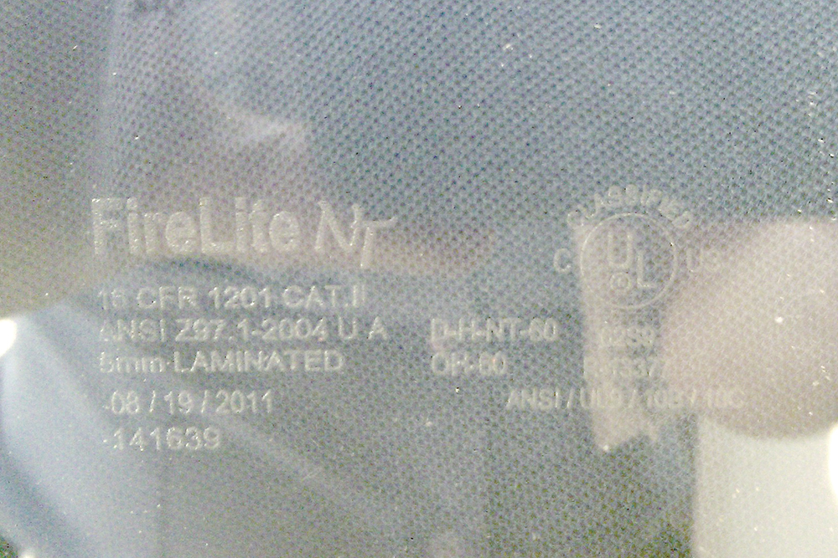
Know the characteristics and uses of fire-rated glass.
Courtesy of Scott Strassburg
Fire-rated glass
Does not use interior wires
Made from a combination of glass and plastic
Must be installed in a fire-rated framing that is rated as an assembly

Slide 60
NOTE
All fire-rated glass is marked, whether it is wired glass or not, and the inspector should check for the appropriate markings.

Slide 61
REVIEW QUESTION
What are the most commonly encountered types of glazing (glass)?

Slide 62
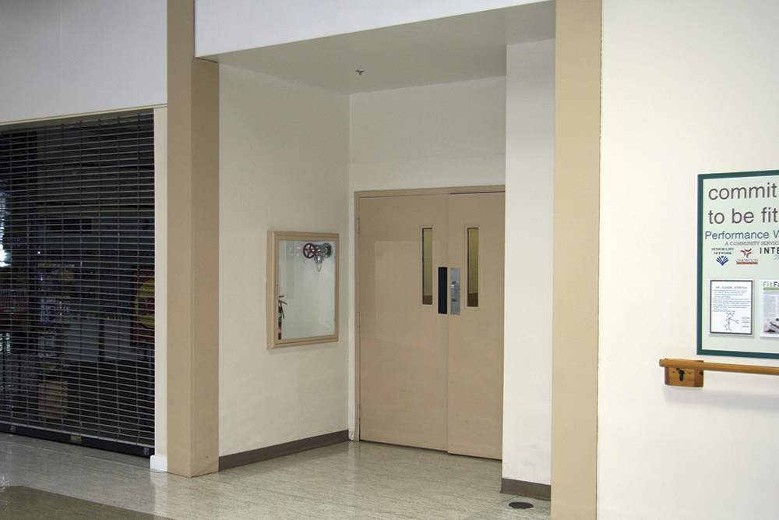
Know the characteristics of gypsum board.
Also known as drywall or Sheetrock®
Mineral-based product used to construct plaster and wallboards
High water content gives it excellent heat-resistant and fire-retardant properties

Slide 63
Inspectors need to know the common uses of gypsum board.
Corridor partitions
Stair enclosures
Shaft walls
Column protection
Membrane ceilings

Slide 64
Inspectors need to know the different types of gypsum board.
Type X
Used in fire-rated assemblies
Produced with glass fibers that act as reinforcement and provide tensile strength; prevent its deterioration when exposed to fire
Type C
Contains vermiculite that expands as it is exposed to heat; allows the gypsum to maintain its integrity and remain dimensionally stable for longer periods of exposure

Slide 65
Several types of gypsum board are produced for different purposes.
Regular gypsum board
Used for most applications
Water-resistant gypsum board
Water-repellent paper facing for use where it may be exposed to moisture
Type X and Type C gypsum board
Used in fire-rated assemblies
Foil-backed gypsum board
Used to replace the vapor barrier in outside walls
Gypsum backing board
Used as a backing layer in multilayer assemblies
Coreboard
Used for shaft walls and solid partitions

Slide 66
REVIEW QUESTION
In a structure, where are you most likely to find gypsum board?

Slide 67
In building construction, plastics are used for many components.
Siding
Floor covering
Insulation
Tub/shower enclosures
Vapor barriers
Pipe and pipe fittings
Lighting fixtures
Skylights and roof domes
Sprinkler piping
Moldings
Wall coverings
Gratings and mantel pieces

Slide 68
Inspectors need to know the characteristics of plastic.
Strength of plastic materials is close to that of wood
Glass-fiber-reinforced plastic may be nearly as strong as steel
Not usually used for structural applications in buildings because of their generally lower strength and their greater tendency to bend

Slide 69
Inspectors need to know the plastics commonly used in construction.
(Cont.)

Slide 70
Inspectors need to know the plastics commonly used in construction.

Slide 71
Inspectors must recognize that the use of plastics increases the amount of combustible materials.
Increases fire hazards, both inside and outside the structure
Other plastics, used for external veneer, may be difficult to recognize
Some plastics used as thermal barriers may be invisible to the inspector once the structure is completed

Slide 72
Inspectors must understand the flammability of plastics.
Flammability of plastics varies widely
Some plastics, such as cellulose nitrate, burn so rapidly that they constitute a unique fire hazard
Other plastics may burn slowly and stop burning when the ignition source is removed
Fire retardants can be added to some plastics to reduce their flammability and ignition sensitivity
Even plastics with low flammability are subject to deterioration and may give off toxic gases at temperatures above 500°F (260°C)
(Cont.)

Slide 73
Inspectors must understand the flammability of plastics.
Plastic materials frequently exhibit burning properties different from other materials
Some materials drip
Some plastics generate enormous quantities of heavy smoke
Products of combustion of some plastics are more toxic than nonplastic materials

Slide 74
Plastics used in building construction increase the fire hazard.
They add to the amount of fuel in a building
Increase the toxicity of products of combustion
Where large amounts of plastic are used the fire hazard is greatly increased
Requires special treatment like covering the surface of the insulation with a noncombustible material or installing automatic sprinklers

Slide 75
Understand the characteristics and uses of thermal barriers.
Installed to reduce the heat rise of the material it is protecting
Adopted building codes may require the use to separate plastics and other combustible materials from the interior of the building

Slide 76
Understand the characteristics and uses of exterior insulation and finish systems (EIFS).
One application for plastic in an exterior veneer system
Consists of fiberglass insulation, gypsum board, expanded polystyrene beadboard , extruded foam with a noncombustible hand-troweled finish
Finished product closely resembles a stucco or etched-concrete finish
Way to improve the appearance of existing masonry wall that has become deteriorated
Courtesy of Ed Prendergast

Slide 77
Inspectors need to recognize the use of EIFS in a building’s construction.
EIFS can be ignited from exterior source or radiant heat of exposed fire
Building codes impose stringent regulations on the use because
Foam insulation is combustible
Flame spreads rapidly over its surface
Typically, a code will require that foam insulation be faced with a thermal barrier

Slide 78
REVIEW QUESTION
Why is it important for an inspector to recognize the use of plastics in building construction?

Slide 79
Summary
The inspector must have a clear understanding of the materials that are used to construct a building and the common structural components of buildings.
This knowledge is necessary to evaluate the structure’s ability to resist the effects of fire.
(Cont.)

Slide 80
Summary
Combined with the construction types (presented in the previous chapter), the inspector can readily categorize a building and determine the necessary code enforcement approaches and applications that apply to it.

